Slide 1
CMO Report
March 3rd, 2020

Slide 2
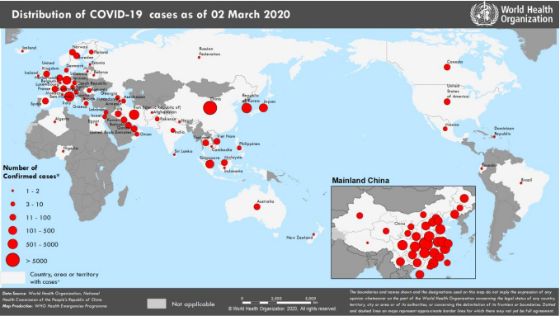
COVID-19: Overview
All Cases as of 03 March 2020
Worldwide Cases:
92,200 confirmed cases
3,127 deaths
China Cases:
80,150 confirmed cases
2,945 deaths
United States Cases:
105 confirmed cases
48 confirmed cases in repatriated persons
27 presumptive positive cases
6 deaths
2 cases in Massachusetts
Notes:
** A presumptive positive case has tested positive by a public health laboratory and is pending confirmatory testing at CDC. States are reporting presumptive positive cases independently

Slide 3
COVID-19: Boston Medical Center Strategies Screening
Boston Medical Center Screening at Entry Points:
BMC is screening for symptom and travel history using EPIC at all points of entry to include:
Emergency Department
Ambulatory Care Clinics
Same day sick appointment calls
Screening Criteria per CDC Guidelines:
Patients who arrive with a fever and severe symptoms of a lower respiratory illness (pneumonia, ARDS) requiring hospitalization and without alternative explanatory diagnosis where no source of exposure has been identified
OR Patients who arrive with a fever and symptoms of a lower respiratory illness requiring hospitalization AND in the last 14 days before symptom onset, travel history from China, Iran, Italy, Japan, or South Korea
OR Patients who arrive with symptoms of a lower respiratory illness with or without a fever AND in the last 14 days had close contact with an ill laboratory-confirmed COVID-19 patient
Isolation Strategies:
Patients who have respiratory illness and have travelled to an area of concern will activate a practice alert in EPIC
The patient will be given a surgical mask, moved to a negative flow room and treated under airborne, droplet, and contact precautions
Staff will don an N-95 and enhanced PPE to further interview the patient to the more detailed screening criteria found above.
If suspect, Clinicians will page ID Fellow who will contact Hospital Epidemiology
Hospital Epidemiology will discuss case with DPH to determine suspect cases and advise clinical treatment

Slide 4
COVID-19: Boston Medical Center Strategies Resources
Staff Personal Protective Equipment:
N95 mask
Precaution gown
Eye protection—splash shield
Two pairs of gloves
Resource Availability:
Reasonable level of PPE in warehouse and stockpile (5months of typical use)
Resource conservation strategies have been implemented due to the world wide shortage
Reuse N95 masks until and unless the mask gets wet, damaged, or if a good seal cannot be maintained.
Small supply of N95 masks in med rooms for airborne precautions and chemo agent administration
Additional resupply of N95 masks must be requested by the Nurse Manager
Where can I get the latest information?
Centers for Disease Control guidelines changing rapidly
The most updated information on screening criteria, phone screening, isolation recommendations, and PPE have been posted on the HUB under Emergency Management https://internal.bmc.org/departments/emergency-management/flu-and-covid-19-coronavirus-disease-2019)

Slide 5
COVID-19: Boston Medical Center Strategies Clinical Care
What type of isolation precautions are being required to take care of a patient?
BMC is following both droplet (flu) and airborne (TB) precautions as required by the CDC.
If a patient meets the criteria to be classified as a suspect case of COVID-19 or if they are being admitted for ARDS without a known cause:
the patient should be managed in a negative flow isolation room if available using enhanced PPE for COVID-19 (precaution gown, N95, face shield, and 2 pairs of gloves)
Are there special instructions for aerosolizing procedures?
Any patient meeting the criteria should be in a negative flow room if available.
Staff should don the enhanced PPE (precaution gown, N95, face shield, and 2 pairs of gloves) for any aerosolizing procedures
Rafael Ortega developed a 2 minute video related to airway management
What if there are a lot of bodily fluids?
Staff can replace the precaution gown with a fluid impermeable surgical gown if needed to manage copious amounts of bodily fluids
Where can I get training in PPE?
PPE used for COVID-19 is same as used daily for infection control
For refresher training, a donning and doffing demonstration video is posted on the HUB under emergency management ( https://internal.bmc.org/departments/emergency-management/flu-and-covid-19-coronavirus-disease-2019 ).
In person demonstrations will be made available in the next weeks
FIT testing sessions ongoing, will use just in time training where appropriate
What if another hospital wants to transfer a COVID-19 suspect case?
Any outside hospital transfer request should be screened for COVID-19
If the screen is positive for suspected COVID-19, a call should be made to Dr. Ravin Davidoff prior to accepting the patient

Slide 6
COVID-19: Boston Medical Center Strategies Escalation Plans
What are we doing?
Multidisciplinary team has been meeting regularly; started having daily calls
A COVID-19 specific plan is being developed from our ID Emergency Management Plan
How will we trigger various stages of action plans?
Being modified from our surge plan
Aligned with escalation of the outbreak.
Calls with other AMC’s, COBTH – we will be formalizing this
Liaising with city, state and federal agencies.
Planning
Emergency Management structure
Infection Control and Clinical
ED, entry points of patients,
# of patients, severity of illness
Negative pressure room capacity → very large numbers, hospital capacity…….
Homeless patients, shelters
Employee Health:
Working Well Clinic, Travel Guidance (AMC’s and Universities quite variable)
Human Resources
Who can work from home, staffing, support of employees and families…
Facilities and maintenance
alternative sites of care for low acuity patients, cohorting
IT resources
remote working capability, essential versus non essential
Supplies and materials management
Environmental Services – optimal way to clean rooms and areas

Slide 7
COVID-19: Boston Medical Center Strategies What you can do
Read the communications and share with your department and trainees
Work with administrative staff to ensure that the most up to date information and guidelines are available in your areas
Communicate frequently with your teams and if unsure of answers, ask me/us
Familiarize yourself with the Emergency Management Home page on Flu and Covid-19
Don’t come to work if you feel ill and certainly not if you have a fever
Ensure others do the same
Wash your hands often with soap and water for at least 20 seconds
If appropriate, get FIT tested
Avoid/reconsider “non essential” travel: BMC guidance may change, BU posted theirs
This will evolve but current CDC advisories
Level 1: Usual precautions – Hong Kong
Level 2: Enhanced precautions – Japan
Level 3: Avoid non essential travel – China, South Korea, Italy, Iran
Singapore, Thailand, Taiwan considered at risk for community spread

Slide 8
FIT Testing for clinicians at BMC
The BMC Working Well Clinic and BU Environmental Health & Safety (EHS) requires FIT testing for all clinicians at BMC
For individuals who have never been tested, or who are due for testing, you must:
First be medically cleared by Working Well by submitting the Respiratory Medical Evaluation Questionnaire available at https://internal.bmc.org/employee-center/working-well-clinic/forms
Review the N95 Respirator Training and sign up for a session at https://www.bu.edu/researchsupport/forms-policies/fit-test-sign-up-form/
Upcoming sessions; all sessions are held in Fuller 411
As needed, we will add sessions
Staff should bring their BMC ID Badge or have their BMC ID number available. Sessions take approximately 20-30minutes
Clinic Date | Event time
Tuesday, March 10th | 7:00 am
Thursday, March 26th | 2:00 pm
Tuesday, April 7th | 7:00 am
Wednesday, April 22nd | 2:00 pm
Full list of sessions available here

