Slide 2
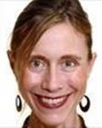
From the Program Director
Welcome to the BMC Family Medicine Residency Program! We’re delighted to have you join us. This year, in order to try and get your rotation schedules to you prior to your arrival in June, we are asking you if you have any preferences for Health Center assignment now rather than waiting until you get here.
In order to assist you in thinking about which HC you might prefer we have prepared this powerpoint presentation which gives you a wealth of information about each site, as well as about Boston’s health in general. We have also scheduled a phone in conference call on March 30th at 8:00pm ET where you can ask questions of faculty and residents from the different sites. Details will follow by e-mail as that date approaches.
So look over the slides and get the preference forms you will be receiving back to us. And remember:
* The CHC’s are more alike than different! All are community based and directed and provide great care to their communities.
* It is possible that you will not be assigned to the CHC of your first preference, but in the long run no one has been disappointed with their experiences at their assigned center.
See you in June! Katherine Gergen Barnett, MD.

Slide 3
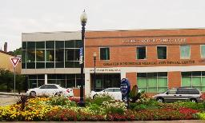
Our Community Health Centers
EBNHC
SBCHC
Boston Medical Center
CSHC
CSHC
GRMDC

Slide 4
Boston Demographics By Neighborhood

Slide 5
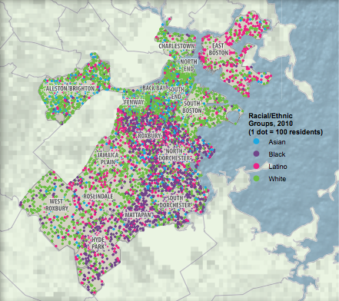

Slide 6
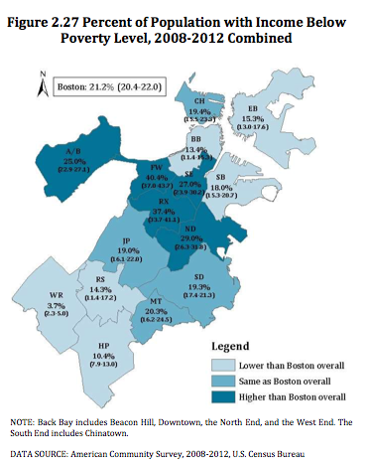
Neighborhood Key
A/B – Allston/Brighton
BB – Back Bay
CH – Chelsea
EB- East Boston
FW - Fenway
HP – Hyde Park
JP – Jamaica Plain
MT – Mattapan
ND – North Dorchester
RS – Roslindale
RX – Roxbury
SB – South Boston
SD – South Dorchester
SE – South End
WR – West Roxbury

Slide 7
Boston Health Data by Neighborhood

Slide 8
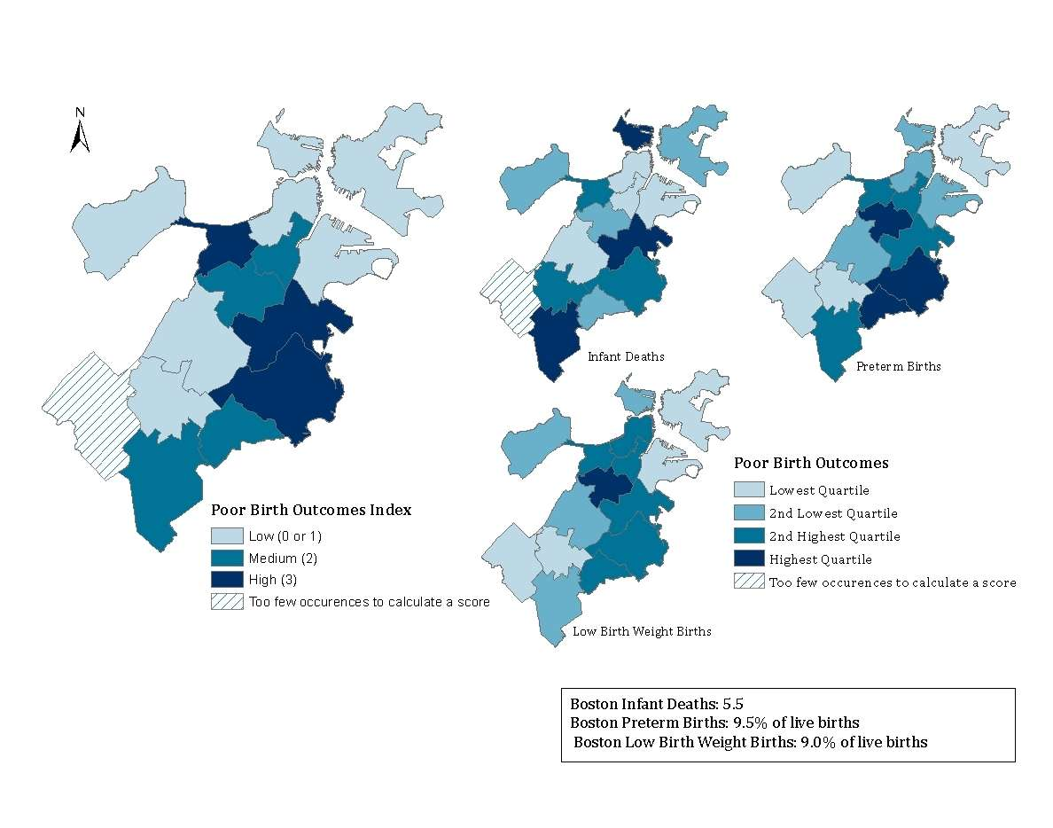
Figure 5.14 Birth Outcomes by Neighborhood, 2008-2012*

Slide 9
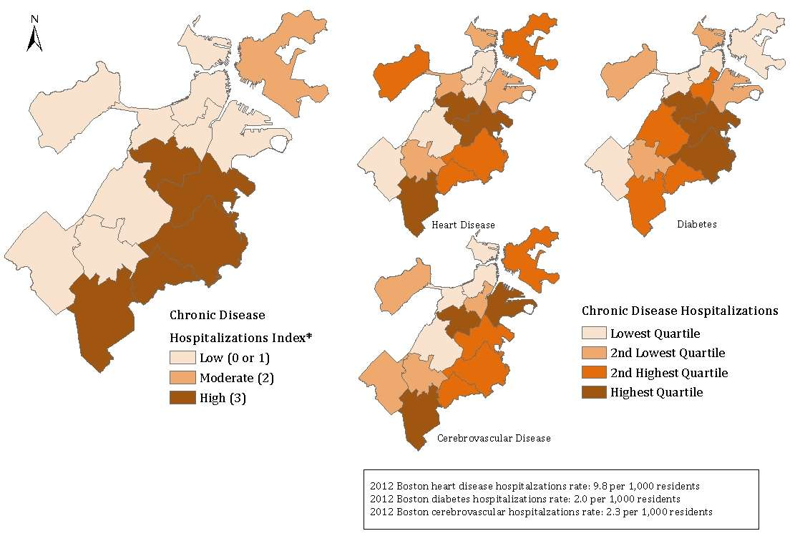
Figure 6.32 Chronic Disease Hospitalizations* by Neighborhood, 2012

Slide 10
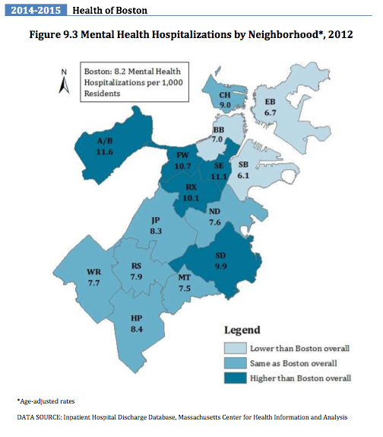

Slide 11
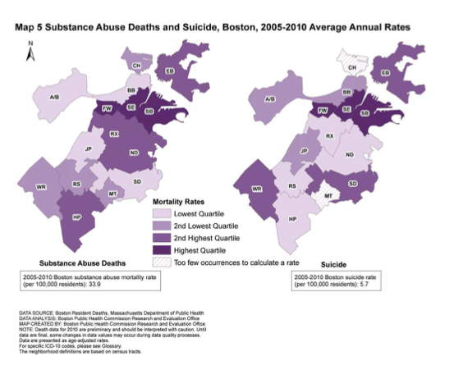

Slide 12
South Boston
Community Health Center
Mission: To provide health care to the entire community while ensuring care to those most in need. Our governing principle is “all who seek care are welcome here”
www.sbchc.org

Slide 13
SBCHC: History
Serving the South Boston community since 1972
Over 60,000 visits a year from almost half of South Boston’s population
Health center is the second-largest nonprofit employer in the community
56% of employees live in the South Boston area
4 family medicine residents/year

Slide 14
Clinical Services
Family Medicine
Adult Medicine
Pediatrics
OB/GYN
Dermatology
Cardiology
Pulmonology
Gastroenterology
Psychiatry
Office based opioid treatment
Podiatry
Adult and Pedi Dental
Vision
Nutrition
Integrative Medicine

Slide 15
Other Services
Radiology, lab and pharmacy
Integrated Behavioral Health/Social Work
Interprofessional complex care clinic with BU trainees
Food pantry
Breast feeding groups
Teen ambassador program
Patient shuttle from housing developments to main health center

Slide 16
SBCHC Patient Age/Gender

Slide 17
SBCHC Patient Race/Ethnicity
18% best served in a language other than English

Slide 18
SBCHC Insurance Payer

Slide 19
South Boston Community
“South Boston is home to Dorchester Heights and other hills where George Washington’s army set up cannons to force the British out of Boston in 1776. The cannons were dragged from Fort Ticonderoga by Henry Knox. Dorchester Heights is now a national park
South Boston became largely a working-class neighborhood, with residents finding work on the South Boston waterfront or in factories such as Gillette, which still employs local residents. Parts of the neighborhood were heavily industrial, with businesses including ironworks and glassworks
South Boston is now a highly desirable residential neighborhood. Residents enjoy the convenience of living in South Boston as well as the amenities available in the neighborhood. Fort Point is a hub for the arts community, and has a large population of working artists.”
https://www.boston.gov/neighborhood/south-boston

Slide 20
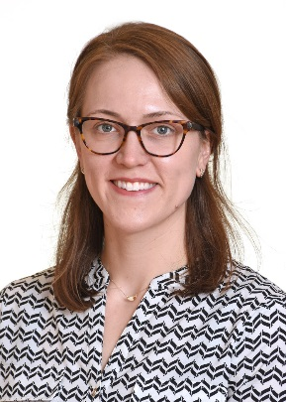
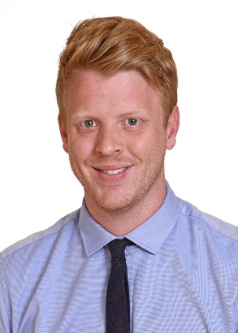
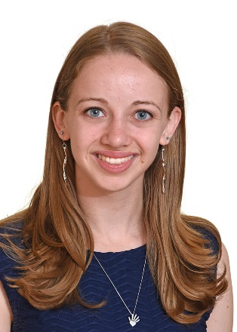
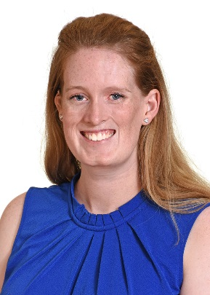
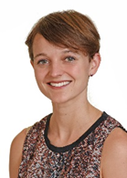
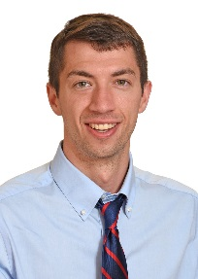
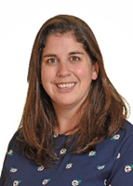
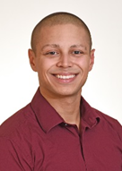
Current SBCHC Residents

Slide 21
What our residents say about working at SBCHC
“I love Southie because I feel like I really get to connect with the community and meet some of the most interesting people- for such a tight knit community I have felt very welcomed. It makes me feel privileged to care for these patients and get to know them and their families.”
“Southie is awesome! Our small CHC has amazing staff and a collaborative culture! Our patients are living with addiction and other chronic conditions, are long time residents of South Boston, families from Albania, the DR, and more. I love walking from the hospital to clinic.”
My favorite thing about working at Southie is the range of socioeconomic status that I see among my patient panel. I have the pleasure of getting to take care of patients who are homeless and help connect them to resources while also seeing patients who are working in the financial district and have stable sufficient resources. It helps train and reinforce the impact that Social Determinants of Health have on our patients given the stark contrast.

Slide 22
Getting there from BMC
Walk or bike
Take the #10 bus
Drive - street parking at clinic
South Boston CHC
Boston Medical Center

Slide 23
Where SBCHC residents live

Slide 24
Codman Square Health Center
Mission: To serve as a resource for improving the physical, mental and social well being of the community
www.codman.org

Slide 25
Codman Square: History
Founded by a group of neighborhood activists in the 1970s who joined together to seek creative ways to improve the neighborhood. Opened in the basement of the former Codman Square Library in 1979
115,000 clinical visits annually
310 employees, 80% of whom live in the community. Staff are multilingual, with fluency in Haitian Creole, Spanish, Portuguese and French
4 family medicine residents/year

Slide 26
Clinical Services
Primary Care
Family Medicine
Internal Medicine
Pediatric & Adolescent Medicine
Maternal & Child Health
Centering Pregnancy & Centering Parenting groups
Case Management
Urgent Care
HIV/STD Care
Geriatric Care
Nutrition
Podiatry
Eye Care
Dental Care
Behavioral Health
Substance Use services

Slide 27
Other Services
Laboratory, Radiology and Pharmacy
WIC
Food Pantry
Farmers Market
Social Services
Resource Connector
Housing
Food Stamps
Legal Services
School based health center
Partnership with Healthworks Community Fitness
Partnership with Codman Academy Charter Public School
Community programs
School Readiness
Community outreach and education
Financial literacy and tax preparation

Slide 28
CSHC: Patient Age/Gender

Slide 29
CSHC: Patient Race/Ethnicity
18.4% best served in a language other than English

Slide 30
CSHC: Insurance Payer

Slide 31
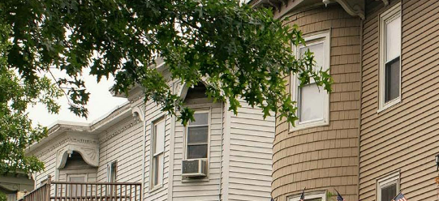
Dorchester Community
“The largest neighborhood in Boston is also one of the most diverse. Long-time residents mingle together with new immigrants from Vietnam, Cape Verde, Ireland and many other countries. This wonderful mix of residents from all cultures and backgrounds makes it an incredibly vibrant place to live, work and spend time.
Field’s Corner is the heart of the Vietnamese community in Boston. There you’ll find the first Vietnamese Community Center in the country and the best Vietnamese restaurants in the City. Dorchester Avenue is the center of the business district and features restaurants, local small businesses, pharmacies, ethnic stores, and more
Dorchester is also home to Franklin Park, the “crown jewel” of the Emerald Necklace Park System. Than park has more than 527 acre of green space, a zoo and a public golf course. Among the dozens of other parks in the neighborhood, recently renovated Pope John Paul II Park offers numerous walking and bike paths, athletic fields, and picnic areas with beautiful views of Boston Harbor and the Neponset River.”
https://www.boston.gov/neighborhood/dorchester

Slide 32
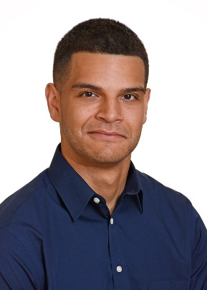
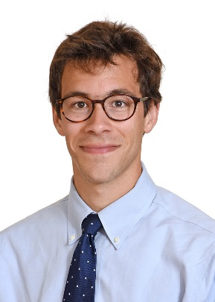
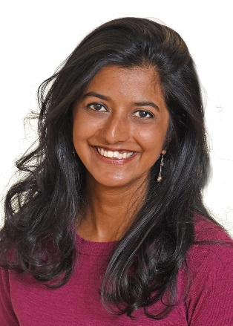
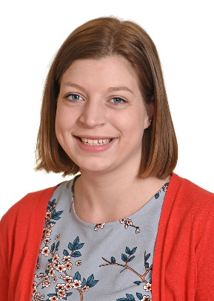
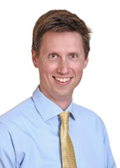
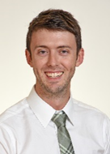
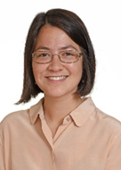
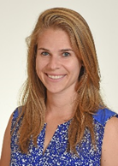
Current CSHC Residents

Slide 33
What our residents say about working at CSHC
“ I love Codman’s focus on integrative medicine. Mind/body at its best. Our attendings do acupuncture and reiki! Warm handoffs available all the time for BH, nutrition and addiction.”
“Strong sense of community in Dorchester, specifically Codman Square. Many of the employees live in the area.”
“I love working with a linguistically talented and racially diverse team of providers, and the openness and trust of my patients.”
“My favorite thing about Codman Square are my patients, and the integrated services available that help address mental health, addiction, nutrition and social needs”
“Things that make Codman a little special - group care - centering in pregnancy (prenatal group visits) and group well child visits (often the babies that you delivered with some extras in the mix). The group is a great way to learn child development because you get to see 5 babies around the same age, and look for the same milestones. You also get longer visits (2 hours) with the group which is pretty special.”

Slide 34
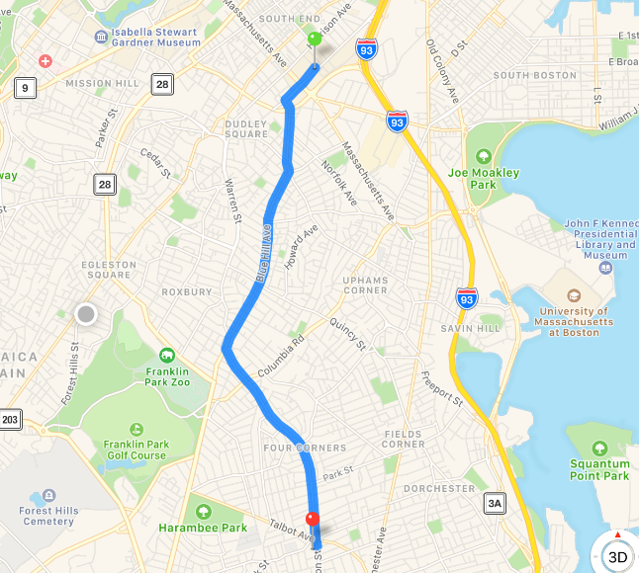
Getting there from BMC
Drive (parking available)
Commuter rail
Uber
Bike if you’re more ambitious (3.6 mi)
Boston Medical Center
Codman Square Health Center

Slide 35
Where CSHC residents live

Slide 36
East Boston
Neighborhood Health Center
Mission: to provide easily accessible, affordable, appropriate, high-quality, personalized, coordinated primary care for all who live and work in East Boston and the surrounding communities without regard to age, income, insurance status, language, culture, or social circumstances
www.ebnhc.org

Slide 37
EBNHC: History
Founded in the 1960s by community groups recognizing lack of health care services in East Boston. At that time, Boston 2 hours away by public transportation and many community members going untreated, late to prenatal care or missing preventative care
Clinic open in 1970 with a goal that the health center would become an institution where every community member - including the board of directors - would want to come for their own medical care
One of the oldest and largest community health centers in the nation, with 300,000 patient visits/year
2 family medicine residents/year

Slide 38
Clinical Services
Adult Medicine
Pediatrics
OB-GYN
Family Medicine
ENT
Dermatology (pedi & adult)
Endocrinology
GI
Pulmonology
Rheumatology
Emergency Department
Suboxone Clinic
Sports Medicine (pedi & adult)
Nutrition
Podiatry
Pediatric Neurology
Optometry
Audiology (pedi & adult)
Pediatric Dental

Slide 39
Other Services
Interpretor services
Care navigation
Integrated behavioral health
Laboratory, radiology and pharmacy (340B)
WIC
Patient enrollment/insurance assistance
Specialty programs including:
Chronic disease education & management
Project Shine (HIV/AIDS)
Let’s Get Moving (healthy lifestyle for children/adolescents)
Education and Training institute (career advancement - employees & community)

Slide 40
EBNHC: Patient Age/Gender

Slide 41
EBNHC: Patient Race/Ethnicity
58.5% best served in a language other than English

Slide 42
EBNHC: Insurance Payer

Slide 43
East Boston Community
What is today East Boston was initially a group of islands first used by Native Americans as hunting/fishing grounds. The areas became a resort destination for wealthy Boston residents with grand hotels (the Maverick House) and the Suffolk Downs Race Track, then in the 1800s East Boston became the center of clippership building, shipping and trade. The islands were connected by landfill in the 1830s and annexed by the City of Boston in 1836
Area has been a neighborhood of immigrants since the 1840s. Currently, of the roughly 40,000 residents, about 50% are foreign born - the highest of any Boston neighborhood.
East Boston is home to the nation’s first branch library, built in 1870. You’ll also find Logan Airport here. Neighborhood homes mix the old with the new, and include many restored triple deckers. Resident enjoy waterfront views of the City skyline from across Boston Harbor.
https://www.boston.gov/neighborhood/east-boston

Slide 44
East Boston and Immigration
1840s - Canadian immigrants arrived
1850s - more than 1.5 million Irish immigrants came through East Boston
1890s -Russian and Eastern European Jews(one of largest Jewish groups in New England) as well as Norwegian and Polish immigrants
1900s- wave of Italian immigrants, major ethnic group in East Boston by 1915 and remained so for 25 years
Today’s Immigrants to East Boston

Slide 45
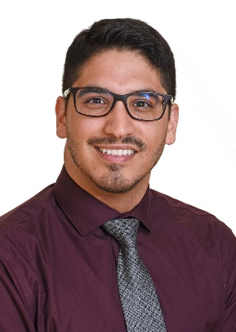
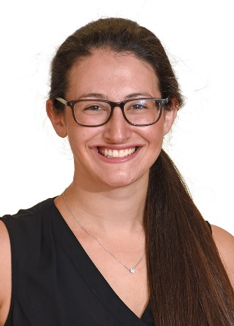
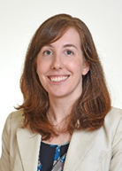
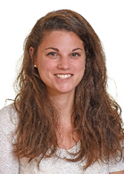
Current EBNHC Residents

Slide 46
What our residents say about working at EBNHC
“I love working at East Boston because of the true team-based approach to care, the passion all providers have for comprehensive care for vulnerable patients, and because I get to practice my Spanish every day!”
“I love everything about East Boston, but especially the largely Spanish-speaking patient population (if I speak English in more than one visit in a half-day session, it’s unusual!) and the abundance of young female patients needing contraception or prenatal care.”
“I love East Boston NHC because it gives me an opportunity to practice my Spanish and we have amazing support staff!”

Slide 47
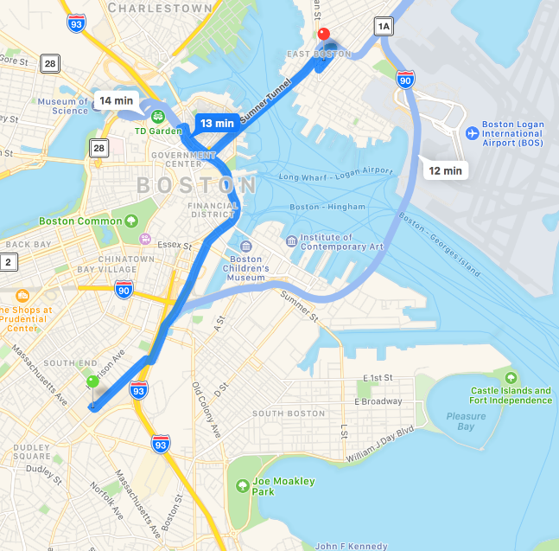
Getting there from BMC
Train (orange line to blue line)
Bike to orange line then take train 2 stops across Harbor
Drive (parking available)
East Boston NHC
Boston Medical Center

Slide 48
Where EBNHC residents live

Slide 49
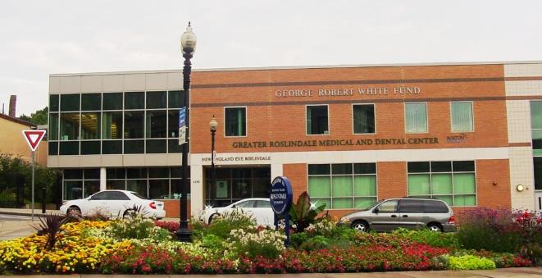
Greater Roslindale
Medical and Dental Center
Mission: to offer comprehensive primary health services to area residents
www.roslindale.org

Slide 50
GRMDC: History
Founded in 1975 by concerned community residents who believed there were many unmet health needs
Has been affiliated with various organizations over the years:
1975-1981: independently licensed
1981-1990: dept of Carney Hospital
1990 - 1997 dept of Faulkner Hospital
1998 - present: dept of Boston Medical Center
25,700 visits annually
New residency site; accepted first class of 2 residents in 2016/2017 academic year!

Slide 51
Clinical Services
Family Practice
Internal Medicine
Pediatrics
Teen Health
OB/GYN
Podiatry
Dental
Psychiatry
Counseling
Nutrition

Slide 52
Other Services
Laboratory
Social services
Patient navigation
Nearby Community Resources:
Sullivan’s Pharmacy (compounding, medical equipment)
Community Centers - Roslindale, West Roxbury & Hyde Park
YMCA - West Roxbury & Hyde park
Flaherty Pool
ABCD Head Start - Roslindale
Roslindale, Hyde Park & West Roxbury Public Library
Family Nurturing Center - Roslindale

Slide 53
GRMDC: Patient Age

Slide 54
GRMDC: Patient Race/Ethnicity

Slide 55
GRDMC: Patient Languages

Slide 56
GRMDC: Insurance Payer

Slide 57
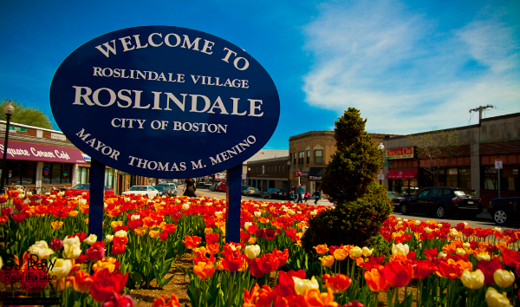
Roslindale Community
Residents used to call Roslindale the “garden suburb” of Boston. Today, they still enjoy the neighborhood’s natural beauty. Here you’ll find the Arnold Arboretum. It’s a 265-acre park that’s part of Boston’s Emerald Necklace many of the area’s colonial homes are now condos that house the City’s Growing population.
Roslindale Village is the original Main Street district. Today, it’s a vibrant shopping and dining area with unique shops and bistros.
https://www.boston.gov/neighborhood/roslindale

Slide 58
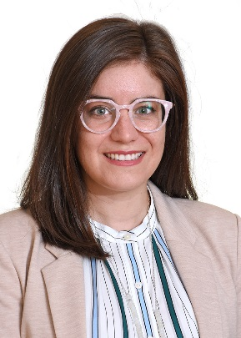
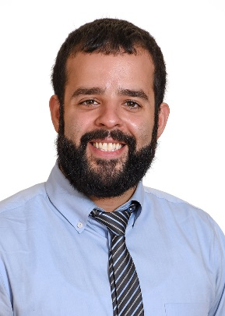
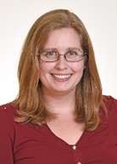
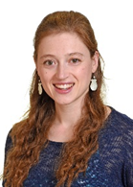
Current Residents

Slide 59
What our residents say about working at GRMDC
“I picked Roslindale because both the clinic and surrounding area has a small town vibe that reminds me of home. The diverse patient population and close collaboration with preceptors has made my clinic experience very rewarding.”
“I really love the spirit of newness at Roslindale and the quickness to implement processes to improve patient care and make our work environment even more enjoyable (ie, intern candy shelf). Also, Roslindale Clinic is situated dead in the center of the adorable town square. There are lots of good eats around too!”

Slide 60
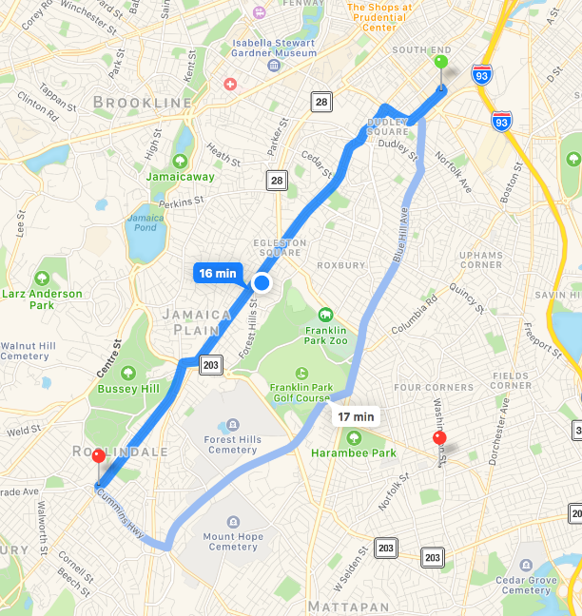
Getting there from BMC
Drive
Commuter rail from Back Bay to Roslindale Village

Slide 61
Where GRMDC residents live

Slide 62
Have Questions?
Please join us for an informational conference call with site directors and residents on March 30th at 8:00pm ET.

