Slide 1
Understanding problems related to substance use
A presentation of the Boston and Cambridge Hospital Consortium
Developed by Miriam Komaromy, MD; Medical Director, Grayken Center for Addiction at Boston Medical Center, with the support of Scott Weiner, MD; Lorraine Magner, NP; Claudia Rodriguez, MD; and Maia Gottlieb, MPH
Notes:
All of us care for some patients who have problems related to substance use
For some of us, treating substance use disorder is our main clinical focus
Others of us do not seek out these patients, but we end of caring for them because substance use is a problem across all boundaries of age, gender, race/ethnicity and socio-economic class
If we increase our understanding of problems related to substance use we can all provide better and more appropriate care for our patients

Slide 2
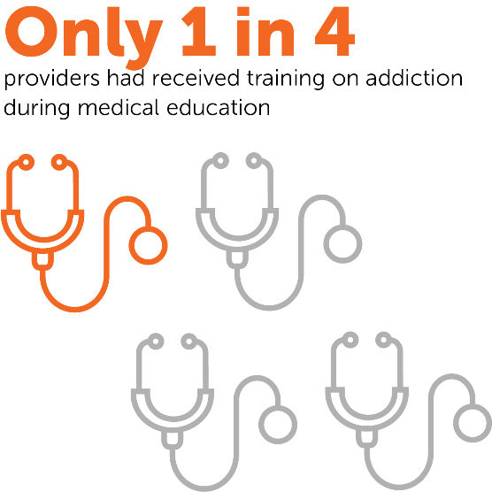
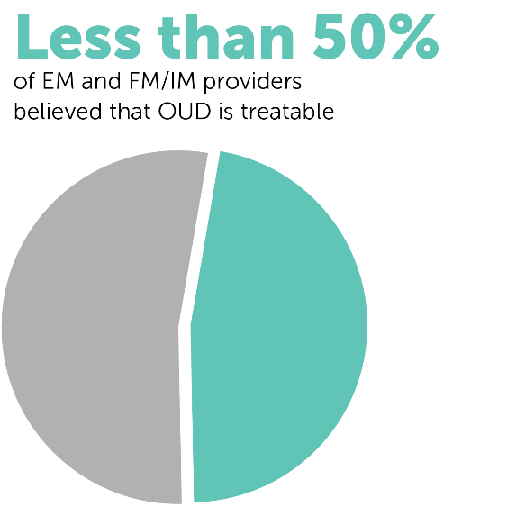
Why are we doing this training?
Shatterproof, 2019
Notes:
A recent survey of providers in Massachusetts on their attitudes towards substance use disorder uncovered some problematic misconceptions and lack of understanding.
Additional findings:
Less than 1/3 of EM, FM/IM, OBGYN/Women’s Health or pediatric providers felt very prepared to screen, diagnose, provide brief intervention for, or discuss or provide treatment for OUD
40% of EM or FM/IM providers feel that treating patients with OUD takes away time and resources from other patients.
2x as many EM providers than any other specialty believe methadone treatment for OUD is substituting one addiction for another
https://www.shatterproof.org/inittogether

Slide 3
Notes:
All of us have something in common

Slide 4
Notes:
We all started out as babies
No baby ever decided that she or he would become addicted to heroin or other opioids, develop alcohol use disorder or problems with cannabis
But some babies and children start out in this world with a much greater risk of developing problems with substance use
In this presentation we’ll talk about why some of us are much more vulnerable to developing problems with substances than others,
and also ways that we can reduce risk and provide effective treatment for anyone with a substance use disorder

Slide 5
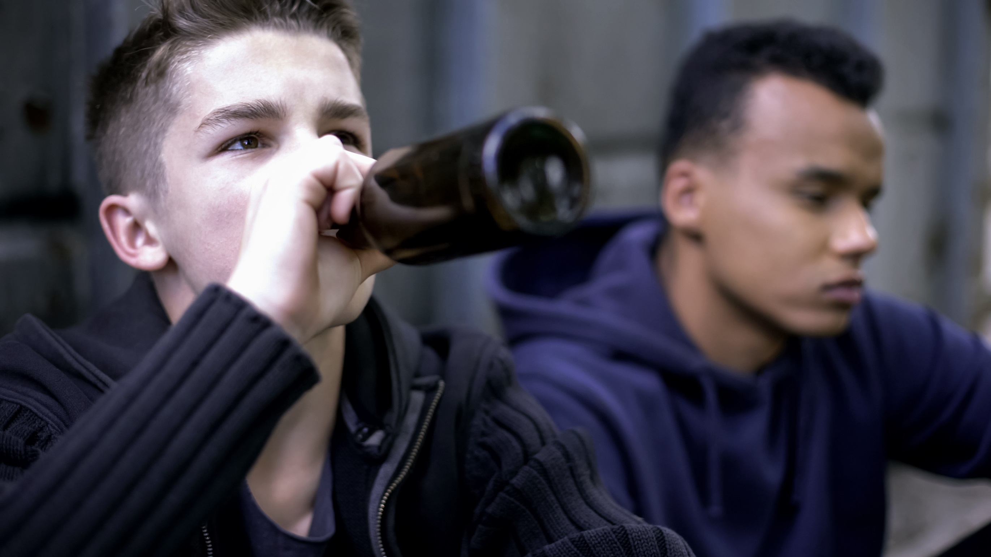
Notes:
As we grow from infants to children to young adults, our risk of developing problems with substances changes
We may begin with an inherited risk of developing these problems. For instance, this may cause our experience of using substances to be stronger and more pleasurable than it is for other people;
On the other hand, other people have lower inherited risk; for instance, they may inherit a trait that makes it unpleasant to drink alcohol, and so their risk of developing alcohol use disorder is lower

Slide 6
Notes:
We may grow up in a culture in which people commonly use substances as part of social interactions or with meals,

Slide 7
Notes:
Or we may grow up in a culture in which young people use substances to fit in, or as a coping mechanism for stress, anxiety, or trauma. Also the impact of legalization of marijuana in our society may have the effect of reinforcing a perception of social acceptability and, therefore, indicate a lower risk for young people.

Slide 8
Notes:
We know that factors that cause us to start using substances at an earlier age increase the likelihood that we will develop a substance use disorder as adults
This could be because we were offered substances when we were very young,
Or because we grew up in very stressful environments and were seeking escape
A big part of our risk of problems with substance use comes from experiences during childhood that are called Adverse Childhood Events, or ACEs.
Show graph of data re age of initiation and
correlation with development of an SUD

Slide 9
Adverse Childhood Events - ACEs
Abuse
Neglect
emotional
emotional
physical
physical
sexual
Mother treated violently
Household mental illness
Household Dysfunction
Incarcerated household member
Parental separation/divorce
Household substance abuse
ASAM Fundamentals of Addiction Medicine
Notes:
Courtesy of ASAM Fundamentals

Slide 10
An introduction
Adverse Childhood Events - ACEs
17000 Kaiser members surveyed 1995-7
2/3 reported at least one ACE
1/5 reported 3 or more ACEs
Strongly predictive of negative outcomes later in life
Each ACE associated with 2-4 fold increased risk of early initiation of drug use ²
Findings replicated in cohort of urban, poor, non-white patients in 2013
Felitti, V, Am J Prev Med, 1998
Dube, Pediatrics, 2003
Mersky, , Child Abuse, Neglect, 2013
Notes:
Felitti and colleagues found in a large survey of Kaiser members that most reported having experienced at least one ACE, and 1/5 of the sample reported 3 or more ACEs.
They also found that experience of ACEs was correlated with the development of a wide variety of later health problems.
In particular, thy found that each ACE was associated with a 2-4 fold increased risk of early initiation of drug use, which in turn is associated with greatly increased risk of developing a substance use disorder.
Many subsequent studies have confirmed this relationship.

Slide 11
Adverse Childhood Events - ACEs
Adolescent pregnancy
ALCOHOL use disorder
COPD
Domestic violence
Substance use disorders
Ischemic heart disease
Depression
Notes:
Researchers have found that childhood experience of ACEs increase the likelihood of developing all of these problems, and many more.
What are the biologic mechanisms underlying these relationships?
Research shows that adults who experienced Adverse Childhood Events as children have higher levels of stress hormones and markers of inflammation, and these likely play a role in greater susceptibility to physical and behavioral health problems.
(Hostinar, Dev Psycho,l 2015)
Conclude: so you can see that people who experienced ACEs did not make a choice to have a high risk of developing problems with substances—their brains tend to respond differently to stress and to be soothed by substance use, and this increases their risk of developing problematic use
When we understand this, we can see why it doesn’t make sense to blame people who have problems with substances. So many different factors influence my risk of developing a substance-related problem—my genes, my family, my culture, my access to substances, and things that happened to me when I am a baby or child.
If we didn’t understand these things, we might be inclined to blame people for their substance-related problem, rather than treating them for their disease.

Slide 12
https://youtu.be/H7HfmYDkBzg
Notes:
In this video, a patient describes the impact of receiving supportive, respectful care for her substance use disorder
After video:
It’s amazing what an impact we can have, simply by being respectful and helping our patients to have hope
So, how do people develop problems with the use of substances?

Slide 13
Biological Background
Why does the human brain develop a substance use disorders? Why can we only develop addictive behaviors in response some substances?
Notes:
When we take a step back from it, it is really kind of strange that we humans develop addiction to some substances, but not to others. Why don’t we have an addictive response to Lisinopril, or to metformin?

Slide 14
Biological Background
The Reward Pathway
A particular pathway in the brain is activated by all of the activities that we find pleasurable
Food, water and sex; “appetites”
Interpersonal relationships, spirituality, exercise, art, music, beauty
The common reward pathway in the brain for all pleasurable activities involves the neurotransmitter Dopamine
Notes:
(Paraphrase slide)
Comment: It makes sense that humans have evolved to take pleasure in things that keep us alive, help us bond, and help to perpetuate our species

Slide 15
Biological Background
The drugs that can cause addictive behaviors are those that hijack the natural pleasure circuitry of the brain
Notes:
Remarkably, the drugs that can cause addictive behavior hijack this natural pleasure circuitry of the brain.
These drugs act as an imposter, activating the powerful systems that compel us to engage in activities that can help us to stay alive—but they don’t deliver on the promise to help us to thrive

Slide 16
Biological Background
All addictive drugs act directly or indirectly via dopaminergic pathways
Dopamine
Notes:
All substances that cause addictive behavior increase dopamine levels in the “pleasure pathway” in our brains

Slide 17
Natural Rewards and Dopamine Levels
Food
Sex
Food
200
200
150
150
% of Basal DA Output
DA Concentration (% Baseline)
100
100
Empty
50
Box Feeding
Female Present
0
0
60
120
180
Sample
Number
1
2
3
4
5
6
7
8
Time (min)
Slide courtesy of Petros Levounis, MD
Adapted from: Di Chiara et al, Neuroscience, 1999
Adapted from: Fiorino and Phillips, J Neuroscience, 1997
Notes:
Natural rewards stimulate dopamine neurotransmission. Eating something that you enjoy or being stimulated sexually can cause dopamine levels to increase. In these graphs, dopamine is being measured inside the brains of rats. Its increase is shown in response to food or sex cues. This basic mechanism of controlled dopamine release and reuptake has been carefully shaped and calibrated by evolution to reward normal activities critical for our survival.

Slide 18
Effects of Drugs on Dopamine Levels
MORPHINE
COCAINE
250
400
Dose mg/kg
200
0.5
300
1.0
2.5
% of Basal Release
150
10
% of Basal Release
200
100
100
0
0
1
2
3
4
5 hr
0
0
1
2
3
4
5 hr
NICOTINE
250
ETHANOL
250
200
Dose (g/kg ip)
200
0.25
0.5
% of Basal Release
1
% of Basal Release
2.5
150
150
100
100
0
0
1
2
3
4hr
0
Slide courtesy of Petros Levounis, MD
0
1
2
3 hr
Adapted from: Di Chiara and Imperato, Proceedings of the National Academy of Sciences USA, 1988; courtesy of Nora D Volkow, MD
Notes:
Here you can see, the response of the rat brain to various substances.
The response in some cases is stronger that the response to sexual activity

Slide 19
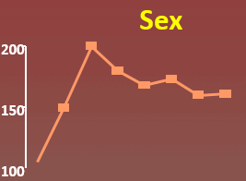
Effects of Amphetamines on Dopamine Levels
1100
1000
AMPHETAMINE
900
800
DA
700
% of Basal Release
600
Adapted from: Di Chiara and Imperato, Proceedings of the National Academy of Sciences USA, 1988; courtesy of Nora D Volkow, MD.
500
400
300
200
100
0
0
1
2
3
4
5 hr
Slide courtesy of Petros Levounis, MD
Notes:
The spike in brain dopamine levels from amphetamine are 5 times as great as the levels produced by sex… (the tiny graph in the inset panel shows the relative size of the peak of dopamine in response to sex)
No wonder addictive drugs overwhelm the balance between pleasure-seeking and cognitive over-ride
The intense stimulation of the dopaminergic system causes people to do things that “don’t make sense” unless we understand the power of the compulsion produced by these overwhelming stimuli:
Our brains did not evolve to be able to handle this type of stimulation, no matter how smart we are, or how strong our will-power is
We are left with a brain that is conditioned to prefer drug over non-drug rewards, and that overall, has a harder time appreciating all rewards due to an increase in the reward threshold caused by changes in the brain with chronic substance use.

Slide 20
https://www.dropbox.com/sh/x4s4836c5jhngxk/AABmgF3JGGR3gAXshVlJ-rWUa?dl=0
Notes:
In this video a physician describes his struggle with substance use disorder, and the way that the drugs altered his thinking
Insert clip of physician in recovery
OpCr_L3.OB1_v1 0:00-2:20

Slide 21
Notes:
In spite of all that we know about the causes of substance use disorders, there is still a tremendous amount of stigma associated with these conditions.
Stigma interferes with people seeking treatment, and it also sometimes interferes with us being willing to provide life-saving treatment for people with substance use disorders
(Downloaded from “Quotefancy” which appears to allow this sort of use free of charge)

Slide 22
Why do you think it is socially “ok” to express stigma toward a few groups, such as people who use drugs or are obese, but not so much toward others, such as people with physical disabilities?
Stigma
Notes:
(Read slide text)
One answer is that we classify these particular problems as choices, rather than diseases;
but do you think a child who has experienced multiple ACEs, or a baby born with a genetic predisposition is just making a bad choice when they develop a substance use disorder?

Slide 23
What are some examples of stigmatizing language used by professionals about people who have substance use disorders?
Stigma
Junkie
Addict
Alcoholic
Abuser
Drug of choice
Shooter
Dirty
Clean
Notes:
We also all recognize that stigma is not just something that comes from society at-large
We, in the health professions, exhibit marked stigma toward people who have SUDs
Relapse rates are similar between SUDs and many other chronic diseases
Think for a minute about the way that staff in an emergency department or clinic talk about a patient who has a substance use disorder, compared with a patient who has heart failure. And yet, the two conditions may be equally likely to kill the patient.
What are some negative consequences of stigma toward people who use drugs?
Examples include: shame; avoiding seeking treatment; avoiding seeking care for other problems; isolation; harsh legal action; denial of services; inability to find work

Slide 24
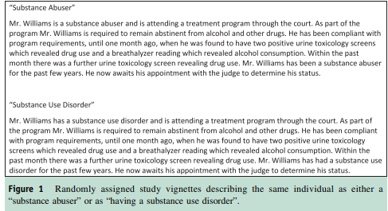
Stigma
Kelly JR, 2010, Int J Drug Policy
Notes:
Researchers Kelly and Westerhoff surveyed more than 500 clinicians attending two separate mental health conferences, and randomly assigned them to read a vignette describing someone as a “substance abuser” or an identical vignette that described the person as having “a substance use disorder”. They then asked about the clinicians’ perception of the patient and thoughts about how he should be treated.

Slide 25
Words matter
Stigma
Comparing responses to a “person with a substance use disorder” vs. the “substance abuser” …
The “substance abuser” was felt to be more likely to be personally culpable (responsible) for his condition; respondents were more likely to feel that:
His problem is caused by a reckless lifestyle He is responsible for causing his problem Clinicians were more likely to agree that punitive measures should be administered to the “substance abuser” than to the person with a substance use disorder
He should be given some kind of jail sentence to serve as a wake-up call
Kelly JR, 2010, Int J Drug Policy

Slide 26
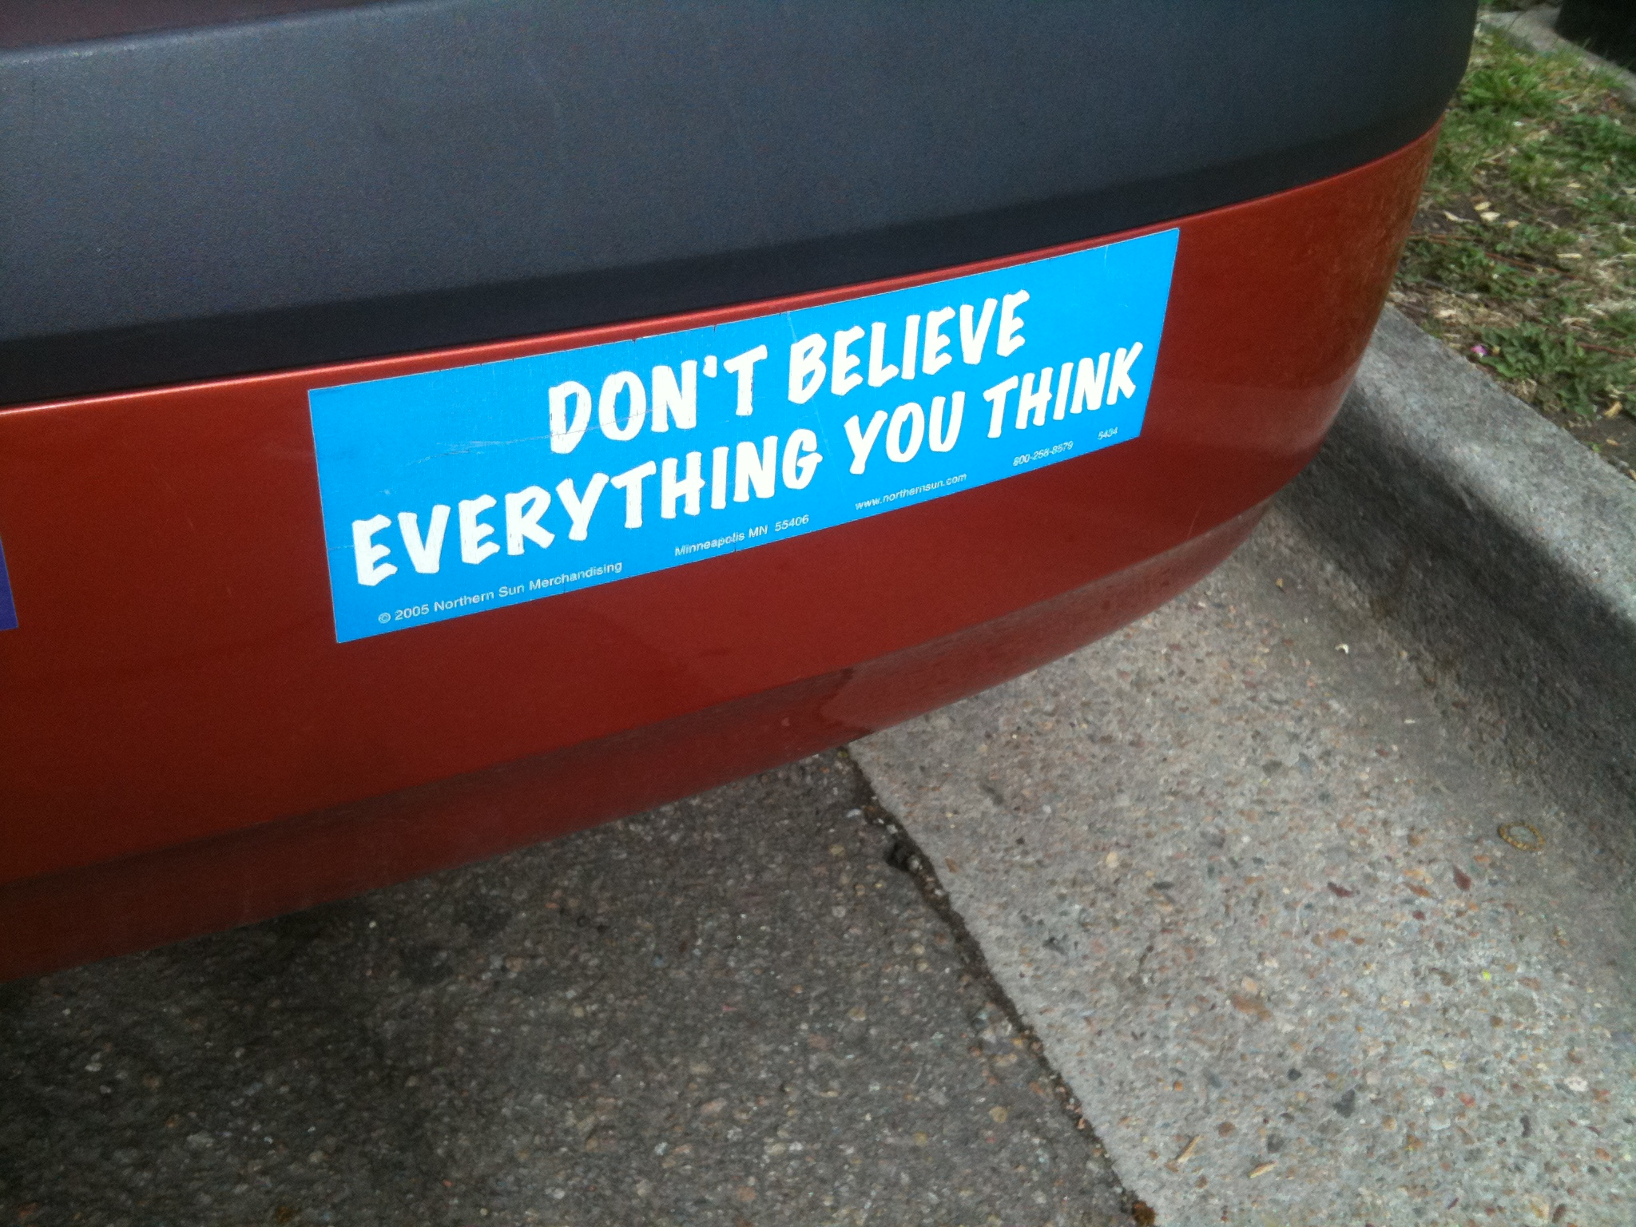
Stigma
Notes:
The first step in reducing our own stigmatizing beliefs is to recognize what we are thinking, and to question it.
For example,
“Someone who has a substance use disorder is less worthy of my care than someone who has another type of disorder”
Stigma is also often combined with lack of knowledge. For instance, in a recent survey of Massachusetts medical providers (the RISE study), 50% considered substance use disorders to be untreatable.
It’s also important to recognize the intersectionality of racial bias and stigma related to SUDs:
The epidemic of opioid overdose deaths has been attributed to “deaths of despair” among white middle-aged American men
But think about it…
Did anyone ever refer to the crack cocaine epidemic, which disproportionally affected black Americans, as representing “deaths of despair”?
Why was that epidemic criminalized, while the opioid epidemic, which disproportionally affects white Americans, is addressed through treatment?

Slide 27
Avoid Stigmatizing Language
Stigma
The language we choose shapes the way we treat our patients…
Instead of: | You can say….
“drug abuse” | Substance use disorder
“addict” or “junkie” | Person with a substance use disorder
“alcoholic” | Person with alcohol use disorder
“dirty urine” | Abnormal, positive, or unexpected urine test result
“clean urine” | Normal or negative urine test result
“clean (referring to a person)” | Abstinent, in remission, In recovery
“dirty (referring to a person)” | In a period disease exacerbation, or relapse
“shooting up” | Injecting
“shooter” | Person who injects drugs
Notes:
https://www.bmc.org/addiction/reducing-stigma
Next, we can work on changing our language
We could launch a campaign in our institution to raise awareness of the damaging effect of stigmatizing language, and suggest alternatives
What else can we do to address substance use disorders?

Slide 28
https://www.dropbox.com/sh/x4s4836c5jhngxk/AABmgF3JGGR3gAXshVlJ-rWUa?dl=0
Notes:
Here is a patient describing how effective medications for opioid use disorder have been for him
Patient describing effectiveness of MOUD
OpCR_L6.OB4_v1, 0:00-2:41

Slide 29
What can we do to address substance use disorders?
Screen:
“How many times in the past year have you used an illegal drug or used a prescription medication for non-medical reasons?”
Recommend or initiate treatment
Reduce risk of harm
Notes:
“Whether we work in primary care, other clinical settings including surgical clinics, the ED, or inpatient settings,
There is a lot that we can do to address substance use disorders.”
Screen
Recommend or initiate treatment
Reduce risk of harm
Screening for substance use disorders may be easier than you think.
This Single item screening question has reasonable sensitivity and specificity and is quick to administer
Providers often worry about screening because there are limits in what to do next. One of the points we'd like to make today is that, for OUD, you are no longer helpless. You can start treatment with buprenorphine in most cases, or refer to treatment.

Slide 30
Medications for Opioid Use Disorder
Treatment
Goals:
Alleviate physical withdrawal and craving
Opioid blockade (blunt the euphoric effect of other opioids)
Reduce or eliminate risky substance use
Normalize brain function
Decrease the risk of injection-related harms
Prevent overdose
Options:
Methadone (full opioid agonist)
Buprenorphine (partial opioid agonist)
Naltrexone (opioid antagonist)
Notes:
Review slide
“Detox” has no effect on long-term outcomes – maintenance treatment with medications is the key to success, and has been shown to reduce relapse, injection drug use, overdose, infection with HIV and hepatitis, crime, and incarceration.
Medications have a much stronger evidence-base as a stand-alone treatment than does psychosocial treatment alone. However, behavioral health approaches to treatment are important to help patients to stabilize and to address co-occurring disorders, such as depression and PTSD.

Slide 31
Treatment
What is the purpose of treating Opioid Use Disorder with long-acting opioid medications?
Euphoria
Normal
Medication Treatment
Withdrawal
Tolerance & Physical Dependence
Acute use
Chronic use
Adapted from Alford, Boston University, 2012
Notes:
Early on in drug use, euphoria is the main effect and function is preserved. With chronic use, tolerance develops and euphoria is replaced by needing to use in order to avoid withdrawal. Medication treatment aims to restore normal functioning by eliminating both euphoria and withdrawal, and returning the person to a psychological and physiologic state that is similar to their pre-drug-use state.

Slide 32
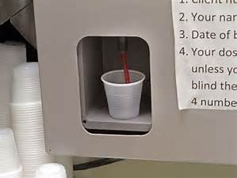
Pharmacotherapy for Opioid Use Disorder: Methadone
How it works
Full mu opioid receptor agonist
Very long-acting; dose is titrated every 3-4 days
Dose 1x/day for OUD; TID dosing for pain.
Who can offer methadone for treatment of a opioid use disorder (OUD)?
Only designated Opioid Treatment Programs (OTP)
Illegal to prescribe methadone for treatment of OUD in general practice
Notes:
(OUD=Opioid use disorder)
Methadone’s once daily dosing allows patients to get out of the cycle of addiction (binge/intoxication, withdrawal, preoccupation/anticipation)- which gets in the way of everyday life, and allows their brains and behavior to stabilize
In spite of the stigma surrounding methadone, the evidence is clear that methadone is highly effective medication for retaining people in treatment and preventing adverse effects, including death.

Slide 33
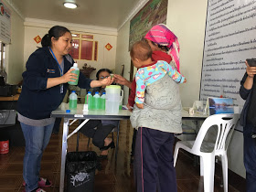
Mom receiving a methadone dose in a rural methadone clinic in Thailand
December, 2018
Notes:
Methadone is offered all over the world, and methadone and buprenorphine are among the WHO list of 100 essential medications that should be available worldwide

Slide 34
Pharmacotherapy for OUD: Methadone
Benefits
Limitations
Daily, observed dosing
Structured environment
Multi-disciplinary approach
Well studied: proven to decrease overdose deaths, hepatitis and HIV, criminal activity; increase employment; and to be cost-effective
Good treatment retention rates
Risk of overdose
Medication interactions (many)
Slow titration results in longer time to stabilize on dose
Poor access in rural areas
Risk of QT prolongation (although questioned in some recent studies)
Environment may be a trigger for relapse
Stigma
Inconvenience
Notes:
OUD=opioid use disorder

Slide 35
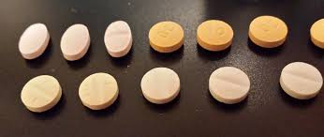
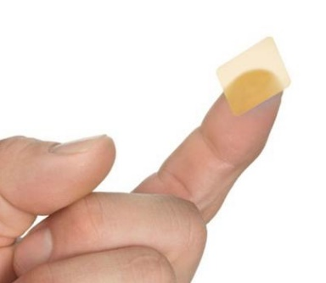
Pharmacotherapy for Opioid Use Disorder: Buprenorphine
How it works
Partial mu opioid agonist
Binds tightly to receptor, long lasting
Formulated with naloxone - deterrent to injection
Sublingual tablets and films, and newer injectable & implant
Who can prescribe
Physicians who have DATA-2000 waiver (DEA-X ) – requires 8 hour training course
As of 2017, NPs, PAs, CNSs, CRNAs, and CNMs can all qualify to prescribe by taking the 8-hour course plus 16 additional hours
Notes:
How it works:
Combining buprenorphine with naloxone encourages patients to take the medication sublingually, as a medication, rather than dissolving it and injecting it (which increases intoxicating effect). When the medication is dissolved under the tongue the naloxone is inactivated, but if it is injected it is active and can precipitate withdrawal.
As of 2017, NPs (nurse practitioners), PA’s (Physician Assistants), CNSs (Clinical Nurse Specialists), CRNAs (Clinical Nurse Anethetists), and CNMs (certified nurse midwives) may take both the eight-hour DATA-waiver course for treatment of opioid use disorder, that physicians currently take, and the additional 16-hour course offered to meet the requirements for the DATA-2000 waiver
Supervising physician must be DEA waived as well

Slide 36
Why is overdose potential low with buprenorphine?
Agonist: Methadone,
Heroin, etc.
Respiratory suppression, death
Opioid
Effects
Partial Agonist: Buprenorphine
Antagonist: Naltrexone
Log dose
Compton WM et al. N Engl J Med 2016;374:154-163
Notes:
Because buprenorphine is a partial agonist, it has a ceiling for its intoxication and also for its respiratory suppression effects. By itself it does not cause overdose deaths.
However, when combined with benzodiazepines or alcohol, overdose death is possible, and
there is a high risk of overdose death if buprenorphine is accidentally consumed by babies or toddlers
Keep in mind that it is still activating by 50% - in an opioid naive brain, this activation will cause intoxication, compared to an opioid dependent brain, where their natural opioid function is affected

Slide 37
Pharmacotherapy for OUD: Buprenorphine
Limitations
Limited access due to reluctance to prescribe
Risk of diversion
(long-acting forms may solve this problem)
Benefits
Lower risk of overdose and sedation than with methadone
Minimal medication interactions
Privacy and convenience
Treatment integrated into primary care
Important tool when problems arise during chronic opioid therapy
Home induction safe and effective
Effective analgesic (and some forms of buprenorphine approved for pain management)
Notes:
Be careful with concurrent use of benzos when prescribing buprenorphine—overdose deaths can occur from high-dose benzos and bup
Review these points if you have time:
Probuphine Implant approved for stable patients on ≤8 mg buprenorphine
requires special training, surgical procedure to implant. Effective x 6 months, but never achieves > 8 mg oral dose drug levels, and wanes over 6 months. Very expensive.
Subcutanous injection appears to very effective and reduces concerns about diversion
Buprenorphine buccal film and Transdermal Patch are approved for pain. Buprenorphine/naloxone is not FDA approved for pain management
A patch does NOT require DEA x waiver and is a good alternative for pain management

Slide 38
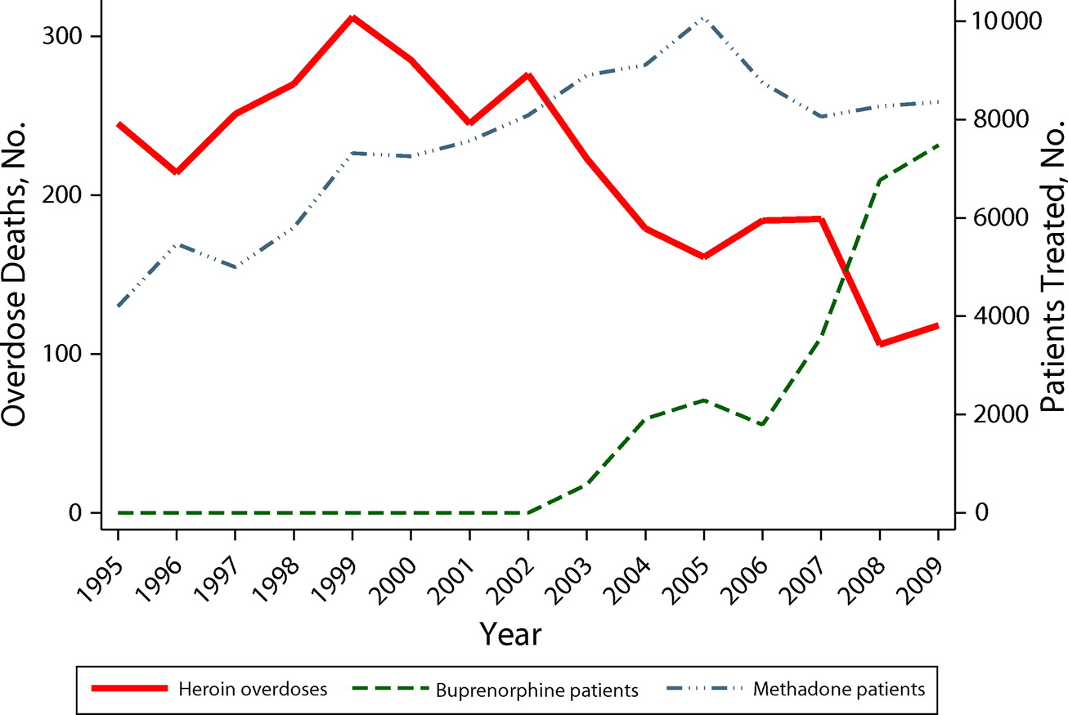
What is the impact of pharmacotherapy on overdose deaths?
Schwartz, AJPH, 2012
Notes:
This graph shows the decline in heroin overdose deaths in Baltimore, in tandem with increasing access to buprenorphine and methadone

Slide 39
What does the differential prescribing of buprenorphine by race look like?
Lagisetty, JAMA Psychiatry, 2019
Notes:
Unfortunately, some patients are more likely to receive access to buprenorphine than other.
Recent work from Lagisetty et al shows that while the number of buprenorphine visits is rising nationally, whites were far more likely to receive a buprenorphine prescription than patients of any other race.
In addition, private insurance or self-pay were more common methods of payment than Medicare/Medicaid or other.

Slide 40
Pharmacotherapy for OUD: Naltrexone
How it works
Opioid antagonist
Patients must be off opioids for 7-10 days as antagonist effects can cause acute withdrawal.
Two formulations available:
Oral 50 mg PO daily—largely ineffective for opioid use disorder
Extended-release injectable (Vivitrol) 380 mg IM monthly
Who can prescribe
Any prescriber

Slide 41
Pharmacotherapy for OUD: Naltrexone
Benefits
No withdrawal if stopped
Also effective in alcohol use disorder treatment
No respiratory depression or sedation
Not a controlled substance, no restrictions on prescribing
Early retention appears similar to buprenorphine if successful initiation is achieved
Tanum, JAMA Psychiatry, 2017
Lee, Lancet, 2018

Slide 42
Pharmacotherapy for OUD: Naltrexone
Limitations
Structured review (Jarvis, 2018, Addiction) concluded:
“Many individuals intending to start extended-release naltrexone (XR-NTX) do not, and most who do start XR-NTX discontinue treatment prematurely, two factors that limit its clinical utility significantly.”
Population-based study of patients in the year after non-fatal overdose in Massachusetts (Larochelle, 2018, Annals) found:
Both methadone and buprenorphine decreased all-cause and opioid-related mortality, but did not find this for naltrexone. Median treatment duration was 5 months for methadone, 4 months for buprenorphine, and 1 month from naltrexone.
Notes:
In practice, Injectable naltrexone has significant limitations. Because of the need for opioid abstinence prior to starting it, it is difficult to start this medication in an office-based setting.
Many patients do not continue the medication after the first month of treatment.

Slide 43
https://www.dropbox.com/sh/x4s4836c5jhngxk/AABmgF3JGGR3gAXshVlJ-rWUa?dl=0
Notes:
Patient turned recovery coach talking about the long term nature of disease
OpCR_L7.OB2_v1, 0:00-1:08

Slide 44
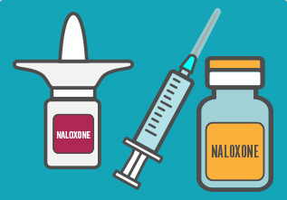
Overdose Prevention
Important for anyone at risk of having or witnessing an overdose, including friends and family
Naloxone (“Narcan”) reverses opioid overdose
Overdose education and naloxone save lives
Populations: syringe exchange, exit from jail, in drug treatment, prescribed opioids, anyone in treatment for OUD, past overdose, opioid prescriptions with benzodiazepines, etc/
PrescribetoPrevent.org

Slide 45
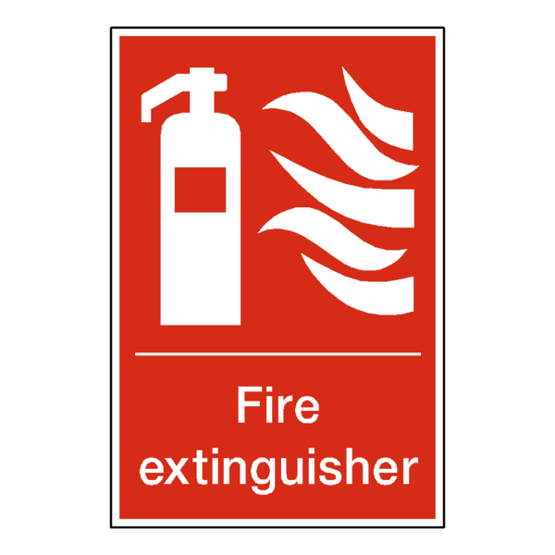
Naloxone availability
Overdose Prevention
Available for free at needle-exchange sites
Masshealth and Medicare plans cover the cost of a naloxone prescription
Most private insurers now cover
Available at most Massachusetts pharmacies
No need for a prescription – just ask!

Slide 46
Ideal state
Immediate access to MOUD for all who need it
Naloxone co-prescribing for all at risk of having or witnessing an overdose
Comprehensive pain management training
Comprehensive data dashboard to track outcomes – prevention, screening, prescribing, treatment, and more.
Comprehensive care for patients with SUD that incorporates their social determinants of health and other behavioral needs

Slide 47
What are next steps towards that state?
Combat stigma
Implement screening
Expand overdose prevention and naloxone distribution
Organize primary care, emergency teams, and other qualified providers to provide medication treatment
Collaborate with behavioral health providers
Address social barriers to health
Notes:
You can take specific steps to address substance use disorders in your health care system
(review slide)

Slide 49
Thank you to members of the consortium from…

Slide 50
References
Amato, L., Minozzi, S., Davoli, M., & Vecchi, S. (2011). Psychosocial combined with agonist maintenance treatments versus agonist maintenance treatments alone for treatment of opioid dependence. Cochrane database of systematic reviews, (10).
Cunningham, C. O., Giovanniello, A., Li, X., Kunins, H. V., Roose, R. J., & Sohler, N. L. (2011). A comparison of buprenorphine induction strategies: patient-centered home-based inductions versus standard-of-care office-based inductions. Journal of substance abuse treatment, 40(4), 349-356.
Dube, S. R., Felitti, V. J., Dong, M., Chapman, D. P., Giles, W. H., & Anda, R. F. (2003). Childhood abuse, neglect, and household dysfunction and the risk of illicit drug use: the adverse childhood experiences study. Pediatrics, 111(3), 564-572
Felitti, V. J. (2002). The relation between adverse childhood experiences and adult health: Turning gold into lead. The Permanente Journal, 6(1), 44.
Hostinar, C. E., Johnson, A. E., & Gunnar, M. R. (2015). Early social deprivation and the social buffering of cortisol stress responses in late childhood: An experimental study. Developmental psychology, 51(11), 1597.

Slide 51
Jarvis, B. P., Holtyn, A. F., Subramaniam, S., Tompkins, D. A., Oga, E. A., Bigelow, G. E., & Silverman, K. (2018). Extended‐release injectable naltrexone for opioid use disorder: a systematic review. Addiction, 113(7), 1188-1209.
Larochelle 2018 Annals
Kelly, J. F., Wakeman, S. E., & Saitz, R. (2015). Stop talking ‘dirty’: clinicians, language, and quality of care for the leading cause of preventable death in the United States. The American journal of medicine, 128(1), 8-9.
Lagisetty, P. A., Ross, R., Bohnert, A., Clay, M., & Maust, D. T. (2019). Buprenorphine Treatment Divide by Race/Ethnicity and Payment. JAMA Psychiatry.
Lee, J. D., Nunes Jr, E. V., Novo, P., Bachrach, K., Bailey, G. L., Bhatt, S., ... & King, J. (2018). Comparative effectiveness of extended-release naltrexone versus buprenorphine-naloxone for opioid relapse prevention (X: BOT): a multicentre, open-label, randomised controlled trial. The Lancet, 391(10118), 309-318.
Lee, J. D., Vocci, F., & Fiellin, D. A. (2014). Unobserved “home” induction onto buprenorphine. Journal of addiction medicine, 8(5), 299-308.
Lewis, M. (2018). Brain change in addiction as learning, not disease. New England Journal of Medicine, 379(16), 1551-1560.
Lim, J. K., Bratberg, J. P., Davis, C. S., Green, T. C., & Walley, A. Y. (2016). Prescribe to prevent: overdose prevention and naloxone rescue kits for prescribers and pharmacists. Journal of addiction medicine, 10(5), 300.

Slide 52
Mattick, R. P., Breen, C., Kimber, J., & Davoli, M. (2014). Buprenorphine maintenance versus placebo or methadone maintenance for opioid dependence. Cochrane database of systematic reviews, (2).
Mersky, J. P., Topitzes, J., & Reynolds, A. J. (2013). Impacts of adverse childhood experiences on health, mental health, and substance use in early adulthood: A cohort study of an urban, minority sample in the US. Child abuse & neglect, 37(11), 917-925.
Reilly, M. T., Noronha, A., Goldman, D., & Koob, G. F. (2017). Genetic studies of alcohol dependence in the context of the addiction cycle. Neuropharmacology, 122, 3-21.
Schwartz, R. P., Gryczynski, J., O’Grady, K. E., Sharfstein, J. M., Warren, G., Olsen, Y., ... & Jaffe, J. H. (2013). Opioid agonist treatments and heroin overdose deaths in Baltimore, Maryland, 1995–2009. American journal of public health, 103(5), 917-922.
Smith, P. C., Schmidt, S. M., Allensworth-Davies, D., & Saitz, R. (2010). A single-question screening test for drug use in primary care. Archives of internal medicine, 170(13), 1155-1160.
Tanum, L., Solli, K. K., Benth, J. Š., Opheim, A., Sharma-Haase, K., Krajci, P., & Kunøe, N. (2017). Effectiveness of injectable extended-release naltrexone vs daily buprenorphine-naloxone for opioid dependence: a randomized clinical noninferiority trial. JAMA psychiatry, 74(12), 1197-1205.

Slide 53
Resources
ASAM. National Practice Guideline for the use of medications in the treatment of addiction involving opioid use: http://www.asam.org/docs/default-source/practice-support/guidelines-and-consensus-docs/asam-national-practice-guideline-supplement.pdf
SAMHSA TIP 63. Medications for Opioid Use Disorder: https://store.samhsa.gov/product/TIP-63-Medications-for-Opioid-Use-Disorder-Full-Document-Including-Executive-Summary-and-Parts-1-5-/SMA19-5063FULLDOC
Providers Clinical Support System. Including MOUD Waiver Training: https://pcssnow.org/
NIDA. Understanding Drug Abuse and Addiction: What Science Says:
https://www.drugabuse.gov/understanding-drug-abuse-addiction-what-science-says
The Grayken Center for Addiction. Reducing Stigma and Words Matter Guide: https://www.bmc.org/addiction/reducing-stigma
The Grayken Center for Addiction and IHI. Effective Strategies for Hospitals Responding to the Opioid Crisis: http://www.ihi.org/resources/Pages/Publications/Effective-Strategies-for-Hospitals-Responding-to-Opioid-Crisis.aspx
Shatterproof. In It Together. https://www.shatterproof.org/inittogether

Slide 54
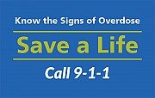
How to recognize an Opioid Overdose
Appendix
Blue lips and fingertips
Limp and pale
Small pupils
Breathing slow, irregular or has stopped
Pulse slow, erratic, absent
Nonresponsive to voice or sternal rub

Slide 55
Responding to a Suspected Overdose
Appendix
Assess the scene
Assess the person
Call 911
Rescue breathing
Administer Naloxone
Stay with the person until help arrives

Slide 56
Appendix
Massachusetts Consultation Service for the Treatment of Addiction and Pain (MCSTAP)
MISSION: To support primary care teams in increasing their capacity for, and comfort in, using evidence-based practices in screening for, diagnosing, treating and managing care of all patients with chronic pain and/or SUD.
Real-time phone consultation on safe prescribing and managing care for adults with chronic pain, SUD or both
Information on community-based resources to address patient needs
Free consultations on all patients statewide, regardless of insurance
Call 1-833-PAIN-SUD (1-833-724-6783), Monday to Friday, 9 a.m. – 5 p.m.
Consults on questions across a broad range of topics, from managing medications (including opioids, MAT and non-opioid pain medications) to pain management strategies
Staffed by physician consultants with expertise in addiction and pain
Funded by Massachusetts Executive Office of Health and Human Services

Slide 57
“Words matter” pledge
Appendix
Notes:
You can even consider introducing the possibility of change throughout the system where you work. This “Words Matter” pledge” is sent out to everyone who works at Boston Medical Center.

