Slide 1
The Opioid Epidemic: Crisis in the Workplace
Michael Botticelli
Executive Director, Grayken Center for Addiction

Slide 2
Executive Summary
Substance use disorders (SUDs) are a pervasive national problem
Nearly 22 million Americans aged 12 or older have an SUD
Only 1 in 10 people with SUD receive any form of treatment in a given year
Misuse of tobacco, alcohol, and illicit drugs costs the US more than $740 billion as a result of SUD-related crime, lost work productivity, and avoidable healthcare utilization
Community Partners
Philanthropic Individuals and Groups
Grayken Center
Local and National Stakeholders
The launch of the Grayken Center for Addiction has given us the opportunity to expand evidence-based SUD treatment services
Our history of leadership in this space is a strong foundation for this work
Our goals are to:
Expand access to treatment and harm reduction services for young adults with SUDs
Disseminate best practices in SUD care and support
Maximize the impact of BMC’s addiction work
To achieve our goals we are developing strong partnerships with community healthcare providers, local and national stakeholders, and philanthropic individuals and groups
We look forward to sharing details of our efforts to stem the tide of addiction across the Commonwealth and become a model employer for individuals with SUDs

Slide 3
Content
The Growing Epidemic
SUDs in Massachusetts
Becoming a Model Employer

Slide 4
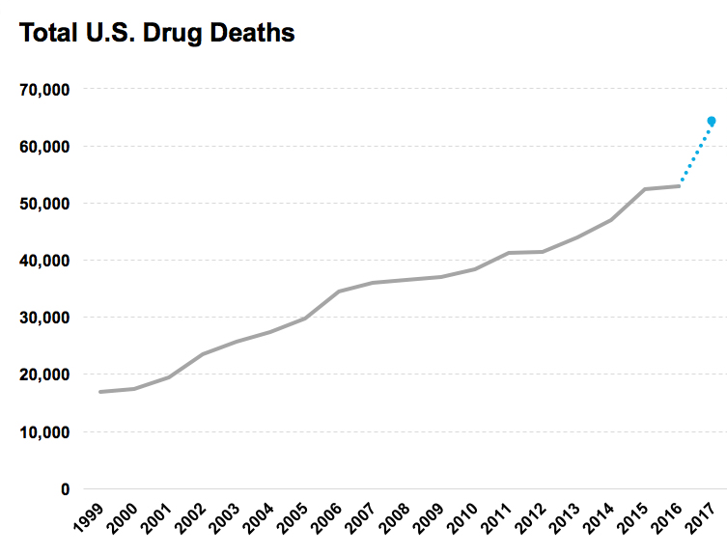
Data has demonstrated that the US overdose epidemic is spreading geographically and increasing across all demographic groups
According to the CDC:
Drug overdoses killed 63,632 Americans in 2016 and nearly two-thirds of deaths (66%) involved a prescription or illicit opioid
Overdose deaths increased in all categories of drugs examined for men and women, people ages 15 and older, all races and ethnicities, and across all levels of urbanization
Source: https://www.cdc.gov/media/releases/2018/p0329-drug-overdose-deaths.html

Slide 5
The rising prevalence of SUDs has led to dramatic increases in infectious diseases, and other societal consequences
It is estimated that more than 22 million Americans are suffering from a substance use disorder
Misuse of tobacco, alcohol, and illicit drugs costs the United States more than $740 billion annually as a result of related crime, lost work productivity, and healthcare associated expenses
Significant increases in acute hepatitis C infections across the nation have been attributed to an increase in injection drug use
Dramatic increases in maternal opioid use has led to a rising number of substance exposed newborns
https://www.cdc.gov

Slide 6
The economic impact of SUDs cannot be overstated
The economic costs of SUDs are estimated at $504B or 2.8% of GDP – over 6x larger than the most recent cost estimates
73% of costs are attributed to nonfatal consequences, including: healthcare spending, criminal justice costs, and lost productivity due to addiction and incarceration
27% of costs are attributed to lost potential earnings due to death
Princeton Economist, Alan Kruger, suggests that the epidemic accounts for a 20% decline in labor force participation among men
2.8% of GDP
Lost
Potential
Non-Fatal Consequences
Source: White House Council of Economic Advisers November 2017 – The Underestimated Cost of the Opioid Crisis

Slide 7
Content
The Growing Epidemic
SUDs in Massachusetts
Becoming a Model Employer

Slide 8
While opioid-related deaths have begun to decrease slightly in Massachusetts, there is still a lot of work to be done
Source: https://www.mass.gov/files/documents/2018/05/22/Opioid-related%20Overdose%20Deaths%20among%20MA%20Residents%20-%20May%202018.pdf

Slide 9
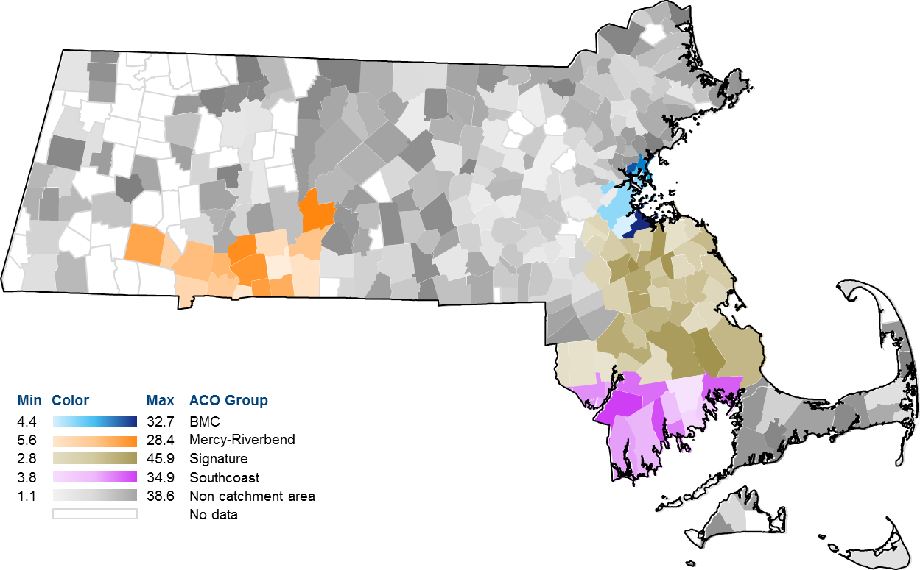
Our area has been particularly hard hit by this crisis
Annual opioid-related deaths
Rate per 100,000 people, 2011 - 2015
Source: Massachusetts Registry of Vital Records and Statistics; Massachusetts Department of Public Health

Slide 10
Content
The Growing Epidemic
SUDs in Massachusetts
Becoming a Model Employer

Slide 11
BMC continues to lead in the face of this epidemic—we are nationally recognized for our SUD research, clinical care, and support services
18+
clinical programs for patients with SUDs
$8M+ addiction-related grant funding in 2016
2,250+ patients served through Project ASSERT in 2015
OBAT is a national best practice of SUD treatment within primary care
One of the first addiction medicine fellowships in the US
130
mothers and babies served through Project RESPECT in 2016
20+ faculty members focused on addiction medicine
1000+ patients served annually via Addiction Consult Service
40+ Health centers across MA supported by OBAT TTA
8
training programs for med students / residents / fellows and attendings
CATALYST clinic for adolescents / young adults one of the first of its kind nationally
Largest provider regionally for pregnant mothers with SUDs
2 fellowship programs for clinical care and research
Source: BMC analysis, CARE unit website

Slide 12
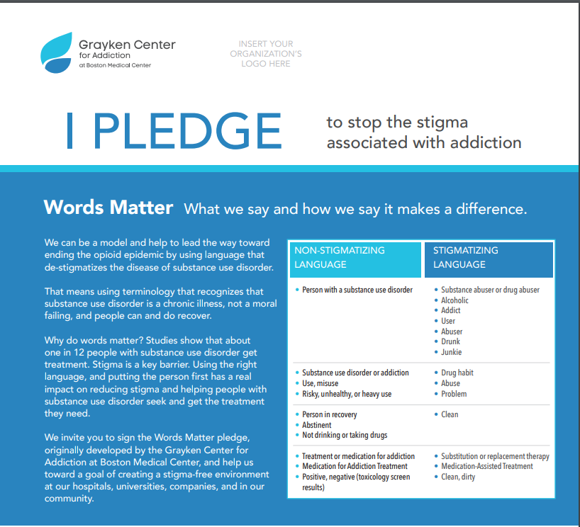
One of the first things we did following the launch of Grayken was to take action to support our employees and become a model employer
We hosted a Recovery Day Event featuring stories from our employees
Kate Walsh led an effort for employees to sign a “Words Matter” pledge to avoid stigmatizing language related to SUDs
We conducted an employee survey and focus groups to examine benefits satisfaction and corporate climate
We mailed a “Rethinking Drinking” fact card to each employee as part of Open Enrollment

