Slide 1
Clinical Trials Office's short and long-term goals
September 11, 2019

Slide 2
Objectives
1. Review BMC's Clinical Trials Office current initiatives
2. Discuss
how BMC can catalyze diversifying data collection across all patient populations

Slide 3
Mission
Welcome! We’re here to help support your clinical and human research.
BMC Clinical Trial Office (CTO) serves as a central resource for principal investigators, study staff and departments involved in clinical research and for sponsors seeking to conduct clinical trials at Boston Medical Center. Our CTO pre-award and post-award team(s) supports and advances BMC’s mission by providing leadership and expertise in research, finance, and administration. In fulfilling this mission, the CTO’s primary functions are to:
Review, negotiate, and approve of protocols that are projected to be IRB: approved, expedited, or exempt AND industry or internally funded (Clinical Trial Agreement, CDA, NDA)
Support Grants & Contracts on protocols that include human subjects (government agency, subaward, foundation award, Boston University)
Oversee document harmonization before final approvals: Informed Consent, Contract, Budget, and Medicare Coverage Analysis
Ensure accurate clinical research: billing process, charge routing, and pricing
Coordinate, educate, and train on clinical research requirements within research community and clinical departments
Monitor and provide oversight of clinical trial account finances
Notes:
Mike

Slide 4
Leadership initiatives
Drafting an annual strategic plan 2019-2020
Collaborating with ancillary service departments who support clinical research protocols
7/15/19- IRB, Investigational Pharmacy Service, Lab Services, Clinical Research Resources Office
9/10/19- BMC Marketing, Radiology, Research Compliance, Cancer Care Administration, and GCRU
Emphasizing that CTO is central point of contact for all BMC clinical research pricing, i.e. departments should not be providing researchers projected clinical procedure rates
Hosting monthly and bi-weekly research billing working groups
Reviewing and providing feedback on clinical research related guidelines and policies
Informing BMC leadership on a variety of clinical research related issues and successes
Engaging in department discussions on areas of improvement for CTO
Notes:
Johanna

Slide 5
Re-design CTO pre & post award workflows
Define CTO roles and responsibilities within Research Operations and departments providing clinical research
Provide high level scope determination
Design research protocol workflow
Develop ease and efficiency of projects routing through Res Ops with clear understanding of ownership
Provide excellent customer service for our clients in pre & post award workflows: BMC/BU departments performing clinical research
Streamline tasks
Increase efficiency
Centralize financial oversight and mitigate risk
Encourage continued education for CTO staff
Notes:
Mike

Slide 6
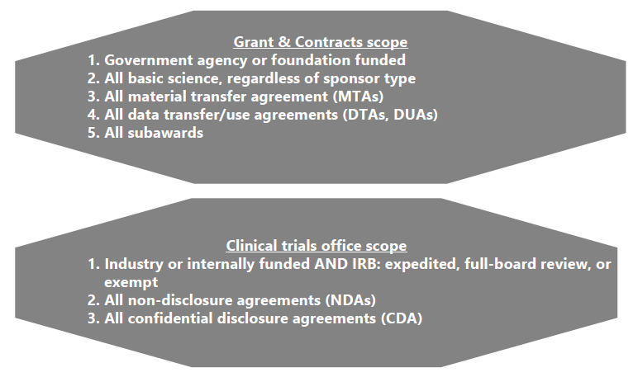
Research Operations scope summary
Notes:
Johanna

Slide 7
Research Operations service intake processes

Slide 8
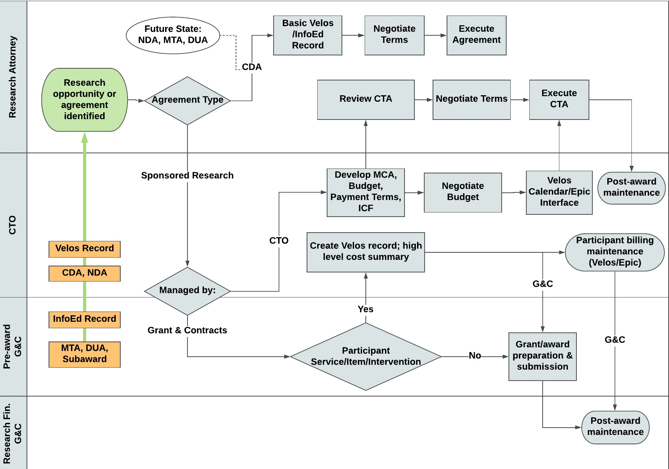
Department Research Operation workflow
Notes:
Mike https://ocr.iu.edu/clinical-trial-process-map/

Slide 9
New CTO initiatives: pre-award
Reorganize CTO study folders by sponsor, allowing for review of all department contracts and budgets before negotiations commence
Improve communications with study teams
update CTO website
develop standard study initiation letter
collaborate on all CTFA lead processes
Use Velos beyond previous definition- all work to be managed by CTO and Research Attorneys will have a Velos record
CTFA will aid in execution of CDAs and NDAs
Serve as primary liaison between the sponsor, the study team, the Research Attorneys, and Ancillary Services = CTFA
Provide review of the Injury and Cost language in the Informed Consent = CTFA
Review and negotiate payment terms with the sponsor = CTFA
Lead kick-off meeting for new clinical research protocols = CTFA
Notes:
Mike

Slide 10
New CTO initiatives: post-award
Focusing on outstanding AR
Identifying and developing short/long-term solutions for research billing issues and audit
Brainstorming ways to improve monthly research department meetings
Notes:
Mike

Slide 11
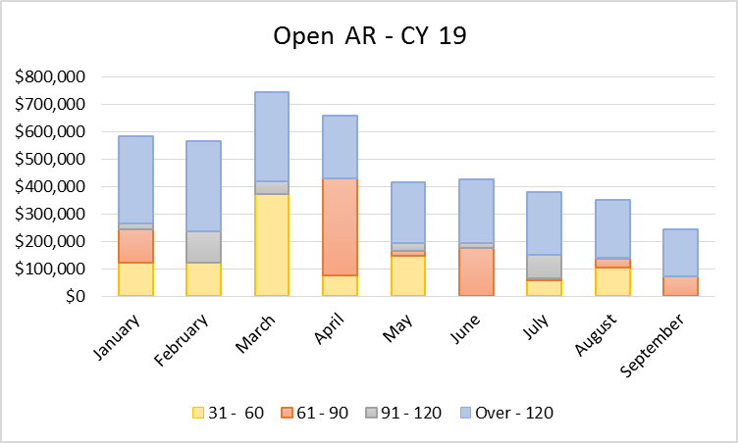
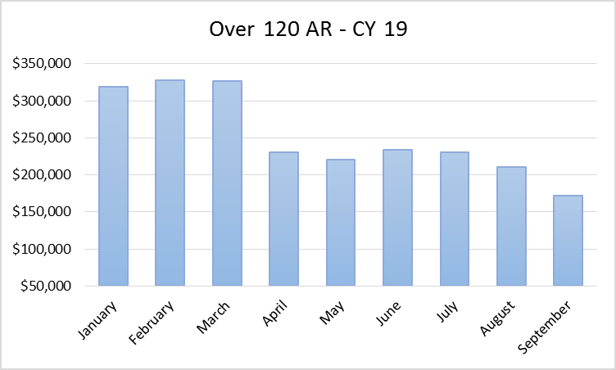
Outstanding AR April – Aug 2019 summary
$154k reduction in open AR over 120 days since project implementation
Goal: to receive payment at 61-90 days = improve fiscal health
Notes:
Mike

Slide 12
Research billing update
Manage working group bi-weekly and leadership meeting monthly
pt status between Epic and Velos- CTO to complete 100% pt status review in Velos and Epic
professional billing
claims logic and coding
Complete research-related denial audit
36 encounters to review with denial code “Experimental/Investigational”
Reviewing 100% of claims in two steps:
step 1: accurate charge routing, confirmed 100% accuracy
step 2: claims processing accuracy, if research related, then review insurance requirements
Request review of 100% of “research-related, bill to insurance” claims
Secure Epic project to begin Oct 2019 to address
final status change requirements to relieve manual review
automatic claims processing requirements to relieve manual review
Medicare Advantage Plan billing and research
Notes:
Johanna

Slide 13
Monthly research department meetings
Welcome suggestions on improved process, draft brainstormed ideas below
Provide one email from Research Operations to department admins containing:
CTO and G&C account balance reports
CTO invoicing/milestone checklist per study
Improve agenda
Include pre-award for statuses G&C and CTO
Discuss lessons learned in pre and post award
Review financial analysis reports
Review invoices/milestones met
Discuss outstanding AR (>120 days)
Review CTO projects effort allocation by personnel and study
Discuss newly awarded accounts, and allocation of related expenses
FFRs and final invoices
Send standard follow-up email with action items listed and deadlines for completion
Notes:
Johanna

Slide 14
Objectives
1. Review BMC's Clinical Trials Office current initiatives
2. Engage in long-term vision:
how BMC can catalyze diversifying data collection for all patient populations

Slide 15
The future of clinical research at BMC
Increase clinical research opportunities across all BMC patients- through efficiency workflows
Velos
Advance Velos software to mirror and replace manual efforts
Develop database of sponsors to include: contract payment terms, budgets, and experience
Data collection and analysis
CTO workflow
Notes:
Johanna

Slide 16
The future of clinical research at BMC, cont.
- Move research fee schedule rates for HB and PB to generate out of Epic, manual journal entry remains for CTO to charge study fund
The nature of research
Look into my crystal ball, if I could only predict the future…….
Provide departments with monthly financial projections for Active accounts
Financial projections
Epic
- Review Coverage with Evidence Development logic and assess process improvement
Notes:
Johanna

Slide 17
Contact information and Questions
Questions, comments, feedback
Mike Porreca Manager, Clinical Trials Office 617-414-5669 Michael.Porreca@bmc.org | Johanna Chesley Director, Clinical Trials Office 617-414-2861 Johanna.Chesley@bmc.org
Other Research Operations resources:
Website: https://www.bmc.org/research-operations
Contact list: http://www.bmc.org/sites/default/files/Research/documents/Combined_Assignment_List.xlsx
CTO inbox: CTO@bmc.org
G&C inbox: grants.admin@bmc.org
Notes:
Johanna

