Slide 1
Unobligated Balance Review April 2018

Slide 2
NIH Grants Policy Statement
8.1.1.1 Carryover of Unobligated Balances from One Budget Period
to Any Subsequent Budget Period
The NoA will include a term and condition to indicate the disposition of unobligated balances (automatic carryover authority vs. prior approval required).
For awards under SNAP, funds are automatically carried over to the subsequent budget period. However, the grantee will be required to indicate, as part of the grant's progress report, whether any estimated unobligated balance (including prior-year carryover) is expected to be greater than 25% of the current year's total approved budget. If greater than 25%, the grantee must provide an explanation and indicate plans for expenditure of those funds within the current budget year.
For both SNAP and non-SNAP, when a grantee reports a balance of unobligated funds in excess of 25%, the GMO will review the circumstances resulting in the balance to ensure that these funds are necessary to complete the project, and may request additional information from the grantee, including a revised budget, as part of the review.
If the GMO determines that some or all of the unobligated funds are not necessary to complete the project, the GMO may restrict the grantee's authority to automatically carry over unobligated balances in the future, use the balance to reduce or offset NIH funding for a subsequent budget period, or use a combination of these actions.
https://grants.nih.gov/policy/nihgps/index.htm

Slide 3
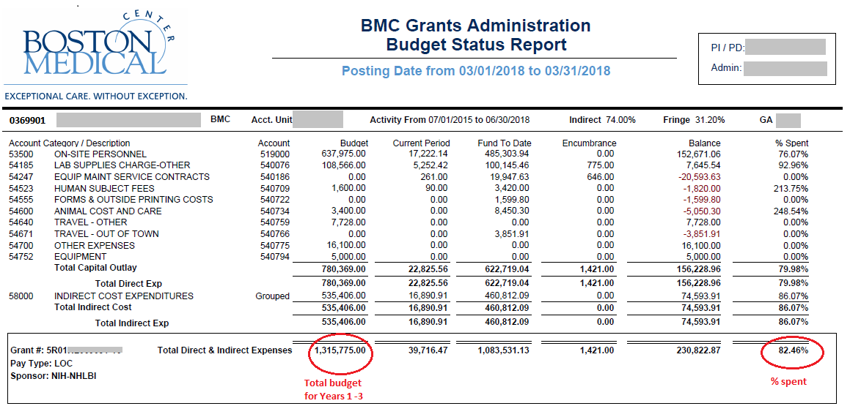
Unobligated Balance Example
R01 subject to SNAP (automatic carryover, annual FFR not required)
Current budget period: Year 3 (from 7/1/17 to 6/30/18)
BSR shows total spent = 82%
Is the unobligated balance greater than 25% of the current year's total budget?

Slide 4
Unobligated Balance Example - Continued
Summary:
We determined that the unobligated balance is expected to be greater than 25% of the current year's total approved budget. PI/Admin should provide an explanation for unobligated balance in RPPR.
Contact your Research Finance Analyst with any questions.

