Slide 1
Research in Epic
April 2018

Slide 2
Research
Owning Application Team: HB
Impacted Groups: PFS, Patient Access, Study Coordinators
Impacted Roles*: Billers, Schedulers, Study Coordinators
Current State Workflows
Future State Workflows
Patients that are enrolled in a research study are flagged in SDK using “ZZ Research”. This flag qualifies the patient related charges onto a report for manual billing review by Revenue Integrity. All charges marked for bill to study versus bill to insurance are managed in SDK and GE.
Users will be linking patients to studies in Epic however an interface from Velos to Epic will flag enrollments at the patient level. This flag will identify patient related charges for research billing review. PFS will perform the billing review function in Epic.
Key Information (outstanding questions, impact on BMC, workflow highlights/positives)
Patient Header- Patients enrolled in an active study may be identified easily in the patient clinical header.
How this impacts your role
Billers- Will be responsible for reviewing charges in Epic to make the determination for billing to study versus to insurance
Schedulers- Will have the ability to link visits to an active research study.
Study Coordinators- Will have the ability to either link visits to studies in Epic or call the scheduling area to request the linking

Slide 3
Summary of Key Points
The active studies and participants will be interfaced from VelosCT
Participants must be entered into VelosCT with 24 hours of being consented
The study nickname in VelosCT will be the Study Name in Epic
The IRB Protocol number in VelosCT will be the Study Code in Epic
The Full protocol title in VelosCT will be in the Description field in Epic
The NCT number will only be interfaced for CMS Qualifying Clinical Trials
We are not going live with Epic calendars or time lines
Patient Financial Services will review all charges for research participants, and process in accordance with research documentation in the VelosCT calendar

Slide 4
What We Know
All research studies will continue to be managed in Velos only
PFS will review research related charges (Pro/Tech) for billing purposes
Enrollment Status Table:
Active | Inactive
Consented- In Screening | Completed
Enrolled | Ineligible
On Intervention | Withdrew Consent
In Follow-Up | Expired
 | Terminated
 | Transferred Care

Slide 5
Epic Research Standard Workflow
Performed by BMC Revenue Cycle staff
Notes:
Core clinical implementation

Slide 6
Recap of Workflow
Professional/technical charges for patients enrolled in a study will qualify for 100% billing review
PFS will be responsible for billing review
In Epic, the “Patients Needing Research Billing Review (Non-Coordinator) Report” will be used by BMC Revenue Cycle staff for billing review
We will not be utilizing the functionality to link orders at this time

Slide 7
What We Know
In Epic, association of the study and study account is accomplished through linking the encounter to the study
Study Coordinators and Schedulers will have the ability to link patients to research studies
Linking can be accomplished via multiple methods:
At time of scheduling
After scheduling using Upcoming Appointments Report
In Epic, study enrollment is performed at the patient level, which satisfies the requirement for billing review. However, visit/encounter association offers enhanced billing review

Slide 8
Workflow – Research Scheduling

Slide 9
Workflow – Encounter Linking

Slide 10
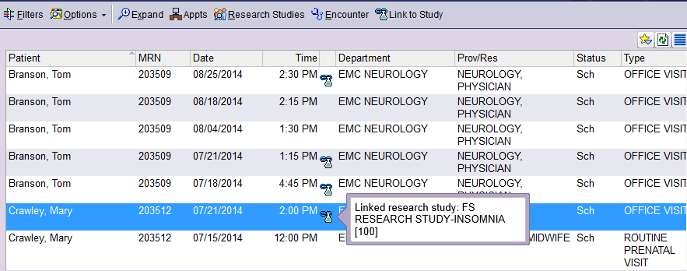
Tools – Upcoming Appointments Report

Slide 11
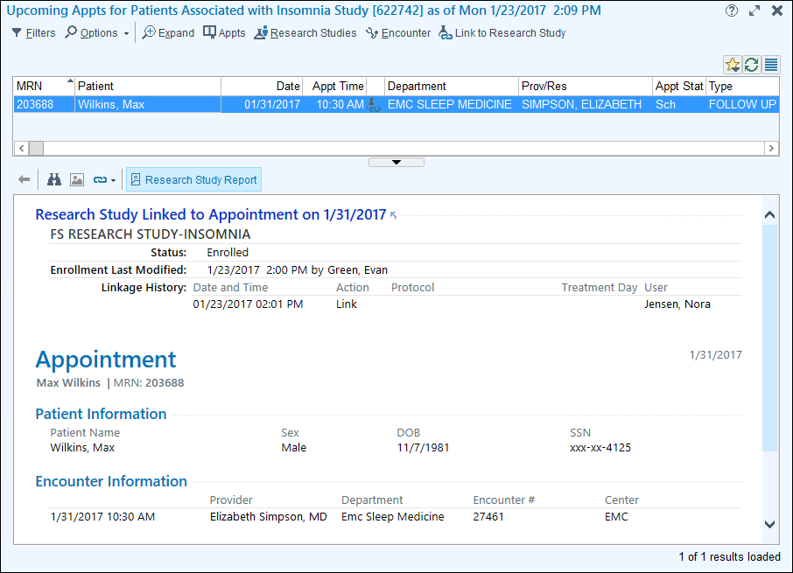
Tools – Upcoming Appointments Report

Slide 12
Recap of Workflow
Study Coordinators will perform outreach to the departments to schedule a study related visit
Schedulers will perform visit encounter linking at the time of scheduling
Study Coordinators will be able to link visit encounters from the Upcoming Appointments Report

Slide 13
Summary of Key Points
The active studies and participants will be interfaced from VelosCT.
Participants must be entered into VelosCT with 24 hours of being consented.
The study nickname in VelosCT will be the Study Name in Epic.
The IRB Protocol number in VelosCT will be the Study Code in Epic.
The Full protocol title in VelosCT will be in the Description field in Epic.
The NCT number will only be interfaced for CMS Qualifying Clinical Trials.
We are not going live with Epic calendars or time lines.
Patient Financial Services will review all charges for research participants, and process in accordance with research documentation in the VelosCT calendar.

Slide 14
Resources
Additional Information | Timing | Location
CAD Link Research Tip Sheet | Posted | http://share.bmc.org/revup/Cadence/Forms/AllItems.aspx?RootFolder=%2frevup%2fCadence%2fFront%20Desk%20Tip%20Sheets&View=%7b3894984F%2d2455%2d48F5%2d8A0F%2d1C6380A5ED52%7d
Research E-Learning | Posted | http://internal.bmc.org/revup/elearning/cadence.html

