Slide 1
Research in Epic Update
May 2018
Terry Stone
Clinical Trial Office

Slide 2
We Are Live…. mostly
The active studies and participants will be interfaced from VelosCT
Participants must be entered into VelosCT within 24 hours of being consented
The study nickname in VelosCT will be the Study Name in Epic
The IRB Protocol number in VelosCT will be the Study Code in Epic
The Full protocol title in VelosCT will be in the Description field in Epic
The NCT number will only be interfaced for CMS Qualifying Clinical Trials
Patient Financial Services will review all charges for research participants, and process in accordance with research documentation in the VelosCT calendar
Notes:
Active studies will be interfaced once the account is setup and the IRB approval is verified.
Participants must be entered in a consented status as quickly as possible, within 24 hours, after signing the consent.
The full protocol title will be in the ‘Description’ field.
PFS will review the charges for every research participant, and compare to the calendar in VelosCT.

Slide 3
Research
Owning Application Team: HB
Impacted Groups: PFS, Patient Access, Study Coordinators
Impacted Roles*: Billers, Schedulers, Study Coordinators
Past State Workflows
Current State Workflows
Patients that are enrolled in a research study are flagged in SDK using “ZZ Research”. This flag qualifies the patient related charges onto a report for manual billing review by Revenue Integrity. All charges marked for bill to study versus bill to insurance are managed in SDK and GE.
Users will be linking patients to studies in Epic however an interface from Velos to Epic will flag enrollments at the patient level. This flag will identify patient related charges for research billing review. PFS will perform the billing review function in Epic.
Key Information (outstanding questions, impact on BMC, workflow highlights/positives)
Chart Review - Patients enrolled in an active study may be identified easily in Chart Review by clicking on the Research Studies box.
How this impacts your role
Billers- Will be responsible for reviewing charges in Epic to make the determination for billing to study versus to insurance
Schedulers- Will have the ability to link visits to an active research study.
Study Coordinators- Will have the ability to either link visits to studies in Epic or call the scheduling area to request the linking
Notes:
SDK and GE systems are both getting replaced with Epic.
The active studies and participants will be interfaced from VelosCT.
The Patient Header will not have the ‘Research: Active’ indicator as documented above. This will be added during optimization.
The research studies that a patient is enrolled in will be visible in the patient chart.

Slide 4
What We Know
All research studies will continue to be administratively managed in Velos only
PFS will review research related charges (Pro/Tech) for billing purposes
Enrollment Status Table:
Active | Inactive
Consented- In Screening | Completed
Enrolled | Ineligible
On Intervention | Withdrew Consent
In Follow-Up | Expired
 | Terminated
 | Transferred Care
Notes:
There will be no ‘pre-consent’ statuses in Epic.
Be sure to manage statuses – for when participants become inactive.

Slide 5
Epic Research Standard Workflow
Performed by BMC Revenue Cycle staff
Notes:
Central review of charges by Finance/Patient Financial Services will continue.

Slide 6
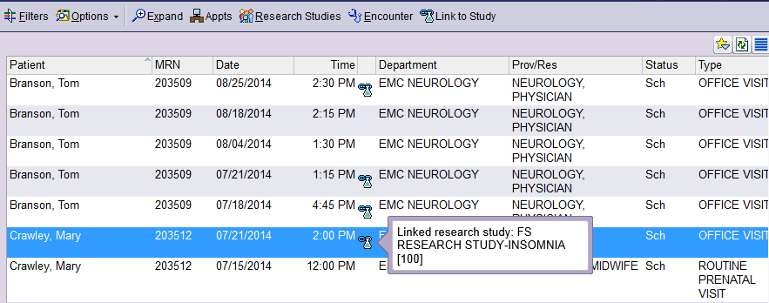
Tools – Upcoming Appointments Report
Notes:
The Upcoming Appointments Report or the patient’s appointment desk will display scheduled appointments. From here, visits or encounters can be linked to the study.

Slide 7
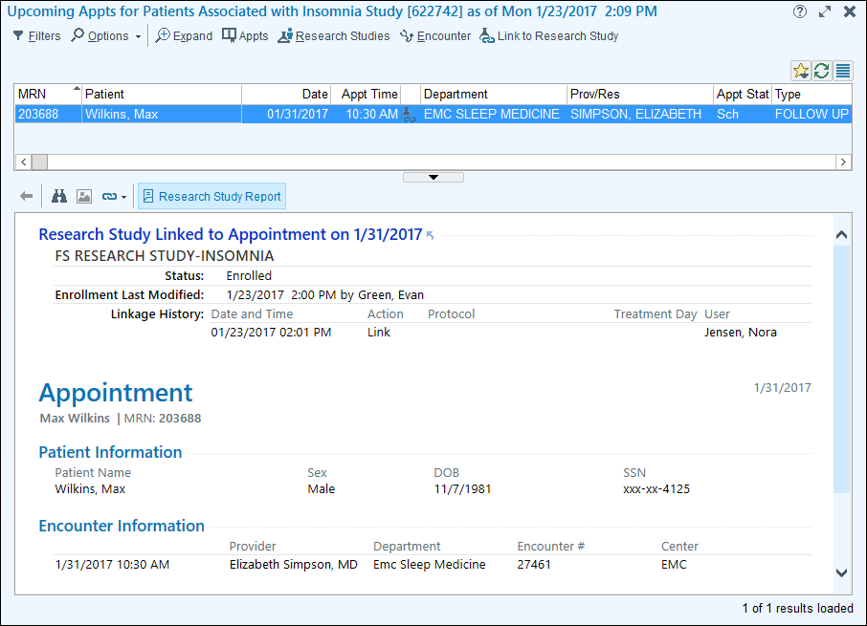
Tools – Upcoming Appointments Report
Notes:
This shows the details of a linked appointment.

Slide 8
Recap of Workflow
Study Coordinators will perform outreach to the departments to schedule a study related visit
Schedulers will perform visit encounter linking at the time of scheduling
Study Coordinators will be able to link visit encounters from the Upcoming Appointments Report
Notes:
If you want to ‘tag on’ a research service onto a standard of care visit in another department (not your own department) it is best practice to notify them.
If you have scheduling access you may link a visit.
Linking can happen directly from the Upcoming Appointments Report.

Slide 9
Resources
Additional Information | Timing | Location
CAD Link Research Tip Sheet | Posted | http://share.bmc.org/revup/Cadence/Forms/AllItems.aspx?RootFolder=%2frevup%2fCadence%2fFront%20Desk%20Tip%20Sheets&View=%7b3894984F%2d2455%2d48F5%2d8A0F%2d1C6380A5ED52%7d
Research E-Learning | Posted | http://internal.bmc.org/revup/elearning/cadence.html

