Slide 1
Research Administrator Quarterly Meeting
Tuesday, September 10, 2019

Slide 2
Compliance Department – Resources for Research Conflict of Interest and Privacy
Fanny Ennever, PhD, CHC
Research Compliance Officer

Slide 3
Conflict of Interest
Who is required to disclose outside interests?
Investigators:
Definition: The project director (PD) or principal investigator (PI) and any other person, regardless of title or position, who is responsible for the design, conduct, or reporting of Research, taking into account the degree of independence with which the person works.
When are they required to disclose?
Annually or within 30 days of acquiring a new interest.

Slide 4
Conflict of Interest Assurance #1
Email from Research Operations with ePSF:
PI/PD Assurance
I certify that:
1. I and the individuals I have identified above are the Investigators for this project and each has COI disclosure in the COI-SMART system;

Slide 5
Conflict of Interest Assurance #2
INSPIR:
5.2 Conflict of Interest Disclosure
I confirm that all those responsible for the design, conduct, or reporting of the proposed program, including at minimum, all Senior/key personnel in the grant application, will, before this application is submitted, have completed the required financial interest disclosure through COI Smart for Boston Medical Center or through the Financial Interest Disclosure form for Boston University. NOTE: The IRB considers any missing financial interest disclosures to be noncompliance by the Principal Investigator I confirm Of the financial interest disclosure forms that will be completed, will any significant financial interests that are related to the research be disclosed?  Yes  No

Slide 6
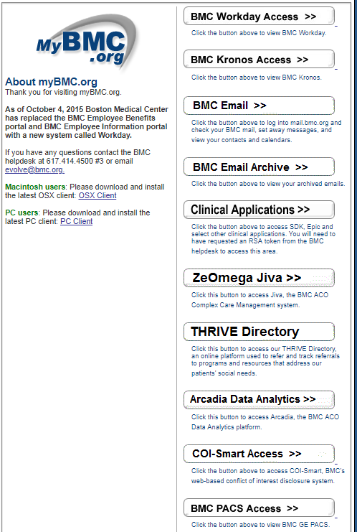
Disclosure Software: BMC COI Smart

Slide 7
Conflict of Interest: BMC Process
BMC Grants Office checks COI Smart to ensure that all Investigators have completed disclosures.
BMC Compliance Department reviews all conflict of interest forms and Investigators with Significant Financial Interests (SFI’s).
If an Investigator has an SFI, Compliance reviews their disclosure form for conflicts and implements a management plan if necessary (this can take > 1 month).
Investigators with SFI’s: About 100
Investigators with Management Plans: 5

Slide 8
Conflict of Interest Summary
Your role:
Recognize potential conflicts
Remind investigators to complete COI Smart form
Refer questions to:
COI-Compliance@bmc.org
Fanny Ennever, PhD, CHC, Research Compliance Officer
Alisia Lamborghini, JD, CHC, Conflict of Interest Manager

Slide 9
Privacy [/Confidentiality/Data Security]
What privacy rules apply to research?
IRB – must minimize the risk of data being revealed outside the research context
HIPAA – must obtain a waiver or an authorization to use and disclose Protected Health Information (PHI)
What information does the IRB need?
Confidentiality of Identifiable Data
HIPAA Waiver
HIPAA Authorization

Slide 10
Confidentiality of Identifiable Data
INSPIR:
9.2 Confidentiality of the Data
In the section below, indicate how the study will ensure subject confidentiality and privacy on all study data/results, documents, CRFs, and
9.3 Release of identifiable data
Do you plan to share data with a third-party vendor or software application or program? Note: sponsors are not considered third parties.  Yes  No For BMC research, reach out to privacyofficer@bmc.org For BU research, reach out to buinfosec@bu.edu They will need to review their privacy and security practices, and obtain a BMC and/or BU HIPAA Business Associate Agreement before HIPAA data is shared with the third party/vendor or application. Please be sure to make this contact promptly because this process can require significant information gathering and analysis.
9.4 Destruction of Identifiers
If the data are identifiable and/or if a master-code exists, when and how will the data be de-identified or the master-code be destroyed?
9.5 Certificate of Confidentiality
Please check one option below. For more information, click here.

Slide 11
HIPAA Waiver
INSPIR:
HIPAA Compliance
10.1 Do you need access to protected health information (PHI) without signed authorization from the individual whose information you need?
Yes No

Slide 12
HIPAA Authorization
Consent Form Template
[Include Use and Sharing of Your Health Information if HIPAA authorization is required; otherwise, delete entire Use and Sharing of Your Health Information section] Use and Sharing of Your Health Information
The research team has to use and share your health information to do this study, including information that may identify you. By agreeing to be in this study and signing this form, you are giving us your permission where needed to use and share your health information as described in this form.
Health information that might be used or shared during this research includes:
Information that is in your hospital or office health

Slide 13
Privacy Summary
Your role:
Recognize potential privacy, confidentiality, and data security issues
If data are going to a third-party vendor, contact privacyofficer@bmc.org promptly
Refer questions to:
Fanny Ennever, PhD, CHC, Research Compliance Officer, Fanny.Ennever@bmc.org
Seraphina Rasmussen, JD, Privacy Analyst, Seraphina.Rasmussen@bmc.org
Your IRB Administrator

