Slide 1
Research Administrator Quarterly
July 15, 2019

Slide 2
Agenda
Updates
New Research Operations Team Members
Stephanie Wasserman – Director, Grants and Contracts
Kristin Pezzone – Research Finance Analyst I
Minhao Yin – Clinical Trial Financial Analyst
Pallabi Gupta – Agreement Associate
Jamie Flaherty – Senior Research Counsel
Huron Training Feedback
Monthly Meetings with Departments/Sections and Research Operations
Extended Sick Leave, Short-Term Disability, and Earned Time on Grants
Update on Closeouts
Update on Subcontracts
Items for Discussion
CTO update: areas of improvement, focus, and review
Clinical research ancillary department service reviews-
Group 1: Clinical Research Resource Office, Pathology, Institutional Review Board, Investigational pharmacy services

Slide 3
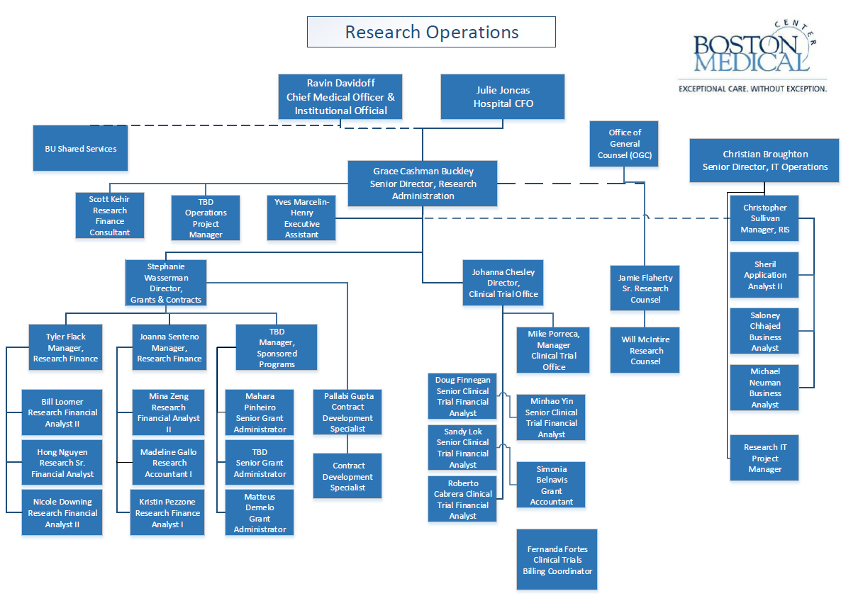
Updated Org Chart

Slide 4
Feedback on Huron Training
Future Training Topics
BMC specific content tailored towards BMC policies, processes and systems
Workspace
SPIN
Info Ed
State funded contracts
T32s
Budget reconciliation
Cost Principles

Slide 5
ESL, STD, and ET on Grants
Earned Time (ET) – ET policy is the same for grants and operations. Expense posts to individual cost centers and grants.
Earned time cash out/termination pay posts to corporate (not individual grants)
Extended Sick Leave (ESL)/FMLA – Expense posts to corporate for grants. There is a one week waiting period for accessing ESL. Employees must use one scheduled work week of ET prior to accessing ESL. If an employee does not have ET available, the one week period will be unpaid.
Short-term Disability (STD) – Expense posts at corporate level for grants and operations. An employee’s ESL accruals must be fully exhausted prior to the utilization of STD.
Currently STD and ESL are posting to grants. For FY19, Accounting will review grant postings monthly and reclassify any ESL/STD expense to a corporate AU. BMC is working on changing the policy around ESL/STD and having all ESL/STD post to corporate for FY20. Please notify your RFA if you see any of these charges on your accounts.
Policies:
FMLA
Paid Time Off (Earned Time, Extended Sick Leave, Bereavement, Military Training, Jury Duty)

Slide 6
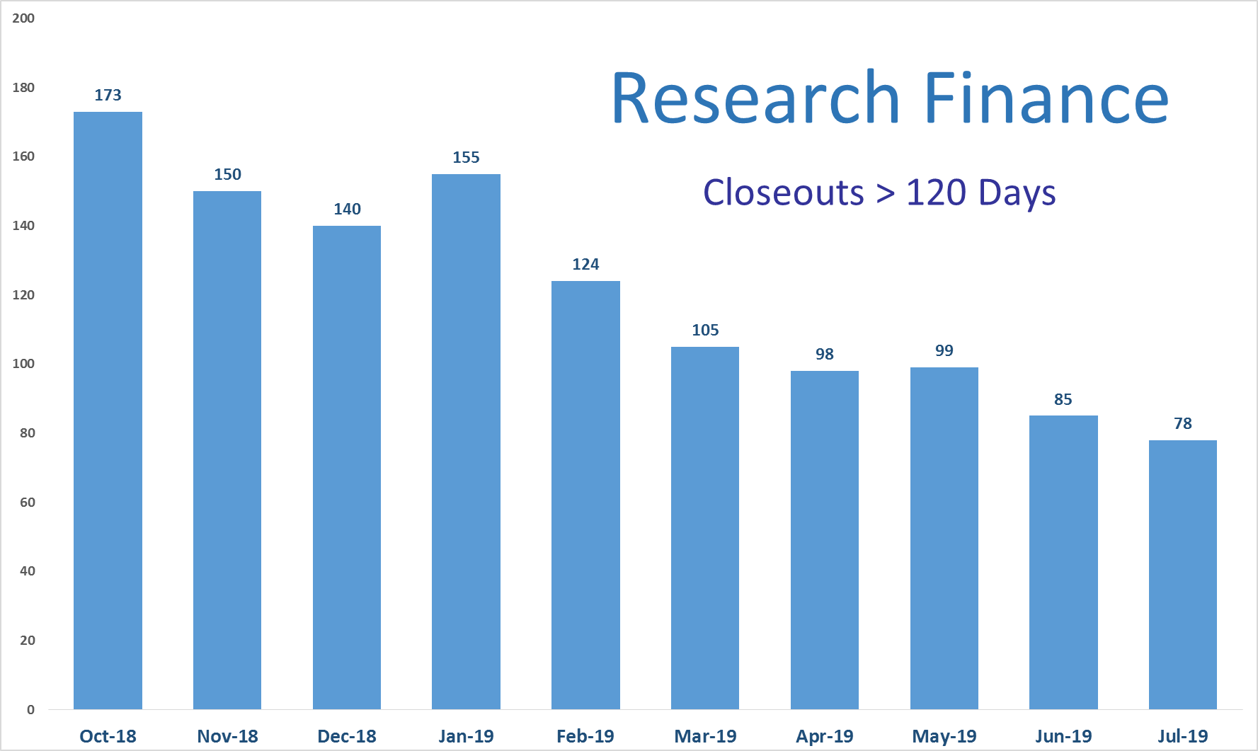
Closeouts

Slide 7
Clinical Trials Office updates
Drafting mission statement, purpose, and CTO scope within Research Operations
Improving proactive communication and ownership
Updated CTO process for new studies entered into Velos
Changed management of CTO inbox
Standardized CTFA pre-award workflow
Fiscal year close and review of clinical research accounts in deficit
staff effort, patient care, lack of invoicing and lack of payment (see open AR reconciliation, next slide)
Recommendation to track study staff time per study: most common deficit issue
Improved IRB workflow for CTO informed consent review
New concept: stakeholder kick-off meeting

Slide 8
Clinical Trials Office updates, continued
Study closeout focus, current count 11 in close-out state
Open AR reconciliation
$410K outstanding AR 2016-2019
May & June 2019 invoicing resulted in $125K or 30% received, will continue clean-up
Future process improvements- centralized approach and ownership, new tracking mechanism, long-term expanded use of Velos
Research billing process review and re-design
Sent communication reminding researchers to enroll patients in Velos: greatest risk of billing error
Send Qualifying status from Velos to Epic for claims logic
Update claims logic
Develop prior authorization workflow: best way to prevent denials
Working with Marketing on subject recruitment media offerings: http://www.bmc.org/researchpromotion

Slide 9
Clinical research ancillary service departments
Group 1 representatives
Clinical Research Resource Office- Gina Daniels
Pathology- Chris Andry
Institutional Review Board- Matt Ogrodnik
Investigational pharmacy services- Steve Zalewski
Group 2 representatives
Radiology- Paul Lowe and Jennifer Alex
Research compliance- Fanny Ennever
Cancer Care Administration- Salli Fennessey
GCRU- Ridiane Denis

