Slide 1
Q1 Research Operations Quarterly Meeting
January 19, 2021
Research Operations

Slide 2
Research Operations New Team Members
Pre-Award, Grants & Contracts
Gina Daniels (Dec 2019)
Deb Melnikas (Feb 2020)
Kathy Donnelly (Mar 2020)
Shaniel Walker (May 2020)
Kellye Lymon (Dec 2020)

Slide 3
InfoEd Updates
InfoEd
New format (ie. search feature, look up BU/IOs)
Central repository ie. subawards, invoices, etc
Award set-up with Pre-Award team

Slide 4
Agreements, Federal Updates, and Commitment Transparency Efforts
January 19, 2021
Research Operations

Slide 5
Research Vendor Vetting & Service Agreements
Issue: Many requests to use a variety of digital tool vendors for research coming in primarily through Privacy.
Ongoing Efforts:
Who: BMC Research Operations is currently in discussion with Privacy, Legal, Supply Chain Operations (SCO), IT, and IS representatives
What: streamlined process for vetting and onboarding vendors for research purposes.
Process for research-centric requests will follow the general SCO process with nuances built in to respond for research-specific issues
Deliverables in Development:
Intake Analysis and Work Flow Diagram:
Determines resolution path depending on
whether or not the tool will be used for research,
clinical purposes or mix of both
Intake Checklist/Cover Page of Questions:
Mirroring SCO
Developing a list of general questions
requestors answer to initiate vetting
research vendors.

Slide 6
Commitment Transparency: BMC Disclosure Infrastructure
COI Smart Survey
Submitted annually
Contact the Compliance Dept. for questions or updates.
Other Support & Foreign Component Disclosures
Investigator Updates
BMC Commitment Transparency
Required for all NIH awards
Contact Research Operations for questions or updates.
Should new interests/support arise you must promptly update the COI Compliance office and, if applicable, the NIH via Research Operations.

Slide 7
Commitment Transparency & Foreign Influence
Initiative and Package – Launched 12/2020
Scope & Purpose: Informing the BMC research community about BMC Research Operations efforts, in close coordination with stakeholders, to increase commitment transparency and combat national threats of foreign influence.
Contents:
Foreign Influence Review Process and Checklist of Issues
Guidance Information on Foreign Influence and BMC Review Process
Conflict of Commitment Guidance
Full Educational Slide Deck: Commitment Transparency & Foreign Influence
Abridged Slide Deck for Chairs/PIs on Commitment Transparency & Foreign Influence
Email Informing Research Community of the issues and this package (12/2020)

Slide 8
Other Support & Foreign Component Package
Initiative and Package – Launched 12/2020
Scope & Purpose: Informing the BMC research community about NIH requirements to fully disclose Other Support and Foreign Components for NIH awards.
Contents:
Fundamental Guidance on Other Support & Foreign Component
Flow Chart for Handling Other Support & Foreign Component
Infographic — Other Support, What’s Different?
Cheat Sheet Desk Reference — Do I have an Issue, and What Do I Do?
Case Studies for Other Support and Foreign Influence Issues
Other Support Sample Page
Slide Deck on Other Support and Foreign Influence: Education and Training
Email Informing Research Community of the issues and this package

Slide 9
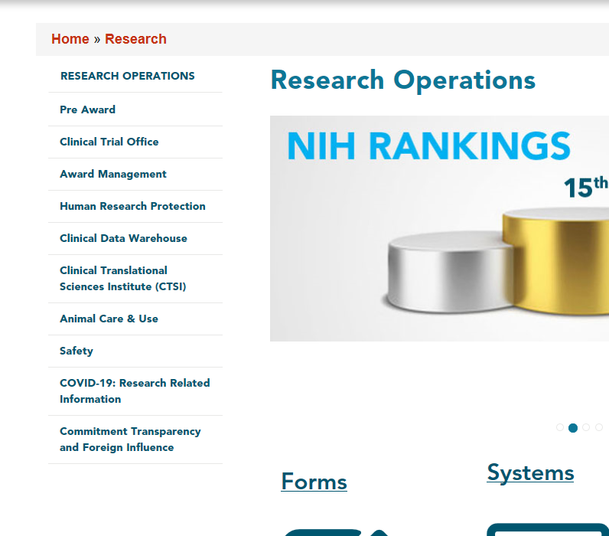
Where to Find These Resources…
Research Operations Website on the Hub: find the Foreign Influence / Commitment Transparency materials and the Other Support materials.

Slide 10
Related Efforts: Travel and Transferring BMC Data or Biological Materials
Scope: The guidance and resources Research Operations developed is relevant for any current or departing BMC researchers.
Purpose: Responds to local trends at Boston research institutions + greater federal oversight at airports of researchers travelling internationally.
Provides general reminder about BMC requirements for transferring/sharing ANY BMC data or biological materials
Provides new guidance, process, and documents for researchers travelling outside of the United States for their research.
Contents:
Guidance on Travel and Transferring BMC Data
Guidance on Travel and Transferring BMC Biological Materials
BMC Template Authorization Letter Permitting Travel with BMC Data
Instructions for Completing Authorization Letter

Slide 11
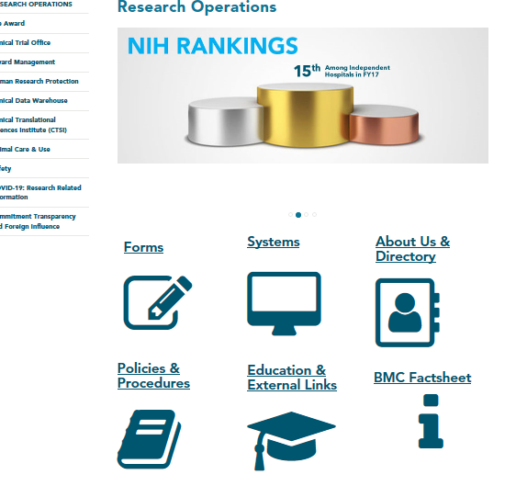
Where to Find These Resources…
Research Operations Website on the Hub – Click on the Training and Education Icon, choose “Resources” in the drop down menu, and look for the Travel and Transferring Data/Biological Materials section in the alphabetized list

Slide 12
BMC Policies and Procedures Updates
Research Operations, engaging outside consulting company Huron, is spearheading efforts to review, revise, and in some cases create updated policies.
Why?
Responding to federal legal and regulatory changes
Clarify policies for better comprehension and compliance
Undergird and support related commitment transparency efforts
Policies in Process
Research Misconduct | Intellectual Property | Conflict of Interest | Conflict of Commitment | Material Transfer Agreements
CDAs/NDAs | Export Control | Subaward Agreements | Proposal Submission | Subrecipient Risk Assessment/Monitoring
Time and Effort | Cost Share | Recharge Centers | F&A | Space Management
Program Income | Account Setup | Account Closeout | Fund Monitoring | Sponsored Project Billing

Slide 13
What’s Next?
Training and Education:
Forthcoming in 2021
Research Operations in coordination with Compliance
Communications will be sent out once training schedules and plans are finalized
Materials will also be uploaded on the Research Operations website

Slide 14
The End
Questions?
Contact us for assistance on any of these topics or related issues
Director of Pre-Award Grants and Contracts, Stephanie Wasserman:
Email: stephanie.wasserman@bmc.org
Senior Research Compliance Manager, Michelle Irick:
Email: michelle.irick@bmc.org

Slide 15
Research IS Program Introduction

Slide 16
The Research IS Program was created to support IT innovation among the BMC research community
Partners with the research community to create a culture of innovation
Supports the collaborative information technology and research community partnership
Advocates for the technology needs of the research community
Promotes data security, compliance, and privacy
Develops strong relationships with vendors
Encourages research goals to be aligned with hospital strategic goals

Slide 17
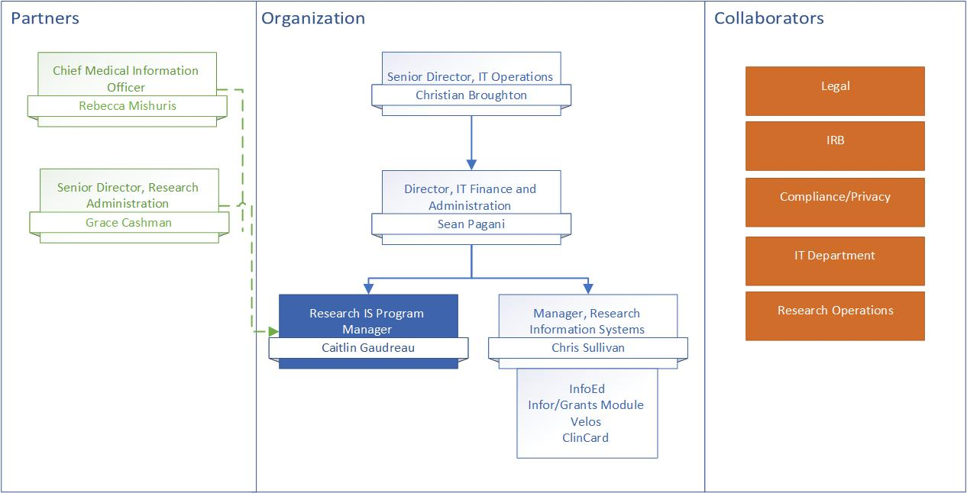
Organization Chart

Slide 18
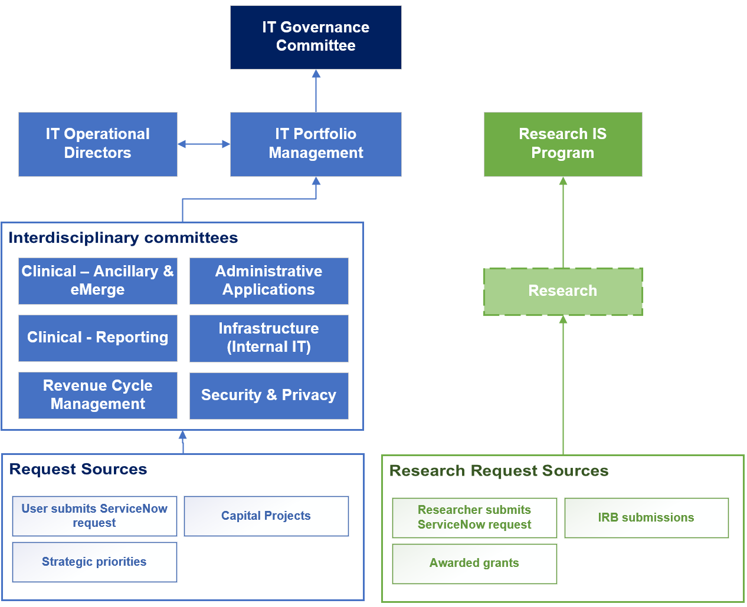
Research IT prioritization is siloed from clinical, but aligned with overall BMC strategy and mission and integrated with Research Operations

Slide 19
Program will support researchers with IT scope, planning, budgeting and implementation of technology to support research studies
Provide guidance on available software
Identify feasibility of proposed solution by consulting with internal IT leadership and outside vendors
Identify IT budget required for research study:
Including (not limited to): hardware, software, equipment, resources, maintenance plan
Hire/manage IT consultants
Important for us to have a reasonable budget identified in pre-award to support the hiring of consultants
Project manage and oversee Research IS projects
Manage research computing equipment purchases and procurement process

Slide 20
Program will support a variety of research IS needs
Technology to be used at Boston Medical Center or to further the care of BMC patients
Technology used to gather data from Boston Medical Center patients
Software integrating with existing software hosted by Boston Medical Center

Slide 21
Requests for support from the program can be in furtherance of either assessment and/or implementation of technologies
Request Type | Stage | Deliverables
Assessment | Pre-award/ Grant writing | Complete Assessment Document Security Review Resource Allocation IT Budget
Implementation | Post Award | Resource assignment Hire & manage consultant (*dependent on project deliverables) Project management & implementation of project

Slide 22
Submissions to the Program should be pursued early in the proposal generation process
Submit your request for review as early as possible
IT review should begin as soon as you start working with Development, Research Ops and/or the IRB
Allow time for the following tasks to be complete:
Discuss with internal IT teams to understand resources necessary for your request
Review software with vendor(s)
Vendor’s completion of Information Security Questionnaire
Information Security Review
Identify necessary budget

Slide 23
Research IS Program requests should be submitted via ServiceNow
Login to ServiceNow
Click Service Catalog
Find Research section and click Research Request
Complete form
Click Submit
Form is routed directly to the Research IS group for prioritization

Slide 24
Providing information in the submission will help the Research IS Program better assist the researcher in engaging with the technology
Provided by the researcher… | Allows the Research IS Program to…
Overview of research study | Properly represent the request to research and IT offices; provide recommendations on software
End-to-end workflow | Ensure vendor accountability to provide the support needed by the researcher
Clear list of IT requirements | Identify all tasks and approach
Funding | Identify appropriate contractor and IS support. Research IS Program is dependent on external funding, particularly when a consultant is necessary to complete the work (most Epic enhancements will require a consultant).
Milestones/deadlines | Prioritize projects based on grant submission or implementation date
Maintenance plan | Understand plan for systems after grant runs out (e.g., sunset IS system, maintain with internal support, maintain through ongoing grant support)
Early IT engagement | Provide appropriate IT budget and resources for research study

Slide 25
Questions

Slide 26
Clinical Trial Office
FY20 Achievements and FY21 Strategic Plan

Slide 27
Clinical Trials Office
FY20 Achievements

Slide 28
FY20 Achievements
COVID-19 Summary and Update
CTO Metrics
COVID contracts were setup in record times, sometimes under two weeks (Add. 1)
Decreased average CDA execution from >2 months to <10 days (Add. 1)
Roughly double the amount of contracts were executed in FY20 than in FY19 (Add. 1)
Total project dollars have increased about 10% every year over the past 4 years (Add. 2)
Usage of Velos has increased 11% with 815 new participants entered this year (Add. 3)
Epic Research Billing Enhancement Project
Completed re-design of Epic research billing logic and work queue holds (Add. 4)
Due to increasing research and several other factors, charges being reviewed in Epic have increased by >100% (Add. 5)
Updated Research Operations scope (Add. 6)

Slide 29
BMC/BU COVID research opportunity timeline
March 13th: Leadership halted most in-person research activity
March 25th: Leadership dedicated COVID research resources, at this point BMC was not selected as a site for any COVID research, and combined forces with physician led group identifying research opportunities
April 27th: Unprecedented 10-day turnaround 3 trials: signed CDA to Active & Enrolling
COVID research infrastructure was built from scratch
Centralized review of ALL COVID research opportunities to 1 person, team developed tracking mechanism
In parallel, assembled grassroots physician group to source research opportunities
Developed 17 person Scientific Review Committee to discuss protocol scientific validity of performing human subjects research at BMC/BU, created review scoring and tracking mechanism
Gathered variety of stakeholders (e.g. IT, nursing, phlebotomy) and drafted SOPs
Created inpatient support team for centralized oversight of trials in the hospital
Developing other research review committees: Biospecimens, Ambulatory and Data
Implemented Active Research Flag and remote monitoring ChartLink access in Epic
March 13th, we had no COVID clinical research opportunities, as of May 11th, BMC/BU had 53 Active or in the pipeline

Slide 30
Since the beginning of the COVID surge in Boston, our academic teams have been involved in 19 studies to help us better understand this disease
RNA Vaccine*
(Barnett)
STOP
(Jacobson)
N= 394
Selinexor
(Sanchorawala)
Etoposide
(Sloan)
Direct antigen rapid test
(Kataria)
SIG-COVID
(Kataria)
N=1426
Biorepository
(Bhadelia)
Ruxolitinib
(Sarosiek)
MAS825
(Siddiq)
April
May
June
Favipiravir
(Marathe)
Ravulizumab
(Ieong)
Prone positioning
(Bosch)
Tocilizumab
(Lin)
Rapid diagnostic evaluation
(Belok)
Hydroxychloroquine (2) – Out Pt TX and Prophylaxis
(Paasche-Orlow)
Tocilizumab & Remdesivir
(Lin)
Canakinumab
(Neogi)
Eculizumab – EAP
(Ieong)
To date, these studies have enrolled 271 patients (excluding specific BMC employee studies)
* Indicates executed study pending recruitment. All others are studies completed or actively recruiting.

Slide 31
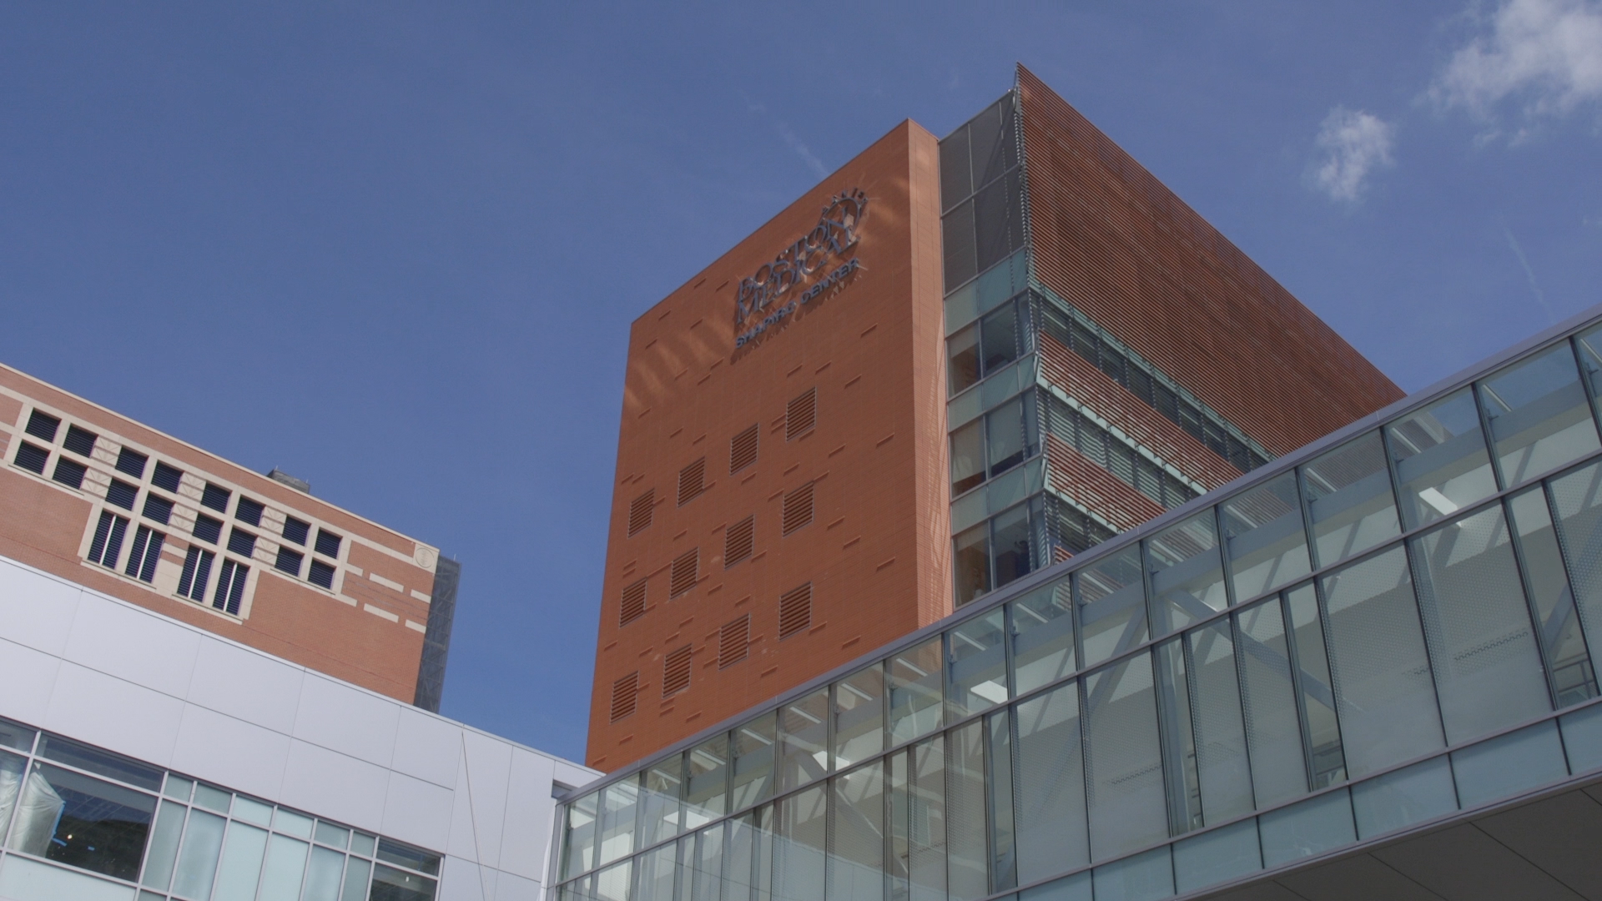
BMC collaborated with BU’s GCRU to successfully develop and run a COVID research program
10
COVID interventional trials completed enrollment
Apr-Dec
1980 PARTICIPANTS
ENROLLED IN SAMPLE COLLECTION PROTOCOLS
Participants
Enrolled in Interventional
Trials
>300
Participants enrolled in COVID ambulatory research
1844
265 PARTICIPANTS ENROLLED IN VACCINE
TRIAL
>300
COVID-RELATED PUBLICATIONS
Actively recruiting COVID Studies
16
CREATED
Biorepository &
Discarded tissue COLLECTION TO ADVANCE COVID RESEARCH
COVID RESEARCH TRIALS IN PRE-AWARD PIPELINE
31
Source: internal BMC data updated as of 12/31/20
Notes:
Hospital leadership, GCRU, and Principal Investigators worked tirelessly to offer trial opportunities to BMC patients admitted

Slide 32
Research During COVID and Beyond…
General COVID-19 Research Information:
https://www.bmc.org/covid-19/covid-19-research-related-information
Remote Study Design Guidance Document:
https://www.bmc.org/sites/default/files/Research/Remote_Study_Design_Optimizing_Feasibility_During_COVID-19.pdf
VNA: see page 2 and contact CTO if: 1. PI initiated submission could incorporate VNA visits to reduce hospital volume or 2. if study sponsor requests VNA to execute some, or all, of the schedule of events
Remote Study Monitoring: see pages 3&4
Contact CTO for SOP and sponsor agreements, takes about 4-weeks to set-up
Research Compliance is developing auditing program
Research Restart (evaluate all clinical research to determine feasibility during pandemic)
https://www.bmc.org/sites/default/files/Research/documents/High_Level_Research_Restart.pdf

Slide 33
Clinical Trials Office
FY21 Strategic Plan

Slide 34
FY21 Strategic Vision
Enable
scalable data
collection across
diverse patient populations
1. Collaborate with Department Administrators
2. Imbed clinical research in clinical model
3. Think differently about clinical trial D&I enrollment
4. Work with CTSI: GCRU and CRRO on clinical research engagement
5. Continue to support COVID clinical research program
6. Identify methods for remote research
1. Work with department administrators on Expense tracking and reporting
2. Confirm management of ClinCard process
3. Work within new Infor system and develop reporting, e.g. clean-up open AR tracking
4. Manage data intake on TriNetX match modeling and other clinical trial inquires
5. Improve feasibility review of clinical research projects- dept. review, recruitment, location, budget, etc.
6. Update PB federal and industry research pricing
7. Evaluate Velos study and participant completion tracking
Long-term vision
Leadership collaboration
CTO process improvement

Slide 35
FY21 Goals
Health Equity and Clinical Research
Study material central translation support
Trigger discussion with sponsor upfront: central IRB translation and what languages or budget for translation to occur
Top 4 languages spoken by BMC patients: English, Spanish, Haitian Creole, and Vietnamese
Since April translated on behalf of 15 studies, that did not have central IRB, with 26 forms translated
Will continue to trigger pre-award discussions and provide central support
BMC Patient eEngagement- A Phase Approach (Add. 15)
Incorporate Clinical Research into Clinical Framework
E.g. engage Hospitalists, advertise research, improve website, report research updates to leadership
Clinical Research Network collaboration with Department of Medicine
Provide regulatory guidance for under supported PI’s and new medicine i.e. COVID
Engage the community to increase D&I around research (Add. 14)
Partner with CTSI: GCRU and Community Engagement Core

Slide 36
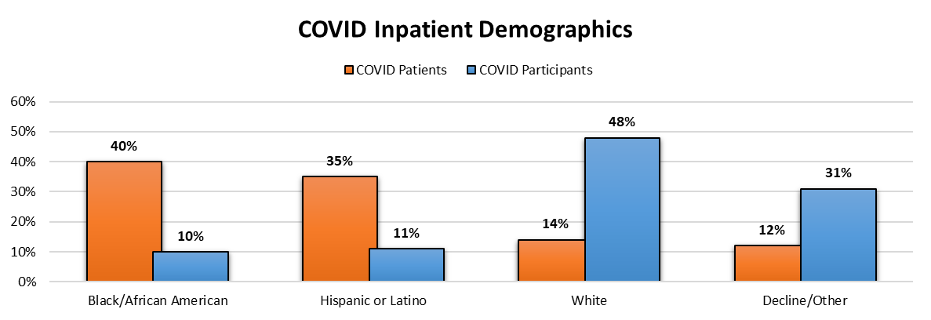
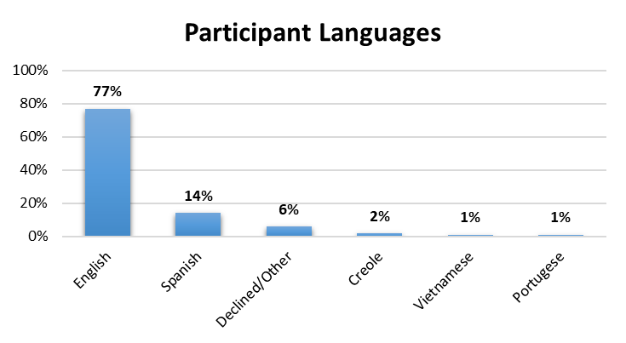
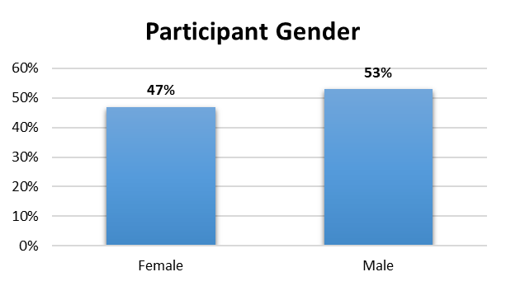
COVID Clinical Research Demographics March-Dec 2020

Slide 37
FY21 Goals, continued
CTO Proposal Support and Hospital feasibility discussions
Psychiatry case study example
CTO Brochure for departments and PI’s (Add. 9)
Expense/Effort Tracking discussions at monthly meetings (Add. 7 & Add. 8)
TriNetX & Boston Medical Center (Add. 10)
Velos outreach and education
FAQ (Add. 11 & Add. 13)
Awareness and ongoing education (Add. 12)

Slide 38
CTO Proposal Support Case Study
Psychiatry’s Director of Research connected Principal Investigator with Research Operations to evaluate clinical needs of the protocol 1.5 months in advance of an R01 deadline
Initial meeting with Research Operations and PI prompted:
language translation quote to be included in grant submission for: Consent and psychiatry evaluations
leadership meeting scheduled to confirm availability of Psychiatry clinic staff and OB-GYN clinic space for research
budget projection discussions on how to reimburse clinic staff and space for the course of the study
We have several experiences where CTO has not been included in submission feasibility, and if award is granted, may end up in significant lack of funds to cover costs or inability to perform research
For more information please refer to Add. 6 for Research Operations Roles and Responsibilities and Add. 9 for Department one-pager on CTO Submission Support

Slide 39
Clinical Trials Office
Addendums

Slide 40
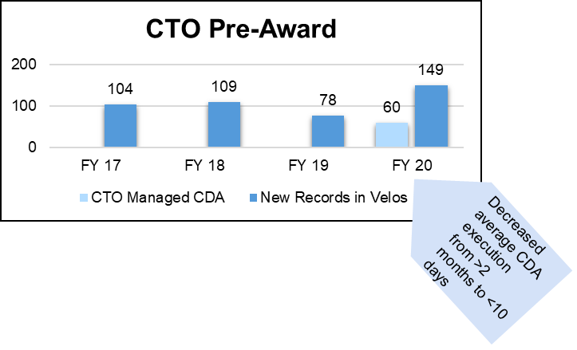
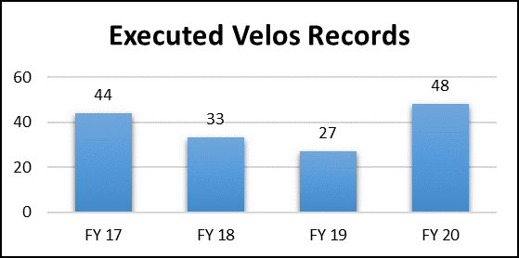
(Add. 1) Clinical Trial Office roles and responsibilities
Clinical cost for budget projections
Research pricing management
Manage Medicare Coverage Analysis process and interpretation
Research billing compliance
Velos management and Epic interface
Epic report for clinical charges routed to research fund
ClinCard management

Slide 41
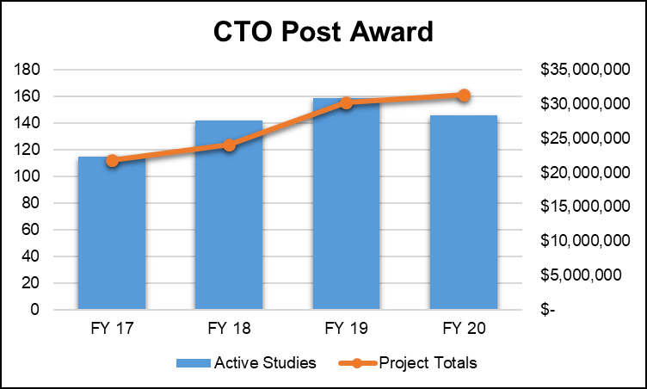
(Add. 2) Post-Award Total Project $’s
Completed clean-up of aging protocols from previous FYs
COVID interrupted regular workflow for new projects, but added some COVID protocols

Slide 42
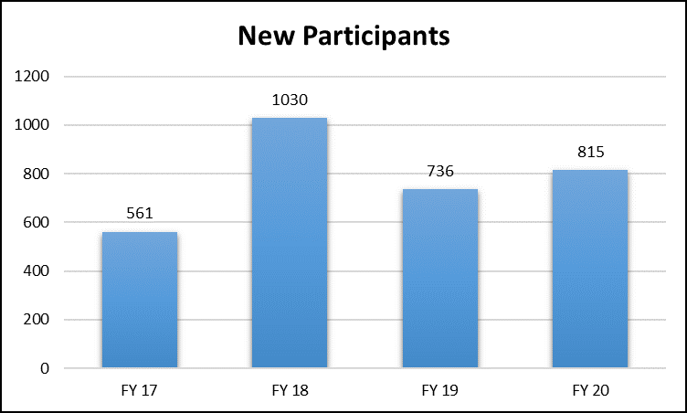
(Add. 3) Post-Award: Participant Tracking in Velos
Even though COVID slowed down enrolled for most Active protocols and prevented execution during March-July, BMC still saw a higher use of Velos than FY19
We expect to see a continued rise in the use of Velos because:
Improved educational material and outreach
GCRU will enter all studies in Velos as of Jan ‘21
New “Research Active” flag in Epic is set by Velos enrollment
Increased focus on recruitment methods and outcomes

Slide 43
(Add. 4) Epic Research Billing Enhancement Project: October 2019- May 2020
Project goal: to improve the research billing workflow to reduce denials and ensure proper flagging of patients as research participants
Collaborated with ITS, RIS, Revenue Cycle, Finance, and Accounting
Tested Velos/Epic interface with: RIS, ITS, and Velos/Epic team to remap patient statuses, send additional fields (funding source & CMS QCT status), study/patient data transfer after upgrades to the interface
Tested improvements to the billing workflow logic in Epic--automating addition or removal of modifiers and codes based on Fernanda/Bryant's research billing review and new workqueues for PB and HB charges
Cleaned up existing data in Velos and Epic--adding missing information such as NCT#, funding source, CMS QCT status, etc.
Confirmed cash processing with accounting from study account to HB and PB

Slide 44
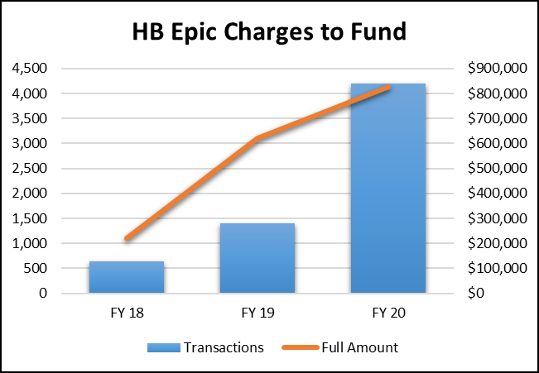
(Add. 5) Post-Award: Epic Charges and Research Billing Review (RBR)
Completed re-design of Epic research billing logic and work queue holds COVID inpatient studies may have increased the volume of RBR PB and HB charge review Increased Velos education and overall CTO outreach, may have increased participant enrollments and HB/PB charge routing

Slide 45
(Add. 6) Research Operations Scope/Intake
Research Operations Scope/Intake
Grant and Contracts Scope | Clinical Trials Office Scope
1. Government agency, foundation funded, or PI initiated 2. Industry AND basic science/non human research 3. All material transfer agreements (MTAs) 4. All data transfer/use agreements (DTAs, DUAs) 5. All sub awards | 1. Industry AND IRB: Expedited, full-board review, or exempt 2. All non-disclosure agreements (NDAs) 3. All confidential disclosure agreements (CDAs)
Crossover Scope
All research protocols with participant service/item/intervention/space - CTO Consultation for all protocols with human subject research send to CTO@bmc.org for high level review. If further CTO review is needed, CTFA will be included. - If further CTO review is needed CTFA will be assigned and supply budget consultation
Research Operations agreement intake process
Research Ops lead | Grants & Contracts | Clinical Trials Office
Agreement type | MTAs, DTAs, DUAs, sub awards | CDAs and NDAs
Department action | Online webform | Online webform
Research Operations software system data entry flow
Research Ops lead | Grants & Contracts | Clinical Trials Office
Protocol funding source and type of research | 1. Government agency, foundation, PI initiated w/ external funding 2. All basic science | 1. industry or internally AND; 2. IRB: expedited, full- board review, or exempt
Department action | Create lnfoEd record | Create Velos record

Slide 46
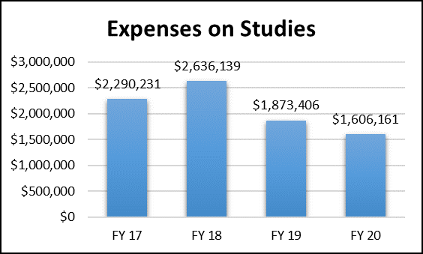
(Add. 7) Post-Award: Expenses on Studies
Expenses may not be accurately allocated onto CTO accounts- area of focus for FY21

Slide 47
(Add. 8) Grant Expense Cube
Project: Develop an automatic cube to provide organized grant expense data based on Infor and estimate personnel expense in the future.
Impact: Allow study team to check grants financial data in a centralized tool.
Outcome:
Study team can access to different levels’ financial data: Section Summary, Project Detail, Personnel Cost Summary;
Study team can check projected personnel cost burn rates and project balance;
Cube is connected to Infor, which can refresh automatically.

Slide 48
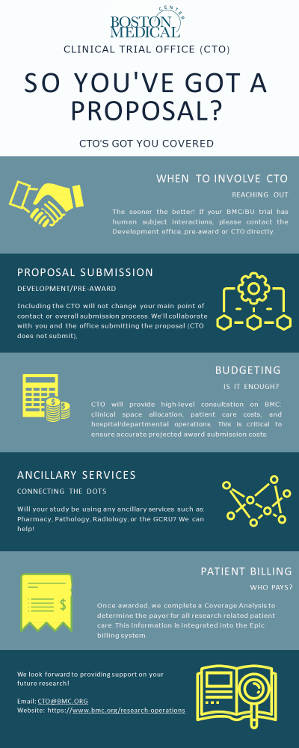
(Add. 9) CTO Proposal Support

Slide 49
(Add. 10)
TriNetX Research at BMC
TriNetX & Boston Medical Center
Apply a Data-Driven Approach to Clinical Research
TriNetX is the global health research network that optimizes clinical research and enables discoveries through real-world evidence. Use TriNetX to identify patient cohorts, participate in sponsored trials, and analyze real patient data.
Explore data and Discover Cohorts
Find groups of eligible patients using “TriNetX Live” by adding terms for your inclusion and exclusion criteria using a simple easy to use interface. Pursue a grant or identify the patients for recruitment.
Participate in Sponsored Trial
Receive trial requests through from industry partners or new sponsors via “Trial Connect”. Get early insight into the study population of interest and explore your patient population to determine feasibility and interest.
Analytics: Replicate Trials and Develop Protocols
Using “TriNetX Research”, perform advanced
analyses including analysis of risk factors and comparison of treatments. Explore current therapy landscapes for diseases of interest. Obtain a risk ratio and Kaplan-Meier analysis in minutes – without statistical software.
Who is eligible to use BMC TriNetX?
Currently, BMC and BUMC researchers who have human subjects research training and a BMC active directory account.
Who can I contact with additional questions? If you have any questions please contact Nicholas Trombley (Nicholas.Trombley@bmc.org).
How do I get access?
To request access to the TriNetX platform please email Nicholas Trombley (Nicholas.Trombley@bmc.org).
.
How do I learn how to use the system?
Upon receiving access to the platform, you will receive a quick start guide that will help you login and navigate to the training center within TriNetX. Additional information is also available at: https://trinetx.com/
What data are available in the system?
BMC is a member of the TriNetX Research Network. BMC data can be evaluated alone or in combination with over 45 other institutions. For BMC, a subset of data from the BMC Clinical Data Warehouse are transformed into a de-identified limited dataset and uploaded to TriNetX every 1-2 months. For added privacy protection all dates for an individual are adjusted by +- 30 days. Data uploaded dates back to 2000 and include: diagnoses, medications, laboratory results, encounters, vital signs, and demographic features. Narrative notes and results are not shared.

Slide 50
(Add. 11)
What is VelosCT?
VelosCT is a Clinical Trial Management System (CTMS)
VelosCT connects financial, administrative and clinical research activities to help manage studies
Links study status, participant enrollment, calendars, budgets, and participant status to ensure compliant billing to Medicare/third party payers
Other capabilities include budgeting, milestones, billing, protocol management, participant recruitment & management, query management, adverse event reporting, etc.
50

Slide 51
(Add. 12)
How does Velos impact my clinical research work?
VelosCT will allow you to enter data and upload documents that the Clinical Trial Office (CTO) needs to initiate your studies internally
You can now initiate your IRB application in VelosCT (See VelosCT IRB Interface document)
CTO will build study calendars with visits/events, coverage analysis, budget, and milestones for your study
Once your study is active, you will be able to manage participants throughout the research process including, recruitment, enrollment, scheduling, visit/event tracking, data entry, notifications and monitoring
All participants must be enrolled within 24 hours of the research visit, and associated to calendars with visits updated within 24-48 hours of when they occur.

Slide 52
(Add. 13)
What studies will I have to enter?
All New studies must include the submission of the MCA/VelosCT Determination Checklist
All studies managed by CTO will be entered in VelosCT. All studies that have hospital services will also be entered in VelosCT.
This applies whether the study is managed by BMC or BU. If BMC infrastructure and/or clinical services are utilized, the study will need to be in VelosCT.
In addition to studies, VelosCT will also be used to track legal documents (work with your assigned CTFA to enter these):
Confidential Disclosure agreements (CDAs)
Non-disclosure agreements (NDAs)
52

Slide 53
(Add.14) To ensure our work effects systemic change, we are taking the groundwater approach
We have a vision to establish an action-oriented approach to clinical research that acknowledges systemic inequities, learns from past mistakes, empowers historically disenfranchised individuals, invests in community engagement, and builds an environment of trust and inclusion
Increase research participation and career opportunity locally and around the world
Embed research into the Boston HealthNet clinical model
Build-off of successful COVID centralized administration to co-design with the community and lead technology solution
Stop expecting individual study teams to tackle deeply-rooted issues on their own

Slide 54
(Add. 15) BMC Patient Engagement
Phase I
Developed Research Facilitator role to centralize inpatient and outpatient COVID approach, consent, enrollment, and participation declines
Began April 2020 and formalized in Dec 2020
Phase II
COVID Inpatient Research Liaison daily Rounds with Hospitalist teams (began Jan 2021)
COVID-19 Research Flyers in patient rooms & ILI clinic (English, Spanish, and Haitian Creole)
Movement away from siloed research protocol recruitment method and into a culture shift of including research as a part of clinical model
Phase III
New Clinical Research Network to have Recruitment Specialist lead (starts 3/1) community discussions around research
Develop ½ day retreat on Clinical Research, Health Equity, and Community Engagement
Work with Communications, IRB, and others to think differently about community engagement
Develop Research Registry for BMC patient to express interest in research
Collaborate with Cancer Clinical Trial Office on their enrollment initiatives and outreach
Report annual demographic data, and evaluate methods

