Slide 1
Research Administrator Quarterly
December 13, 2019

Slide 2
Agenda
Research Operations Updates
New Research Operations Team Members
Wenxue Yao – Sr Research Finance Analyst
Gina Daniels – Grant Administrator
Bryant Shields – Billing Compliance Specialist
Michelle Irick – Senior Research Compliance Manager
Caitlyn Gaudreau – Research IS Program Manager
Effort Certifications for Jan-June, 2019
Grants and Contracts
Cost Transfer Form Update and Workday Retro Adjustments – Julienne Carty/Joanna Senteno
BU Salary and Fringe and Push Reports Update – Stephanie Wasserman
F&A Rate Policy and Fringe Rate Update – Stephanie Wasserman
Clinical Trial Office
Culture shift over the past 6 months; summary of our focus areas– Johanna Chesley
Data analysis of current work– Mike Porreca
VelosCT updates and user tips– Sandy Lok
Research billing process management and Epic development– Johanna Chesley
Ancillary Service engagement- Johanna Chesley
FY20 Strategic plan summary– Johanna Chesley
Resources

Slide 3
Cost Transfer Form Update
As a result of our FY18 audit finding, BMC developed policies and procedures which now involves Research Finance approval on distribution of salaries allocated to federal programs/awards.
Costing allocations will go to the Efforts Certification Administrator (Tyler, Joanna, and Julienne) to approve once the manager submits them.
Once submitted, the manager can view the status of the process by going to the employee’s worker history:
Upon review, RF can either send back to the manager (if edits are required, including missing CT form attachment, etc.), deny (which will cancel the process), or approve (which will send it to Payroll for a CPAA).
If the workday request is sent back/denied, RF reaches out to the managers via email alerting them of their need to review/complete/update the allocation request and resubmit for its ultimate approval.
Effective 11/18/19- To maintain audit compliancy and adherence to our existing cost transfer published policy the cost transfer form was updated, and is now REQUIRED to be uploaded in WorkDay for all retroactive adjustments request.
The updated form is available online and can be found via our portal

Slide 4
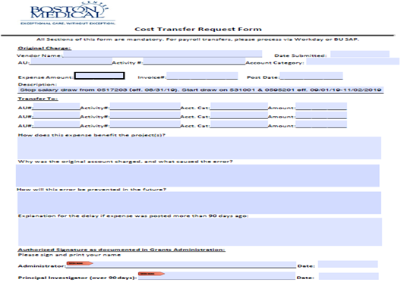
Cost Transfer Form Update
For all retro active request, please complete the form, and upload in Workday by adding the form in the Costing Allocation field

Slide 5
F&A Rate Policy and Fringe Rate Update
Updated F&A Rate Policy
Clarifies when F&A rate reductions can be applied
F&A Rate Reduction Form request process
Fringe Rate Changes
BMC’s new fringe rate 33% for FY19 and FY20
Project ending in first 90 days FY20 (10/01/2019-12/31/2019) will remain at their current fringe rate

Slide 6
CTO FY19 and FY20 Strategic Overview
Goal | Status
Research billing compliance | In progress
Ancillary Service collaboration | In progress
Central resource for research pricing | Ongoing
Departmental engagement | Ongoing
Res Ops scope and workflow | Done
CTO mission | Done
Website revamp | In progress
Pre-award improvements | Done
Post-award improvements | In progress

Slide 7
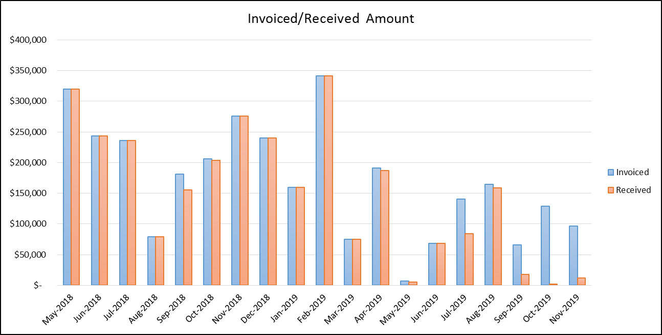
Data placeholder for Mike on work output

Slide 8
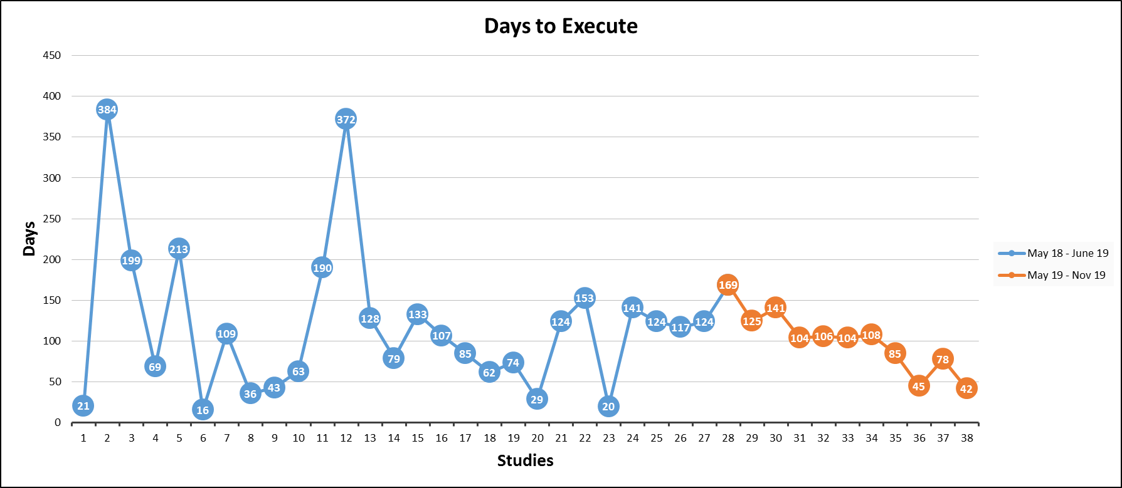
New Study Execution Metrics

Slide 9
Epic Charges to Fund

Slide 10
Participant Activity Metrics

Slide 11
VelosCT updates
Changes to the process to match policy and track workflows
According to BMC’s policy “Type of Clinical Research entered into VelosCT”:
“All new clinical research studies that utilize BMC clinical infrastructure will be entered into VelosCT prior to the enrollment of the first participant.”
MCA/VelosCT Determination checklist has been updated and is required for all studies that use BMC clinical infrastructure, regardless of funding source or contracting office
All confidential disclosure agreements (CDAs) and non-disclosure agreements (NDAs) will be tracked in VelosCT
VelosCT resource updates, see “Resource VelosCT” slide

Slide 12
VelosCT tips to keep in mind
All studies utilizing BMC infrastructure are required to be entered in VelosCT regardless of:
Funding source (industry, federal, department/internal)
Pre- and post-award management (BMC Grants & Contracting, Development, CTO, or BU)
Coverage determination (billed to insurance and/or research account)
To ensure research billing compliance, update patient statuses and visits in a timely manner:
First patient status should be entered prior to closing the encounter in Epic
Patient status should be updated throughout their participation in the trial (enrolled, screen failure, in follow-up, etc.)
All calendar visits should be updated within 24-48 hours
If you have any concerns, please do not hesitate to contact your assigned Clinical Trial Financial Analyst (CTFA) or CTO Inbox

Slide 13
Research billing update
Denials management
Completed research billing audit
18/37 claims reviewed were processed incorrectly
37/37 were routed correctly
Most common billing error results from lack of Velos enrollment
Epic Oct-Dec 2019 project
Velos interface updates: Qualifying/Non-Qualifying status, Study funding source, start and end dates
Epic claims logic rebuild: automate insurance requirements based on Qualifying/Non-Qualifying status (see next slide)
Update GL accounting logic to possibly discount within Epic to accurately track research write-off based on funding source
Deep dive into Radiology to start: reconciling charges
IRB report of all Draft or Active (Cede or Approved) studies that require Radiation services: 73
Those that are Active and not in Velos: 28 or 35% (deep dive required of location of Radiology)
Create a Work Queue review of all routine encounters related to research and billed to insurance
Complete deep dive into professional billing workflow

Slide 14
Research billing update
Research fee schedules
Updated research procedure budget templates to display negotiate rate charged to sponsor and projected amount to charge the fund
Note, the projected amount charged to the fund may increase overtime, BMC = Medicare provider requires us to use CMS fee schedule, CTO suggests assuming a 5-6% inflation overtime
Research-related prior authorizations workflow- future work
Related to denials management
Coverage with Evidence Development (CED)- future work
5 out of 23 occurring BMC
Update Epic logic to correctly route claims, if not addressed may result in large revenue loss (e.g. one TAVR procedure is >$100K)
 | HB Industry | HB Federal | PB Industry | PB Federal
Negotiated rate | 40% | 75% | 100% | 0%
Charge amount | 63.9% | 75% | 100% | 0%

Slide 15
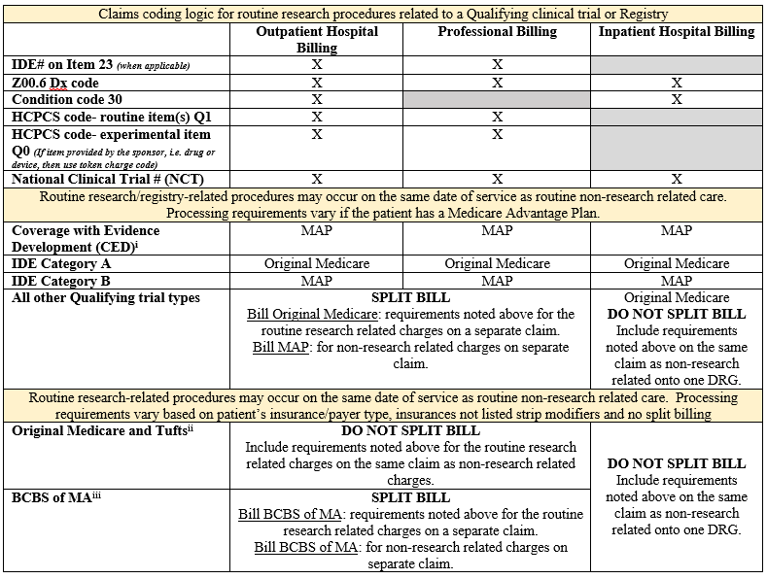
Research billing claims logic

Slide 16
Ancillary Service engagement
Overall goal of including ancillary service departments in pre-award conversations
Pathology
Query where study labs are being processed
Urine pregnancy discussions
Radiology
Process improvement conversations: full review of workflow requirements
Breakdown of what should have occurred, what did occur, and what/how procedure billed
Pharmacy
Review of token charge code process for routine, research-related, billing
DPH of MA IND Controlled Substance licensing requirement
Details will be provided in Jan 2020, but on our radar and working with CRRO, IRB, and Departments to determine institutional process
BMC marketing review of recruitment material workflow
Updated workflow to come!

Slide 17
FY20 goals
Send research community survey in May 2020 to gage CTO’s successes, areas of improvement
Review and update all CTO owned policies, including Coverage Analysis and Velos CT
Improve post-award financial management
Central database of current payment terms (short-term)
Update Velos (long-term)
Complete research billing claims logic build and update GL accounting for research
Update website for improved user interface
Encourage regular feedback from study teams, departments, and hospital leadership on areas of improvement for clinical research operations
Improve monthly meetings to contain valuable content and discussion
Continue to improve workflow with Research Attorneys to encourage diligent and timely reviews

Slide 18
Resources
CTO Inbox CTO@bmc.org
CTO mission: https://www.bmc.org/research-operations/clinical-trial-office#about-us
Research Operations workflow: https://www.bmc.org/sites/default/files/Research/documents/BMC_Research_Operations_workflow_15Oct19.pdf
Research Operations Directory: http://www.bmc.org/sites/default/files/Research/documents/Combined_Assignment_List.xlsx
VelosCT policy: https://bostonmedicalcenter.policytech.com/dotNet/documents/?docid=968
BMC Radiology guide and forms
https://www.bmc.org/sites/default/files/Research/documents/Radiology_Research_Step_by_Step_Guide.doc
https://www.bmc.org/sites/default/files/Research/documents/New_Radiology_Research_Study_Form.docx
IPS resources: https://internal.bmc.org/departments/compliance/research-compliance/investigational-pharmacy-services-resources
BMC marketing review of recruitment materials: https://airtable.com/shrwoEWUWetzKLSI6
DPH of MA IND additional information: https://www.bumc.bu.edu/irb/cr-times/
Clincard reference guide (see next slide for additional information): https://www.bmc.org/sites/default/files/Research/documents/BMC-ClinCard-Quick-Reference-Guide.pdf

Slide 19
Resource: what is VelosCT?
VelosCT is a clinical trial management system used to help manage the financial, administrative, and clinical research activities of studies
Financial
Build budgets with per patient totals and other site costs in the study record
Create milestones for invoicing sponsors
Administrative
Easy access to all study-related documents, including invoices, payments received, IRB documents, and others.
Clinical Research
Track patient enrollment statuses and study visits via VelosCT calendars
Ensure compliant billing to Medicare/third party payers
Run reports to review study status, patient activities, milestones achieved, etc.

Slide 20
Resource: VelosCT educational materials
Training updates:
Next VelosCT class will be on Monday, December 16, 2019, 10:00am – 11:30am, DOB 10th floor, room 1003
If interested in this class or inquiring about future classes, please e-mail Sandy.Lok@bmc.org
Training videos and materials will be updated within the next two weeks
Training materials on Research Operations website: https://www.bmc.org/research-operations/clinical-trial-office#training

