Slide 1
Research Finance ClinCard Overview
Justin Magerman
Junior Financial Analyst

Slide 2
What we will discuss
What is ClinCard / What are its uses?
Research Finance Review Process
Where to get more information about ClinCard?
Questions/Concerns

Slide 3
ClinCard Set up – Who should I contact?
Research Studies: Research.Finance@bmc.org
Clinical Trial Studies: CTO@bmc.org
Accounting / Donor Restricted Studies: Kaitlyn.Clifford@bmc.org, Judy.Nguyen@bmc.org

Slide 4
What is ClinCard?
Research participants are often paid for participating in studies as a recruitment incentive. ClinCard was implemented to improve the process efficiency, customer service, and payment controls when payments are made to participants, via a reloadable prepaid card.
ClinCard Benefits Include:
Enhanced transaction security/approvals, reporting and monitoring options.
Uses a streamlined online process.
Web-based reloadable debit card that can be loaded at any time.
Participants receive prepaid card with funds at time of visit

Slide 5
ClinCard Uses
Compensation is a predetermined amount defined within the project for time, effort, inconvenience and general expense to participate in a research study. Compensation may be in the form of cash or cash equivalent and is considered taxable income.
Unallowable:
Salary supplementation
Employee reimbursements
Transportation
Meals & lodging
Parking
Actual expenses are not considered taxable income and should be reimbursed via check request forms to AP.

Slide 6
Study Setup: Required Documentation
Required to send to Research Finance for setup:
Completed Setup Request Form
IRB protocol number & Informed Consent Form (if applicable)
Awarded Budget / Budget Justification
After study has been set up:
ClinCard *Card* Pick Up Request Form
ClinCard User Access Request Form (first time users only)
3. CPIF (ClinCard Participant Information Form)
- Study Team uploads CPIFs to secure folder \\Emcnas\researchparticipant$
4. ClinCard Return Slip
- For all unused ClinCards in a study

Slide 7
Research Finance Review Process
For ClinCard requests on Research Finance awards, the following areas will be reviewed:
Is the award active?
IRB Protocol
Active status
Correct AU/Activity & Sponsor
Grant PI listed as Key Personnel within IRB approval
Compensation section is in line with setup request forms
Is the expense allowable under awarded contract?
IRB Exempt (no IRB)
Is the expense allowable under awarded grant/contract?
Budget/Justification matches set-up request
PI listed on set-up request forms matches PI of award/contract
**If rebudgeting needed, work with RFA.

Slide 8
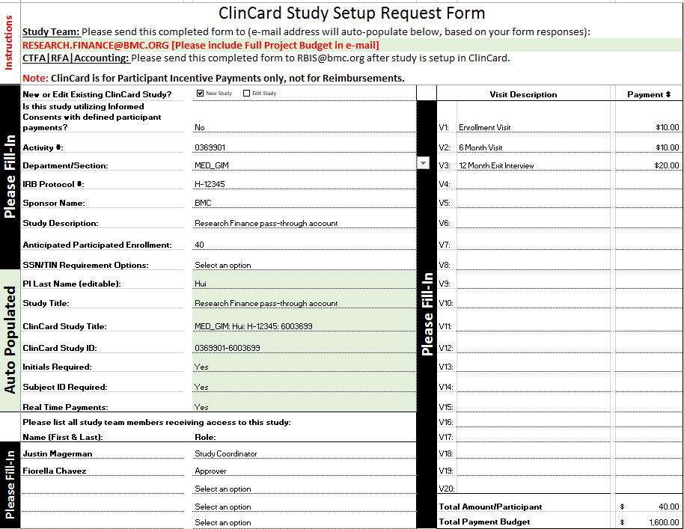
ClinCard Study Setup Example

Slide 9
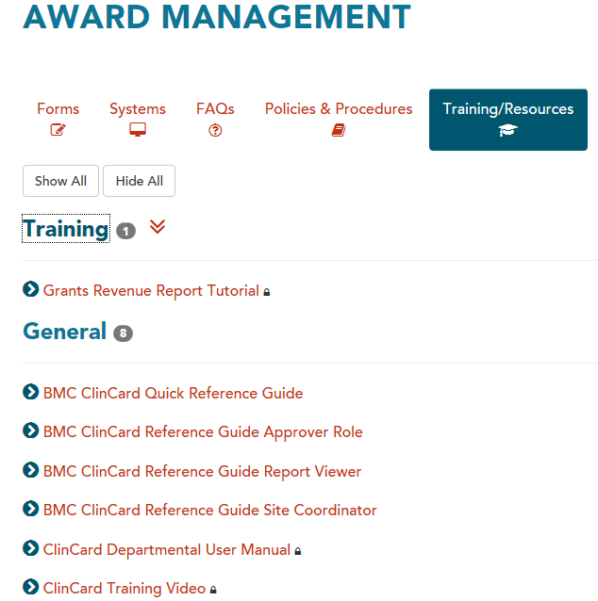
Resources
Research Finance: Justin.Magerman@bmc.org
Clinical Trials: Michael.Porreca@bmc.org
RBIS Email: RBIS@bmc.org
For more information and ClinCard training materials, visit our site! https://www.bmc.org/research-operations/award-management#training

