Slide 1
Website: http://www.bumc.bu.edu/crro/
Director: Mary-Tara Roth, mtroth@bu.edu, 617-358-7679
Human Research Quality Manager(s): Gina Daniels, gdaniels@bu.edu, 617-358-7385
Fiona Rice, fionar@bu.edu, 617-358-7554
Supported by the BU CTSI and the Office of Human Research Affairs
Serving all BMC and BU Medical Campus Clinical/Human Researchers

Slide 2
Boston Medical Center
Boston University Medical Campus
Office of Human Research Affairs (OHRA)
BU Clinical Translational Science Institute (CTSI)
Human Research Protection Program (HRPP)
ClinicalTrials.gov
Research Quality Program
Institutional Review Board (IRB)
Clinical Research Resources Office (CRRO)
Clinical Data Warehouse (CDW)
Research Professionals Network (RPN)

Slide 3
Clinical Research Resources Office (CRRO)
- Trainings: PI and Fundamentals
- Research Consultations
- Clinical Research Seminar
- Study Management Tools
Research Professionals Network (RPN)
- Workshop Trainings
- Research Reference Guide
- Study Management Tools
- Recognition Event/Awards
- Zoho Connect

Slide 4
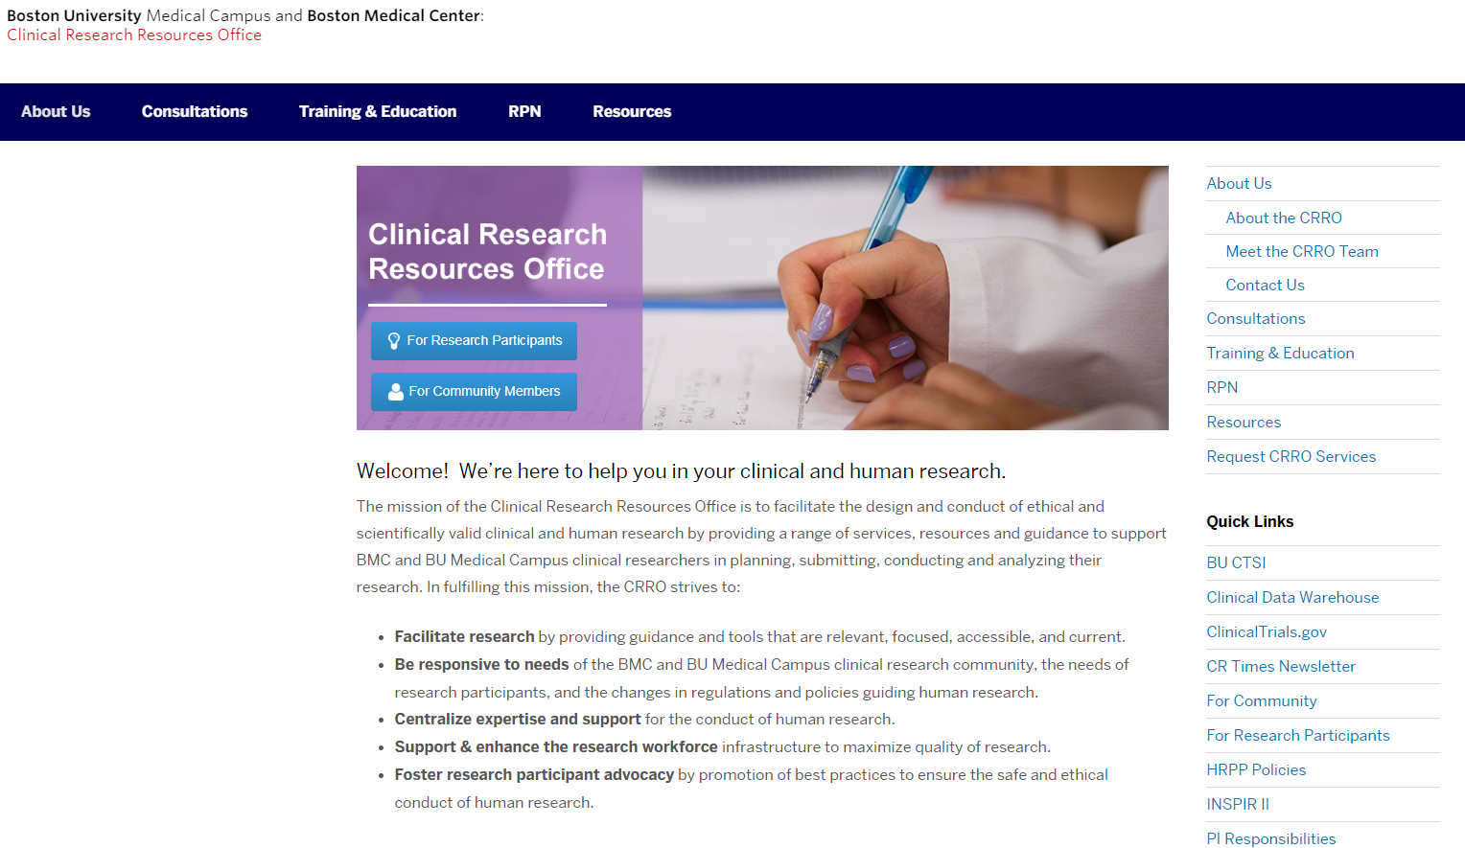

Slide 5
Links to BMC/BU Medical Campus Resources
Office of Human Research Affairs http://www.bumc.bu.edu/ohra/
HRPP Policies and Procedures http://www.bumc.bu.edu/ohra/hrpp-policies/
Clinical Research Resources Office http://www.bumc.bu.edu/crro/
CRRO Consultation Request http://www.bumc.bu.edu/crro/research-and-regulatory-consultations/
Study Management Tools http://www.bumc.bu.edu/crro/tools/
Research Professionals Network http://www.bumc.bu.edu/crro/research-professional-network/
RPN Resources and Programs http://www.bumc.bu.edu/crro/research-professional-network/resources-programs/
RPN Clinical Research Reference Guide http://www.bumc.bu.edu/crro/research-professional-network/resources-programs/reference-guide/

