Slide 1
BMC Conflict of Interest Process Fanny Ennever, PhD BMC Research Compliance Officer Research Administrators Meeting May 17, 2018

Slide 2
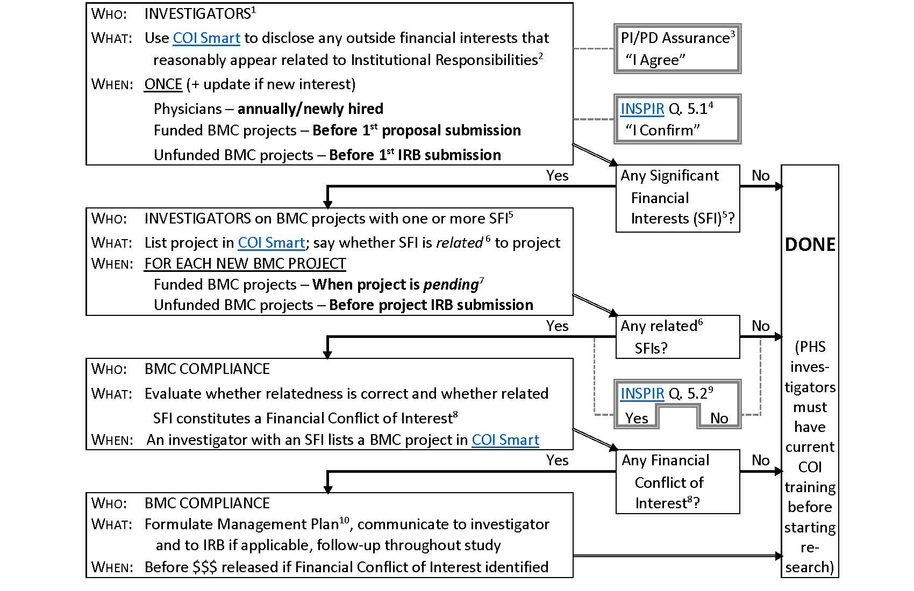
FULL PROCESS

Slide 3
PI/PD Assurance emailed with Proposal Summary Form
Hello Dr. XXX,
Please find and review the attached completed Proposal Summary Form for the “…” PAR 18-… submission to the National Institute on … due tomorrow by 5:00PM.
Please read the PI/PD Assurance paragraph below. Please “reply all” to this email and say “I AGREE,” which will serve as your certification to the assurance.
PI/PD Assurance
I certify that:
I and the individuals I have identified above are the Investigators for this project and each has COI disclosure in the COI-SMART system;
…

Slide 4
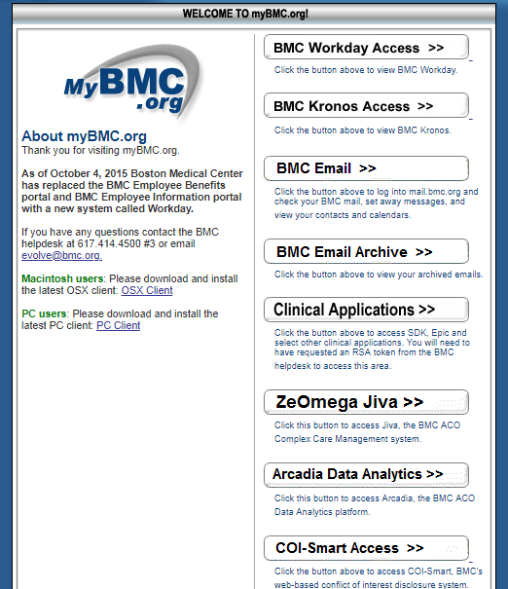
COI Smart – from MyBMC

Slide 5
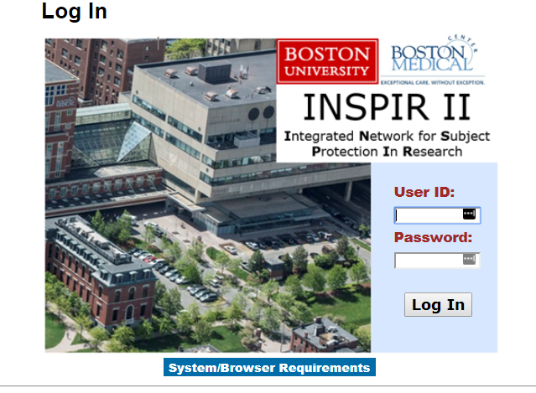
INSPIR

Slide 6
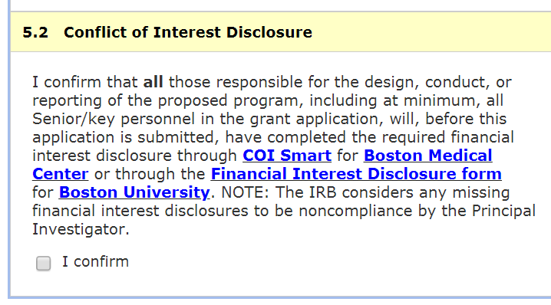
INSPIR – Required Training and Conflict of Interest

Slide 7
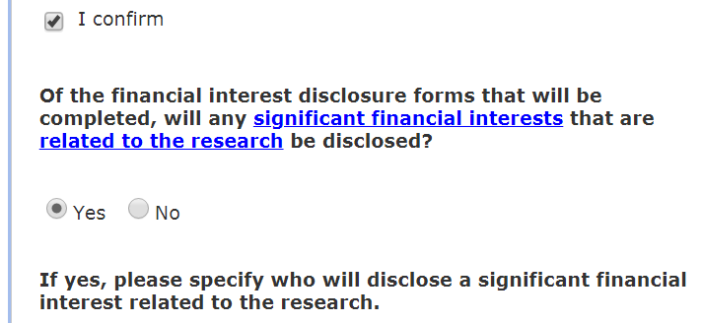
INSPIR – Required Training and Conflict of Interest (con’t)

Slide 8
FULL PROCESS

Slide 9
Step 1 – Investigator Interests
Who: | INVESTIGATORS¹
What: | Use COI Smart to disclose any outside financial interests that
 | reasonably appear related to Institutional Responsibilities²
When: | ONCE (+ update if new interest)
 | Physicians – annually/newly hired
 | Funded BMC projects – Before 1st proposal submission
 | Unfunded BMC projects – Before 1st IRB submission
⁹ INSPIR question 5.2: Any significant financial interests that are related to the research?

Slide 10
Step 1 – Investigator Interests
Who: | INVESTIGATORS¹
What: | Use COI Smart to disclose any outside financial interests that
 | reasonably appear related to Institutional Responsibilities²
When: | ONCE (+ update if new interest)
 | Physicians – annually/newly hired
 | Funded BMC projects – Before 1st proposal submission
 | Unfunded BMC projects – Before 1st IRB submission
¹ Investigator means a person who is responsible for the design, conduct, or reporting of Research, taking into account the degree of independence with which the person works.

Slide 11
Step 1 – Investigator Interests
Who: | INVESTIGATORS¹
What: | Use COI Smart to disclose any outside financial interests that
 | reasonably appear related to Institutional Responsibilities²
When: | ONCE (+ update if new interest)
 | Physicians – annually/newly hired
 | Funded BMC projects – Before 1st proposal submission
 | Unfunded BMC projects – Before 1st IRB submission
¹ Investigator means a person who is responsible for the design, conduct, or reporting of Research, taking into account the degree of independence with which the person works.
² Related to Institutional Responsibilities means related to professional responsibilities on behalf of BMC or BU, e.g., research, teaching, professional practice, service on committees or panels.

Slide 12
Step 1 – Investigator Interests
Who: | INVESTIGATORS¹
What: | Use COI Smart to disclose any outside financial interests that
 | reasonably appear related to Institutional Responsibilities²
When: | ONCE (+ update if new interest)
Once this step is completed, can answer:

Slide 13
Step 1 – Investigator Interests
Who: | INVESTIGATORS¹
What: | Use COI Smart to disclose any outside financial interests that
 | reasonably appear related to Institutional Responsibilities²
When: | ONCE (+ update if new interest)
Once this step is completed, can answer:
PI/PD Assurance³
“I Agree”

Slide 14
Step 1 – Investigator Interests
Who: | INVESTIGATORS¹
What: | Use COI Smart to disclose any outside financial interests that
 | reasonably appear related to Institutional Responsibilities²
When: | ONCE (+ update if new interest)
Once this step is completed, can answer:
PI/PD Assurance³
“I Agree”
³ PI/PD Assurance (email with Proposal Summary Form): “I certify that: 1. I and the individuals I have identi­fied above are the Investigators for this project and each has COI disclosure in the COI-SMART system…”

Slide 15
Step 1 – Investigator Interests
Who: | INVESTIGATORS¹
What: | Use COI Smart to disclose any outside financial interests that
 | reasonably appear related to Institutional Responsibilities²
When: | ONCE (+ update if new interest)
Once this step is completed, can answer:
PI/PD Assurance³
“I Agree”
INSPIR Q. 5.1⁴
“I Confirm”
³ PI/PD Assurance (email with Proposal Summary Form): “I certify that: 1. I and the individuals I have identi­fied above are the Investigators for this project and each has COI disclosure in the COI-SMART system…”

Slide 16
Step 1 – Investigator Interests
Who: | INVESTIGATORS¹
What: | Use COI Smart to disclose any outside financial interests that
 | reasonably appear related to Institutional Responsibilities²
When: | ONCE (+ update if new interest)
Once this step is completed, can answer:
PI/PD Assurance³
“I Agree”
INSPIR Q. 5.1⁴
“I Confirm”
³ PI/PD Assurance (email with Proposal Summary Form): “I certify that: 1. I and the individuals I have identi­fied above are the Investigators for this project and each has COI disclosure in the COI-SMART system…”
⁴ INSPIR question 5.1: I confirm that all [investigators] …will, before this application is submitted, have completed the required financial interest disclosure…

Slide 17
FULL PROCESS
You are here

Slide 18
Decision Point – after Step 1
Step 1
Any Significant
Financial
Interests (SFI)⁵?

Slide 19
Decision Point – after Step 1
Step 1
Any Significant
Financial
Interests (SFI)⁵?
⁵ Significant Financial Interest (SFI), briefly, means an interest >$5,000 or unknown equity

Slide 20
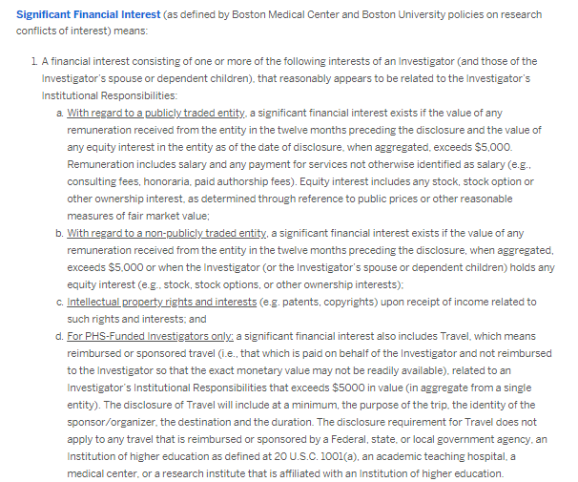
Significant Financial Interest additional details

Slide 21
Decision Point – after Step 1
Step 1
Any Significant
Financial
Interests (SFI)⁵?
⁵ Significant Financial Interest (SFI), briefly, means an interest >$5,000 or unknown equity

Slide 22
Decision Point – after Step 1
Step 1
Any Significant
Financial
Interests (SFI)⁵?
No
DONE
⁵ Significant Financial Interest (SFI), briefly, means an interest >$5,000 or unknown equity

Slide 23
Decision Point – after Step 1
Step 1
Any Significant
Financial
Interests (SFI)⁵?
No
DONE
(PHS inves­tiga­tors must have current COI train­ing before start­ing re­search)
⁵ Significant Financial Interest (SFI), briefly, means an interest >$5,000 or unknown equity

Slide 24
Decision Point – after Step 1
Step 1
Any Significant
Financial
Interests (SFI)⁵?
Yes
No
DONE
(PHS inves­tiga­tors must have current COI train­ing before start­ing re­search)
Step 2
⁵ Significant Financial Interest (SFI), briefly, means an interest >$5,000 or unknown equity

Slide 25
Step 2 – Investigator BMC Projects
Who: | INVESTIGATORS on BMC projects with one or more SFI⁵
What: | List project in COI Smart; say if SFI is related ⁶ to project
When: | FOR EACH NEW BMC PROJECT
 | Funded BMC projects – When project is pending⁷
 | Unfunded BMC projects – Before project IRB submission

Slide 26
Step 2 – Investigator BMC Projects
Who: | INVESTIGATORS on BMC projects with one or more SFI⁵
What: | List project in COI Smart; say if SFI is related ⁶ to project
When: | FOR EACH NEW BMC PROJECT
 | Funded BMC projects – When project is pending⁷
 | Unfunded BMC projects – Before project IRB submission
⁵ Significant Financial Interest (SFI), briefly, means an interest >$5,000 or unknown equity

Slide 27
Step 2 – Investigator BMC Projects
Who: | INVESTIGATORS on BMC projects with one or more SFI⁵
What: | List project in COI Smart; say if SFI is related ⁶ to project
When: | FOR EACH NEW BMC PROJECT
 | Funded BMC projects – When project is pending⁷
 | Unfunded BMC projects – Before project IRB submission
⁵ Significant Financial Interest (SFI), briefly, means an interest >$5,000 or unknown equity
⁶ Related means the amount of the interest and/or the company providing the interest could reasonably be affected by the outcome of the project (BMC Compliance checks the investigator’s determination)

Slide 28
Step 2 – Investigator BMC Projects
Who: | INVESTIGATORS on BMC projects with one or more SFI⁵
What: | List project in COI Smart; say if SFI is related ⁶ to project
When: | FOR EACH NEW BMC PROJECT
 | Funded BMC projects – When project is pending⁷
 | Unfunded BMC projects – Before project IRB submission
⁵ Significant Financial Interest (SFI), briefly, means an interest >$5,000 or unknown equity
⁶ Related means the amount of the interest and/or the company providing the interest could reasonably be affected by the outcome of the project (BMC Compliance checks the investigator’s determination)
⁷ Pending means (1) for PHS-funded: Just-in-Time submitted; (2) for all others: proposal submitted

Slide 29
FULL PROCESS
You are here

Slide 30
Decision Point – after Step 2
Step 2
Any related⁶
SFIs?

Slide 31
Decision Point – after Step 2
Step 2
Any related⁶
SFIs?
⁶ Related means the amount of the interest and/or the company providing the interest could reasonably be affected by the outcome of the project (BMC Compliance checks the investigator’s determination)

Slide 32
Decision Point – after Step 2
Step 2
Any related⁶
SFIs?
No
DONE
⁶ Related means the amount of the interest and/or the company providing the interest could reasonably be affected by the outcome of the project (BMC Compliance checks the investigator’s determination)

Slide 33
Decision Point – after Step 2
Step 2
Any related⁶
SFIs?
No
DONE
(PHS inves­tiga­tors must have current COI train­ing before start­ing re­search)
⁶ Related means the amount of the interest and/or the company providing the interest could reasonably be affected by the outcome of the project (BMC Compliance checks the investigator’s determination)

Slide 34
Decision Point – after Step 2
Step 2
Yes
Any related⁶
SFIs?
No
DONE
(PHS inves­tiga­tors must have current COI train­ing before start­ing re­search)
Step 3
⁶ Related means the amount of the interest and/or the company providing the interest could reasonably be affected by the outcome of the project (BMC Compliance checks the investigator’s determination)

Slide 35
Decision Point – after Step 2
Step 2
Yes
Any related⁶
SFIs?
No
DONE
(PHS inves­tiga­tors must have current COI train­ing before start­ing re­search)
Step 3
Use this to answer:
⁶ Related means the amount of the interest and/or the company providing the interest could reasonably be affected by the outcome of the project (BMC Compliance checks the investigator’s determination)

Slide 36
Decision Point – after Step 2
Step 2
Yes
Any related⁶
SFIs?
No
DONE
(PHS inves­tiga­tors must have current COI train­ing before start­ing re­search)
Step 3
Use this to answer:
INSPIR Q. 5.2⁹
Yes No
⁶ Related means the amount of the interest and/or the company providing the interest could reasonably be affected by the outcome of the project (BMC Compliance checks the investigator’s determination)

Slide 37
Decision Point – after Step 2
Step 2
Yes
Any related⁶
SFIs?
No
DONE
(PHS inves­tiga­tors must have current COI train­ing before start­ing re­search)
Step 3
Use this to answer:
INSPIR Q. 5.2⁹
Yes No
⁶ Related means the amount of the interest and/or the company providing the interest could reasonably be affected by the outcome of the project (BMC Compliance checks the investigator’s determination)
⁹ INSPIR question 5.2: Any significant financial interests that are related to the research?

Slide 38
Decision Point – after Step 2
Step 2
Yes
Any related⁶
SFIs?
No
DONE
(PHS inves­tiga­tors must have current COI train­ing before start­ing re­search)
Step 3
Use this to answer:
INSPIR Q. 5.2⁹
Yes No
⁶ Related means the amount of the interest and/or the company providing the interest could reasonably be affected by the outcome of the project (BMC Compliance checks the investigator’s determination)
⁹ INSPIR question 5.2: Any significant financial interests that are related to the research?

Slide 39
Decision Point – after Step 2
Step 2
Yes
Any related⁶
SFIs?
No
DONE
(PHS inves­tiga­tors must have current COI train­ing before start­ing re­search)
Step 3
Use this to answer:
INSPIR Q. 5.2⁹
Yes No
⁶ Related means the amount of the interest and/or the company providing the interest could reasonably be affected by the outcome of the project (BMC Compliance checks the investigator’s determination)
⁹ INSPIR question 5.2: Any significant financial interests that are related to the research?

Slide 40
Step 3 – BMC Compliance Evaluation
Who: | BMC COMPLIANCE
What: | Evaluate whether relatedness is correct and whether
related SFI constitutes a Financial Conflict of Interest⁸
When: | An investigator with an SFI lists a project in COI Smart

Slide 41
Step 3 – BMC Compliance Evaluation
Who: | BMC COMPLIANCE
What: | Evaluate whether relatedness is correct and whether
related SFI constitutes a Financial Conflict of Interest⁸
When: | An investigator with an SFI lists a project in COI Smart
⁸ Financial Conflict of Interest (FCOI) means an SFI that could directly and significantly affect the design, conduct or reporting of the project

Slide 42
FULL PROCESS
You are here

Slide 43
Decision Point – after Step 3
Step 3
Any Financial
Conflict of
Interest⁸?

Slide 44
Decision Point – after Step 3
Step 3
Any Financial
Conflict of
Interest⁸?
⁸ Financial Conflict of Interest (FCOI) means an SFI that could directly and significantly affect the design, conduct or reporting of the project

Slide 45
Decision Point – after Step 3
Step 3
Any Financial
Conflict of
Interest⁸?
No
DONE
⁸ Financial Conflict of Interest (FCOI) means an SFI that could directly and significantly affect the design, conduct or reporting of the project

Slide 46
Decision Point – after Step 3
Step 3
Any Financial
Conflict of
Interest⁸?
DONE
(PHS inves­tiga­tors must have current COI train­ing before start­ing re­search)
No
⁸ Financial Conflict of Interest (FCOI) means an SFI that could directly and significantly affect the design, conduct or reporting of the project

Slide 47
Decision Point – after Step 3
Step 3
Any Financial
Conflict of
Interest⁸?
DONE
(PHS inves­tiga­tors must have current COI train­ing before start­ing re­search)
Yes
No
Step 4
⁸ Financial Conflict of Interest (FCOI) means an SFI that could directly and significantly affect the design, conduct or reporting of the project

Slide 48
Step 4 – BMC Compliance Management
Who: | BMC COMPLIANCE
What: | Formulate Management Plan¹⁰, communicate to investigator
and to IRB if applicable, follow-up throughout study
When: | Before $$$ released if Financial Conflict of Interest identified

Slide 49
Step 4 – BMC Compliance Management
Who: | BMC COMPLIANCE
What: | Formulate Management Plan¹⁰, communicate to investigator
and to IRB if applicable, follow-up throughout study
When: | Before $$$ released if Financial Conflict of Interest identified
¹⁰ Management plan means a plan to manage the FCOI to prevent bias; may include disclosures, restrictions on investigator responsibilities, divesture of SFI, and/or an independent monitor.

Slide 50
Step 4 – BMC Compliance Management
Who: | BMC COMPLIANCE
What: | Formulate Management Plan¹⁰, communicate to investigator
and to IRB if applicable, follow-up throughout study
When: | Before $$$ released if Financial Conflict of Interest identified
DONE
¹⁰ Management plan means a plan to manage the FCOI to prevent bias; may include disclosures, restrictions on investigator responsibilities, divesture of SFI, and/or an independent monitor.

Slide 51
Step 4 – BMC Compliance Management
Who: | BMC COMPLIANCE
What: | Formulate Management Plan¹⁰, communicate to investigator
and to IRB if applicable, follow-up throughout study
When: | Before $$$ released if Financial Conflict of Interest identified
DONE
(PHS inves­tiga­tors must have current COI train­ing before start­ing re­search)
¹⁰ Management plan means a plan to manage the FCOI to prevent bias; may include disclosures, restrictions on investigator responsibilities, divesture of SFI, and/or an independent monitor.

Slide 52
FULL PROCESS

Slide 53
QUESTIONS?
Fanny Ennever
Fanny.Ennever@bmc.org
617-638-8874
Alisia Lamborghini
Alisia.Lamborghini@bmc.org
617-638-7906
COI-Compliance@bmc.org

