Slide 1
Research Operations and Lab Services
7/15/19

Slide 2
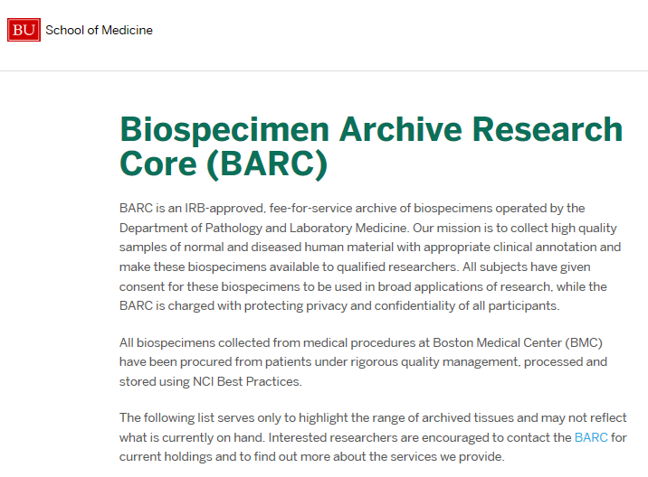
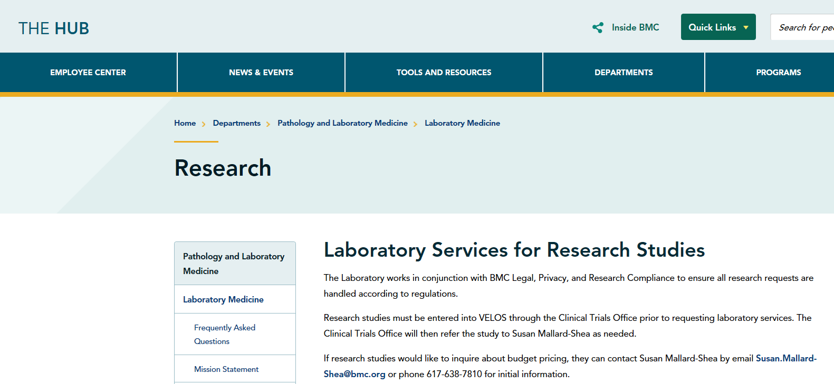
Roles and Contacts
Chris Andry PhD Administrative Director for the Department of Pathology and Laboratory Medicine
Susan Mallard-Shea Office Manager/Study Coordinator (Main Contact)
Abigail Brown DiScipio Quality and Compliance Coordinator for the Department of Pathology and Lab Medicine
Elizabeth Duffy Quality Director, Biospecimen Archive Research Core (BARC)
Notes:
Collection manager is just one example of our departments quality improvement projects. Our department has a robust quality management system in which we monitor both regulatory and self identified monitors for pre-analytical, analytical and post analytical aspects of testing. Our pathology department currently monitors over 25 QA/QI monitors, and our lab medicine department currently monitors over 35 QA/QI monitors. In addition, both departments collaborate with other hospital departments on QA/QI initiatives. If you have any questions or have any projects you would like to collaborate on, do not hesitate to contact me directly.

Slide 3
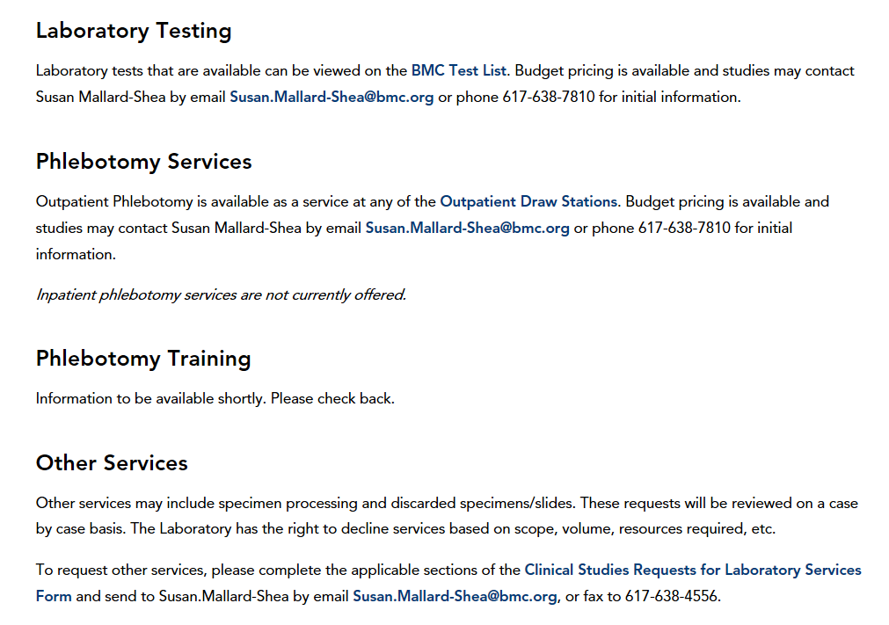
Current Services
Notes:
Collection manager is just one example of our departments quality improvement projects. Our department has a robust quality management system in which we monitor both regulatory and self identified monitors for pre-analytical, analytical and post analytical aspects of testing. Our pathology department currently monitors over 25 QA/QI monitors, and our lab medicine department currently monitors over 35 QA/QI monitors. In addition, both departments collaborate with other hospital departments on QA/QI initiatives. If you have any questions or have any projects you would like to collaborate on, do not hesitate to contact me directly.

Slide 4
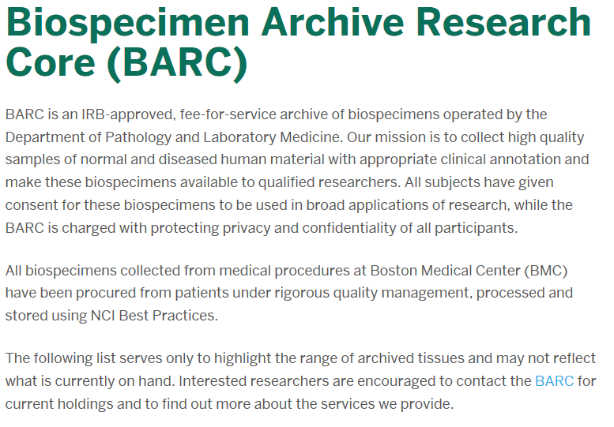
Current Services
Pathology Services:
Testing services including cytology and molecular tests
Slide preparation
Notes:
Collection manager is just one example of our departments quality improvement projects. Our department has a robust quality management system in which we monitor both regulatory and self identified monitors for pre-analytical, analytical and post analytical aspects of testing. Our pathology department currently monitors over 25 QA/QI monitors, and our lab medicine department currently monitors over 35 QA/QI monitors. In addition, both departments collaborate with other hospital departments on QA/QI initiatives. If you have any questions or have any projects you would like to collaborate on, do not hesitate to contact me directly.

Slide 5
Areas of Discussion/Topics of Concern
Research
Laboratory
-The active engagement of the lab in research activities at the onset
-The use of the lab CLIA
Notes:
Collection manager is just one example of our departments quality improvement projects. Our department has a robust quality management system in which we monitor both regulatory and self identified monitors for pre-analytical, analytical and post analytical aspects of testing. Our pathology department currently monitors over 25 QA/QI monitors, and our lab medicine department currently monitors over 35 QA/QI monitors. In addition, both departments collaborate with other hospital departments on QA/QI initiatives. If you have any questions or have any projects you would like to collaborate on, do not hesitate to contact me directly.

Slide 6
Clinical Laboratory Improvement Amendments (CLIA):
Quick Education
Signed into law 1988. Passed by Congress to establish quality standards for all laboratory testing to ensure accuracy, reliability, and timeliness of patient test results.
42 USC 263 CLIA-statute for certification and oversight of clinical laboratory testing
CLIA applies to all laboratories including research. The CLIA regulations define a laboratory to be:
“a facility for the biological, microbiological, serological, chemical, immunohematological, hematological, biophysical, cytological, pathological, or other examination of materials derived from the human body for the purposes of providing information for the diagnosis, preven tion, or treatment of any disease or impairment of, or the assessment of the health of, human beings. These examinations also include procedures to determine, measure, or otherwise describe the presence or absence of various substances or organisms in the body” (42 C.F.R. § 493.2 (definition of “laboratory”).
CLIA requirements are based on complexity of testing; waived, moderate and high complexity. Laboratories must obtain an appropriate CLIA certificate prior to testing.
42 CFR 493-laboratory requirements under CLIA
Centers for Medicare & Medicaid Services (CMS) regulates all laboratory testing performed on humans in the U.S. through the Clinical Laboratory Improvement Amendments (CLIA)
References CDC.gov, CMS.gov

Slide 7
CLIA Certificates
All lab testing must be done under an appropriate CLIA certificate if it meets the definition of a laboratory.
Research activities are not automatically exempt, nor are they automatically covered by the lab CLIA
Having a CLIA certificate is not an umbrella for performing lab tests. A test list is submitted to the MDPH and our accrediting agency stating the testing that is being conducted under that CLIA certificate.
The CLIA certificate does not automatically cover all sites on the BMC campus. The lab has to state where testing is being conducted to the MDPH and our accrediting agency.
The CLIA holder, known as the Lab Director, has ultimate responsibility for all activities done under that CLIA
Certificate of Waiver: only waived testing
Certificate for PPMP: provider performed microscopy procedures + waived testing
Certificate of Accreditation (COA): Issued to a laboratory on the basis of the laboratory’s accreditation by an accreditation organization approved by CMS. This type of certificate is issued to a laboratory that performs non-waived testing. Our clinical lab is accredited by the College of American Pathologists.
References CDC.gov, CMS.gov

Slide 8
Deviations from CLIA
Deviations from CLIA regulations can result in serious consequences, such as suspension of BMC medicare payments and/or revocation of the CLIA certification
§493.1840 Suspension, limitation, or revocation of any type of CLIA certificate.
(a) Adverse action based on actions of the laboratory's owner, operator or employees. CMS may initiate adverse action to suspend, limit or revoke any CLIA certificate if CMS finds that a laboratory's owner or operator or one of its employees has—
(2) Performed, or represented the laboratory as entitled to perform, a laboratory examination or other procedure that is not within a category of laboratory examinations or other procedures authorized by its CLIA certificate;

Slide 9
Summary/Highlights
The lab is fully supportive of research activities at BMC
The lab has a responsibility to ensure it is adhering to state and federal regulations (CLIA)
The lab needs to be aware of any patient testing being conducted on campus, for example:
Use of Point of Care devices
Urine Pregnancy testing (includes vendor supplied and over-the-counter)
Use of Lab CLIA
The lab is working to standardize and streamline processes to ensure coordinated efforts for all research requests, including involvement of lab during budget development, IRB application process, or sooner
The lab would like to get to a place where they are included in the processes early and have established resources to support research
Notes:
Collection manager is just one example of our departments quality improvement projects. Our department has a robust quality management system in which we monitor both regulatory and self identified monitors for pre-analytical, analytical and post analytical aspects of testing. Our pathology department currently monitors over 25 QA/QI monitors, and our lab medicine department currently monitors over 35 QA/QI monitors. In addition, both departments collaborate with other hospital departments on QA/QI initiatives. If you have any questions or have any projects you would like to collaborate on, do not hesitate to contact me directly.

