Slide 1
December 14th Research Admin Meeting

Slide 2
Agenda
9:00am – 10:00am
Welcome
Accounts Payable – Chrome River
Research Operations updates
9:55am – 10:00am
Introducing Tina Dasilva
10:00am – 10:30am
Clinical Data Warehouse
Biorepository to LABS transition

Slide 3
Chrome River: Per Diem Expenses and Pre-approvals Kathryn Loup

Slide 4
Chrome River Features
Now that people have started traveling and going to conferences, there are a couple of features in Chrome River that may be of interest to Grants
Per diem expenses
Pre-approvals reports

Slide 5
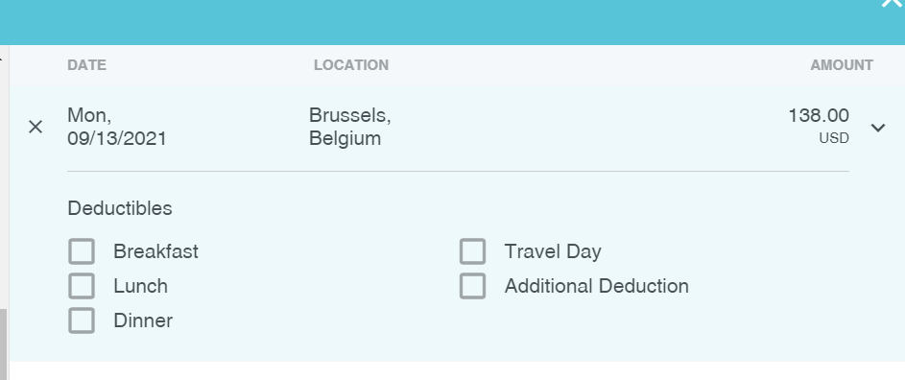
Per Diems
Can be used as a cash advance proxy or paid after a trip
Linked to U.S. government rates (excluding hotel)
Enter one day or multiple days
Allows deductions for meals, travel days, or “other”
Entered as part of a regular expense report and paid through Workday
Only an option in Research report type

Slide 6
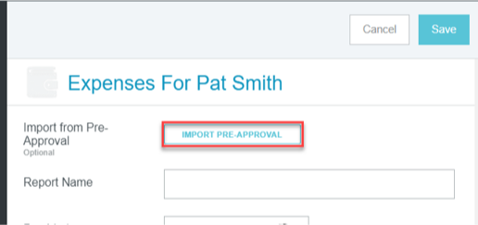
Pre-Approval
Pre-approvals are entered as estimates to get documented approval before travel
Can enter all expense types – airfare, hotel, registration fees, etc.
The pre-approval report routes for approval the same as a regular expense report
Pre-approvals are not exported for payment
After the trip, the pre-approval is imported into an expense report and receipts attached showing actual costs
The employee will be reimbursed for the actual costs after the report is approved

Slide 7
Research Operations Updates

Slide 8
BMC Research Operations
Introducing new staff:
11/15 Hiral Parikh- Research Finance Analyst II
11/29 Kaye Mottola- Research Education Manager
11/29 Valerie LeBrun- Manager, Research Finance
12/13 Tina DaSilva- Executive Director, Research Administration
CSO candidate update
Notes:
Research Operations maintains a contact list of dept research administrators, finance/accounting staff, and other dept. contacts, to begin a quarterly update cycle
Continuing Resolution keeps govt funded thru 12/3, take action on sponsor/prior approval requests so there will be no pause/gap in funding, plan as though the federal budget will not be approved
Note: CR funding stopgap sustains federal agencies’ existing spending until Dec. 3, at which point Congress must adopt another short-term fix, called a continuing resolution, or pass a dozen appropriations bills that fund federal agencies through the 2022 fiscal year.

Slide 9
Grants & Contracts Stephanie Wasserman

Slide 10
Pre-Award
REMINDER:
NIH changes (NOT-OD-21-169/Forms-G) effective on January 25, 2022:
Revised Other Support and Biographic Sketches versions will be required.
All key personnel will be required to have eRA Commons user IDs.
Unique Entity Identifier (UEI) numbers go into effect. UEI numbers will be replacing the DUNS number.
BMC’s Factsheet will be updated to reflect this change once UEI is issued.
Proposal Review Matrix
Vacancies:
Senior Grant Administrator
Award Administrator – not posted yet.

Slide 11
Grants & Contracts
Outgoing Subaward Process
Sub-agreement Request Form link
Please use this link: https://bmc.tfaforms.net/f/forms-research-subcontract-request
Purchase Order #s
Fully executed subcontracts uploaded in InfoEd in PT under Agreements tab, and include the PO #.
Vendor Adds
In Infor, all subcontracts, domestic and international/foreign will need a PO#.
Some international subrecipients are not in Infor as a vendor yet.
When submitting a new subcontract request, please check that subrecipient is a vendor in system.
Link for vendor adds: https://hub.bmc.org/departments/finance/accounts-payable.

Slide 12
Research Metrics & Cost Analysis Tyler Flack

Slide 13
RMCA – Updates
Filed FY20 UG Audit
One repeat finding related to BU PARs. A couple reoccurring issues: cost share for faculty over the salary cap not recorded on the PAR. Greater than 25% reduction in effort for key personnel.
Space Survey kicking off soon. Planning to get the data forms out before the holidays
RHCC LDR reports available on Infor reporting on the Research Homepage. ADs given access and can request additional access for their staff via a FIS Service Now ticket. RFAs also have access.
New Research Core Facility Policy approved by the Policy and Procedure Committee. It’s available on Policy Tech: https://bostonmedicalcenter.policytech.com/dotNet/documents/?docid=3295

Slide 14
CTO Updates Johanna Chesley

Slide 15
CTO updates
VeevaVault Free update
Completed review of 3 Regulatory Management Systems and VeevaVault Free was comparable, or better, than two other two systems at zero system cost
RIS will support IT needs and department representatives will be asked to support staff
Velos / Epic Training update
Due to increase in billing errors held for review, CTO will be requesting study teams to complete the Epic/Velos research billing workflow live training if an error is identified
Updating our Velos training requirements for user access – stay tuned
Velos use and Epic research flag with no billing
Increase potential use of Velos/Epic integration
CTO will determine if billing or no-billing will occur
CRN providing educational process improvement consults to CTO; experienced central research perspective with departmental needs
Elevates all research
Inclusive partner to organize a collective voice to improve research process

Slide 16
SiteVault Free encourages remote, compliant work
https://www.youtube.com/watch?v=23WKYUxA9lo

Slide 17
CRN Updates Ryan Schroeder

Slide 18
Clinical Trial Standard Operating Procedures
CRN is partnering with the following stakeholders to create a set of BMC SOPs for clinical trial conduct.
Principal Investigators
GCRU
Department Administrators/Research Coordinators
Research Compliance
Clinical Research Resources Office
Approving Committee: Research Compliance Committee
SOP List | Status
Case Report Form Completion | Under Research Compliance Committee Review/Approval
Site Monitoring Visits / Monitoring Checklist | Circulated for input. Next Step - Moving to Mary Tara and La Tina
GCP Training
Authority and Delegations of Responsibilities of Research Staff
Subject Screening and Recruitment
Informed Consent Process and Documentation
Eligibility Confirmation
Protocol Deviations
Adverse Events and Serious Adverse Events Reporting
Confidentiality of Information
Drug/Device Storage, Accountability and Management
Regulatory Document Submission Process (Initial Submissions, Amendments and Continuing Reviews)
Sample Processing and Shipping Training
Sponsor, CRO and Internal Audits
FDA Audits
Record Organization and Retention

Slide 19
Research Education Kaye Mottola

Slide 20
Research Education Manager: Kaye Mottola
13 years: research compliance program development
Clinical Research Compliance Officer, University of Utah: billing, finance, GCP
via oversight, policy, process software design, education, audit
Research Compliance Officer, Sutter Health, expands to: COI, HSP, ID Services,
biosafety, animal care and investigations, CAPA plans
3 years: genetics research and coordination
Familial melanoma epidemiology
Pediatric neuromuscular disorders
NIH writing coach, research plan and IND protocol design/submission
12 years: university instruction/research/programming
Dissertation: philosophy of science/epistemology(theory of knowledge)
Ethics, history of philosophy, environmental ethics, feminism, rhetoric
Also writing consultation, graduate writing program development

Slide 21
Goals, Priorities, Plan of Engagement
Provide effective education across the research community
Efficient, timely, tailored to roles and responsibilities
Ranging across all forms of research and all risk areas
Supporting equitable, inclusive CR participation
For exceptional patient care and robust scientific power
Multi-focused prioritization
Research community needs: e.g., new PIs and staff, efficient job aids
Greatest risk areas: e.g., HSP, COI, billing, grants requirements
Immediate needs; BMC-BU collaboration; 5-year plan
Listening across the research community
Collaborate with BMC-BU research admin, BMC departments, ancillaries
Identify present state, order and map desirables, develop transition plan
Invite and engage investigator-champions

Slide 22
Research Technology Program (RTP) Caitlin Gaudreau

Slide 23
Program helps guide researchers with IT scope, planning, budgeting and implementation of technology to support research studies
Pre-Award – Early engagement
Provide guidance on available software and/or hardware
Review expectations of Sponsor and of BMC/BU study team
Identify feasibility of proposed solution by consulting with internal IT leadership and outside vendors
Identify IT budget required for research study:
Including (not limited to): hardware, software, equipment, Epic consultants, maintenance plan
Coordinate information security review between Vendor(s) and BMC Information Security
Post Award
Hire/manage IT consultants
Important for us to have a reasonable budget identified in pre-award to support the hiring of consultants
Coordinate resources necessary from internal IT resources, identify appropriate quarter start
Project manage and oversee all Research Technology projects
Manage research computing equipment purchases and procurement process

Slide 24
Research Technology Program (RTP) can assist with the procurement of most types of computing hardware
Device Type | Process Detail
 | Standard offerings include BMC laptop, small form factor (SFF) and micro desktop options. Standard offerings are the most supportable and the best value.
 | Tablets, including iPad and Android devices, are sourced from CDW-G. Upon approval by Research Finance, a quote will be provided to the requestor to be entered into the Infor system to complete purchase. Please note that cellular iPads (with LTE service, for example) are also available via BMC ITS Finance.
 | If BMC’s standard PC offerings do not match an application’s requirements, a unique PC can be spec’d and sourced from Greenpages. RTP will ensure the recommended PC meets the specifications and is on budget.

Slide 25
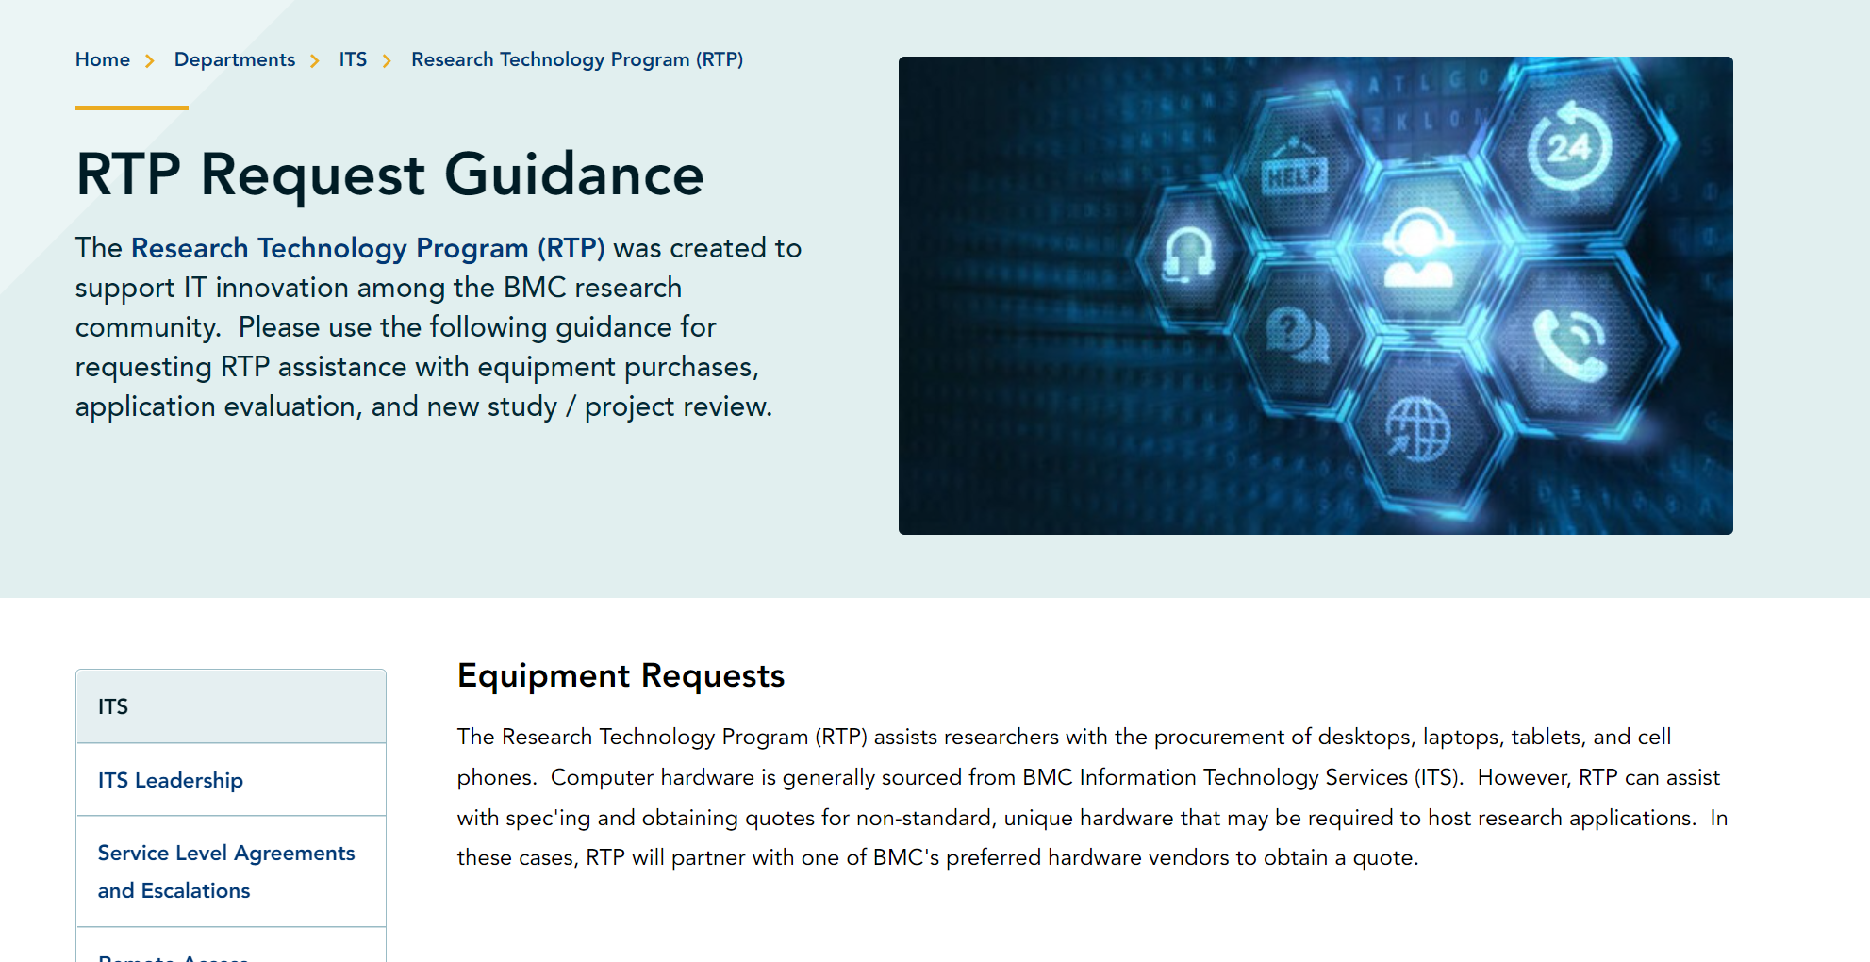
Research Technology Program on the HUB
RTP Request Guidance provides helpful tips for researchers to engage with the team:

Slide 26
Questions

Slide 27
Introducing: Tina Dasilva!

Slide 28
BMC Clinical Data Warehouse for Research
Melissa Hofman, MSIS
Research Informatics Director
December 14, 2021

Slide 29
What is the BMC Clinical Data Warehouse (CDW) for Research?
A database containing data from multiple sources
Current electronic health records data (e.g., Epic)
Historical data extracted from BMC’s multiple legacy clinical systems
Miscellaneous other data sources
Different domains of data are related to each other with patient-level unique identifiers
A resource for research!
Observational/retrospective studies
Recruitment lists & data sets for prospective studies
Complement to chart review
Collaborations with Departments and Division to support research efforts and programs and explore how to leverage data for research
Notes:
START WITH BIG PICTURE – What we’ve been striving for over the last year
Breaking out of the mold – FY21 updates – big picture what we are working on and where we are going

Slide 30
What data are available?
BMC Epic EHR Data
IP: May 2014-current
AMB: May 2015-current
(weekly update)
SDOH Data Sets linked via geocodes
BEST Data
Static Legacy Data
(Pre-2014/2015)
SDK
Patient Registration
Data
IBEX
ED Data
CHC OCHIN Data*
(monthly extract)
BMC
Clinical Data Warehouse
Logician
Outpatient EHR Data
EWS
Appointment Scheduling
Internal Department Sources
SCM
Inpatient EHR Data
PICIS
OR Data
Future Directions
Tumor Registry*
Other External Data (including death data)
BMC HealthNet Claims Data
*special permission required to access

Slide 31
Why would a research team use the CDW?
Obtain a list of patients who are eligible for study recruitment
Obtain extracts of data (instead of doing manual chart reviews)
Create a data repository for Departments to facilitate research
Obtain large data sets for machine learning and AI
Obtain data from other health system data streams – CHC data, claims data

Slide 32
Department Collaborations & Infrastructure
Collaborate with Departments to increase department research infrastructure
Create algorithms to capture SDOH data within the EHR and bring in external SDOH datasets to link via geocodes
Develop phenotypes for identifying patients and variables, improving consistency and data capture
Link EHR datasets with external datasets to enable answering broader research questions (e.g., BEST)
Notes:
Getting better at what we do and expanding what we offer

Slide 33
CDW for Research Fees
$75 per hour if BMC/BU account or grant.
$131.25 per hour if account is external to BU\BMC or if funded by industry/for-profit funders.
Investigators can include the cost of CDW services in their grant proposal budgets or can pay for services using internal funds, such as Department or Division funding or discretionary funds.
CDW can work with you to provide quotes to include in grants or budgets and/or keep costs within budget restrictions!
Notes:
Anesthesiology example

Slide 34
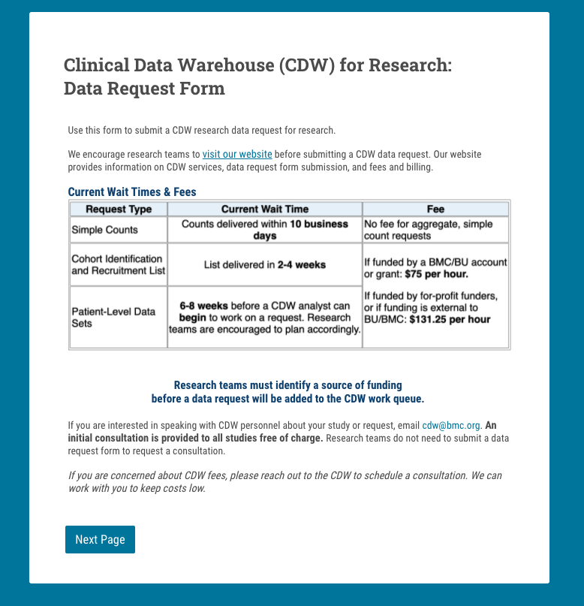
https://www.bmc.org/research/clinical-data-warehouse-cdw

Slide 35
Updates on the COVID-19 Biorepository and the new Laboratory and Biorepository Research Services Core (LABS) Lizzy Ragan 14 December 2021

Slide 36
A recap of the COVID-19 Biorepository, first launched in May 2020
In May 2020, BMC launched a COVID-19 Biorepository which aimed to bank samples from COVID-19 patients and survivors for future research
Sample types include: blood, PBMCs, DNA, respiratory swabs, urine, etc.
Samples were collected from prospectively enrolled patients, as well as clinical remnants from the clinical laboratories
We established a governance structure and the Scientific Review Committee (SRC) which was tasked with reviewing sample request applications from BU/BMC investigators
To date:
>2,000 samples distributed
>10,000 BMC patients represented
15 active studies supported
>40,000 samples banked

Slide 37
Leveraging the Biorepository’s success & infrastructure, we expanded our core to systematize pathology & laboratory research services
The Laboratory And Biorepository Research Services (LABS) Core
A major success of the Biorepository is its infrastructure, including leadership, governance, and process
Leveraging this, the BMC Department of Pathology & Lab Medicine is launching a new umbrella research services core which will include the following service pillars:
COVID-19 Biorepository
Clinical Remnant Sample Services
Pathology Services
Biorepository Services
Access to prospectively collected and clinical remnant samples from COVID-19 patients
Investigator-initiated access to clinical remnant samples (i.e., leftover sample initially collected for clinical purposes)
Research tissue microarray (TMA) generation and tissue and slide retrieval
Sample processing services (e.g., PBMC isolation, plasma)

Slide 38
Impact of expanded and centralized research laboratory services on advancing research at BMC
By bringing existing pathology and laboratory research services under one roof, we streamline the process both administratively and for researchers
Provide a clear, centralized process and interface for accessing samples, tissue, and quality pathology/histology services
Reduced impact on laboratory’s clinical functions and responsibilities
Designed for cost-neutrality and sustainability; standardized sample and service fees and regular invoicing will allow the Core to recoup expenses
Improved research experience for BMC patients (e.g., use of clinical remnant samples in research can lead to fewer study visits, fewer procedures, and overall reduced burden)
Facilitated linkage for researchers to Clinical Data Warehouse (CDW) and testing services by the clinical laboratory

Slide 39
A few notes for this audience
Invoicing
For BMC studies, invoices are sent to an investigator as an “FYI”; our team (Kristin) performs a journal entry from the account provided
Investigator may choose to obtain additional data from the CDW to complement their study; i.e., there may be invoices from both LABS & CDW for a given project
Agreements
If samples/data are being sent to/shared with a BU investigator or lab, an MTA/DUA will need to be put in place
Grant proposals
LABS can support budget development for grant proposals
LABS can provide letters of support to support grant applications (e.g., describe the resources available, ability to support proposed study, etc.) need ~one week lead time
Fees
BU investigators are charged our “internal” fees
External fees are base fee + F&A Rate
Industry-funded studies are charged “external” fees

Slide 40
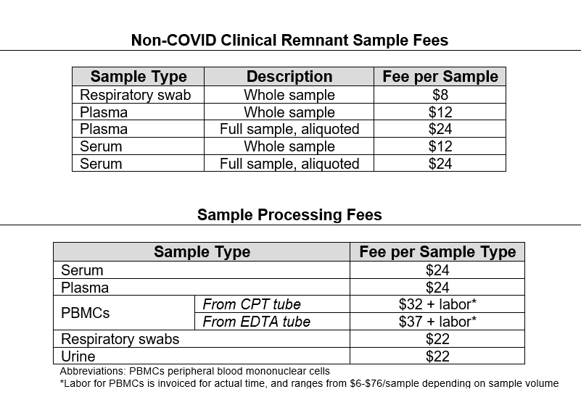
What’s next and upcoming from the LABS Core, and how investigators should engage us for services
Webpage is under construction and forthcoming; will detail formal service/sample request process and fees
In meantime, investigators should reach out directly to us (LABS_Core@bmc.org) to discuss how we might be able to support your study as a pilot project
Example fees:

Slide 41
Open Discussion and Questions
Thank-you for attending today’s meeting!

