Slide 1
Time and Effort: Overview Research Operations March 24, 2021

Slide 2
Effort Reporting
Effort Reporting is the mechanism used to provide assurance to federal sponsors that salaries charged, or cost shared on awards are reasonable in relation to the actual work performed.
Faculty and staff salaries charged to sponsored research projects must be consistent with the actual effort devoted to the project.
Effort reports are also referred to as “certifications” or “statements.”

Slide 3
Effort Certification
Certification signed by the principal investigator or responsible official who has suitable means of verification that the work was performed.
Reflect the total activity for which the employee is compensated –equals 100%.
Charges to Federal awards for salaries and wages must be based on records that accurately reflect the work performed.
Be supported by a system of internal controls that provides reasonable assurance that the charges are accurate, allowable, and properly allocated.
Reasonably reflect the total activity for which the employee is compensated.

Slide 4
Importance and Potential Risks
Federal requirement for Principal Investigators or other knowledgeable individuals report and certify compensation and cost-shared effort on federal awards in a timely manner.
Institutional requirement to report ALL effort (federal and non-federal)
Risks of non-compliance include:
Institution and PI susceptible to False Claims Acts allegations.
Institution may incur financial penalties.
Sponsor may reduce future funding.
Adverse publicity.

Slide 5
BMC Effort Audit Findings Summary
FY | Finding Description
18 | Time not approved before posting to the grant and certifications not completed on time. Payroll adjustments occurred after an employee's period of effort.
19 | Lack of controls in payroll allocation process.

Slide 6
Roles in Effort Process
Role | Responsibilities
Principal Investigator, BMC Employee or BUMG Faculty | Responsible for proposing time and effort expected on a project, ensuring effort is charged to project, and certifying their effort is accurate.
Department Administrator | Responsible for distributing the PI and employee’s effort onto sponsored projects or monitoring the salary distributions if they are paid from a Boston University account. Reviews effort and reconciles for accuracy in a timely manner.
Research Operations | Reviews effort commitments, cost transfers and certifications.
Development | Reviews PI and employee’s effort at the time of proposal submission to ensure there is not an over commitment, or cost sharing.
Boston University Department Counterpart | Distributes BU faculty to BMC sponsored projects. Allocates effort on BU system for BU faculty.

Slide 7
Key Steps in Effort Reporting Process at BMC
Salary is reviewed and certified at BMC for BMC staff and PIs through Workday and for BU based faculty through BU and SAP.
Salary Review
Boston Medical Center
Boston University
Faculty
Staff and a few PIs

Slide 8
Key Steps in Effort Reporting Process at BMC
BU Faculty certifications are initiated through SAP, then routed to the DA/Mail Contact, reviewed and approved by the PI and then sent back to BU and BMC once compete.
Initiation
First Reviewer
Approver
Submission
Effort@BU.edu
SAP
DA/Mail Contact
PI
Send to BU via email
Copy
BMC-PARS@bmc.org

Slide 9
Key Steps in Effort Reporting Process at BMC
BMC Staff and PIs certify their effort through Workday, it is then routed to the grant manager or employee’s manager, certified by the individual in Workday. The entire process is routed through the system.
Initiation
First Reviewer
Approver
Submission
SAP
Grant Manger/
Manager
PI
Submitted to Workday

Slide 10
Changes in Key Personnel Effort
Prior approval is only required for a change in effort for the PD/PI or other senior/key personnel specifically named in the NoA.
NIH prior approval is required for any reduction of effort of 25% or more from the level that was approved at the time of the initial competing year award, or a change of 25% or more from a previously approved reduction in effort level as reflected in a revised Notice of Award (NOA).
For example, a PI’s proposed change from 12 person months (100% effort) to 9 person months (75% effort) or fewer would require prior approval.
Other personnel, if not named in the NoA, do not need prior approval. Note that prior approval is not needed for a reduction in effort during a no-cost extension period.

Slide 11
Cost Share
Cost-sharing is any project cost that is not reimbursed by the sponsor to support the scope of work defined by the award.
Cost share types:
Mandatory Committed
Sponsor requires grantee to contribute funds toward the project as a condition of the award.
Typically noted in Notice of Award.
Voluntary Committed
PI voluntarily commits resources
Not required by the sponsor yet reflected in proposal budget.
Must be tracked and reported to sponsor.
Must be tracked and reported to sponsor.
In-Kind

Slide 12
Over the Cap
If an investigator has salary above the NIH Salary cap, the administrator should calculate their percentage of effort based on the NIH Salary cap, not the full salary amount.
Category | Amount | 50%
Investigator Salary | $250,000 | $125,000
NIH Salary Cap | $199,300 | $99,650
The difference between the investigator's full salary and their percent effort amount applied to the NIH Salary cap should be recorded as cost share on the PAR. In this example the difference between $125,000 and $99,650 is $25,350 or 10% and should be recorded as cost share on the PAR.

Slide 13
General Considerations for Salary Allocation
Is the documentation complete?
Is the transfer timely? Or will it require a CT?
Is the account active?
Was the individual in the original budget? What was their role? Is this role allowed on the project?
Is the individual's salary over the NIH salary cap or other sponsor salary cap?
Is salary change within original salary budget?
Does salary charged align with effort commitment?
Does amount requested trigger greater than/less than 25% change?

Slide 14
How to Complete the PAR

Slide 15
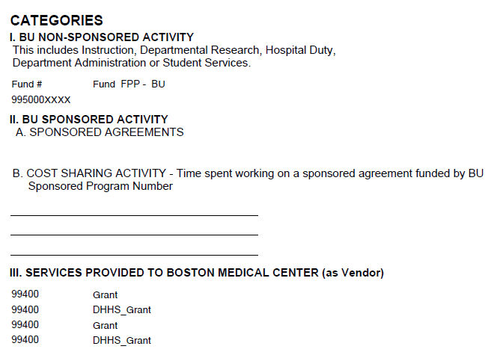
How to Complete the PAR: Core Categories
I. BU NON-SPONSORED ACTIVITY
For BU or BMC
Clinical time
II. BU SPONSORED ACTIVITY
BU Sponsored Agreements
III. SERVICES PROVIDED TO BOSTON MEDICAL CENTER (as Vendor)
BMC Sponsored Agreements
Cost Sharing: BMC or BU Cost Sharing
Teaching time
Non-sponsored gifts
Administrative time
The PAR is intended to capture BU and BMC Activity for an effort reporting period across three categories.

Slide 16
How to Complete the PAR – Capturing Effort
The PAR is intended to capture BU and BMC Activity for an effort reporting period across three categories.
Category | Unrestricted Breakdown | % of Salary Charged | % of Effort Expended
BU NON-SPONSORED ACTIVITY | Validate that pre-populated value is accurate. | Validate that pre-populated value is accurate. | Enter % of Aggregate Effort Calculated here
BU SPONSORED ACTIVITY | NA | Validate that pre-populated value is accurate. | Enter % of Aggregate Effort Calculated here
COST SHARING ACTIVITY | NA | NA | Enter % of Cost Share Effort by Grant (IO #)
SERVICES PROVIDED TO BOSTON MEDICAL CENTER (as Vendor) | NA | Validate that pre-populated value is accurate. | Enter % of Aggregate Effort Calculated here
Total Effort Should be 100%

Slide 17
How to Complete the PAR
& BMC-PARs@bmc.org

Slide 18
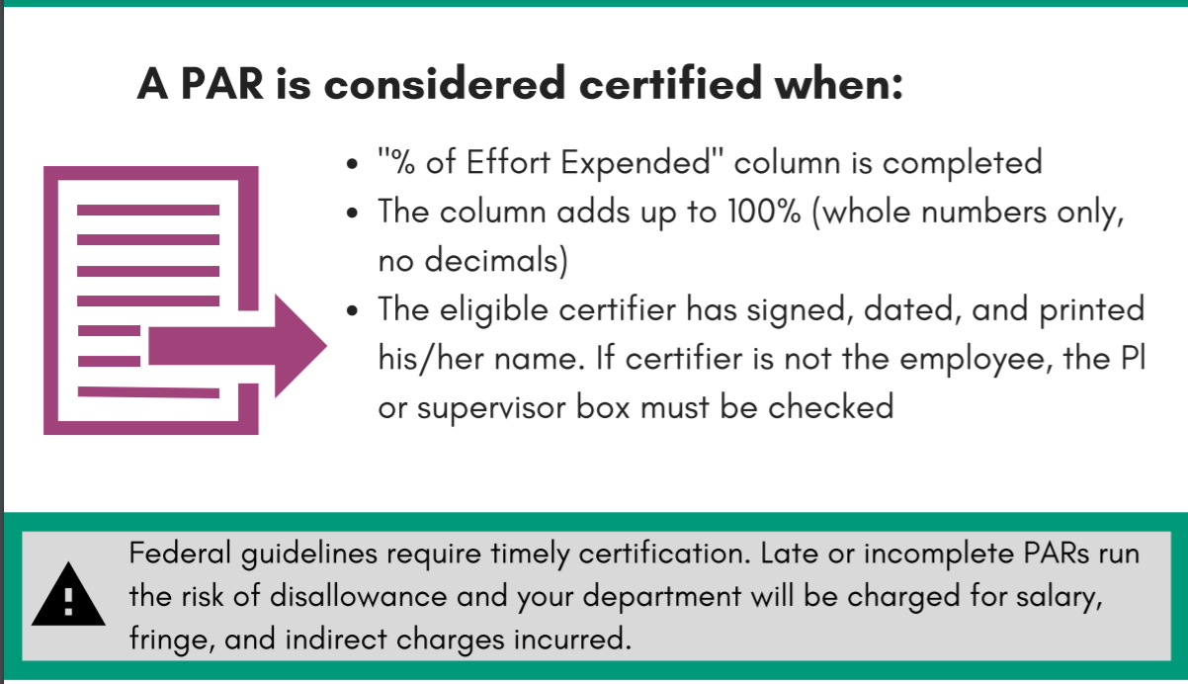
How to Complete the PAR

Slide 19
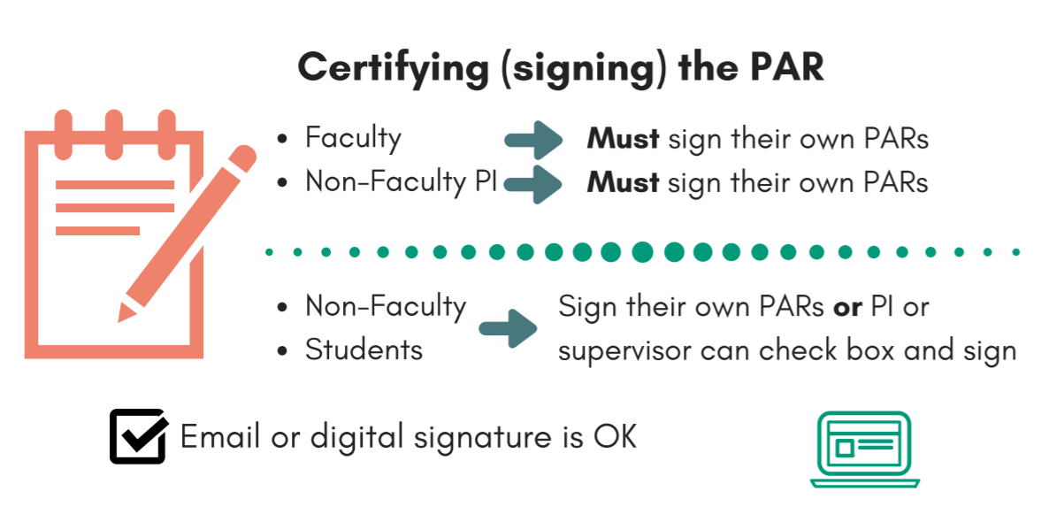
How to Complete the PAR

Slide 20
BU Effort Training Resources
Effort presentation slides (including example PARs and how to run the PA15 report in Business Warehouse)
Effort Reporting (elearning module)
Effort Reporting (Zoom or in-person)
Training videos on salary cap and cost share
FAQ: Does my grant impose a salary cap?
Effort Presentation October 2020
Effort Zoom Recording October 2020
How to complete the PAR
Memo with 2020 guidelines
Effort reporting period dates

