Slide 1

Infor Implementation
Grants and Funds
Research Town Hall
BMC Research Operations
Wednesday, September 10th, 2020

Slide 2

Welcome Note
Presenters:
Grace Cashman – Sr. Director of Research Operations
Kaitlyn Clifford – Director of Accounting
Kathryn Loup – Associate Director of Financial Operations
Marley Crowell – Sr. Director, Financial Information Systems
Don Hagman - Sr. Change Management / Project Management Consultant - Infor

Slide 3
Agenda
Welcome Note
What is Infor and Why are we Implementing it?
Project Overview – Strategic Improvements
Timing of Implementation
What Systems are Impacted?
Improvements
  System Improvements
  Common Enhancements for All End Users
  Accounts Payable Improvements
  Reporting Improvements
Grants and Funds Specific
Training Plan and Schedule
Next Steps

Slide 4
What is Infor and Why are we Implementing?
Infor
is replacing unsupported Lawson product
Modules will house all Finance, Grants, and Supply Chain functions for BMC, BUMG, and BMCHP
Cloud based and cross functional, Infor will increase efficiency, standardize processes & promote future health system growth

Slide 5
Project Overview – Strategic Improvements
Infor’s new Global ledger architecture will facilitate analytical reporting
BMCHS can automate business processes using Infor’s new technologies to reduce manual effort and significantly improve cycle times:
  Invoice Approval Automation
  New interfaces for new systems and improved integrations
Modern, integrated applications improve communication among entities in the health system
Integrated document imaging for faster, improved, auditable decisions
New audit functionality shows tracking and will satisfy auditors
Provides automatic updates and enhancements
  On a fixed, more predictable schedule - monthly
  New enhancements delivered faster - use new functionality sooner

Slide 6
Timing of Implementation
The new Infor system goes live on October 1, 2020.
Communications are coming to keep the community up to date on important news including:
  Key changes and need to know information
  Training courses and schedules
  Go Live!
  Ongoing Support
Due to the evolving COVID19 situation, we’re prepared for remote Training.
  Training will be delivered in various forms including eLearning, Virtual Instructor Led Training, and self-directed Simulations
  People and tools are available for remote assistance during Training.
Notes:
Prepared to answer questions about remote help

Slide 7

What Systems are Impacted?
NEW
MHC
Doc Mmgt
NEW
Financial Data Warehouse
Epic Revenue
Epic OR Supplies
GHX
EDI
Banks
NEW Clinical Bridge
NEW Chrome River Expense
Professional Services Billing - Optum
McKesson
Abeo Anesthesia
NEW VitalAxis
Infor
NEW
InfoEd
Grants
NEW
Strata Decision Support/ from EPSI Cost Acct.
SAP BU
Kronos
NEW
Strata
Capital
Workday BMC
Strata Jazz Operating Budget
Workday
Health Plan
Notes:
This slide depicts our new Infor system and that a lot of people are impacted by the changes. The green highlighted systems will have the largest impacts on you. Many other systems feed into Infor or are bidirectional. The SAP, Kronos are P/R system. What does Grace want to say if anything about InfoEd – no interface for go live but ? Later? No need to talk about InfoEd integration piece that only impacts my office, but InfoEd information will be improved because of integration

Slide 8



System Improvements
Accounting Structure
Chart of Accounts (COA) and General Ledger (GL) numbering enhancements
Cost Centers replacing outdated Accounting Units
Documents
Electronic and mobile expense reimbursement
Accounts Payable
Combining 3 companies: BUMG, BMCHP and BMC into 1 for BMCHS unified reporting
Invoices entered by system via OCR
Supports P&L reports for Grant/projects
Attach e-receipts via phone/tablet/web
Electronic Invoice Approval
Pre-Award and Funds Documents stored in InfoEd
Financial Transactions stored in Infor and visible in Reports
Notes:
Check with Grace on terminology of structure Contracts/projects? AUs are being replaced by projects We can also store Kaity’s fund documentation in InfoEd

Slide 9
Common Enhancements for All End Users
User Interface
User Friendly and Intuitive
Simplified Chart of Accounts
New Cost Centers
Expense Management
Requisitioning
Accounting Units retired
New Cost Centers with new numbering
Reduction of duplicate accounts
New Chrome River expense system
Electronic Invoice Approvals
Simplified expense types
Unique requester ID tied to employee ID
New look and feel that is menu driven
Item numbers and vendor numbers change
Reporting
More flexibility, accessibility and accuracy

Slide 10
Accounts Payable Improvements
Electronic Invoice Approval is here!!
All invoices will be emailed or mailed to Accounts Payable for upload into Infor
  No more check requests!
Invoices without POs and invoices with service POs will be routed for approval through Infor
  Approvers will receive an email alerting them an invoice is waiting for approval
  Approver accepts or rejects in Infor
    Invoice document is viewable from a link on the approval screen
    Approval is electronically documented and auditable
Invoices with POs will be approved through matching – requisitions continue to require electronic approval
The approval hierarchy will remain the same (cost center/project driven and according to the appropriate policy)

Slide 11

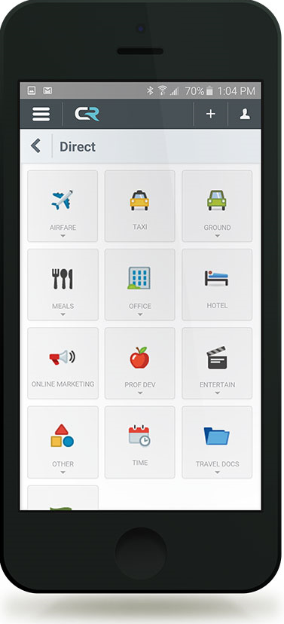
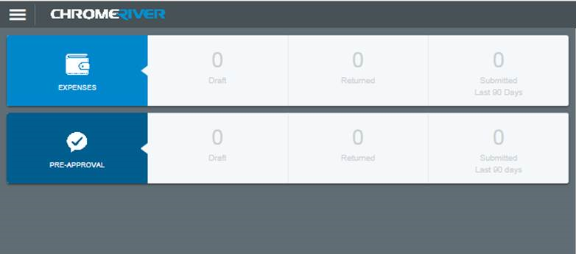
Accounts Payable Improvements
Electronic and Mobile Expense Reimbursements!
New expense reimbursement software, Chrome River
  Will be available on the web/phone/tablet
  No more check requests!
Upload and categorize receipts
Route for approval (based on Cost Center)
Employees will be reimbursed through payroll.
  BU employees will still be reimbursed through AP

Slide 12
Reporting Improvements
Financial Data Warehouse
Parameterized Reports
Easier to find
Filter Reports based on user parameters including Cost Center & Project
Use a single report with different filters for consistent reporting
Fewer Reports required
Wider use for new reports
GL Detail Account Data from 2018
Sub-GL Transaction Data from 2018
Reporting for Departments will be easier to access as it’s more centralized.
Standardized reporting formats
Existing reports will still be available for 6 months after Go Live (10/1/20)
Notes:
Does this group care about historical information? How should it be emphasized? Yes let’s discuss
Analysis – Access by Cost Center & Project? (Chris Banks)
Check on cubes for PI’s and the external community BSR drillable report will be available to PIs and Administrators with improved accuracy and usability

Slide 13
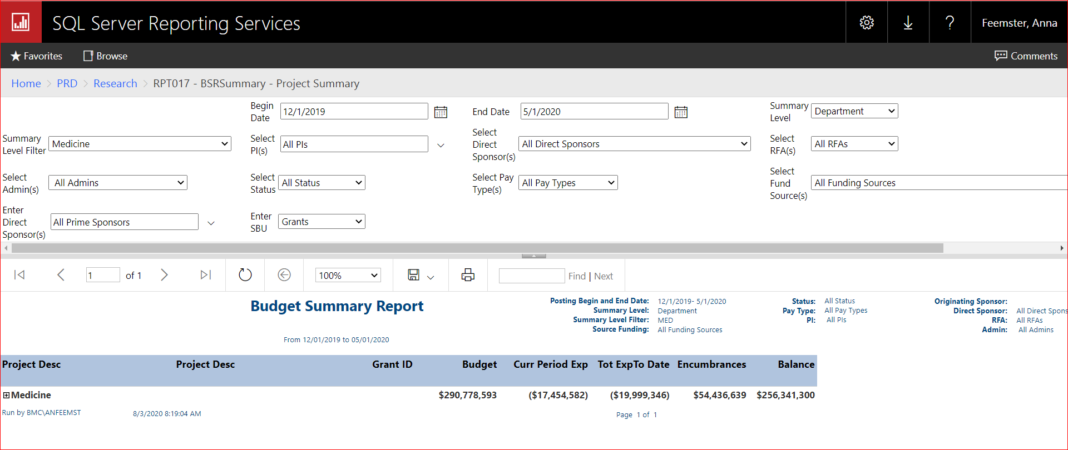
*Update* Reporting Example – Budget Summary Report (BSR)
Notes:
Reduced from 10 reports to 3
Single Point of Entry

Slide 14
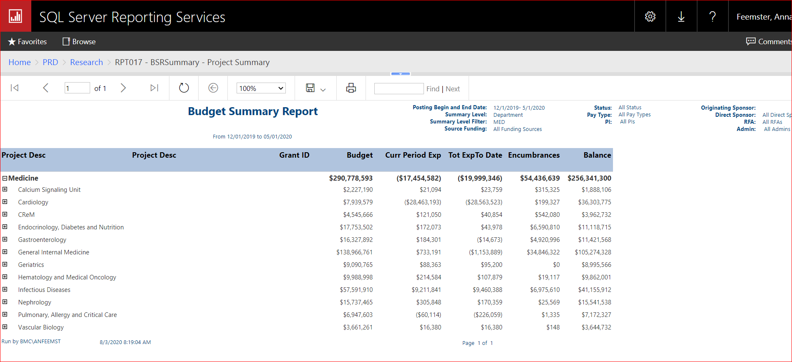
Reporting Example – Budget Summary Report (BSR) Drilldown 1
Notes:
Reduced from 10 reports to 3
Single Point of Entry

Slide 15
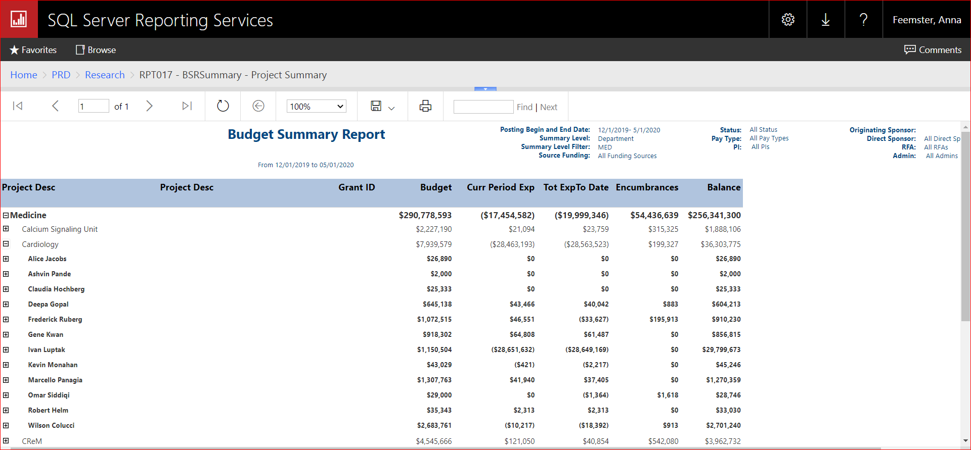
Reporting Example – Budget Summary Report (BSR) Drilldown 2
Notes:
Reduced from 10 reports to 3
Single Point of Entry

Slide 16
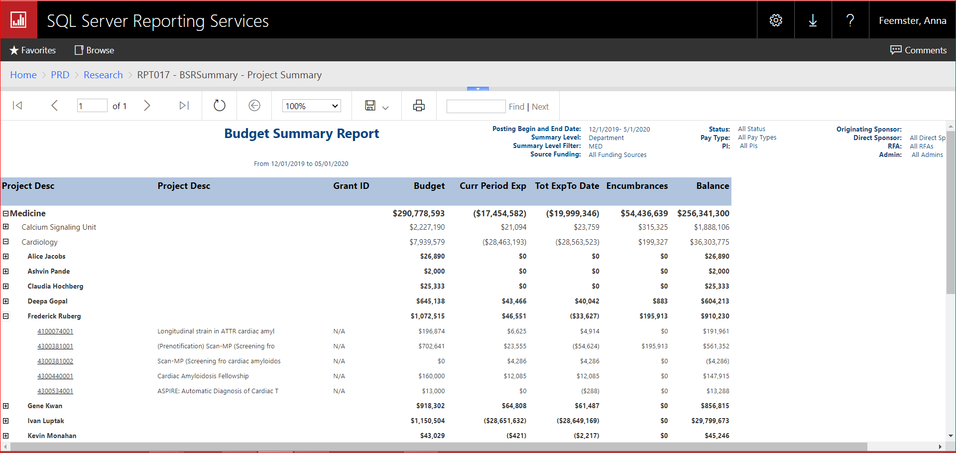
Reporting Example – Budget Summary Report (BSR) Drilldown 3
Notes:
Reduced from 10 reports to 3
Single Point of Entry

Slide 17
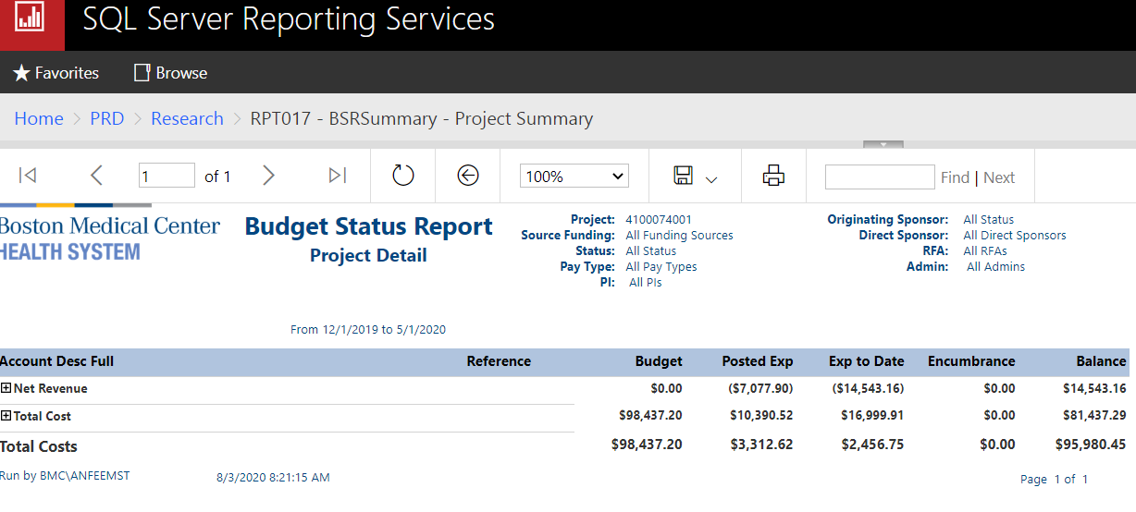
Reporting Example – Budget Status Report: Project Detail
Notes:
Reduced from 10 reports to 3
Single Point of Entry

Slide 18
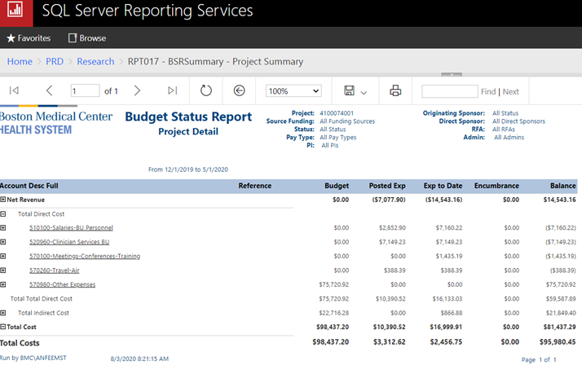
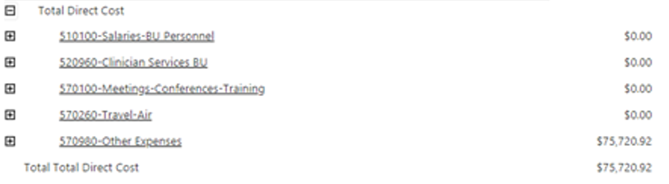
Reporting Example – Budget Status Report: Project Detail Drilldown 1
Notes:
Reduced from 10 reports to 3
Single Point of Entry

Slide 19
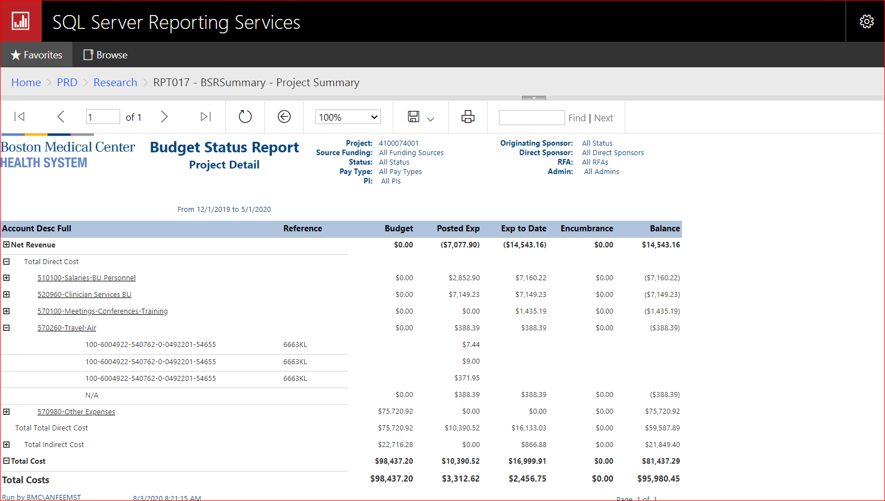
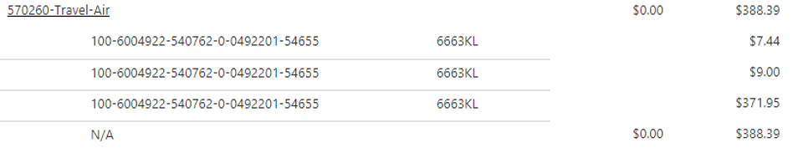
Reporting Example – Budget Status Report: Project Detail Drilldown 2
Notes:
Reduced from 10 reports to 3
Single Point of Entry

Slide 20
Grants & Funds Specific
Overview and Next Steps

Slide 21
General Ledger Design
Company – Co1 ‘BMC and Other Entities’
Cost Center – 10201100 ‘’Grants’ and 10201200 ‘Funds’
Detail Account – Detail account from Chart of Accounts
Provider – N/A for projects within “Grants” and “Funds”
Project – Posting Project number associated to each Grant/Fund; ‘Activity’ is the current state equivalent. All Projects are 10 digits. Grant Projects begin with a “4” and Fund Projects begin with a “5”.

Slide 22
Ledger Changes - Activity (Projects) Changes Grants / Funds
Project Grants
 |  | Company | AU | Description | Detail Account | Subaccount | Description | Activity | Description | Account Category
Old |  | 100 | 6001006 | Ma Ctr For Sudden Infant Death | 519030 | 0000 | Consultants | 0101623 | Ma Ctr For Sudden Infant Death | 52030
 |  | Company | Cost Center | Description | Detail Account | Subaccount | Description | Project | Description | Account Category
New |  | 1 | 10201100 | Research & Grants | 550250 | N/A | Consulting Expense | 4300000023 | Ma Ctr For Sudden Infant Death | N/A
Project Funds
 |  | Company | AU | Description | Detail Account | Subaccount | Description | Activity | Description | Account Category
Old |  | 100 | 6520036 | Grow Clinic Special Fund | 5419030 | 0000 | Consultants | 0652036 | Grow Clinic Special Fund | 52030
 |  | Company | Cost Center | Description | Detail Account | Subaccount | Description | Project | Description | Account Category
New |  | 1 | 10201200 | Funds | 550250 | N/A | Consulting Expense | 5205001801 | Grow Clinic Special Fund | N/A
Notes:
Update Title to Grants/Funds instead of Research Grants

Slide 23
Training Plan and Schedule

Slide 24
Training
 | What | Comment
Began Aug 14th | Training Sign-ups | Workday for Virtual ILT, Sims and e-Learning SharePoint site and email address for Questions
Aug 24th-Oct 15th | Training | Training will go several weeks post go live for refreshers, new hires, make up, absentees, etc.
Nov TBD | Report Training | Grant specific report training
JUL
AUG
SEP
OCT
~
Cut Over
10/1
Go Live
Month End Close Support
Early August
Instructions
Training Sign-ups
Starts Aug 14
Training
Aug 24 – Oct 15th
E-Learning available 8/14
Post Go-Live &
Refresher Training
Oct 15 – Late Oct
Notes:
Reporting only Research specific training and that won’t be until Nov – rest of training applies to everyone (explain 2 waves of training and enrollment)

Slide 25


BMCHS Training Site
  Infor and related financial systems Training Site
  (https://share.bmc.org/InforAndRelatedFinancialSystemsTraining/default.aspx)
Notes:
Link to site, examples on next slide Add Workday link and PPT to find classes

Slide 26

BMCHS Training Site
Class lists and Schedules
eLearning: Web based training & walkthrough
User Friendly SharePoint Site
Virtual Instructor led Training via Zoom
Exercise guides for specific Infor functions
Online and Virtual job training
Job-aids with step by step instructions
Online sign up and training registration
Detailed materials stored for future reference
Simulations
Notes:
Exercise guides for specific Infor functions
Flow-wise – Does it make sense to put in order: Class Lists & Schedule, Sign-up, Training, SharePoint foes with Exercise, etc.

Slide 27
User Training
Training will be available for all aspects of Infor and complementary systems
  Information about training options and schedules will be available.
  Curriculum descriptions are available.
  SharePoint site available for information, updated as go live approaches.
INFOR-Cloud-Training@bmc.org – email address for questions, monitored.
Who will need training and why?
  Most non-Finance users will require training in limited areas
    Staff who create requisitions will likely be creating requisitions in Infor.
    Invoice entry automation may eliminate the need for some user access.
    Electronic invoice approvals will require system access and training.
    Approvers will likely be approving in Infor.

Slide 28
User Training – Courses Needed
Do you requisition or order services, goods and supplies?
  Course: Infor CSF Requisition Processing with RSS Receiving
Do you approve requisitions?
  Course: Infor CSF Requisition Approval
Do you approve AP invoices? This process is now automated.
  Course: Infor CSF Invoice Approval (eLearning available)
Do you submit check requests for Goods and Services?
  The new Infor software provides electronic Invoice approval.
  Therefore, AP check request are no longer needed and no training is required.
Do you submit for reimbursement of travel and expenses?
  Infor CSF: Chrome River Introduction
Do you use reports?
  Research specific Reporting training will be available in November
INFOR-Cloud-Training@bmc.org – email address for questions, monitored.

Slide 29
Next Steps….
Old to New Mappings
  Will provide the following:
    Old to new G/L strings
      Accounting Unit to Cost Center
      Projects (old to new numbering)
      Detail Accounts plus a Glossary describing usage
Training
  Grant and Fund Team Specific
    Reporting
  BMCHS-Wide
    Accounts Payable
      Centralized AP Invoice receiving
      Automated AP Invoice approval
      Travel & expenses (Chrome River)
      No more check requests
    Reporting
    New end user forms (e.g. request of new accounting unit/access to systems)
Notes:
Company-wide Glossary

Slide 30
Appendix - Infor Training
Tips to Find Information in Workday

Slide 31
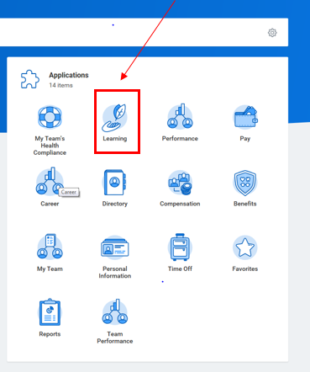
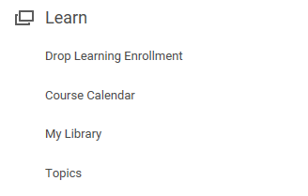
Workday - How to Access Courses
Go to Learning
Then Topics

Slide 32
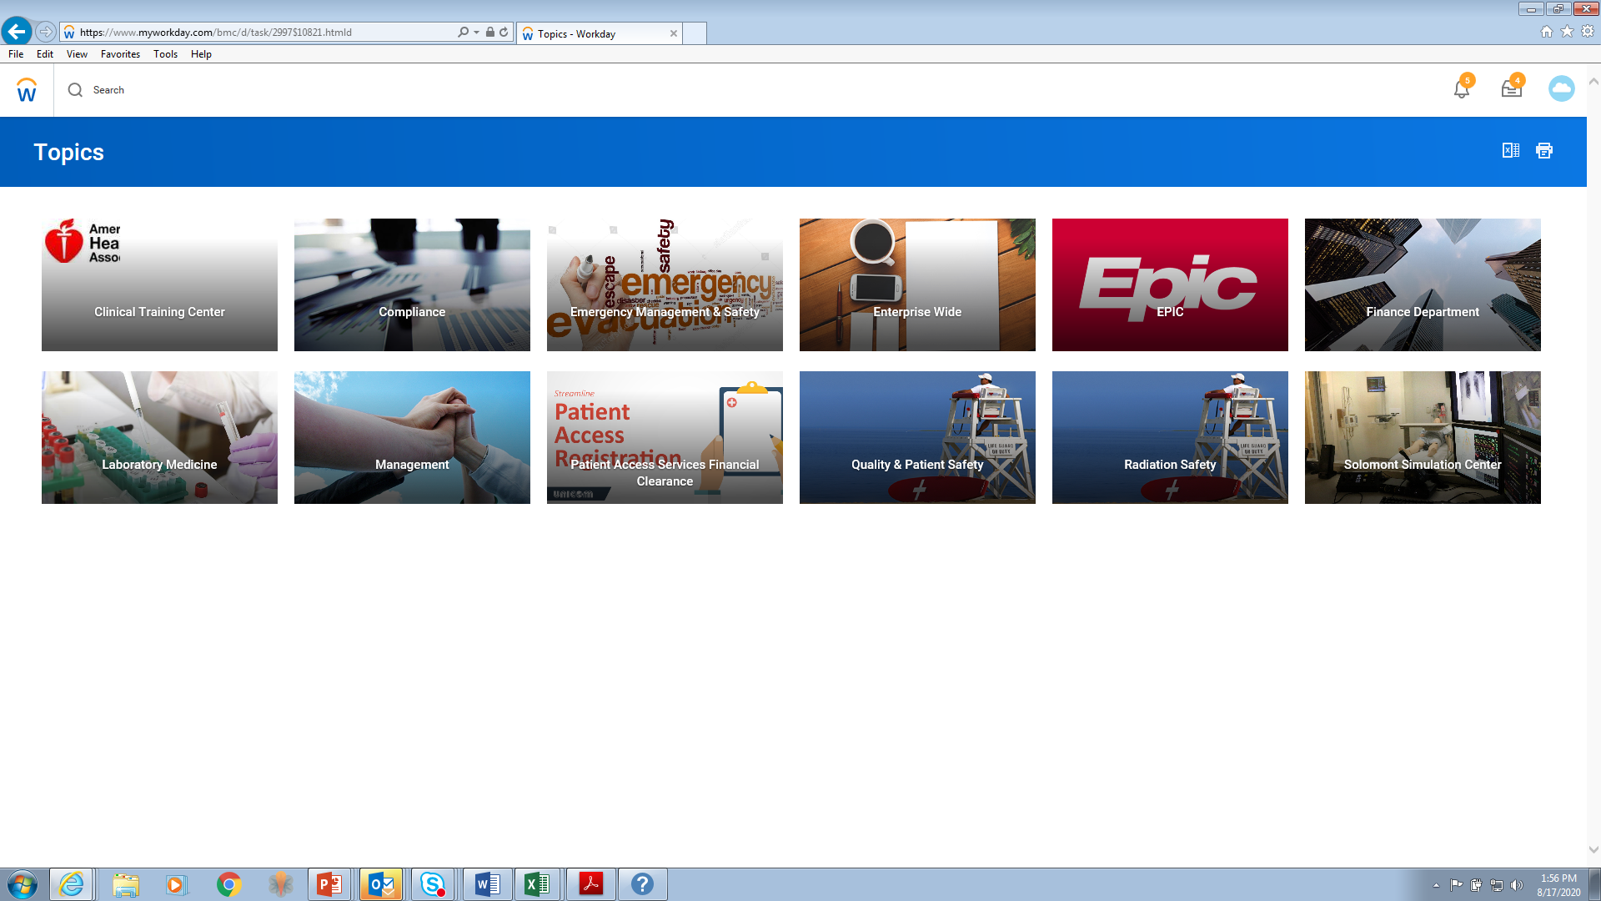
Workday - How to access Courses cont.
Select Finance Department

Slide 33
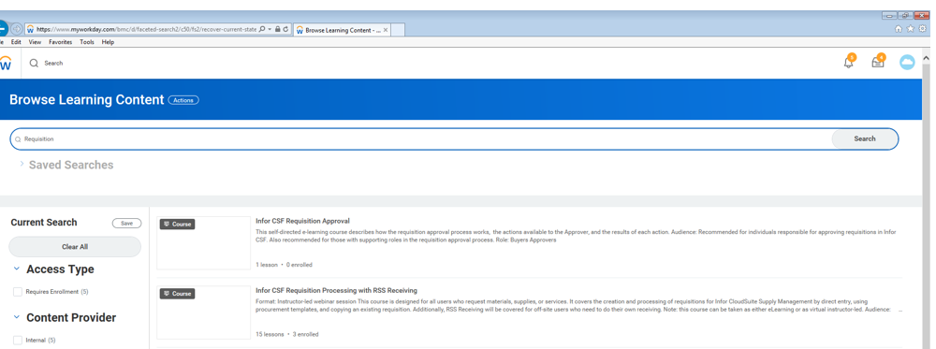
Search to find courses – example
Typing in Requisition in the search box brings up:
  Requisition approval course and
  Requisition processing course

Slide 34
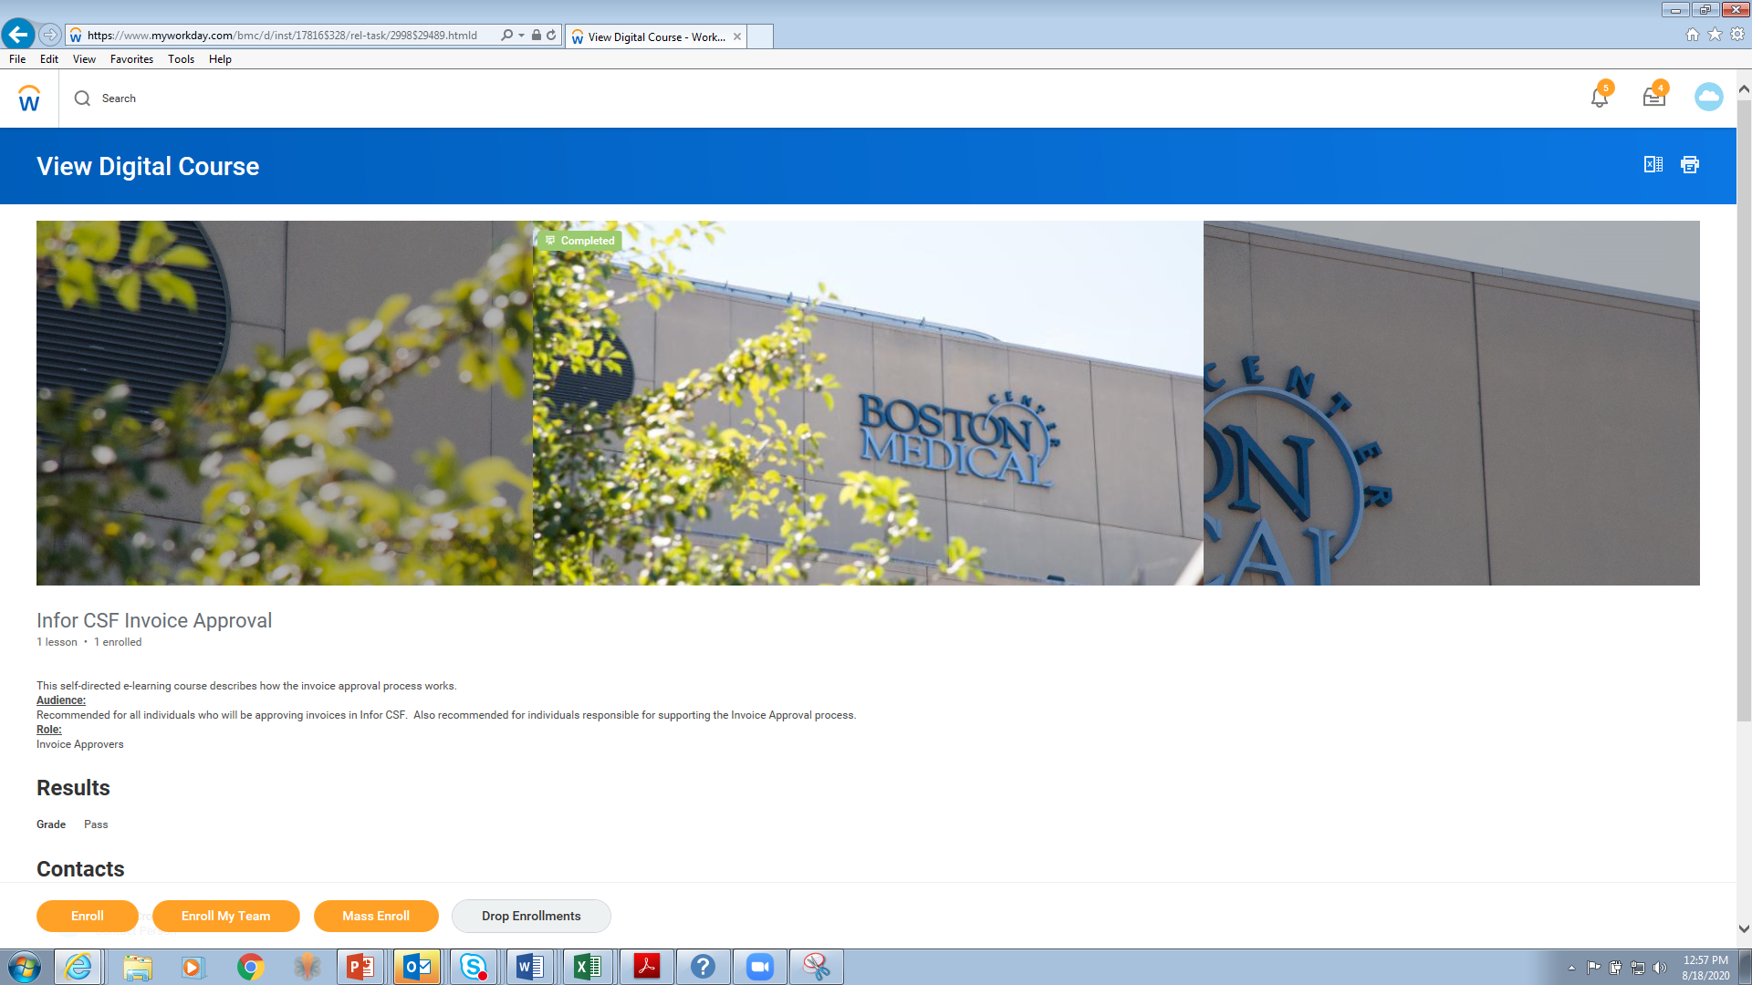
Example of an e-learning course – Enroll and take the course

Slide 35
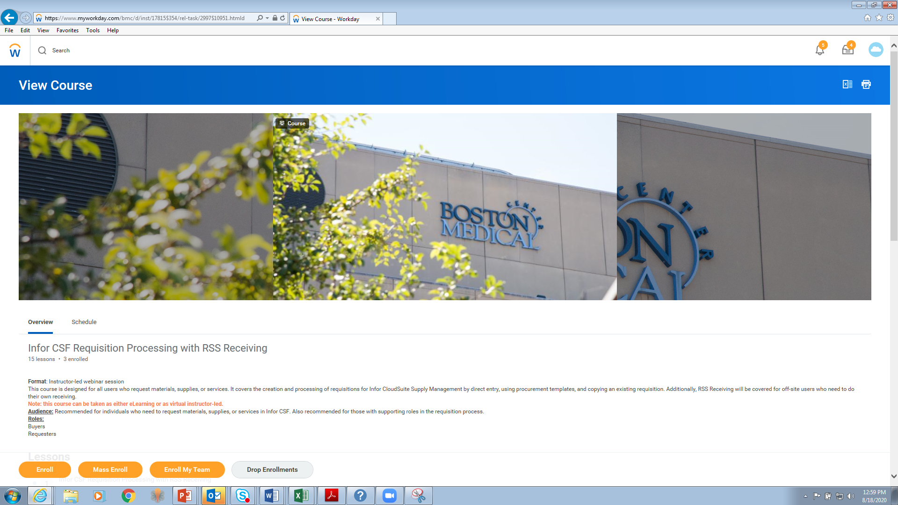
Example of Virtual Instructor Led Course – Enroll, pick time option

