Slide 1
NIH Other Support & Biosketch Updates
NIH Notice, NOT-OD-21-073, contains policy points and includes links to other references that include further policy points.
Effective May 25, 2021 – Other Support & Foreign Contracts Updates
Report resources and/or financial support from all foreign and domestic entities, that are available to the researcher. Examples: laboratory personnel; high-value, rare materials (e.g., biologics, chemical, model systems, technology, etc
Report supporting documentation, which includes copies (translated; machine-read ok) of contracts, grants or any other agreement specific to senior/key personnel foreign appointments and/or employment with a foreign institution for all foreign activities and resources
providing consulting agreements when the PI will be conducting research through the consulting,
In Kind Contributions: Materials (data, samples, etc.) from external collaborators: list source, summary description, and value (estimated ok) or estimated time commitment/effort
PI/PDs need to sign their Other Support pages.
Immediate notification of undisclosed Other Support. Of PI or other Senior/Key personnel on an active NIH grant
Effective January 25, 2022 --New Biosketch requirements
Personal Statement: include ongoing and completed research projects from the past three years that you want to draw attention to (previously known as research support)
Positions, Scientific Appointments, and Honors: In reverse chronological order, include all positions and scientific appointments (domestic and foreign),including titled academic, professional, or institutional appointments, whether paid or unpaid, and whether full-time, part-time, or voluntary/honorary
NIH notice, Biosketch and Other Support templates posted on Research Operations website

Slide 2
Clinical Trial Office
Going back to basics

Slide 3
CTO is moving beyond COVID focused research and going Back to Basics
Prior to COVID, CTO was designing and implementing new customer service based initiatives
CTO played an integral part in implementing the COVID research program at BMC
Transitioned ACTIV Network trials and Community Engagement to Clinical Research Network
COVID research is less time intensive, allowing CTO to return to process improvement projects
Current initiatives being discussed today:
  Continue to encourage efficient communication across G&C and CTO for overlapping trials
  Improve communications on roles, responsibilities, and pre-award timeline expectation
  Centralize Ancillary Service tracking
  Create CTO live education: ClinCard, VelosCT/Epic, Other- looking for input

Slide 4
Back to Basics continued
Additional initiatives:
  5. Update departmental monthly meetings agenda – start April/May
    Trigger expense discussions
    Use new milestone tracker (summer)
    Review new Ancillary Services summary and forms
  Implement pre-award status checklist / Create Velos Status reporting for study teams to be award of current pre-award tasks
  Identify unique BU and BMC cross institutional clinical research areas for process improvement and develop solutions
  Collaborate on urine pregnancy discussions
  Aid in development of research encounter hospital and professional charge codes
  Provide TriNetX support
  Support VNA conversations to identify one partner for applicable clinical research protocols
  Engage in pipeline conversations with sponsors
  Incorporate community engagement costs in budget negotiations
  Include research requirements in Infor implementation, SOPs, training, reporting
  Create clear roles and responsibilities chart for CTO, department administrators, and study teams

Slide 5
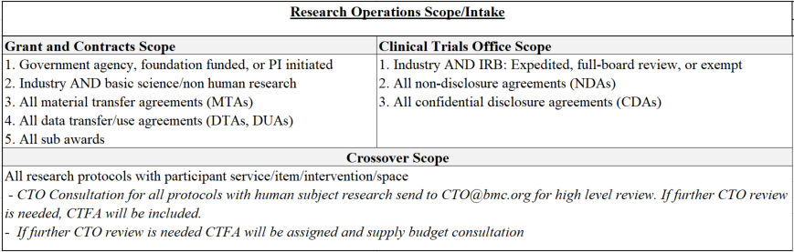
Research Operations Scope for Grants & Contracts and CTO
Note: all internally funded trials with patient care charges must go through Velos

Slide 6
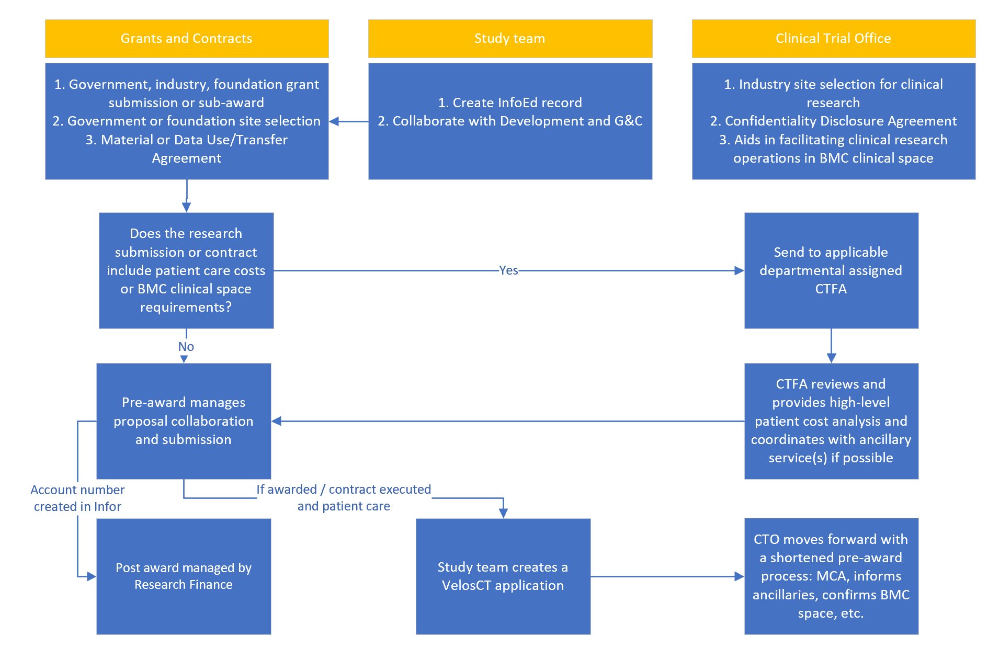
Crossover: Grants & Contracts and CTO decision tree

Slide 7
Industry sponsored clinical trial financial lifecycle; CTO collaborates with department administrators, study teams, and ancillary services
CDA / NDA Intake
Study Initiation in Velos
CTO WIP
Awarded or Executed
Active
Close-out
MCA
Budget
ICF Injury language
CTA
Ancillary Service(s)
Patient care costs
Invoicing and expense tracking
Collection
Reconciliation
Amendment
Reporting
Research Billing: Velos and Epic

Slide 8
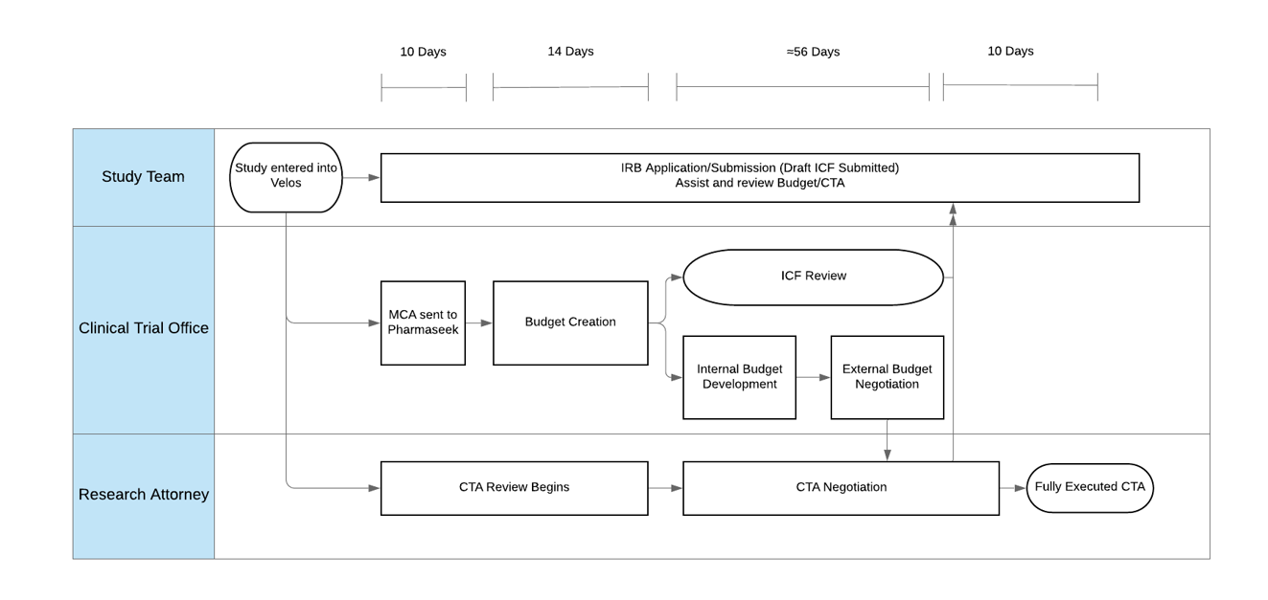
Pre-award timeline, return to pre-COVID expectations

Slide 9
The Clinical Trial Office coordinates with study teams and ancillary services for budget development, contract review, and workflow development
CTO
Research Attorneys
CDA/NDA, CTA, remote access MOU
Radiology
Medical Coverage Analysis*
Epic Research Billing and VelosCT*
Investigational Pharmacy Services (IPS)
Ophthalmology
General Clinical Research Unit
Pathology / Laboratory Medicine
Marketing
Informed Consent Translation*
For non-Research Operations managed services, study teams can decide if they would like CTO to manage discussions or not
Creating central website location to list all Ancillary Service contacts and forms
Designing Velos to track protocol required Ancillary Service needs
Confirm pre-award status with departmental administrators during monthly meeting
* CTO managed service

Slide 10


VelosCT/Epic, used for CTO intake AND Research Billing Compliance
What studies are Required to Use VelosCT?
All research that requires a service or intervention occurring within Boston Medical Center space, regardless of funding source
All clinical research that is managed by the CTO, used for intake and may be used for research billing
Some protocols may choose to use VelosCT to track participant enrollment but not used for research billing- this is optional
What Is VelosCT and Why Is It Important?
Connects financial, administrative and clinical research activities to help better manage research studies
Helps to ensure compliant billing to Medicare and other 3rd party payers
Enrolling/Associating Participants To VelosCT Calendar and Updating Visits
Participants must be enrolled within 24 hours of the research visit, and associated to calendars with visits updated within 24-48 hours of when they occur
    Failure to do so could result in the following billing compliance issues:
VelosCT Study Setup Overview
Adding participants to the study
Updating patient schedule
Patients/insurance being incorrectly billed | Additional communication to resolve issues
Missing the timely filling limit | Audits risk/findings
Mistrust with our patients | Confidentiality breech

Slide 11
CTO Education Opportunities
Hyperlinks or contact listed below:
CTO website
Velos and ClinCard education series will be held monthly
Self administered VelosCT training
MCA/Velos Determination Checklist
CDA/NDA submission
Remote Monitoring Workflow
TriNetX support information- contact Minhao.Yin@bmc.org
Research re-start, remote monitoring recent communication
Comments and questions welcome
clinicaltrialoffice@bmc.org

Slide 12
Clinical Research Network Overview
April 12, 2021

Slide 13
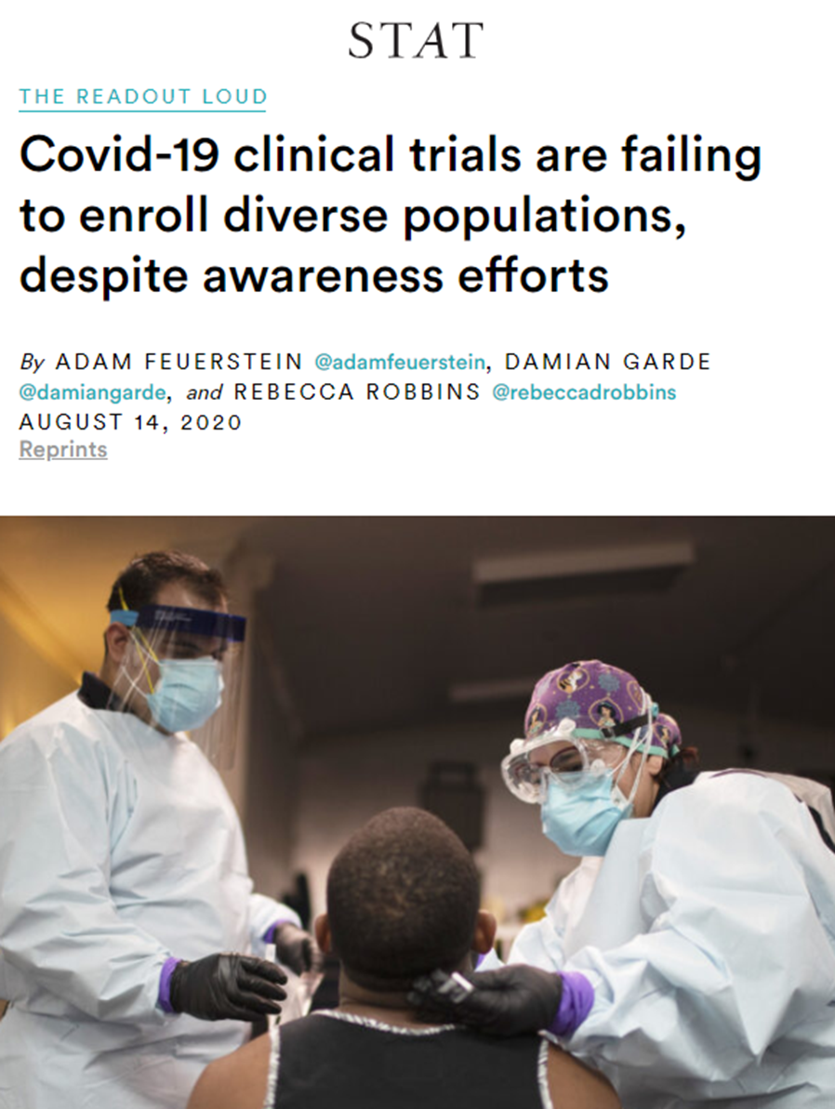

Disparities in access to clinical trials persists

Slide 14
New Research Infrastructure April ‘20- Mar ’21: a multifaceted stakeholder approach to succeed
COVID Scientific Review Committee
  Dedicated COVID scientific review committee to review feasibility, mission appropriateness & scientific merit
  Coordinated intake of COVID trials
GCRU and BMC developed a COVID Inpatient and Ambulatory research coordination program
  GCRU is a critical partner in pre-award regulatory submissions and floor/clinic research activities
  Centralized Inpatient Research Facilitator to track: not approached, approached, declined, and enrolled
New Research Biorepository
  Dedicated biorepository for the collection of research critical biospecimen samples
Addition of Investigational Phlebotomy Services
  Protected research resources to support clinical trial blood collection
Flagging of Research Patients in Epic
  Supported billing compliance and visibility of patients undergoing research to clinical teams
  Developed remote EMR access for monitors process ChartLink
Notes:
Due to the fast paced nature of COVID-19 research, BMC made a conscience decision to prioritize the ACTIV trials, through the CTSI Trial Innovation Network (TIN) because 1. Trials were evolving with clinical decision making over time 2. Increased academic pursuit 3. centralized ACTIV leadership vs. individual pharma companies randomly applying INDs with pre-existing drugs

Slide 15
New Research Infrastructure April ‘20- Mar ’21: future of BMC clinical research is inclusive
Identified immediate diversity and inclusion budget gaps across COVID trials
  Organized consent translation in 4 primary languages and collaboration with interpreter services
  Suggested transportation services in addition to participant stipend
  Collaborated with marketing and communications
Hosted two interns from Urban College of Boston (UCB) in Michael Paasche-Orlow’s team
  Independent, non-profit 501(c)3 co-educational two-year college established to provide the opportunity for post-secondary education and professional advancement to those in the urban community traditionally underserved by higher education
  UCB enrolled student body is 82% Black or LantinX, ~2/3 are learning English as a second language. Urban College grants an Associate of Arts degree as well as Certificate programs in 11 areas
  In 2020, Urban College launched a new program entitled The Research Apprenticeship Multicultural Partnership (RAMP) Program at Urban College of Boston. The RAMP Program leads to an academic certificate in Clinical Research Coordination and is aimed at training the next generation of clinical research professionals
Created Clinical Research Network – March 2021
  Determined by COVID-19 physicians and administration that ACTIV trials would become BMC’s priority
  Implemented dedicated team to oversee the NIH sponsored ACTIV studies, due to under resourced PIs
  Committed to improving diversity in research; engage BMC’s underserved population through ACTIV
Notes:
Due to the fast paced nature of COVID-19 research, BMC made a conscience decision to prioritize the ACTIV trials, through the CTSI Trial Innovation Network (TIN) because 1. Trials were evolving with clinical decision making over time 2. Increased academic pursuit 3. centralized ACTIV leadership vs. individual pharma companies randomly applying INDs with pre-existing drugs

Slide 16
COVID-19 Study Summary – Active/Completed Studies: 25 as of April 9, 2021
Notes:
Red star = ACTIV Network trial

Slide 17
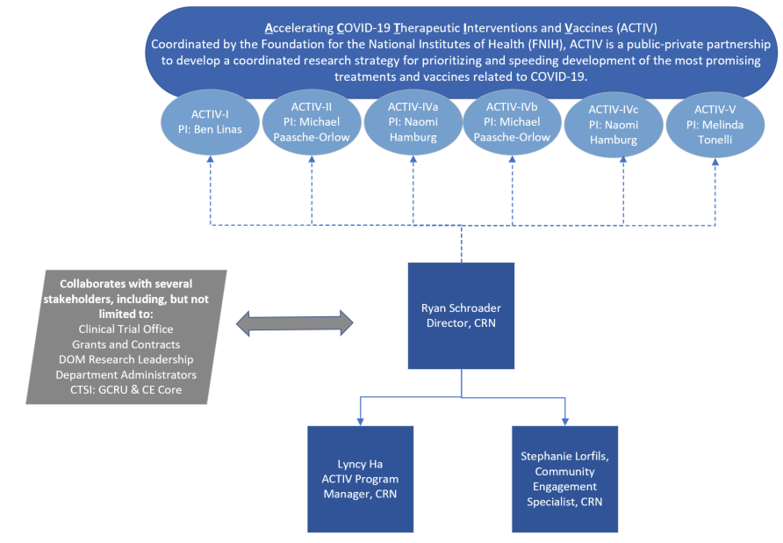
Clinical Research Network structure
Notes:
Important to note that ACTIV opportunities and PIs will change overtime. But each comes with their own source(s).
https://www.nih.gov/research-training/medical-research-initiatives/active

Slide 18
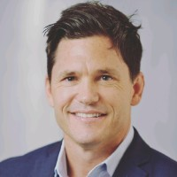


Clinical Research Network Team
Clinical Research Network (CRN) Mission: Develop a community engagement and equity support structure to ensure BMC is a world class research organization and is inclusive of our diverse patient population for the ACTIV trials.
Scope of the CRN:
Oversee lifecycle of the ACTIV COVID Research Trials
Develop and deploy an ACTIV trial Community Engagement strategy with BMC care providers and patients
Ryan Schroeder
Director, Clinical Research Network
Lyncy Ha
ACTIV Program Manager
Stephaie Lorfils
Community Engagement Recruitment Specialist

Slide 19
Community Engagement ACTIV investment opportunities
Ground water infrastructure |  | Study specific costs
CE Networking within BMC health system |  | Pre-screening- 20:1 ratio of pre-screen to enroll
Community Health Center outreach |  | Food vouchers per occurrence
CTSI engagement workshops |  | Transportation vouchers per occurrence
Boston Health Equity Research Network (BHERN) connection |  | Consent translation per translation, preference is 4 languages
Demographic metrics reporting infrastructure creation |  | Interpreter support per occurrence
Nursing, physician, and patient engagement |  | Establish time and effort estimates to compensate for lower patient engagement: conversation to enrollment ratios
Study team outreach |  | Childcare support for visit completion
General marketing campaign to rebuild trust |  | Patient stipends
Community Advisory Board |  | Marketing materials
Patient Advisory Groups |  | Community Ambassadors to speak at community events and community centers

Slide 20
Vision for the Future of Research at BMC
BMC is a high performing site within leading edge research across all primary clinical areas
Culture of research where physicians, nurses, staff and our community of patients understand and communicate the importance of diversity and inclusion in research
BMC is a national leader and model institution where our intentional efforts to engage the community at every phase of research is reflected in the diversity of our clinical trial enrollment
Our adoption and use of technology, and our role in establishing industry best practices demonstrates our commitment to innovation and reduces the burden of research participation for our patients

Slide 21
The NCDW
(The NEW Clinical Data Warehouse)

Slide 22
Advancing Health Equity through Data
Foundational to Aspirational
Data governance, access, management, linkage
Data self-service, cloud-based access; claims data for research
D4E initiative
Quality, meaning, transparency of data; coordination with clinical operations
Science to Logistics

Slide 23

Foundational Logistics: Efficient and Transparent Processes and Procedures
Improved processes for requesting data and monitoring revenue
  Revised online interface captures information from data requestors efficiently, without redundancies to other systems
  Tracks incoming data requests to help CDW analysts work more efficiently
Online billing and project tracking
  Allows CDW to project it’s yearly revenue and plan strategically
  Minimizes cost-shifting from departments to CDW
Transparent Policies and Procedures
  Procedure manual
    Guidance on scope of CDW services
    Transparent logistic (e.g. data requesting, billing) and scientific procedures
  Assist data requestors with requests that translate into accurate data and reliable results
  Develop standard operating procedures to support data access, quality, reliability, confidentiality, and distribution
Metrics Dashboard
  Visualization of metrics including wait times
Notes:
CDW REQUEST FORM
New data request form examples: clarification & streamlining throughout form, including in funding section; capturing if a request is for multiple extractions over time; identifying primary contact if not PI.
P&P
The purpose of this Procedure Manual is to communicate the policies and procedures by which the CDW fulfills its mission to provide investigators with high quality, reliable data and to provide guidance for investigators requesting CDW data for research data.
Two goals:
#1. Speak to Requestors –
Document what they can, and cannot, expect from the CDW
Document the process to request data
Provide useful information requestors can refer to during the life cycle of a CDW request (request form through data delivery) and set expectations appropriately
Documents other vital resources on campus (TriNetX, BEDAC, CTSI, etc.)
#2. Speak to CDW Team/Analysts –
Document policies for analysts to follow to bolster standardization across the CDW team
Document new polices that will be enforced, and act as a reference guide that clearly states our policies, particularly on new policies that will be enforced as a product of the CDW coming under BMC

Slide 24
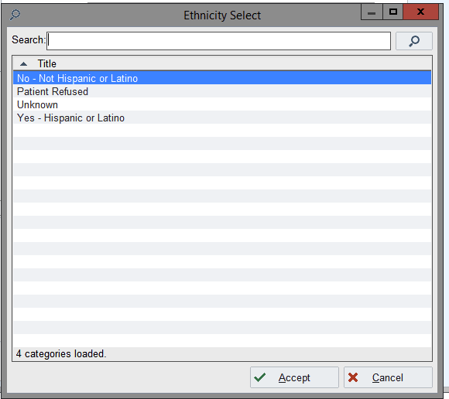
Foundational Science: Quality, Meaning and Transparency of Data
Options for selecting “ethnicity” in the demographics tab in Epic – example highlighting problems at the point of data entry
Data are entered (My Chart, Front Desk)
Based on data in EHR, there are four options for “ethnicity”

Slide 25
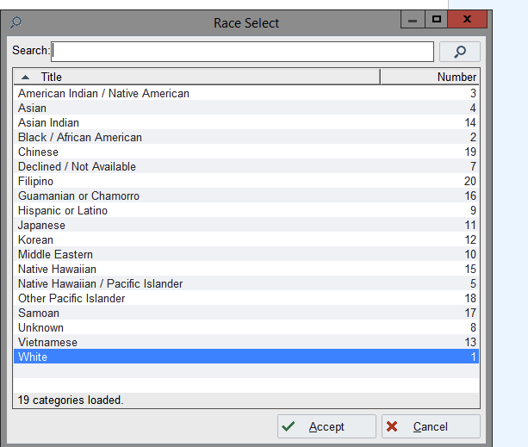
Foundational Science: Quality, Meaning and Transparency of Data
Options for selecting “race” in the demographics tab in Epic
19 options for “race”
“Hispanic or Latino” recently added to this list
This classification system is inconsistent with what the NIH and CDC recommends
Mismatch between ‘the BMC way” and other national standards has implications for health equity research

Slide 26

Foundational Science: Problems in classifying people by race or ethnicity
Conflicting Information. Real patient examples from Epic (N=11,450):
CDW team faces decisions about race/ethnicity data interpretation
  Example: in a CDW project addressing food insecurity screening and food pantry referrals among 14,000 patients, ~30% have potentially conflicting race, ethnicity and ethnic origin data.
  Decision rules for interpretation of conflicting information
    How do we categorize people when BMC includes “Hispanic/Latino” as a race?
    Look at language preference, birth place, country of origin – and create an algorithm?
  Essential to work with clinical operations to reform the system beyond the CDW

Slide 27
Foundational Science: CDW Solutions
Establish standardized workflows to ensure data quality, consistency, and efficiency
  Cultivate key partnerships across the medical campus to enhance understanding of nuances of data collection (e.g., pharmacy, clinical operations, patient registration, billing, THRIVE screening, food pantry, patient navigation, interpreter services, etc.)
  Development of standardized approaches to key health equity variables (e.g., race/ethnicity, THRIVE screening, identification of persons experiencing homelessness, language barriers/interpreter use, etc.)
  Development of BMC-tailored methods to identify special populations (e.g., identifying patients with substance use disorders through orders for Addiction Consults, prior OBAT visits, and inpatient orders for withdrawal monitoring in addition to ICD10 codes)
  Advisory Committee
    Rebecca Mishuris
    Allan Walkey
    Tuhina Neogi
    Jake Nudel
    Bill Adams

Slide 28
Aspirational Processes to Facilitate Research: data availability and access
Expand the data available within the CDW
  Establish streamlined agreements with Community Health Centers to facilitate access to local data for health equity research
  Expand access to location-based social determinants of health data currently housed at BUSPH (e.g., geocoded addresses linked to neighborhood-based measures of opportunity or social vulnerability)
  CLAIMS DATA. CLAIMS DATA. CLAIMS DATA.
Expand data access through use of the cloud-based TriNetX system for identification of local and national cohorts
  Trial Connect: supports invitations for collaboration with industry-sponsored clinical trials
  Query Builder: allows exploration of BMC data via self-service “drag-and-drop” interface
  Self-service analytics: tools for more advanced queries that compare outcomes and populations to support comparative effectiveness and health services research
  Limited dataset extracts: with special permission, researchers can download BMC-specific or national limited datasets for additional local analytics

Slide 29
Aspirational Science: Data for Equity (D4E) Initiative
Goal: Advance health equity research in Boston by developing a de-identified, secure, high-performance data system that links clinical data from BMC and local CHCs with detailed data about where patients live
Specifics
  Establish the BMC D4E data platform by converting our existing informatics framework into a more flexible model connected to a national research community
  Join the OHDSI (www.odhsi.org) national research community to leverage existing informatics tools, knowledge and resources
  Augment existing clinical data with additional data sources and linkages:
    BMC CDW: Geocode all addresses and link clinical data with BMC HealthNet claims
    D4E: Include census tract and zip code-level SDoH and air quality data
  Explore potential for D4E to link persons living in the same household
  Expand D4E to include Boston HealthNet CHCs
  Engage 2-3 pilot user groups within BMC/BU to submit specific project proposals and use the system for health equity research projects.
  Move local installation (server and workspace) into a HIPAA compliant cloud-based framework to support scalability and expanded research use

Slide 30
Infor FSM
Financials and Supply Management
Status Update
April 2021

Slide 31
Background Refresher
  The Lawson system was end of life after 20+ years and was re-implemented with the newly developed Infor system, on 10/1/20.
  This replaced the Finance, Supply Chain, Accounts Payable functions. A new Research module was implemented as well
  Several related systems had to be implemented along with Infor
    Chrome River – employee reimbursements
    MHC document management software
    Financial Data Warehouse
  This newer version is being improved and updated monthly on the 3rd Sat of the month automatically.
    The updates can be significant.
    Release notes are received 1.5 weeks prior to implementation and BMC reviews them for impact and notification as necessary.

Slide 32

Refresher – Systems Impacted
NEW
MHC
Doc Mngt
NEW
Strata Decision Support/ from EPSI Cost Acct.
Epic Revenue
Epic OR Supplies
GHX
EDI
Banks
NEW Clinical Bridge
NEW Chrome River Expense
Optum
McKesson
Abeo Anesthesia
NEW VitalAxis
Infor
InfoEd
Grants
Kronos
NEW
Financial Data Warehouse
SAP BU
NEW
Strata
Capital
Workday BMC
StrataJazz Budget
Workday
Health Plan
Note: HP Workday has been
consolidated into BMC workday as of 1/1/21.
Notes:
Bigger icon for unnecessary groups and delete icons unused systems

Slide 33
Post go-live: Prioritization of work and issues
Ensuring back end processes that affect patient care work smoothly e.g.
  Requisitions getting processed and approved
  PO’s are issued and sent to vendors for procurement of goods
  Invoices moving through the steps to payment
Access for users
  Ensuring users have access to the systems and information they need
Month-end / Financial information
  Focus on data files as they move through processing
  Addressing any data issues that may become clear or arise e.g. mapping issues
Focus on refinement of processes that impact the enterprise
  New on line forms, and information requirements are now being utilized
  With continued experience and evaluation, the need for modification will be done.
A change management process for prioritization of ongoing work with governance, scoring, tracking of inventory, estimated level of effort is in the development process.

Slide 34
Infor Access Updates and Tips
User access and reporting access
  Infor, Reporting and LDR access are all separate access and there are 2 different vendors
    Have been revisiting forms and provisioning with more experience
FIS is working on process improvement of the existing forms based on feedback to:
    Combine the user access and reporting forms into a single form
    Make it more user friendly with guidance on how to complete it
    In process now – expect to update this in the next several weeks
Dependencies for access and the steps to follow to assist you in obtaining access:
    1. Need Workday ID and BMC email address to create Infor Access
      If necessary, complete the Visiting Personnel form to obtain a Workday ID from HRIS @ VisitingPersonnelRegistration@bmc.org
    2. Active directory ticket through Service Now to create a network ID and BMC email
    address
    3. Then create a ticket for Infor access and attach the completed user access form
    specifying the access you are requesting

Slide 35
Infor Access updates and tips cont.
What | Role / description | Comments
Research assistant, need access to view Grant expense reports | Provide cost centers and/or projects needed to view in reports | Will need access to Research Home Page
If you need to create PO’s for orders in RSS | Choose the Role Requester* | E-learning course is in Workday with the overview Manual is located there Also located on training sharepoint
If you need to approve invoices and purchases | Choose the Role Approver* | You will need to designate / be a Level 1 approver
If you need to approve requisitions | Choose the Role Requisition approver | Ensure that approvers are updated

Slide 36
Other Updates
Open PO report
  Projects are in the system at the line level
  Currently no clean way in Infor to obtain a summary report by project of encumbrances
  Status:
    Some data clean up required completion and is now done
    Currently working with our reporting vendor to develop a report that will pull this information – logic under development
Training/refreshers and updates
  High need training will be available either on Workday in e-learning format or in handout/manual format
    Examples: Requisitioning (e-learning w/manual posted), Chrome River (e-learning), and others for reporting as well as tip sheets on training SharePoint
    Finalizing “keys to the car” items and updating them
  Major enhancements will be communicated and if part of these trainings will be updated
  Tip sheets will be provided for other changes and items that need to be communicated

Slide 37
Accounts Payable General Update
Transition from manual, paper based process to invoice handling through three systems lead to inevitable learnings – these will smooth out and have allowed us to evaluate steps as issues come up, but this also created slowdowns at times
FIS and Financial Operations meet regularly to review issues, including
  Correcting Approver roles fixed approvals going forward but earlier stuck approvals had to be addressed
  Regular metric tracking and review – in part to learn which metrics are most meaningful
  Alerting Supply Chain if any areas fall under them, such as older INR (invoice but not received) that needed to be cleaned up
Focused temp staff on key areas to move larger than typical numbers of invoices out for approval
Supply Chain has prioritized placing orders and ensuring the Hospital has supplies needed for patient care
  At times this has pulled them away from routine work that keep the requisition to receipt to invoice to payment process flowing smoothly
  They continue to be solid partners overall

Slide 38
Approval Flow Improvements
Changes to the requisition and invoice approval flows are in development
Requisition approval updates have been programmed and gone through initial unit testing and are in final user acceptance testing of 40+ scenarios.
Invoice approval changes to be developed, tested, and rolled out after requisition approval updates have been completed.
Item | Current | Update
No level 1 approver exists | Requisitions and invoices require manual intervention | Requisitions and invoices will move to the next level approver
Level 1 approver is the same as the requisitioner | Requisitions and invoices require manual intervention | Requisitions and invoices will move to the next level approver
More than one approval required | Approvals required more than once if the same person approves both levels | System will validate that the same person approves at the upper level, and release the requisition or invoice
Timeout | Requisitions take several days to time out. Invoices do not escalate | Requisitions will time out sooner Invoices will escalate to the next level approver

Slide 39
How you can help us
Check AP’s pages on the Hub for current information
  Invoice handling process description
  Form for vendor adds, one-time payments, and recurring payments
  Tip sheets and link to Chrome River
  NEW tip sheet on running the Vendor Distribution report, which is available on the Infor Management Reports page
    Chrome River reimbursements through AP can be seen on the Vendor Distribution report
An approval and report access listing and the change request form are available on the Infor Management Reports page
  Keep approvers for your areas updated – submit changes whenever someone starts, gets promoted, transfers or leaves
  Review approvers on the listing periodically (quarterly)
Invoice handling
  Request new vendors before sending an invoice whenever possible
  If invoices come to you, forward to BMCHS_Invoices@bmc.org as soon as possible. Invoices must be approved before they can be paid, so there will be time to review the invoice after it’s sent for approval

Slide 40
How you can help us cont.
Utilize the resources available on line that can assist
  Training SharePoint:
  http://share.bmc.org/InforAndRelatedFinancialSystemsTraining/default.aspx
Service Now Tickets
  If you have issues, please submit a ticket so that these can be tracked, addressed and resolved.

Slide 41
Appendix

Slide 42
Invoice Activity
We have seen higher invoice volumes than FY20. Other than October, each month AP has received more invoices and the average number of invoices to date has been higher than last year
94% of invoices in Infor have been paid or are ready to be paid when due
We will continue to work through invoices that need to be sent for approval, the number and average age continues to decrease

Slide 43
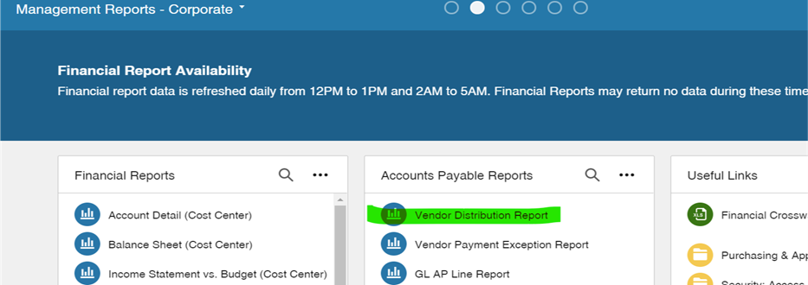
How to get to Vendor Distribution report from Management Tab

Slide 44
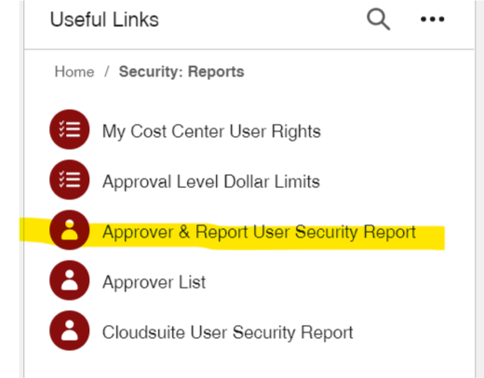
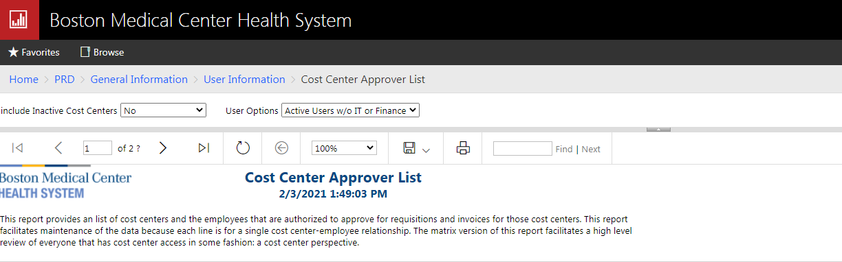
How to get to Approver List Report from Infor Home Page

Slide 45

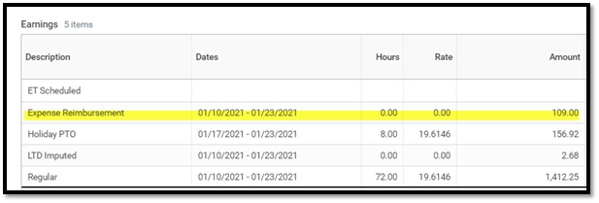
BMC Employee Reimbursement example
Reimbursement appears under earnings on paycheck

Slide 46
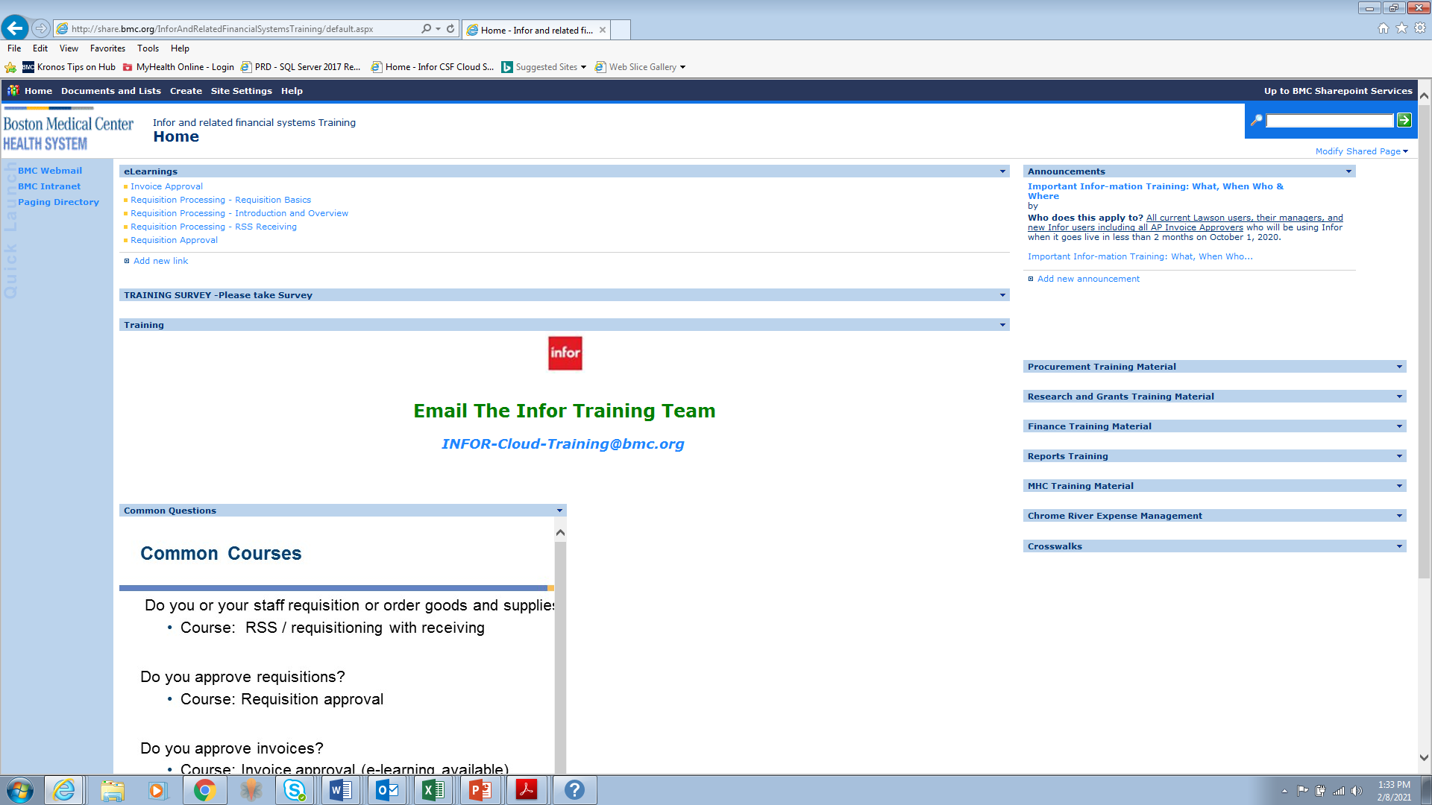
Training SharePoint

Slide 47
Open Discussion and Questions
Thank-you for attending today’s meeting!

