Slide 1
October 12th Research Admin Meeting

Slide 2
Agenda
9:00am – 9:05am
Welcome: Johanna on behalf of David Lynch
9:05am – 9:45am
Research Operations and Accounting updates with Kaity Clifford
9:45am – 10:00am
CRN Inclusive Research Practices
10:00am – 10:30am
“Minimum Necessary” and PHI with external parties with Privacy

Slide 3
Accounting Updates
Kaity Clifford

Slide 4
Research Operations Updates

Slide 5
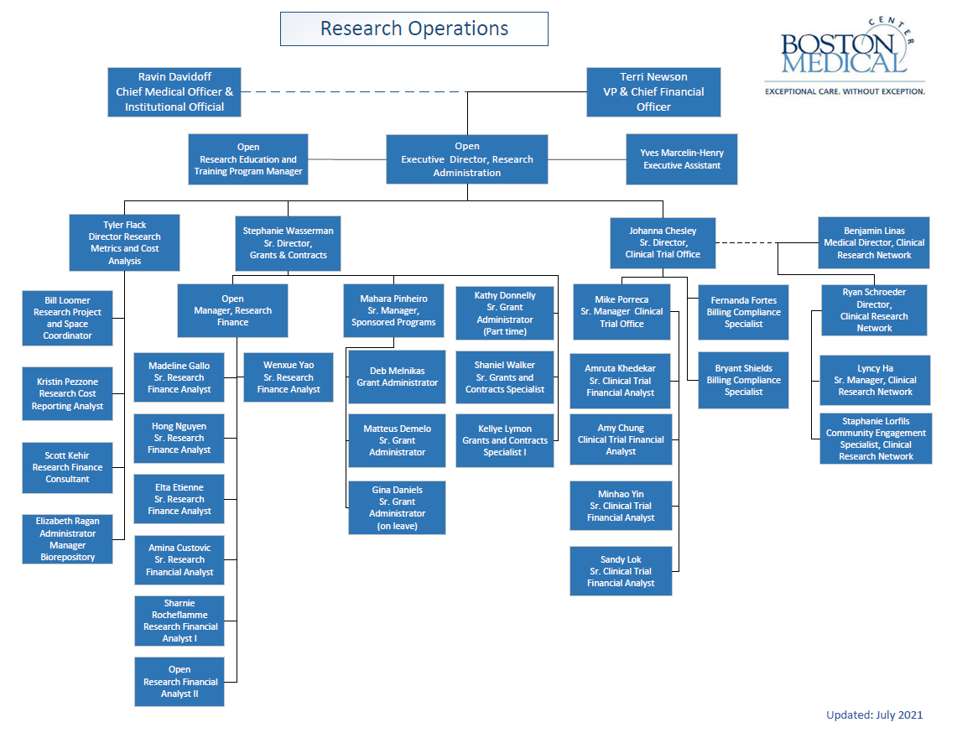
Notes:
Promotions:
Johanna and Stephanie to Senior Directors
Tyler to Director
Yao to Lead RFA
Job openings and staff LOAs
Executive Director (was Grace Cashman, interim Dave Lynch)
Research Education and Training Program Manager (new position)
Manager Research Finance (was Joanna Senteno)
Research Financial Analyst II (was ???)
Hong due to return Monday, Oct 18
Bushra completing roll file, award validation/set up

Slide 6
BMC Research Policies Reminder
BMC is audited for
presence of policies that meet regulatory requirements, and
compliance with the policies
Recurring issues in some areas
Effort Certification requires timely and accurate completion of PARS, salary over the cap recorded as cost sharing
Charging expenses to awards, must meet cost principles, applies to grants, CTs and all sponsored awards (rule of thumb, expenses should generally align with approved budget)
Notes:
Research policies
BMC is audited for whether we have policies and whether we follow these policies
Several recurring issues identified with protecting PHI, effort certification, timely and accurate charging expenses to sponsored awards
Policies are not discretionary, we cannot pick and choose which ones we want to follow
Policies are a shared responsibility, we each need to abide by them and advise others according to policy requirements
Each of us needs to become more familiar with research policies to this end

Slide 7
BMC Research Operations resources
Contact list of department administrators, finance/accounting staff
To initiate a quarterly update cycle,
Staffing changes can also be sent as they occur
Continuing Resolution
Federal government funded through 12/3
Take action on sponsor/prior approval requests (need Stephanie’s signature) to avoid pause/gaps in funding (rule of thumb, plan as though federal budget approval will be delayed for an extended period)
Notes:
Research Operations maintains a contact list of dept research administrators, finance/accounting staff, and other dept. contacts, to begin a quarterly update cycle
Continuing Resolution keeps govt funded thru 12/3, take action on sponsor/prior approval requests so there will be no pause/gap in funding, plan as though the federal budget will not be approved
Note: CR funding stopgap sustains federal agencies’ existing spending until Dec. 3, at which point Congress must adopt another short-term fix, called a continuing resolution, or pass a dozen appropriations bills that fund federal agencies through the 2022 fiscal year.

Slide 8
Proposal Submission Matrix
Stephanie Wasserman

Slide 9
Pre-Award Updates
NIH Updated Biosketch and Other Support Format Pages Required January 25, 2022
InfoEd Proposal Routing Pilot
New Proposal Review Matrix

Slide 10
Research Operations Proposal Review
Proposal review process will depend on when a final and complete application is received by Pre-Award Grant Administrator
Proposal submission policy – complete application 5 business days in advance of sponsor deadline
Proposals received later than 5 business days receive abbreviated review and no guarantee successful submission
Corrected applications

Slide 11
Research Finance Update
Recruitments:
  Sr Research Finance Manager
  Research Financial Analyst

Slide 12
Cost Analysis & Metrics
Tyler Flack

Slide 13
Single Audit Updates
OMB granted broad extensions for filing our FY20 Audit. The last day to file will be Dec 31st, 2021.
We plan to file sooner. We are waiting on KMPG’s final signoff.
We are receiving a repeat finding related to effort reporting.
  Any personnel over the salary cap must report cost share on their effort reports (AKA PARS). This has been the biggest issue for audit.
  More to come

Slide 14
Single Audit Updates
Residual Balance Policy
  All allocable and allowable expenditures have been charged to the account
  All requests for use of residual funds in a Discretionary Account must be approved by the section chief and must be used to further the institution’s research mission
  When residual funds are 25% of the total award amount received or $25,000, whichever is less, the PI must provide a written explanation for the substantial residual amount. The Associate Director of Research Finance or Director, Clinical Trial Office as applicable will review and sign all requests that exceed the aforementioned thresholds.

Slide 15
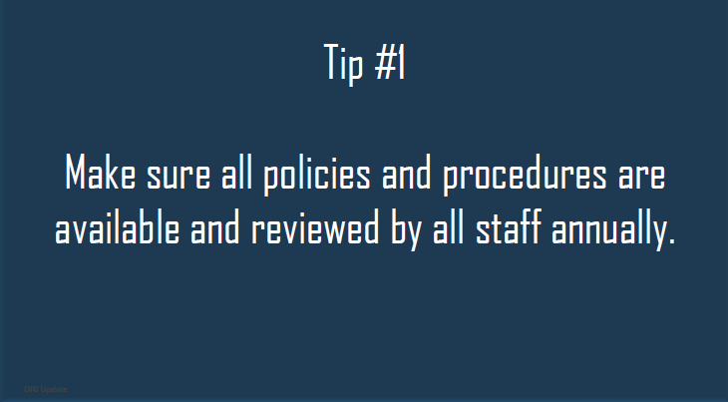
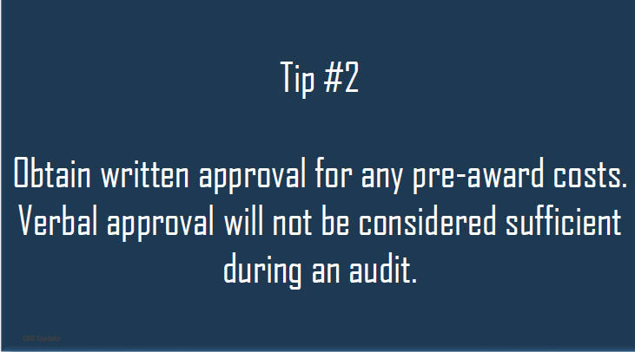
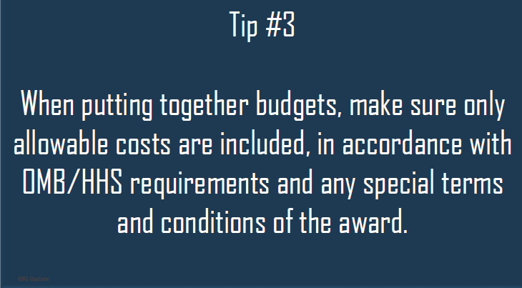
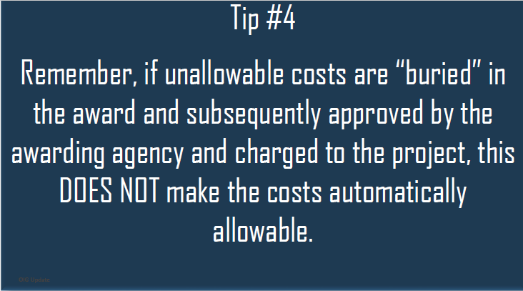
OIG Audit Tips to Prevent False Claims and Fraud

Slide 16
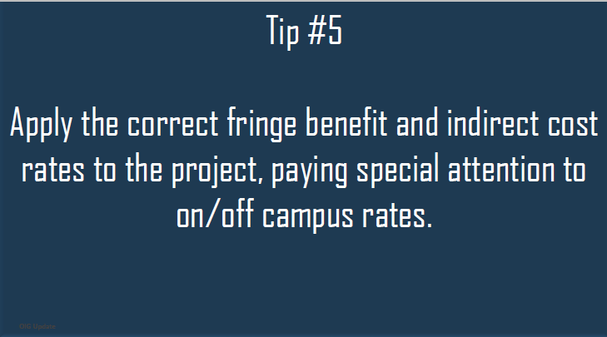
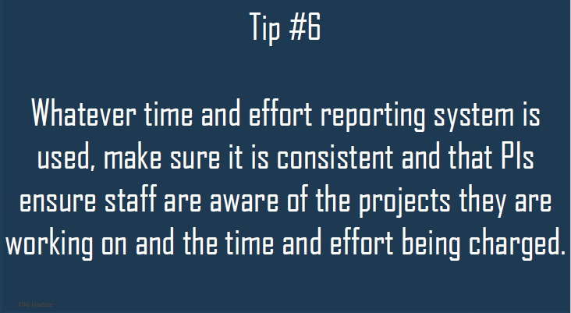
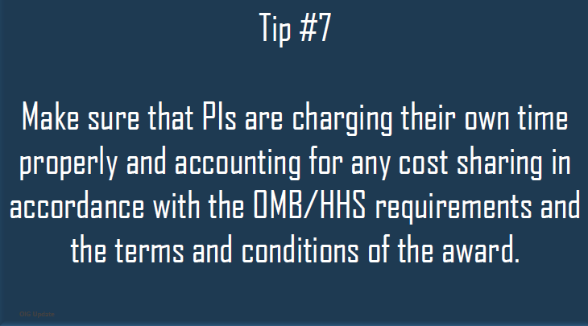
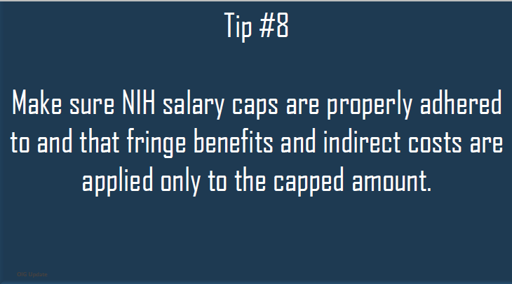
OIG Audit Tips

Slide 17
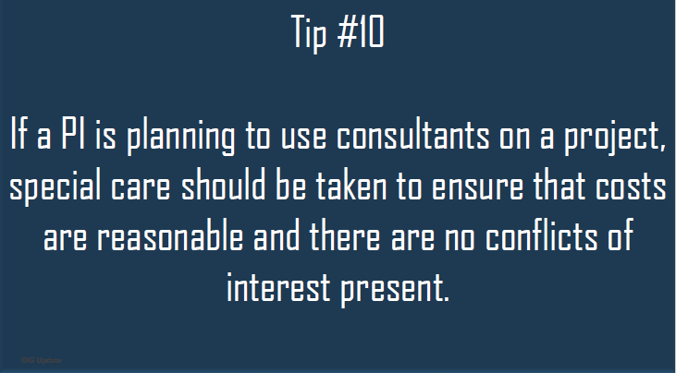
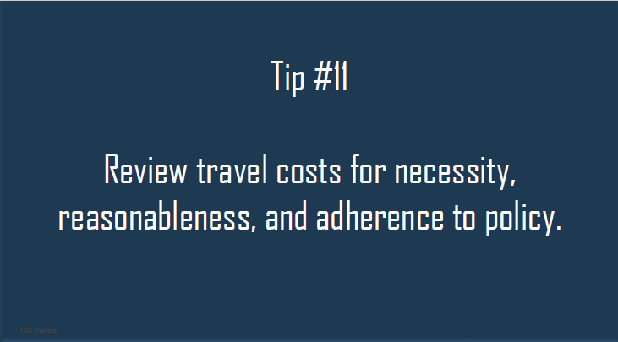
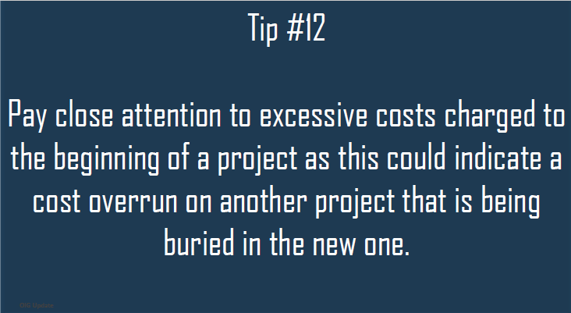
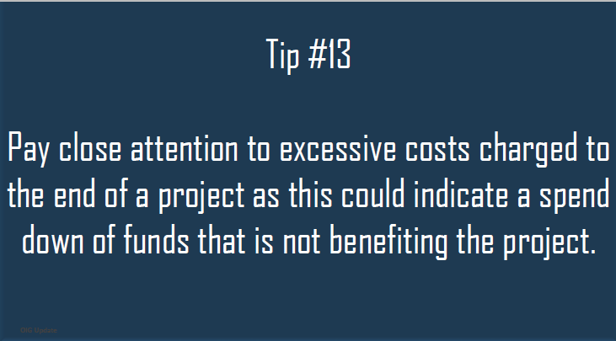
OIG Audit Tips

Slide 18
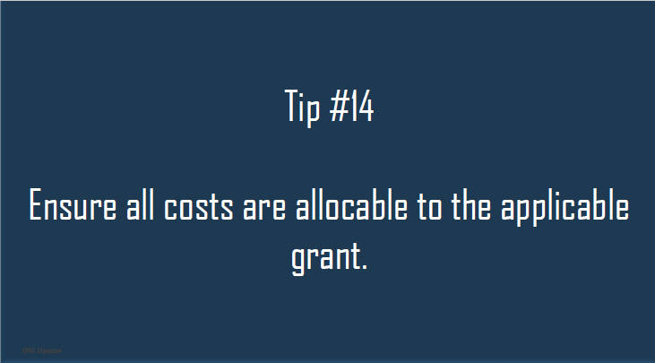
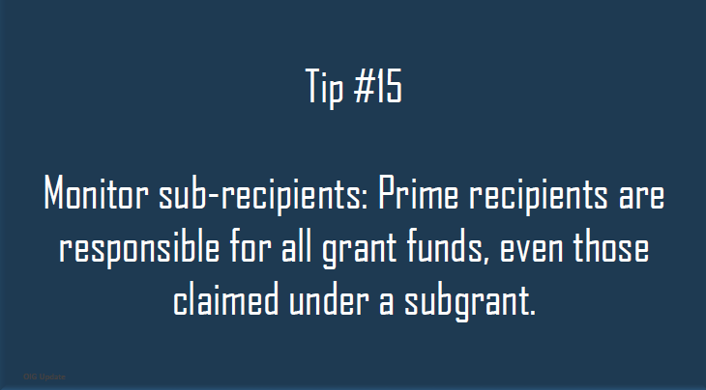
OIG Audit Tips

Slide 19
CTO Updates
Michael Porreca

Slide 20
CTO Updates
ClinCard process updates
  Updated FAQ for participants will contain additional tips for how they may avoid fees
  CTO will be managing all ClinCard setups and card disbursements, including funds outside of Research
  Monthly ClinCard and Velos training
Pre-award tracker report
  Are testing out a few samples with the community and aim to use this type of report regularly prior to December.
  Frequency and content are still being tweaked

Slide 21
Clinical Research Network
Committed to Diversity and Inclusion
Hope White, CEAL Community Engagement Ambassador
Ryan Schroeder – Director, CRN
Stephanie Lorfils, Community Engagement & Recruitment Specialist

Slide 22

DEATH RATES FOR PEOPLE OF COLOR ARE TWICE THAT OF WHITES
Rate ratios compared to White, Non-Hispanic persons | American Indian or Alaska Native, Non-Hispanic persons | Asian, Non-Hispanic persons | Black or African American, Non-Hispanic persons | Hispanic or Latino persons
Cases | 1.7x | 0.7x | 1.1x | 1.9x
Hospitalization | 3.5x | 1.0x | 2.8x | 2.8x
Death | 2.4x | 1.0x | 2.0x | 2.3x
Notes:
Hope

Slide 23
CLINICAL RESEARCH NETWORK
QUALITY RESEARCH GUIDED BY COMMUNITY ENGAGEMENT
  “Quality” in clinical trials is defined by the selection of community-guided, leading-edge research, efficient activation, diversity and rate of enrollment, and compliant oversight.
SUPPORT STRATEGIC AREAS OF RESEARCH
BUILD COMMUNITY ENGAGED NETWORK SERVING AS THE NERVE CENTER BETWEEN OUR COMMUNITIES AND THE RESEARCH PROGRAM
Choosing the right studies is the first step to building a high quality and respected research program.
Well-defined policy, standardized procedure and centralized management is critical to the oversight of risks, and ensures a long-term successful program
    CRN SERVICES:
    OVERSEE ACTIVATION
    COMMUNITY ENGAGEMENT & DIVERSITY STRATEGY
    STUDY MANAGEMENT
    FINANCIAL OVERSIGHT
  HOW CRN IS DEPLOYED:
    FEASIBILITY ASSESSMENT
    CRN LEADERSHIP
    HOSPITAL LEADERSHIP
    PI(s) & DEPT CHIEFS
Notes:
Ryan

Slide 24
CLINICAL RESEARCH NETWORK
PILLARS OF SERVICES
Community Advisory Board
Partner with CTSI to establish research-focused Community Advisory Board
Education & Outreach
Provide education to our community members
Events
Feasibility determination of institutional prioritized trials with community engagement priorities
Clinical Research Oversight
Gather and assess needs/barriers
CAB will help facilitate a research-based community needs assessment
Build relationships and trust
Visibility in the community
Responsiveness to needs, working with community organizations
Deliver trustworthy information
Encourage general inclusion in health research
Host study specific recruitment events
Partner with MDs and Residents of color to answer questions and deliver trustworthy information
Share research results
Workforce development model: utilizing internships and long-term, full-time roles that attract a racially and linguistically diverse workforce
Collaborate with GCRU to ensure quality driven data collection
Provide financial and regulatory oversight
Offer community engagement consults for non-CRN managed trials
Design symposium around BMC’s community engagement in research approach to become a national thought leader in diversity and inclusion in science
Notes:
Ryan

Slide 25
CRN SCORECARD – 120 DAYS
ACTIV I: Benjamin Linas, MD
  Completed a financial clean-up of invoicing, open AR, expenses, effort allocation, Velos data entry
  Performed a regulatory audit/resolution effort
  Serve as primary point of contact for sponsor and BMC ancillary departments
ACTIV II: PI – Michael Paasche-Orlow, MD
  Partner with study team, sponsor and GCRU on ongoing regulatory issues
  Performing financial review and clean-up
ACTIV IV(a): PI – Naomi Hamburg, MD
  Led reactivation of ACTIV 4(a)
  Serve as primary point of contact for sponsor and BMC ancillary departments
ACTIV IV(c): PI – Naomi Hamburg, MD
  Led study activation, including IRB prep and submission, coordination of SIV and internal kick-off
  Serve as primary point of contact for sponsor and BMC ancillary departments
ACTIV V: PI – Melinda Tonelli, MD
  Led start-up of ACTIV 5, including regulatory filings and documentation, development of complex inter-departmental study workflows, establishing Quality Control Management Plans and coordinating internal kick-off meetings
  Serve as primary point of contact for sponsor and BMC, GCRU and IPS
  Coordinate sponsor monitoring visits and resolution of findings
ACTIV VI: PI – Michael Paasche-Orlow, MD
  Completion of site qualification documentation within 2 days of receiving invitation
  Coordinate rapid activation timeline with OGC, CTO, Pre-Award and Study Team
Notes:
Ryan

Slide 26
CRN SCORECARD – 120 DAYS (cont’d)
COMMUNITY ENGAGEMENT ALLIANCE (CEAL): PI – Benjamin Linas, MD
  CRN providing administrative and program direction, leading community engagement strategy, financial management and staffing.
  Creating a Clinical Research Community Advisory Board (CAB), collaborate with CTSI Community Engagement (CE) Core
EDUCATION / EVENTS:
  Partnering with vaccine teams to deliver ambassador and MD-led vaccine education at vaccine pop-up events. Using a “train-the-trainer” approach that will empower and mobilize leaders within our community.
    Curriculum developed
    Multiple events scheduled
  Teaming with “WE GOT US” youth leaders to support vaccine outreach and education in underserved communities.
    MA-CEAL mentoring We Got Us youth on fundamentals of quantitative and qualitative research and publications
  Developing research education curriculum for BMC Interpreters - research literacy and the importance of diversity in research.
    We want Interpreters to 1) see themselves as an extension of the research team, 2) better understand the materials they’re interpreting, and 3) impact the quality and trustworthiness of the consenting process.
DIVERSITY IN RESEARCH METRICS
  Producing demographic reporting tool, extracting enrollment data from Velos and TriNetX.
Notes:
Steph

Slide 27






COMMUNITY PARTNERSHIPS
Community-based Storytelling circle
Serving Boston 50 years - churches, ministries, non-profits working together in our communities
Urban college in Boston – multilingual education/serving a diverse community of learners.
BHERN
Boston Health Equity Research Network – 12 Community Health Centers partnered with BMC
Black community members, students, health professionals addressing medical racism, COVID-19, and the vaccine.
WE GOT US
Community Vaccine Clinics
6 community vaccine clinics within Boston’s most vulnerable communities
Notes:
Steph

Slide 28


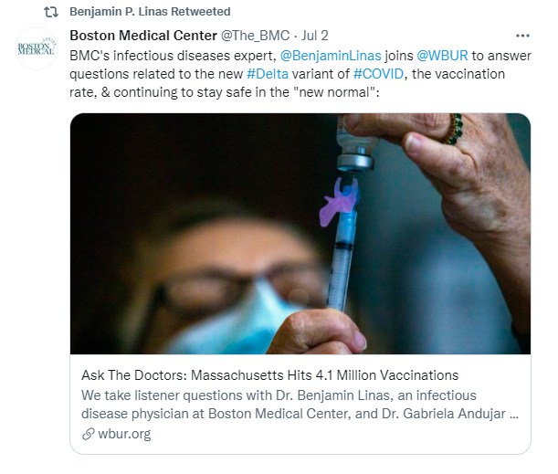
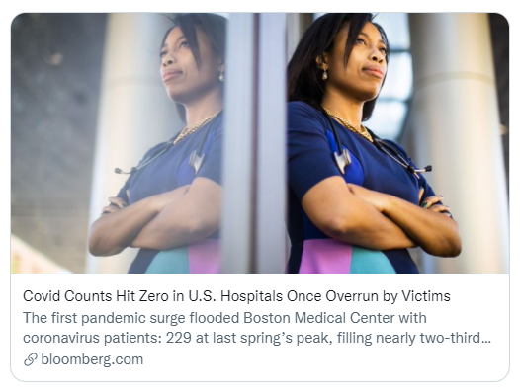
IN THE COMMUNITY
Sabrina Assoumou, MD
Ben Linas, MD
Cassandra Pierre, MD
Notes:
Steph

Slide 29
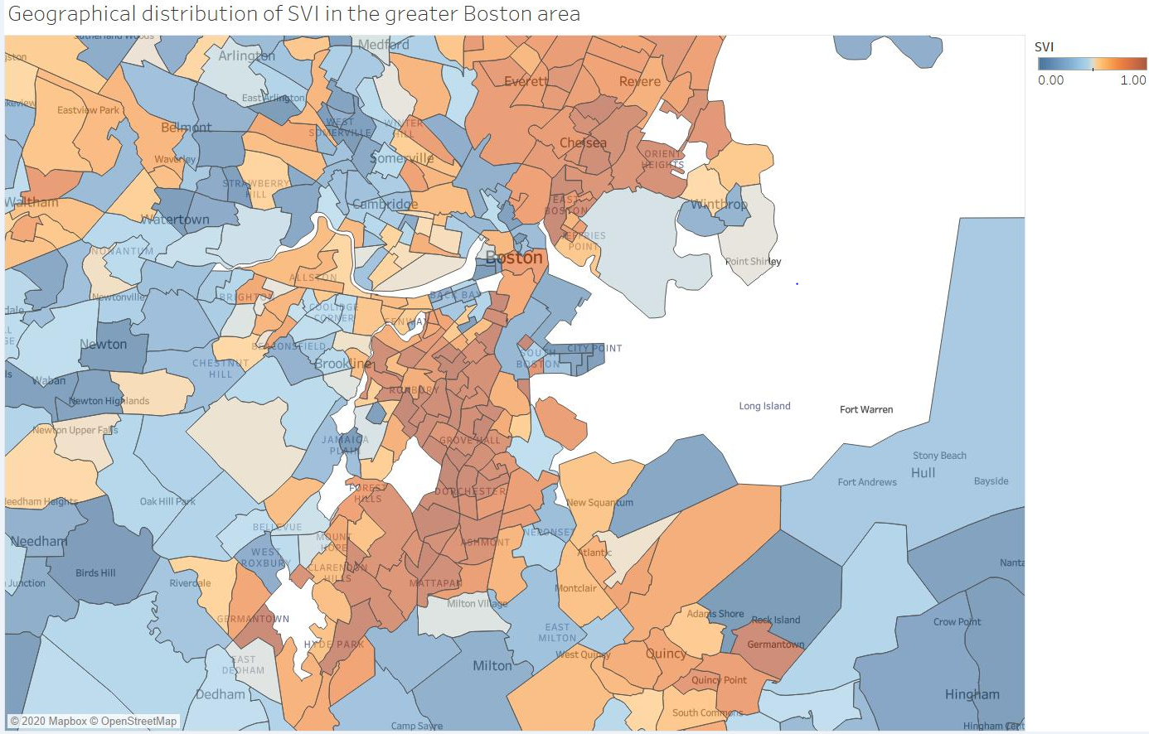









SOCIAL VULNERABILITY INDEX (SVI) SCORE USED TO PRIORITIZE FIXED SITES & POP-UPS TARGET THE UNREACHED
The SVI incorporates socioeconomic status, household composition, minority status/language, and housing type (e.g., crowded housing)
Neighborhoods with high SVI include Dorchester, Mattapan, Roxbury, East Boston, Chelsea
12th Baptist Church
85 E Concord St @ BMC
17 Corinth St
Russell Auditorium
Morning Star
Baptist Church
Menino YMCA
Notes:
Hope

Slide 30
AGE-ADJUSTED DEATH RATES BY CAUSE, RACE AND SEX
Cause of Death
Heart Disease
All Cancer
Lung Cancer
Colorectal Cancer
Prostate Cancer
Breast Cancer
Stroke
Unintentional Injuries
Motor Vehicle Injuries
COPD
Pneumonia & Influenza
Diabetes
Suicide
Firearm Suicide
Liver Disease
HIV
Homicide
Firearm Homicide
Notes:
Hope

Slide 31
Our goal is to embed clinical research into prevention and treatment for all people, regardless of race or socioeconomic status—without exception
REMOVING
BARRIERS
BUILDING
BRIDGES
Notes:
Hope

Slide 32
Patient Privacy:
HIPAA & Disclosures
Tristan Brown, Sr. Privacy Analyst
Erika Barber, Director of Compliance & Privacy

Slide 33
Agenda
Policies
Minimum Necessary Standard
Use of PHI for Research
Proactive Monitoring and Reporting Incidents*

Slide 34









The Compliance and Privacy Department
Ensures we follow the rules that govern
health care
Ensures outside interests do not influence the performance of our jobs
Investigates reports of vendors giving gifts to
our employees
Protects patient privacy
Audits Medicare and Medicaid bills
Provides information and education on Compliance and Privacy issues
Monitors access to electronic medical records

Slide 35
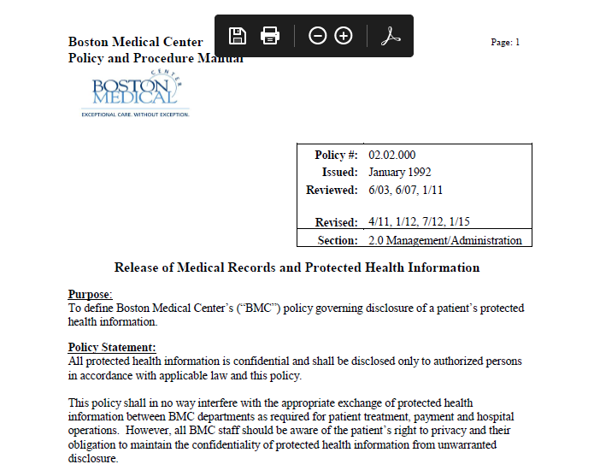
BMC Policies

Slide 36
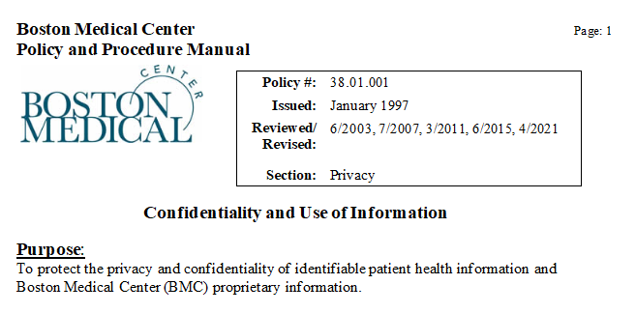
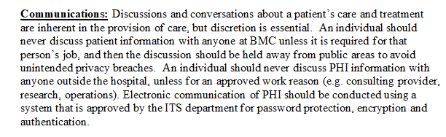
BMC Policies

Slide 37
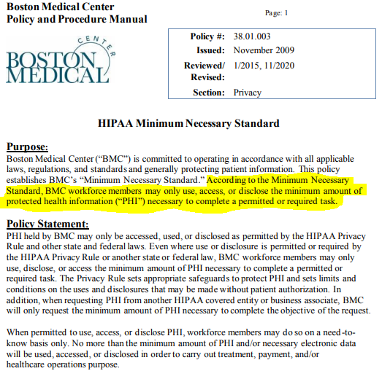
BMC Minimum Necessary Standard

Slide 38
Privacy in 2021
FTC says health apps must notify consumers about data breaches — or face fines (TechCrunch, 9/19/2021)
“Digital apps are routinely caught playing fast and loose with user data, leaving users’ sensitive health information susceptible to hacks and breaches,” said FTC Chair Lisa Khan pointing to a study that found health apps suffer from “serious problems” ranging from the insecure transmission of user data to the unauthorized sharing of data with advertisers.”
Hacked Simon Eye Management Email Accounts Contained PHI of More than 144,000 Patients (HIPAA Journal, 9/20/2021)
Hacked employee emails led not only to the exposure of PHI for more than 144,000 patients but also allowed hackers to attempt an fraudulent transfer of funds
Home Working Is Creating Dangers, New Business for Cybersecurity (Bloomberg, 10/06/2021)
The average cost of a data breach was highest for organizations where more than 60% of employees were working remotely.

Slide 39
Why Protect Our Patients’ Privacy
Our patients have a right to privacy regarding their personal information or information about their health
Our patients trust us with their most sensitive information, so it is your duty to protect that information
The threat is real. Inappropriate use or release of this information can cause serious harm
There are a lot of rules to follow:
  HIPAA and HITECH (federal patient privacy rules)
  Substance Use Disorder Confidentiality Rules (federal regulations)
  Mass. Data Breach Notification Law (State laws)
  Sensitive Information (e.g., genetic information, mental health, or HIV/AIDS)
  And more

Slide 40
Patient Rights Under HIPAA
HIPAA tells us not only when we cannot disclose or use protected health information (“PHI”), but also when we can.
Under HIPAA, you are allowed to use PHI for:
  Treatment of the patient (past, present, future, physical or mental health);
  Hospital Operations, like quality improvement, investigations, responding to regulatory inquiries;
  Payment for treatment or services.
  Disclosure to other health care providers for the purposes of patient treatment or operational purposes can be permissible, too.
Obtain written consent wherever possible to make another disclosure at the patient’s request.
You should not disclose or access any patient information unless: (1) it directly related to patient treatment, hospital operations, or payment; (2) the patient has signed a written authorization; (3) or it is otherwise part of your job to do so (e.g., an Emergency Dept. employee assigned to report certain wounds to the Boston Police as required by law).

Slide 41
Use of Patient Information for Research
  The Privacy Rule at 45 CFR 164.501 allows access or disclosure of PHI/data for research purposes when:
    Patient consent is obtained; or
    When there is a waiver of consent by the IRB; or
    The data is de-identified; and
    When contracts are in place that cover the data to be disclosed (Data Use Agreements, Business Associate Agreements, Data Transfer Agreements, etc.)
    Patient data that is disclosed or accessed that exceeds the scope approved by the IRB protocol, terms in contracts, or the Rule may be considered a HIPAA violation
NOTE: Even when allowed to use or disclose PHI, the Minimum Necessary Standard still applies. No more than the minimum amount of information needed may be used, accessed, or disclosed

Slide 42
Minimum Necessary in Releases to Sponsors
Know your protocol
  Many sponsors want fully de-identified data
  If you are required to release, remember the Minimum Necessary Standard
  If none, review everything that is sent to the sponsor to ensure de-identification
Team effort
  All workflows have multiple check and fail-safes to prevent the unintentional disclosure of health information
  It takes every step along the data chain doing its part to prevent Privacy incidents
Sponsors are not entitled to our health information automatically
  Be conscious of stuff you send
  Unless there are proper agreements in place and sharing complies with federal regulations, disclosure may violate HIPAA.

Slide 43
Recap
Remember: you have three big reasons to use, access, or disclose PHI:
  Treatment of the patient (past, present, future, physical or mental health)
  Hospital Operations, like quality improvement, investigations, responding to regulatory inquiries
  Payment for treatment or services
If you are not dealing with a situation directly relevant for treatment, payment, or hospital operations proceed with caution
Obtain written consent wherever possible to make another disclosure at the patient’s request
Disclosure to others always confirm:
  Right information (Remember Minimum Necessary!)
  Right recipient
  Right patient

Slide 44




Proactive Privacy and Drug Diversion Monitoring
Auditing System
The Protenus Assessment
Audits informed by Protenus algorithm
AI detects potential inappropriate activity.
Notes:
In March 2021, Pharmacy and Compliance went live with a vendor solution that provides dual functionality that has significantly enhanced drug diversion and patient access monitoring
HIPAA mandates proactive auditing and monitoring to identify inappropriate access to patient information
Drug diversion in hospitals is a serious concern that can impact patient care, worker safety and organization finance

Slide 45

Reporting, Education and Training
Training:
Upon hire
Annual: Core modules include Safety & Infection Prevention, Emergency Management, Compliance is Everyone’s Responsibility
All trainings explain how to report
Workforce have a responsibility to report any known or suspected violations of Federal, State or local laws, rules, regulations or BMC policies, procedures, and standards
Ways to report a compliance concern:
    Supervisor or manager;
    Human Resources;
    Hospital and Plan Compliance internal numbers and emails;
    Hospital and Plan Anonymous Hotlines
BMCHS does not permit retaliation. Employees will be protected from retaliation for reporting concerns
Notes:
HIPAA, and other rules or state law require us to review and report actual or suspected privacy concerns. Workforce are reminded of the responsibility to report known or suspected violations.
If you have questions about whether or not you are permitted to do something, contact us and we can work through it together.
If you have concerns or wish to report an incident involving patient information, contact us so we can address the situation.
If you are confused about whether or not privacy or compliance needs to be involved in a review or incident contact us and we can help determine if we need to be involved.
Importantly, you can make reports anonymously through our compliance hotline.

Slide 46
Thank you
Discussion

Slide 47
Open Discussion and Questions
Thank-you for attending today’s meeting!

