Slide 1
February 8th Research Admin Meeting

Slide 2
Agenda
9:00am – 10:00am
Welcome
Research Operations updates
Accounts Payable updates
10:00am – 10:30am
Community Engagement Core and CHC Research Engagement

Slide 3
Welcome!

Slide 4
Research Operations Updates

Slide 5
Proposal Submission: Overview David Lynch & Mahara Pinheiro
Notes:
Mahara
Steps to manage the proposal development and submission process at BMC
What is proposal submission
Importance of timely submission
Dept vs central office roles in the proposal submission process
Key steps for managing proposal submission at BMC.

Slide 6
Proposal Submission
Proposals are generally submitted in response to:
Funding Announcement Opportunity (FOA)
Request for Proposals (RFPs)
Program Announcements (PAs)
Direct solicitation, invitation to apply
Proposal involves collaboration between:
Proposal development by the PI and DA/DRA
on behalf of the department/section
Proposal review and submission by the Research
Operations Grant Administrator on behalf of BMC
Proposals are submitted by BMC Research Operations
Awards are made to BMC through Research Operations
Foundations
Federal, State, Local Govt
Industry
BMC Sponsors of Research
Notes:
Dave
Proposal submission is the time within the lifecycle where PIs, Departmental staff and Research Operations work together to develop and submit a proposal to the sponsor.
Proposal development is the primary responsibility of the Principal Investigator, Departmental Research Administrator/Development Office (as an extension of the DRA), and Research Operations
Research Operations is responsible for reviewing all proposals for conformance with sponsor requirements, compliance BMC policy, and submitting on behalf of BMC

Slide 7
Roles in Proposal Submission Process
The following individuals are involved in the proposal submission process:
Roles and Responsibilities
Principal Investigator (PI) | Department Administrator/Development Office (FRGG) | Department / Division Chief or Proxy | Pre-Award Grants Administrator (Grants and Contracts)
Identifies funding opportunities. | Assists in identifying funding opportunities for investigators. | Approves submission of PI’s proposal to sponsor. | Reviews proposal to ensure regulatory compliance.
Works with Department Administrator/FRGG develop proposal that meets funding program requirements and BMC policy. | Assists PI with development of proposal. Works as a liaison between the PI and Grants and Contracts to ensure successful submission to sponsor | Certifies the department’s commitment to the project and the investigator’s effort. | Reviews proposal for accuracy based on terms and conditions outlined by sponsor.
Responsible for development of final and complete proposal components. | Acts as a “project manager” for the proposal submission process. Responsible for ensuring that internal deadlines are met. | Dept Chair signature signifies acknowledgement of scientific oversight and commitment of space & facilities needed for the proposal. | Signs off as institutional official and submits on behalf of institution.
Notes:
Mahara
Proposal development by the PI and Dept Admin/Research Admin
Plan for accurate, complete and timely submission; internal deadline is 5 days prior to published deadline, start InfoEd record
Review the FOA/RFP develop a proposal submission plan, assign tasks, identify key personnel and register in sponsor system, identify subrecipients and establish contact names, collect biosketches, other support, budget, ancillary services, core facilities
PI approval, dept/section chair/chief commitment of resources to complete the project (e.g. – space, equipment, time/effort,
Proposal Review and Submission by Research Operations, Grant Administrator
Research Operations is authorized to submit on behalf of BMC
GA responsibilities are to review the proposal for
Conformance with FOA/RFP
Compliance with BMC Policy
Ensure proposed work has full commitment of resources to complete the project.

Slide 8
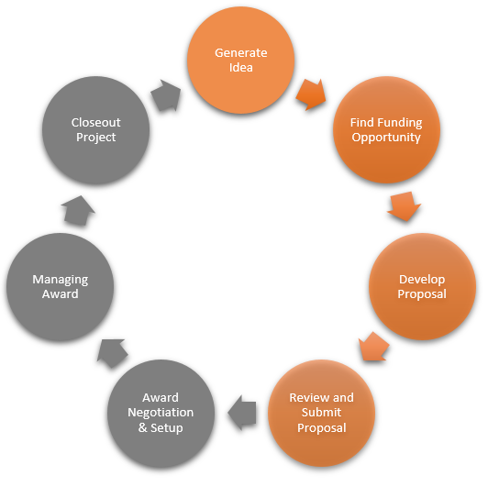
Key Steps at BMC
Proposal Submission
Generate Idea & Find Funding Opportunity.
Develop Proposal & Initiate an InfoEd record.
Review the Proposal*
Seek PI & Chief Approvals*
Submit the Proposal
Notes:
Dave
There are 5 key steps for Proposal Submission at BMC.
Principal Investigator (PI) expresses interest in submitting proposal in response to a FOA or the Development Office finds funding opportunities on behalf of investigators.
PI works with the development officer or their Department/Division administrator (DA) staff to prepare all proposal documents. The development officer or DA reviews FOA and works in coordination with PI to compile the application documents. An InfoEd record is initiated as soon as a FOA is identified.
Once complete, the Research Operation’s Pre-Award Grants Administrators (GAs) are notified via email from the DA or development officer that a proposal is ready for their review. They review the proposal to ensure that all regulatory and compliance components are met. If there are any changes that need to be made- the GA will work with the Dept Admin/Development to make corrections.
The GA then requests the PI to certify the proposal (ePSF) as well as seek approval from the Department/Division chief for the proposal. This process will change when InfoEd ePSF routing is implemented. Implementation will happen in 2022.
Once approvals have been received from PI and Department/Division chief, the GA will submit on behalf of BMC to the sponsor.
* Steps 3 and 4 will change when InfoEd routing is implemented.
This completes the key steps. A link to the detailed steps required in the policy and procedures appears on the next slide.

Slide 9
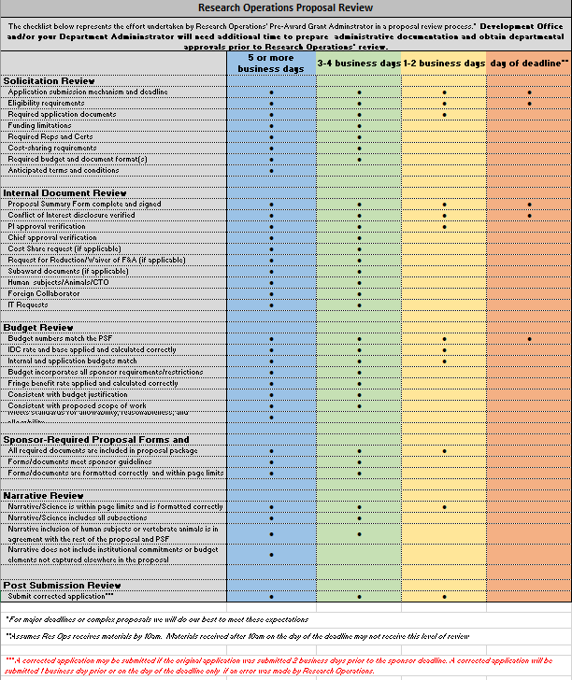
References
Proposal Submission Policy: Proposal Submission v.2 (policytech.com)
Proposal Review Matrix: https://www.bmc.org/research-operations/pre-award
Proposal Development Plan
Proposal submission process to be posted on RO website.
More tools and information welcomed.
Notes:
Mahara and Dave
Mahara
Proposal Submission Policy: Proposal Submission v.2 (policytech.com)
Proposal Review Matrix: https://www.bmc.org/research-operations/pre-award
Dave
Proposal Development Plan – Dave will provide an example?
Proposal submission process to be posted on RO website.
More tools and information welcomed.

Slide 10
CTO Updates Johanna Chesley & Michael Porreca

Slide 11
Clinical Trial Office updates
Budget template updates will be reviewed by a group of research community partners, please let us know if you would like to join.
We are currently reviewing CTO owned policies and will be submitting updates over the next two months – focus to simplify content, pull out procedures, and draft SOPs to live outside policies and within one centralized location.
Epic “no research billing” functionality will be going live in a next 2-weeks.
Required training changes for Velos and ClinCard, currently new users are required to complete pre-recorded trainings in advance of systems access, within the next 2-3 months CTO will require pre-recorded trainings and live Velos or ClinCard trainings to gain access.
Increased user errors in both systems, lead to participant complaints and miss billings
New CTO Intake Form, now required to initiate CTO services beyond CDA/NDA intake
https://www.bmc.org/research-operations/clinical-trial-office (under “Forms” section)
CTO Intake: https://bmc.tfaforms.net/46
CDA/NDA Intake: https://bmc.tfaforms.net/f/forms-research-cda-nda-intake
Notes:
Johanna

Slide 12
CRN Updates Ryan Schroeder

Slide 13
Clinical Research Network
Community Engaged Recruitment + Retention Toolkit
Increasing representation of our underserved communities in clinical research through community engaged values
Gather BMC stakeholders, form Workgroup and perform DEI needs assessment
Leverage industry best practices with solutions designed to address BMC researcher + community needs
Seek and incorporate Community Advisory Board and research team feedback
Identify BMC-specific barriers to inclusive recruitment + retention
Workgroup to Co-deliver Toolkit to research community & support education needs
Track Diversity Metrics and Learn, Improve and Adjust as we Move Forward

Slide 14
Research Policy Update Kaye Mottola
Research Bimonthly, 8 February 2022
Notes:
Policies are institutional rules and principles, written or not, that serve to guide action toward institutional goals. The institution in question could be, eg, the federal government, a particular federal entity, eg, the NIH, or BMC.
In research, as we all know, so many of our rules and guidelines are dictated by federal requirements, and so much of Research Administration is compliance with federal reqs. Less known is the fact that federal agencies expect us to have written policies, and sometimes require specific ones (eg. RFCOI and Scientific Misconduct). Even less known, federal requirements include the rule that a given institution, such as BMC, must follow its own policies.
Examples: Regulation guiding use of federal funds, now called “Uniform Guidance” dictates requirements for certifying effort on a grant or contract. If we do not follow those requirements, our annual audit can identify the non-compliance, which can prompt a federal audit and potential fines. Many research institutions have paid millions for failures of proper effort allocation and documentation.
In addition, if a BMC policy were to require more than federal rule, a federal audit can hold us accountability for our more stringent requirement. If, eg, we stipulated in policy that we would have researchers certify effort weekly, we can be held accountable for failure to follow our own rule.
What continues to surprise me is how few actors failing to apply policy accurately can bring about millions of dollars, for a variety of reasons. One person can commit the same act many times, and each is incident subject to fine. If negligence is identified, fines can be trebled.
Much of our work is governed by federal law, regulations, and other rules, and we must also abide by state and local rules and institutional requirements.
Policies are
Our aim is to make policies easy to read, to provide companion SOPs and other job aids.
Today I’d like to review recent policy history and point to new initiatives.

Slide 15
Research Policy Initiative, Recent Background
March 2020 Research Operations survey
Analyzed: 52 PolicyTech documents indexed under Research
Earmarked: 16 for deletion: policies and forms
To remove redundancies, transfer procedure descriptions to SOPs
Assigned: policy updates to directors, managers
November 2020 Summary of observations/priorities, recommendations, proposed next steps
Identified: compliance and financial operations gaps in policies and procedures
Guidance: amend policies, SOPs to meet industry standards
January-November 2021 Policy development/approval; training materials
Collaboration with BMC Corporate Compliance
10 updated, 2 new, 5 retired
Additionally, 6 forms removed from PT
Drafted: 5-minute policy training modules
Notes:
10 March 2020
November 2020 – Deloitte, Huron

Slide 16
BMC Research Policies: FY2021 Q2-Q4
Policy | Priority | New | Owner*
Conflict of Commitment | High | ✓ | Compliance
Cost Sharing | High
Facilities and Administrative (F&A) Rate
Program Income
Proposal Submission | High
Research Core Facility | High | ✓
Significant Financial Conflicts of Interest in the Conduct of Research | Medium |  | Compliance
Sponsored Projects Fund Monitoring
Sponsored Projects Closeout
Subaward Agreement | Medium
Subrecipient Risk Assessment and Monitoring | Medium
Time and Effort Reporting | High
*Owner is Research Operations unless otherwise specified
Notes:
KM: fix fonts

Slide 17
Research Policy Initiative, FY2022
December: Reviewed existing policies, BMC requirements, FY2021 guidance
Identified those needing update
Scheduled training, P&P Committee orientation, attendance
January: Prepared phase I policy strategy and RO pipeline
Determined: most urgent new policy and updates needed
Completed training, committee orientation and attendance
Assign new owners as needed
February-March: Draft 8 or more policies
Distribute assignments, orient teams, complete drafts
February-April: Submit for approval; gather adjunct materials
Socialize and finalize drafts
Match SOPs, training modules, and correct as needed
Assign 2021 policy modules to RO teams

Slide 18
Policy Initiative Priorities FY2022 Q2
Policy | Priority | New
Allowable Costs for Research | Medium
Clinical Research Coverage Analysis | High
Contract and Subcontract Research Agreements | Medium
Facilities and Administrative (F&A) Rate | High
Federal Financial Reporting
Investigator Eligibility | High | ✓
Pre-award Expenditures
Proposal Submission | High

Slide 19
Research Policy Initiative, Looking Ahead
Review remaining existing policies and identify:
New policies needed
Those to be updated
Those to be retired
Prioritize, draft, socialize, finalize and:
Submit for approval by end of FY2022
Update/create SOPs, training modules
Present training:
2021 policy modules to research community
2022 modules to RO teams, then research community
Notes:
If time allows discussion: In addition to the 5-minute modules, suggestions for communicating policies to community?
How can we keep policies in the forefront of research activities?

Slide 20
Accounts Payable & Supply Chain Sam Suneus & Lee Jean-Louis

Slide 21
Institutional Guidance for reimbursements (Chrome River) and paying Vendors through AP, Purchasing/Supply Chain
When to use Chrome River Reimbursement?
If BU or BMC employee
What expenses can be reimbursed (Chrome River) using grant funds?
All BU and BMC employee Out-of-Pocket business related transactions are processed via Chrome River reimbursement database.
(BU Contingent worker reimbursement checks are processed through AP.
BMC employees receive payment through Payroll.
When should services be paid directly from research staff/faculty and reimbursed?
Cost center authorize approvers determine where products and services are charged.
AP follows the Signature authority Matrix (SAM). Data provide by accounting and maintained by the Financial Information System department.
What vendors can be paid directly versus following the reimbursement process?
Invoice transactions. Any documents stated as an “invoice”
Individual Out-of-Pocket business transactions not pre-approved

Slide 22
Institutional Guidance for reimbursements (Chrome River) and paying Vendors through AP, Purchasing/Supply Chain (Continued)
How do we know when to use each method, Chrome River, Accounts Payable Invoicing and Purchasing/Supply Chain?
Chrome River: BMC, BU employee out of pocket business related transactions
Accounts Payable Invoicing: Purchase order (PO) Invoices, Non-PO vendor invoicing, Invoice Documents and Payments without an invoice (Except if Out-of-Pocket)
What guidance can we share with our Department PIs regarding the process for each method?
Process will be available in a few weeks. In finalize stage with auditors

Slide 23
Invoice Paths:
There are 5 ways AP receive and process invoices/Reimbursements through INFOR
eForm
Manual Entry
EDI

Slide 24
Software's and Sites
eForm
EDI
Brainware
Optical Character Recognition (OCR)

Slide 25
Chrome River
BMC and BU Reimbursement Database
All BMC and BU employees are reimburse through CHROME RIVER
BMC employee receive payment on their paycheck (through payroll)
BU contingent worker receive payment from Accounts Payable
All vendor “reimbursements (not invoice) are process through Infor

Slide 26
Reasons and Purpose
Infor
Purchase Order
Purchase order (PO) Invoices
Non-PO vendor invoicing
Invoice Documents
Payments without an invoice
Purchase of Supplies and Services from vendor
Line item referencing
Use for reporting purpose
Pre-approve authorization to pay
Capital invoices ($5K and above)
eForm
New vendor setup
Payment without an invoice
Vendor data Update
Non-employee Reimbursement

Slide 27
Purchase Order Requisitions, PO Creation , P2P Process related to Accounts Payable
Why do you need a P.O. ? All supplies, equipment, and equipment related services require a valid BMC Purchase Order through Supply Chain Operations per BMC policy 08.13.000. This is to ensure purchases are requested, approved, received, and paid for appropriately as well as documented.
How to create a Purchase Order? Purchase Orders may be requested by submitting a purchase Order requisition via Infor RSS. Information on how to gain access can be found on the Hub. Go to Departments > Supply Chain Operations > Purchase Order Requisition Processing Access and Training
Why is it important to write the PO # on an invoice? Accounts Payable uses the Purchase Order to pay the invoice by matching up the items or service in the invoice with what was requested on the Purchase Order. The purchase order also contains where the charges should be applied to (Cost Center, Detail , project etc) If there is no PO # on the invoice AP does not know where to apply the invoice for payment.
How to add money to PO should it run out before the fiscal year end? Submit a Purchase Order requisition to your Buyer with the PO Number and how much money you want added to the PO.
Notes:
This completes the training module, providing insights and steps required to manage the proposal submission process at BMC. We discussed 1) What is proposal submission, 2) What is the importance of submission, 3) What are the roles in the proposal submission process and 4). Key steps for managing proposal submission at BMC.
A link to the comprehensive and detailed steps outlining the policy and procedures, as well as other reference materials can be found here. If you still have questions, please reach out to BMC Research Operations.
Thank you for taking time to review this training.

Slide 28
Purchase Order Requisitions, PO Creation, P2P Process related to Accounts Payable Cont’d
What vendors can be paid directly versus following the reimbursement process? As mentioned all supply, equipment, and equipment related services require a PO. Staff should work with existing BMC vendors or work with their Buyer to add a new vendor if needed. If staff have a unique scenario where they would like an exception to use their personal funds and be reimbursed for a purchase they can email DG-SupplyChainOperations@bmc.org
SCO does NOT approve or handle expenses related to the following:
Subscription/membership dues
Hotel/lodge
Training/seminars/conferences
Travel
Catering services
Staffing
Entertainment-related services (e.g. guest speaker, piano rental, DJ)
Law firms
Pharmacy (drug-related only)
Marketing (e.g. web page designs, publications, ads, video)

Slide 29
Visit Supply Chain Operations Webpage on BMC Hub

Slide 30
Supply Chain and P2P related Contacts
Purchase Order Requisition Access and Training for Infor RSS visit: https://hub.bmc.org/departments/supply-chain-operations/purchase-order-requisition-processing-access-and-training
Purchase Order increase funds requests Contact: Kenneth Bullock – Kenneth.Bullock@bmc.org or DG-SupplyChainOperations@bmc.org
Reimbursements - DG-Accounts-Payable@bmc.org or Sam.Suneus@bmc.org
New Vendor add requests - DG-SupplyChainOperations@bmc.org

Slide 31
A Guide for Partnering with BHN Community Health Centers to Support Research Engagement Dema Hakim and Allyson Richmond
Updated: Jan. 2022

Slide 32
Boston HealthNet is an integrated delivery network of 11 Community Health Centers which are affiliated with Boston Medical Center Health System
Overall
Over 20 years of working together to provide quality care to the communities served¹
275,000 patients served at these health centers
Provided 1.34 million patient visits in 2019
BMC/BU School of Medicine Partnership
A notable share of BMC patient volume comes from the health center network:
25% of outpatient visits
30% of inpatient admissions
32% of day surgeries
Majority of these CHCs participate in Boston Accountable Care Organization (BACO)
Partnership extends into clinician training and joint hiring²:
~240 BUSM students use health center education programs (pre-COVID)
78 residents have longitudinal ambulatory experience at CHCs
38 individuals jointly hired by health centers and BU Family Medicine across 6 health centers
Geography spans Boston's neighborhoods and Winthrop, Quincy, Taunton, and Attleboro
Annual figures

Slide 33
Established the BHN Research Collaborative and Health Center Liaison role to streamline communication with the Research Community
BHN Research Collaborative
Partnership between Boston HealthNet, CTSI CE Program and 8 participating CHCs
Each Health Center is an independent FWA-assured institution and can be added to INSPIR studies with BMC or BU Medical Campus Principal Investigators
Health Center Research Liaisons
Embedded staff at each CHC to serve as local process expert and liaison to the larger research community
Respond to initial inquiries by researchers
Meet regularly with peers in the BHN Research Forum
Be involved in research design to help represent the community and CHC perspective in the grant planning process

Slide 34
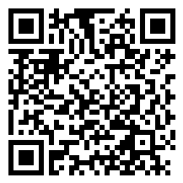
Steps at a Glance for Partnering with Health Centers in Research Projects
Scan now to view the Project Request Form
Step 1
Step 2
Identify potential Health Center partner(s)
Step 3
Complete Project Request Form
Step 4
Engagement with Health Center(s)
Review Health Center Bios which include:
Research Liaison contact
Clinic Information & Demographics
Research Priorities & Methodology
Submit ASAP, at least 1 month prior to grant submission
Review guiding principles and rules of engagement
IRB Approval
Health Center(s) with determine interest and discussions will take place to establish specifics of the partnership.
Health Center(s) will provide the IRB approval letter to be uploaded into the INSPR application.
Notes:
Need to add links for two forms

Slide 35
Greater Roslindale Medical & Dental Center Research Bio
Contact Info
Research Liaison | Arielle Albert (Arielle.albert@bmc.org)
CMO | Jennifer Trieu, MD
CEO | Courtney Urick
Research Priority Topics
Operations: treatment cost analysis, wait-time reduction, medical equipment utilization analysis Population Health: diabetes (A1c), health equity (health access/affordability), needs assessment, cancer prevention, chronic conditions, hypertension, pediatric immunization, COVID-19 Behavioral Health
Clinic Info
Service Area | Roslindale, Hyde Park, West Roxbury
Number of Sites | 1
Primary Care Patients | 6,123 | FWA# 00023612
Annual Clinic Visits | 12,374 | Expiration: 6/4/2025
Patient Demographics
Male | 41% | Asian/Pacific Islander | 2.4%
Female | 59% | Black/African American | 26.1%
Medicaid | 30% | White | 36.9%
Primary Language not English | 20% | Hispanic/Latino | 16.6%
Most Common Languages Spoken | Albanian, English, Greek, Portuguese, French-Creole, Spanish
Best Practices: Research Methodology
Study methodologies: qualitative surveys, focus groups, 1:1 interviews, secondary data analysis (contracted out) Workflow considerations: integrating SDOH into clinical practice, flowcharts, written-workflows (step-by-step/ if-then statements)
https://www.roslindale.org/

Slide 36
Steps at a Glance for Partnering with Health Centers in Research Projects
Scan now to view the Project Request Form
Step 1
Step 2
Identify potential Health Center partner(s)
Step 3
Complete Project Request Form
Step 4
Engagement with Health Center(s)
Review Health Center Bios which include:
Research Liaison contact
Clinic Information & Demographics
Research Priorities & Methodology
Submit ASAP, at least 1 month prior to grant submission
Review guiding principles and rules of engagement
IRB Approval
Health Center(s) with determine interest and discussions will take place to establish specifics of the partnership.
Health Center(s) will provide the IRB approval letter to be uploaded into the INSPR application.
Notes:
Need to add links for two forms

Slide 37
Guiding Principles and Rules of Engagement: At a Glance
Outline of the Rules of Engagement
Research Priorities
Regular Communication
Equitable Partners
Potential Benefits
Research is aligned with Health Center priorities
Communication is transparent and regular throughout the research process
Health Centers are adequately supported and treated as equitable partners
Potential benefits to all participants are prioritized and workflow impact is considered
01
02
03
04

Slide 38
Steps at a Glance for Partnering with Health Centers in Research Projects
Scan now to view the Project Request Form
Step 1
Step 2
Identify potential Health Center partner(s)
Step 3
Complete Project Request Form
Step 4
Engagement with Health Center(s)
Review Health Center Bios which include:
Research Liaison contact
Clinic Information & Demographics
Research Priorities & Methodology
Submit ASAP, at least 1 month prior to grant submission
Review guiding principles and rules of engagement
IRB Approval
Health Center(s) with determine interest and discussions will take place to establish specifics of the partnership.
Health Center(s) will provide the IRB approval letter to be uploaded into the INSPR application.
Notes:
Need to add links for two forms

Slide 39
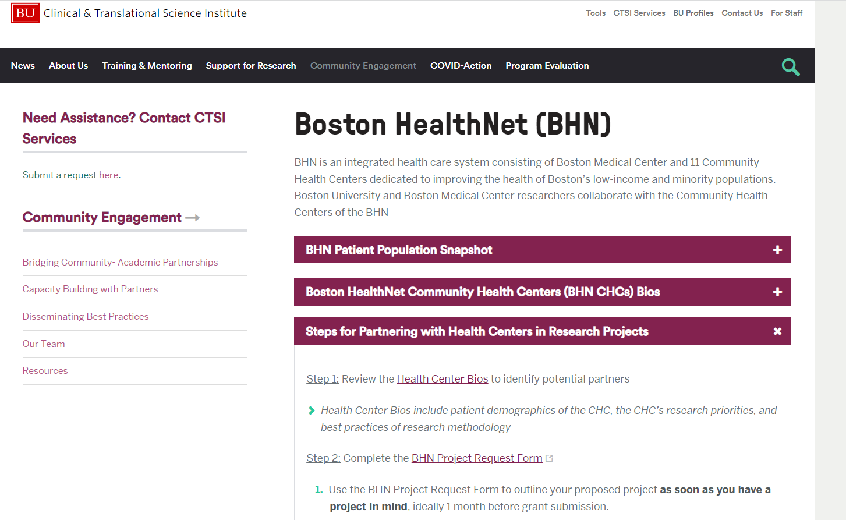
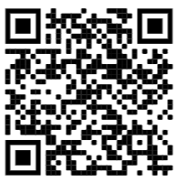
Scan now to view the website

Slide 40
Steps at a Glance for Partnering with Health Centers in Research Projects
Scan now to view the Project Request Form
Step 1
Step 2
Identify potential Health Center partner(s)
Step 3
Complete Project Request Form
Step 4
Engagement with Health Center(s)
Review Health Center Bios which include:
Research Liaison contact
Clinic Information & Demographics
Research Priorities & Methodology
Submit ASAP, at least 1 month prior to grant submission
Review guiding principles and rules of engagement
IRB Approval
Health Center(s) with determine interest and discussions will take place to establish specifics of the partnership.
Health Center(s) will provide the IRB approval letter to be uploaded into the INSPR application.
Notes:
Need to add links for two forms

Slide 41
Open Discussion and Questions
Thank-you for attending today’s meeting!

