Slide 1
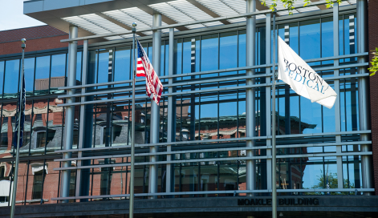
Welcome to Boston Medical Center
Notes:
Welcome to Boston Medical Center – we are very excited that you are here.

Slide 2
Our Innovation
Patients
Medical Professionals
Providers
Payors
We welcome the opportunity to take on the risk and responsibility for our patients’ health and plan to:
Invest to reduce unnecessary healthcare utilization
Address social determinants that drive health care costs (e.g., able to pay for air conditioner in asthmatic’s house)
Partner with community organizations to better integrate BH, LTSS and physical health
Select ACO
Notes:
You are joining us at an exciting time as we transition to delivering care within an accountable care organization. The Boston ACO aims to use an integrative approach to improve patients’ health and experience with care by meeting their specific needs in a manner that is more effective and less expensive.

Slide 3
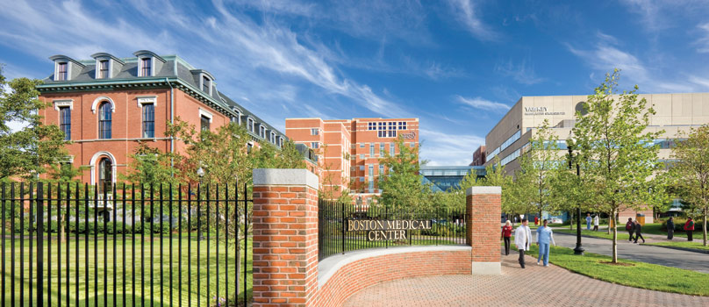
Our Mission
Our Core Purpose Exceptional care. Without exception.
Notes:
Amidst our innovation, our mission remains the same- to provide exceptional care, without exception. As the largest safety-net hospital in New England, Boston Medical Center has a long-standing commitment to providing accessible, community-oriented health services to all in need of care regardless of status or ability to pay.

Slide 4
Our Vision
Our Vision 2030 Make Boston the healthiest urban population in the world.
Notes:
As an organization, Boston Medical Center has a bold vision- to make Boston the healthiest urban population in the world. Given our deep experience addressing medical and social challenges, we believe we are uniquely positioned to reimagine health care that promotes wellness, rather than just treats illness.

Slide 5
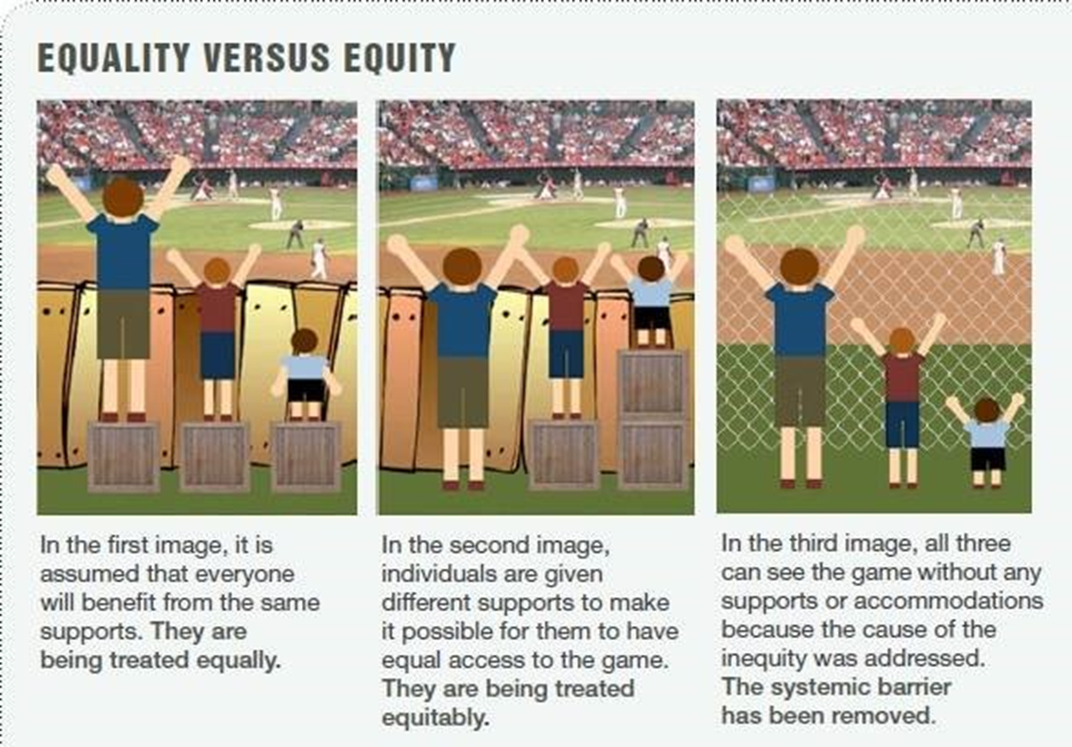
Commitment to Health Equity
Notes:
Our commitment to health equity means we strive for the highest possible standard of health for all of our patients, giving the greatest attention to those at greatest risk. We aim to ultimately eliminate disparities in health by working to address the social conditions and systemic policies that sustain them.

Slide 6
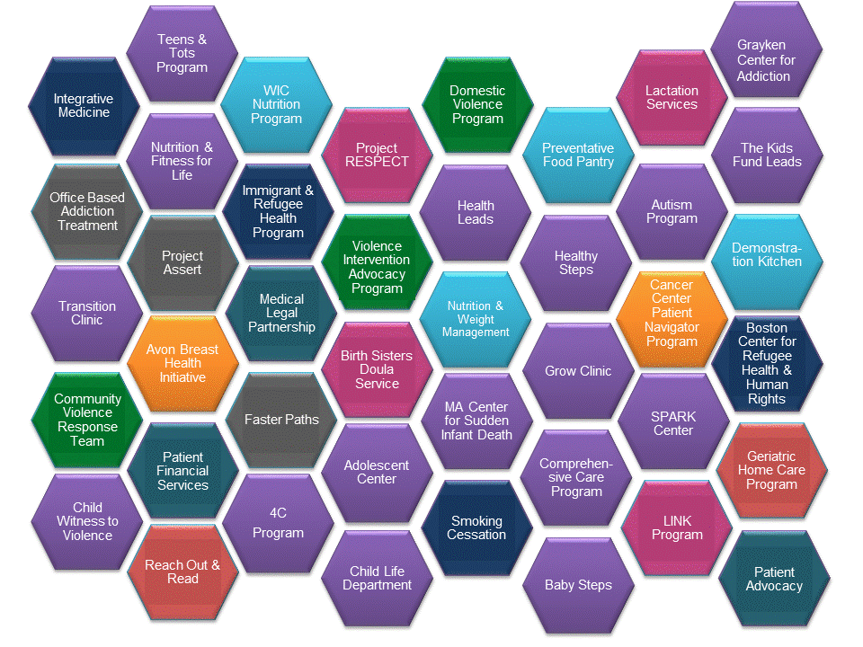
Commitment to Health Equity
Notes:
Given our commitment to health equity, Boston Medical Center provides a wide range of programs and services that extend beyond the traditional medical model to directly address the social determinants of health impacting our community.

Slide 7
Commitment to Diversity: Our Patients
~70% of our patients identify as Black or Hispanic
~30% do not speak English as their primary language
> 50% have an annual household income below $20,400 (close to the federal poverty line for a family of 3)
Notes:
Our patients reflect the diversity of Boston and the surrounding communities. The largest proportion of our patients represent communities that are traditionally underserved including communities of color, low income communities, immigrant and refugee communities, and communities where English is not the primary language.

Slide 8
Commitment to Diversity: Our House Staff
Notes:
We believe that the diversity of our employees, including our residents and fellows, should reflect the diversity of our patient population in many ways, including race and ethnicity. As an institution we are committed to creating a representative housestaff, and over the past five years the number of under-represented minority trainees has increased.

Slide 9
Commitment to Diversity: Our House Staff
Resident & Fellow 2018-19 Race/Ethnic Snapshot
17% self identified as
underrepresented minorities in medicine (URM)
Notes:
Currently, 17% of our residents and fellows identify as under-represented minorities in medicine – compared to the national benchmark of 10%. Our goal is to have 20% URMs by 2020. We believe that diversity as a core value embodies inclusiveness, mutual respect, and multiple perspectives and serves a catalyst for change resulting in health equity.

Slide 10
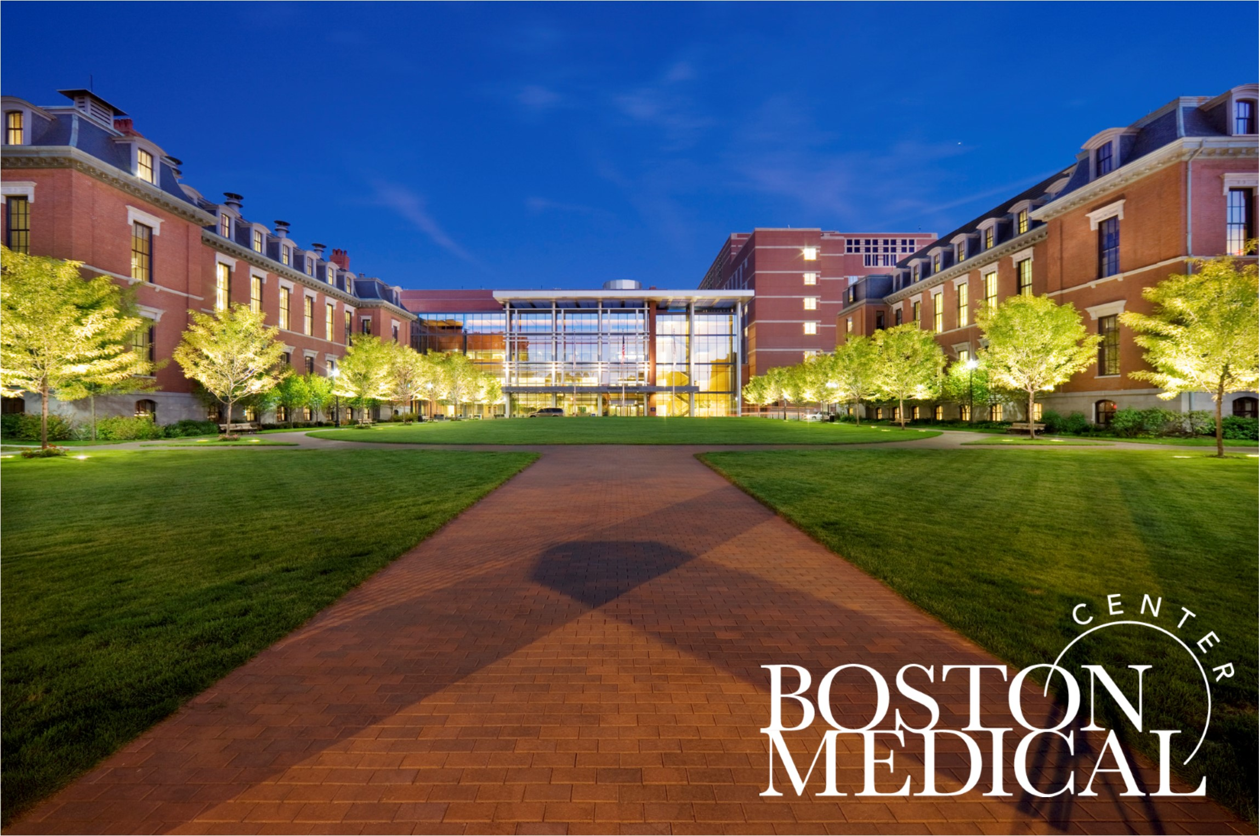
Commitment to Diversity: Our House Staff
We are a "safety net" hospital but a very unique one-one with resources and always leading with nuanced ideas- never afraid to do what is unusual and never afraid to do what has not been done before. Dr. Thea James, Vice President of Mission
“ We are a ‘safety net’ hospital but a very unique one, one with resources and always leading with nuanced ideas- never afraid to do what is unusual and never afraid to do what has not been done before.”
- Dr. Thea James, Vice President of Mission

