Slide 1
Recovery of substance users during Coronavirus outbreak keeping yourself and others healthy
Partners Health Care March 23, 2020

Slide 2
This session will provide you with education to support your substance recovery and to avoid infection with the novel Coronavirus thanks to all images from Pixabay public domain

Slide 3
Golden Rules

Slide 4
WASH YOUR HANDS WITH SOAP FOR 20 seconds
Multiple times a day
Do your fingers separately and your wrists (demo)
Keep your fingernails trimmed short
Use a nailbrush when you can
Learn to stop touching your face – PRACTICE exercise
Cover cough, sneeze, yawns, burps in your elbow
Stay in your elbow for the whole duration (demo)
Eat with your mouth closed, Mom was right

Slide 5
Keep 6 feet away from others
About the length of a public bench
Or height of a standard door

Slide 6
That way you can safely laugh, sing, and debate politics and media all you like
Or height of a standard door

Slide 7
NOT 6 feet

Slide 8
YES 6 feet

Slide 9
Things You Should Know

Slide 10
We are here to help BUT you will not be able to just walk in for help anymore, and hospital beds will be harder to find open during this pandemic

Slide 11
You will need to call for any help you need. Your care provider will give you numbers that are important to keep!
It’s a good idea to write these numbers down and to put them in your phone, if you have one. It’s a good idea to share these numbers with family or friends in case you lose your own copy

Slide 12
Most services are going to be provided by scheduled phone or computer-based visits AND your privacy will still be respected

Slide 13
If you smoke anything, we advise you quit now because you will need healthy lungs to fight Coronavirus if you get it

Slide 14
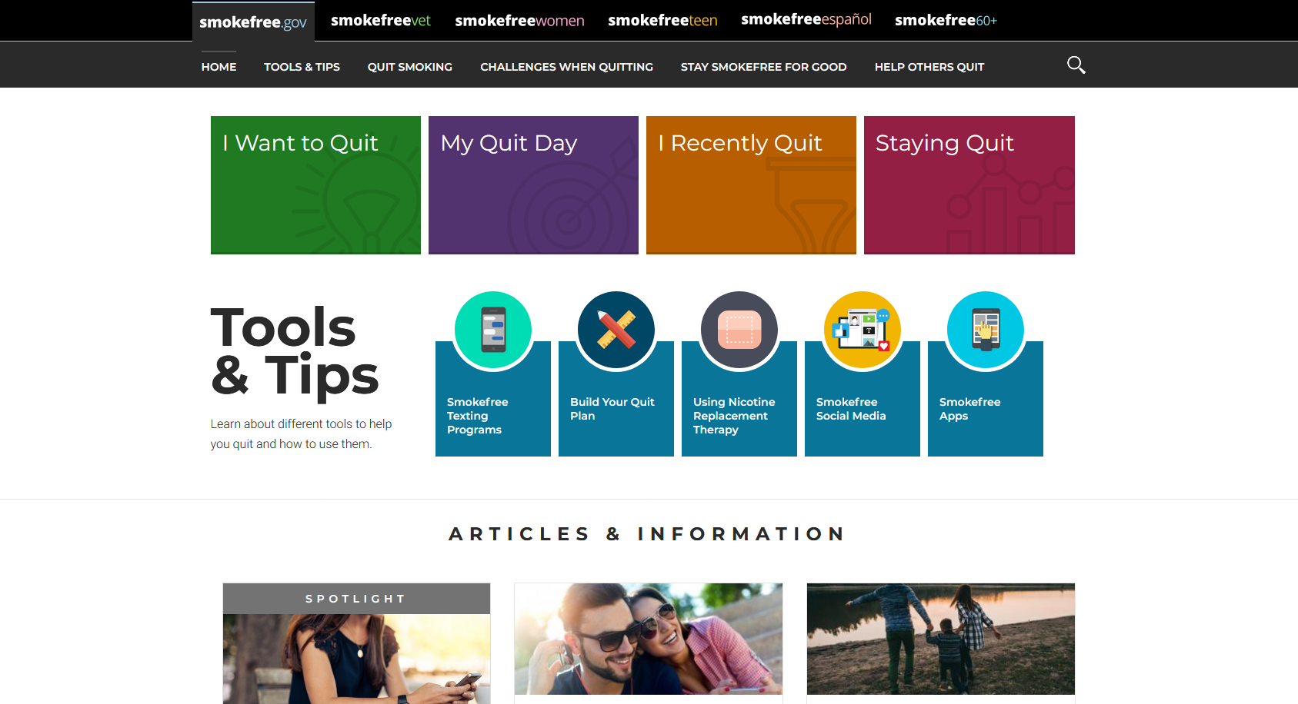
Your care provider can help you to quit with medicine and other supports like Smokefree.gov

Slide 15
Substance use disorders weaken your immune system.
No matter what you are using. Reducing/stopping use helps you to fight Coronavirus if you are exposed.

Slide 16
Medications are effective for nicotine, alcohol, and opioid use disorder AND can be combined with telehealth supports

Slide 17
You are more likely to have a fatal overdose if you are using and you get Coronavirus.
Reducing/stopping use could save your life

Slide 18
Naloxone remains available AND you and the people you live with should have a supply and know how to use it

Slide 19
Narcan nasal spray training video
https://www.youtube.com/watch?v=tGdUFMrCRh4

Slide 20
Methadone maintenance programs are taking fewer new patients because of the pandemic.
Vivitrol is an injection and may also be limited during this time.

Slide 21
For now…. We are recommending that patients new to medication for opioid use disorder receive buprenorphine, a very effective and safe medication

Slide 22
It is NOT safe for anyone with opioid use disorder to be on no medication. Also, there are fewer long-term residential options open during the pandemic.

Slide 23
Peer support groups like Alcoholics Anonymous and SMART Recovery are also running virtual groups. Your care provider can help you get set up for these.

Slide 24
Visit www.intherooms.com see how many meetings and tools are available to you at all times AND a new coronavirus support group!!

Slide 25
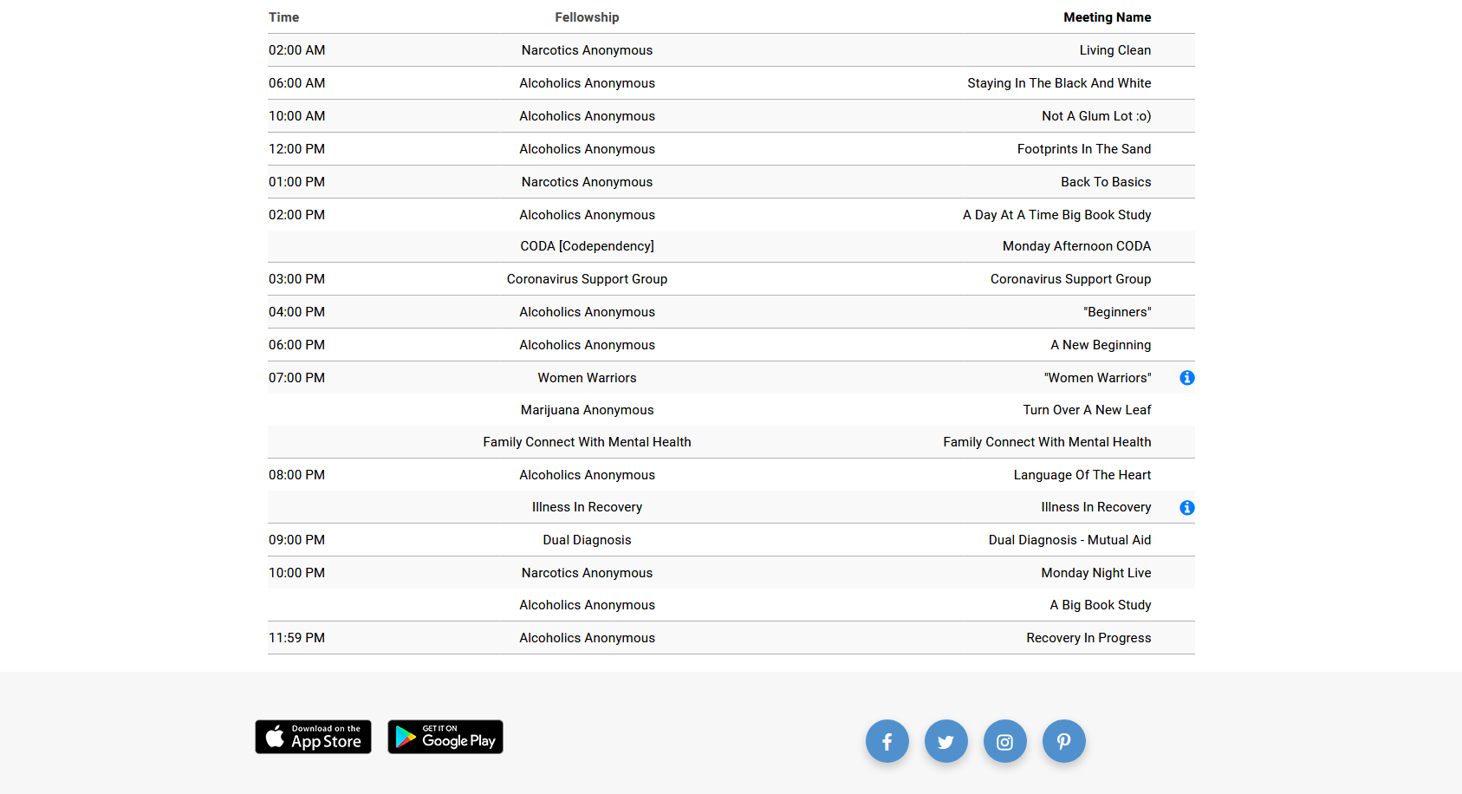
WOW!

Slide 26
It is more important than ever that you
DON’T SHARE
beverages, cigarettes, pipes or vapes of any kind, needles, straws, cottons, etc.

Slide 27
Can I have sex safely? Saliva contact can transmit. We don’t yet know enough about other sexual behaviors, but sharing substances during sex is dangerous.

Slide 28
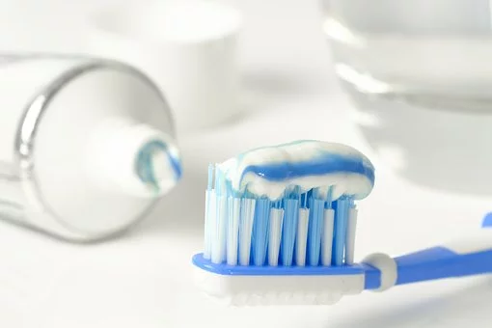
Brush your teeth!!
Coronavirus will infect mucosa more easily if you have poor oral hygiene. Don’t share toothbrushes.

Slide 29
Now let’s discuss all of this…and ask your care provider about medications and other important questions you have about your care
Treatment works!!!!!!

