Slide 1
Epic Beaker Anatomic Pathology (AP) Implementation
Clinician Awareness & Expectations

Slide 2





GO-LIVE
Scope: Anatomic Pathology Orders, Specimens and Results
Epic Beaker AP will support orders, specimen collection and results related to Anatomic Pathology, including biopsies, Pap smears, and other tissue-based specimens. Clinical Pathology (CP) workflows, such as swabs, blood draws, urine dipstick and stool samples are not included in this phase.
NOV 2
2 0 2 6
What’s changing
Epic AP Beaker replaces our current AP lab information system (CoPath) and further integrates AP workflows with the Epic EHR — a more connected experience for ordering, collecting, processing, and reviewing AP specimens and results.
Epic AP Beaker
Is Coming
Clinician Readiness
Impacted Clinicians will receive a tip sheet outlining key workflow changes and a link to optional training in Workday: Epic Beaker Clinician Specimen Collection - MD, APP – Workday. Additional readiness resources will be shared ahead of go-live.
Anatomic Pathology laboratory information system, reimagined — fully connected to the Epic EHR.
Questions or feedback
Share feedback and get answers via the Beaker AP FAQ website (Pathology & Laboratory Medicine section).
CP workflows are unaffected and continue as-is.
Leaders: Reinforce training expectations with your teams and continue to share key Epic Beaker AP readiness updates ahead of the November 2 go-live.
Notes:
Clinics with highest impact: Breast, ENT, Family Medicine / Primary Care, GI, General Surgery, IR / Radiology, OR, L&D, OBGYN...

Slide 3
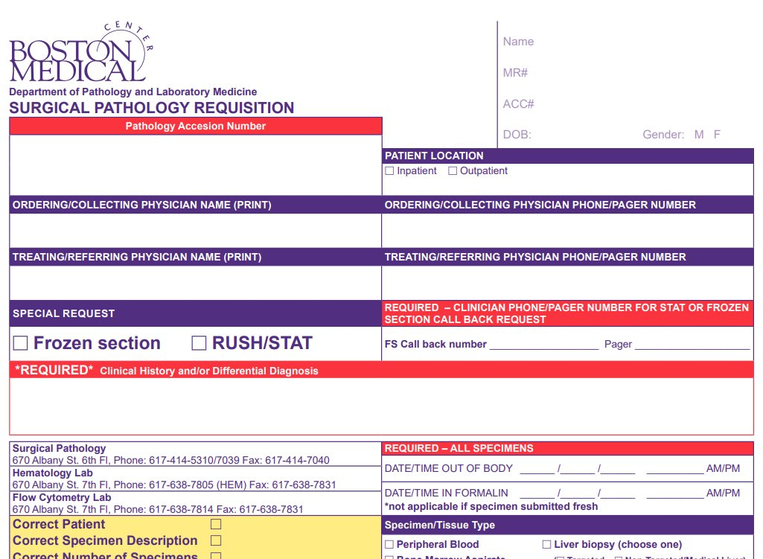
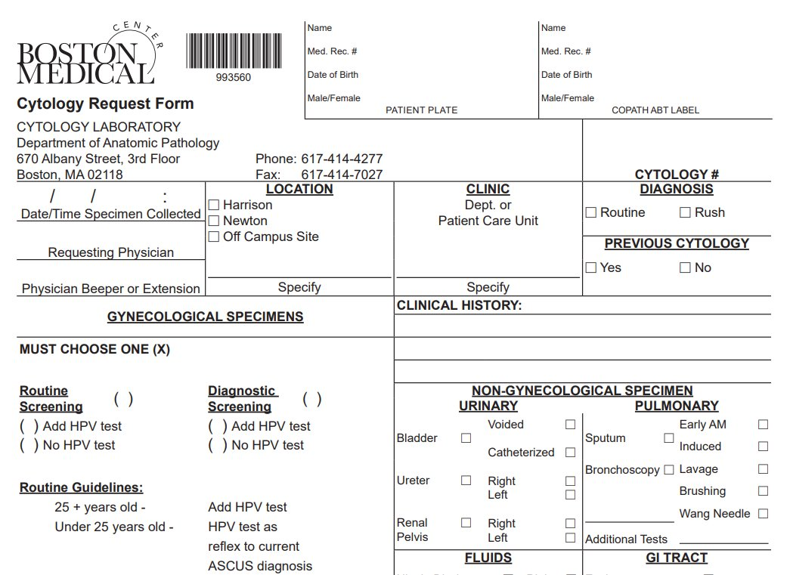
EPIC BEAKER AP
What Clinicians Need to Know
Workflow impacts will vary based on your role and whether you collect specimens.
IF YOU COLLECT SPECIMENS
Ambulatory & Infrequent Collection
Expect changes to specimen collection, labeling and documentation workflows
Epic Beaker AP introduces a paperless process, eliminating the requisition ("req")
Specimens will use Beaker pathology labels as part of the new workflow
A verification step will be required to support downstream laboratory processing
These changes are especially important for clinicians who currently complete Surgical Pathology or Cytology requisitions
Additional focus is being placed on ambulatory and Community Connect workflows
Clinicians who collect specimens infrequently should also become familiar with the new process before go-live
Targeted guidance and resources will be provided to support impacted areas
Clinician RESOURCE
A Clinician tip sheet will be available on the Epic Beaker AP website and will include a link to optional training in Workday.
Notes:
Surgeons should verify verbal orders are correct.

Slide 4
EPIC BEAKER AP
Preparing for November 2
Readiness activities are underway across clinical areas.
People & Workflow
Devices & Testing
Super Users and SMEs are engaged and completing training
Impacted staff are being informed of workflow changes and training expectations
Ambulatory and Community Connect specimen collection workflows are being reviewed and validated
Additional readiness support is being considered for low-volume collection areas
ATE support at go live for high volume areas + command center
Device installation and testing are underway across impacted clinical areas across the health system
Technical Dress Rehearsal (TDR) is validating devices and workflows in the clinical environment
Printer placement and accessibility continue to be reviewed to support specimen collection and labeling
Pathology labeling standards and approved workflows are being confirmed prior to go-live
What Clinicians Can Do Now
Review the Clinician tip sheet on the Epic Beaker AP website, complete optional Workday training if you collect specimens, and watch for additional readiness guidance as we approach November 2.
Notes:
Downtime means reverting to paper reqs and Epic labels

Slide 5
LOOKING AHEAD
What to Expect Between Now and Go-Live
Over the coming weeks, the project will continue to shift from general awareness to workflow readiness, training, and go-live preparation.
Clinicians Can Expect
Continued communication regarding relevant workflow changes
Training and readiness resources based on role and level of impact
Additional guidance for Clinicians who personally collect specimens
Department- and role-based workflow and Q&A drop-in sessions began September 28; clinicians are encouraged to participate.
Continued device and workflow testing in impacted clinical areas
Go-live support information as we approach November 2
Stay Informed
Visit the Epic Beaker AP website for frequently asked questions, important updates, resources, and additional project information.
LABORATORY QUESTIONS
TRAINING QUESTIONS
PROJECT QUESTIONS
Charline Mack / Denise Bland
Vickie Wagner / Krissy Coffee
Pete Balestracci
Notes:
You will continue to see tip sheets, review of workflow mapping, training resources and communications for what happens next.

Slide 6
Questions?

Slide 8
Appendix

Slide 9

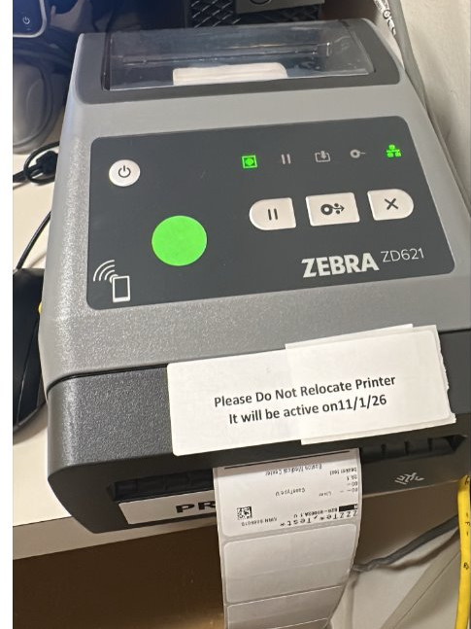

EPIC BEAKER AP · GO-LIVE READINESS
Installation, Testing & TDR Underway
Device Installation & Testing Underway
Device installation and testing, including Technical Dress Rehearsal (TDR), are underway in preparation for the Epic Beaker AP implementation. You may see team members in your area installing, testing, or validating equipment.
IN PROGRESS
Do Not Unplug or Move Validated Equipment
Once equipment has been validated, please do not unplug or move it. Doing so may require retesting and delay completion of TDR.
Prep for Epic Beaker AP implementation

Slide 10
BMC Brighton
APPENDIX | OPERATIONAL READINESS CHAMPIONS
Questions? Reach out to the Operational Readiness Champion for your area.
Department | OR Champion
BMCAP B GEN SURG NEVIN | Mallory Fagone
BMCAP B OB/GYN ALLSTON | Keshaav Krishnaa Pothapur
BMCAP B OB/GYN NORWOOD | Keshaav Krishnaa Pothapur
BMCAP B THORAC SURG | David Phin
BMCB BM PRIMARY CARE | Carolyn Mahoney-Vasconcelos
BMCB C BCAP | Deborah Bryant-Ducharme
BMCB C DANA FARBER | Gabriella Coppola
BMCB C PODIATRY | Kelli Fitzpatrick
BMCB CBR CRA LAB | Christine Minranda-Barba
Department | OR Champion
BMCB DERMATOLOGY NEVIN | Parris Williams
BMCB MCH ENT | Xinia Sinacola
BMCB MCH MFM | Keshaav Krishnaa Pothapur
BMCB MCH OBGYN | Keshaav Krishnaa Pothapur
BMCB MOB INF DIS NEVIN | Jennifer McInerney
BMCB MOB PRIMARY CARE | Humu Marah
BMCB MOB UROLOGY | Camille Parker Straker
Pain Clinic | Rita Marrochio

Slide 11
BMC Main (1 of 2)
APPENDIX | OPERATIONAL READINESS CHAMPIONS
Questions? Reach out to the Operational Readiness Champion for your area.
Department | OR Champion
BMC OFFSITE OBGYN | Ana Jiminian
CRO ADOLESCENT CLINIC | Michelle Saboliauskas
CRO FAM MED START | Kristin Parent
CRO FAMILY MEDICINE | Danielle Fontaine
CRO OBAT | Lexie Bergeron
CRO PEDI GENETICS | Esther Mangoma
CRO PEDI HEMA | Esther Mangoma
CRO PEDI STAR UNIT | TBD
CRO PEDIATRIC CLINIC | Solennia Mejia
CRO PRIMARY CARE 5A | Deb Stevens
CRO PRIMARY CARE 5B | Deb Stevens
Department | OR Champion
CRO PRIMARY CARE 5C | Deb Stevens
CRO PRIMARY CARE 6A | Deb Stevens
CRO PRIMARY CARE 6B | Deb Stevens
CRO PRIMARY CARE 6C | Deb Stevens
MOA AMYLOID | Jennifer Yorko
MOA BELKIN BREAST SURGERY | TBD
MOA DERMATOLOGY - ADULT | Parris Williams
MOA HEM ONC | Jennifer Yorko
MOA OTOLARYNGOLOGY | Erin Zachariasen
MOA SICKLE HEM | Jennifer Yorko

Slide 12
BMC Main (2 of 2)
APPENDIX | OPERATIONAL READINESS CHAMPIONS
Questions? Reach out to the Operational Readiness Champion for your area.
Department | OR Champion
MOA THORACIC ONCOLOGY | Jennifer Yorko
OCM BU CHARLES RIVER | Parris Williams
PRE CARDIAC REHAB | Jill Ross
PRE CARDIOLOGY | Jill Ross
PRE ENDO/NUTR | Sophia Copeland
PRE FOOT CARE SPECL | Nicky Walker
SBO PHYSICAL THERAPY | Jeff Merritt
SHA ANTE NATAL TSTG | Ana Jiminian
SHA CENTER FOR INF DISEASE | Lexie Salters
SHA DERMATOLOGY | Parris Williams
Department | OR Champion
SHA GASTROENTRLGY BUMG | Keith Ellis
SHA GERIATRIC PRACTICE | Celina Cruz
SHA GYN SPECIALTY | Ana Jiminian
SHA OB/GYN MAIN | Ana Jiminian
SHA OMFS | Kate Masters
SHA OMFS URGENT CARE | Kate Masters
SHA PLASTIC SURGERY | TBD
SHA RHEUMATOLOGY CLINIC | Keith Ellis
SHA SURGICAL | Priscilla Melo
SHA UROLOGY | Suzette Dos Santos

