Slide 1
Epic Beaker Anatomic Pathology (AP) Implementation
Clinician Awareness & Expectations

Slide 2





GO-LIVE
Scope: Anatomic Pathology Orders, Specimens and Results
Epic Beaker AP will support orders, specimen collection and results related to Anatomic Pathology, including biopsies, Pap smears, and other tissue-based specimens. Clinical Pathology (CP) workflows, such as swabs, blood draws, urine dipstick and stool samples are not included in this phase.
NOV 2
2 0 2 6
What’s changing
Epic AP Beaker replaces our current AP lab information system (CoPath) and further integrates AP workflows with the Epic EHR — a more connected experience for ordering, collecting, processing, and reviewing AP specimens and results.
Epic AP Beaker
Is Coming
Clinician Readiness
Impacted Clinicians will receive a tip sheet outlining key workflow changes and a link to optional training in Workday: Epic Beaker Clinician Specimen Collection - MD, APP – Workday. Additional readiness resources will be shared ahead of go-live.
Anatomic Pathology laboratory information system, reimagined — fully connected to the Epic EHR.
Questions or feedback
Share feedback and get answers via the Beaker AP FAQ website (Pathology & Laboratory Medicine section).
CP workflows are unaffected and continue as-is.
Leaders: Reinforce training expectations with your teams and continue to share key Epic Beaker AP readiness updates ahead of the November 2 go-live.
Notes:
Clinics with highest impact: Breast, ENT, Family Medicine / Primary Care, GI, General Surgery, IR / Radiology, OR, L&D, OBGYN...

Slide 3
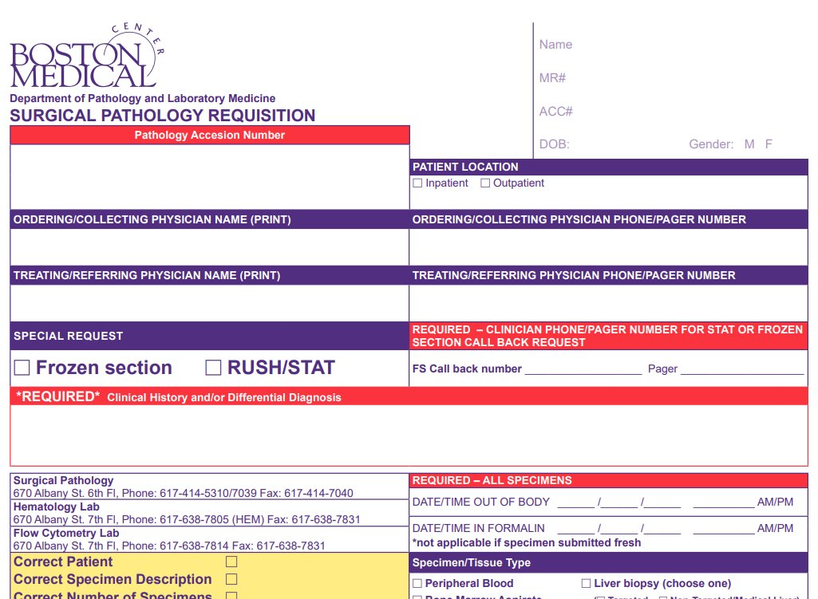
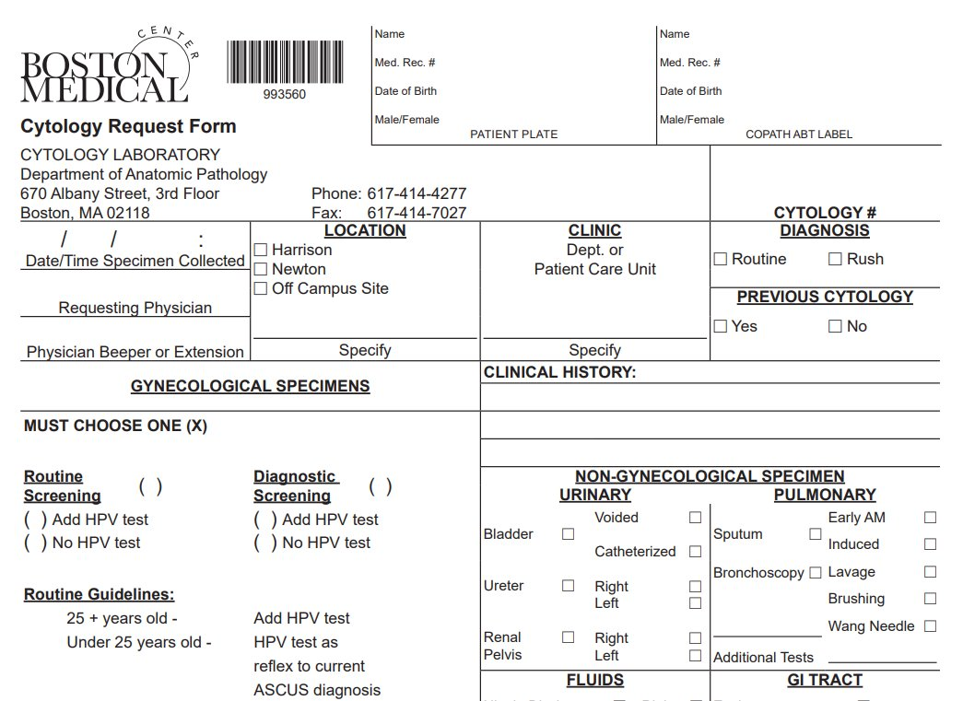
EPIC BEAKER AP
What Clinicians Need to Know
Workflow impacts will vary based on your role and whether you collect specimens.
IF YOU COLLECT SPECIMENS
Clinician RESOURCE
A Clinician tip sheet will be available on the Epic Beaker AP website and will include a link to optional training in Workday.
Epic Beaker Enrolling in Epic Training_Workday
Expect changes to specimen collection, labeling and documentation workflows
Epic Beaker AP introduces a paperless process, eliminating the requisition ("req")
Specimens will use Beaker pathology labels as part of the new workflow
A verification step will be required to support downstream laboratory processing
These changes are especially important for clinicians who currently complete Surgical Pathology or Cytology requisitions
Ambulatory & Infrequent Collection
Additional focus is being placed on ambulatory and Community Connect workflows
Clinicians who collect specimens infrequently should also become familiar with the new process before go-live
Targeted guidance and resources will be provided to support impacted areas
Notes:
Surgeons should verify verbal orders are correct.

Slide 4
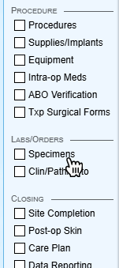
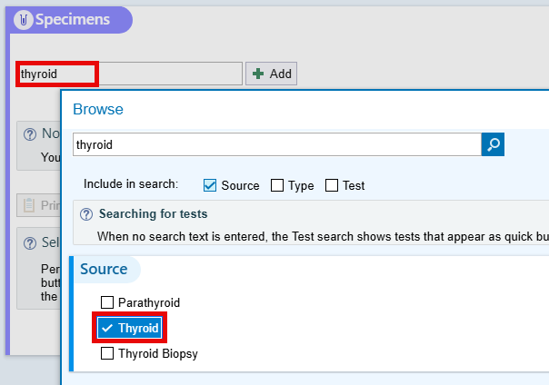
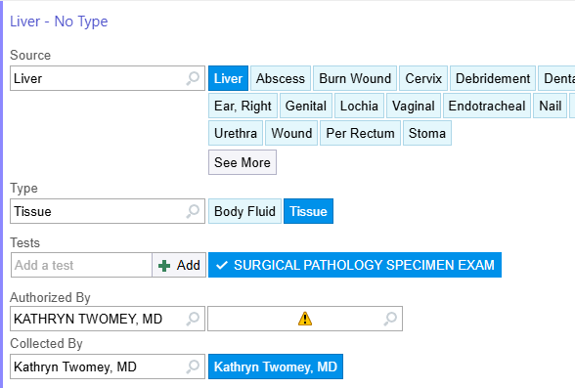
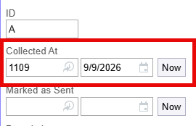



EPIC BEAKER AP
Specimen Collection in Procedural Spaces
Step 1: Specimen Navigator
Step 2: Document Specimen Source
Step 3: Complete Documentation
Step 4: Print Labels & Mark as Sent
Mark as Sent = Notifies the lab that they should be expecting this specimen
How to collect AP specimens in a Surgical or Procedural setting: Tip Sheet!

Slide 5
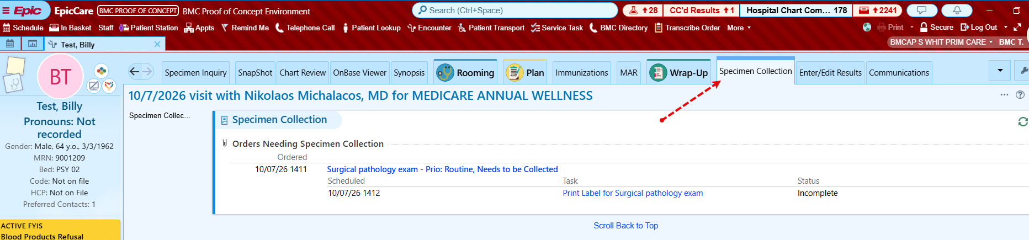
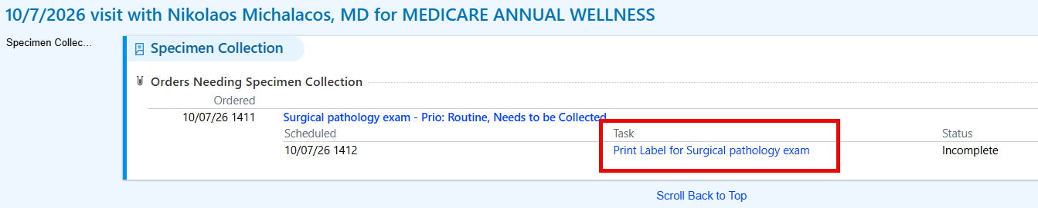
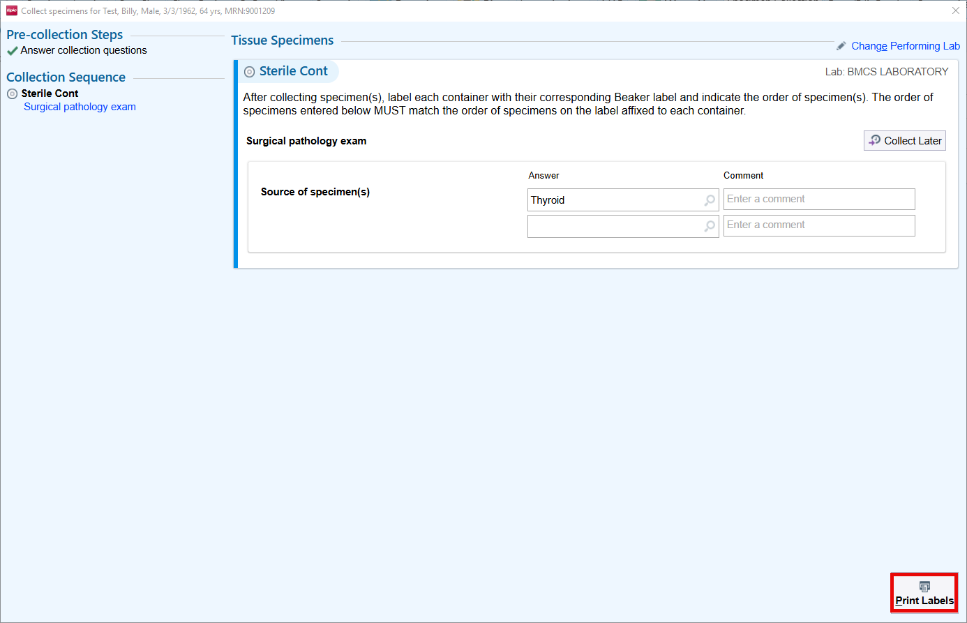
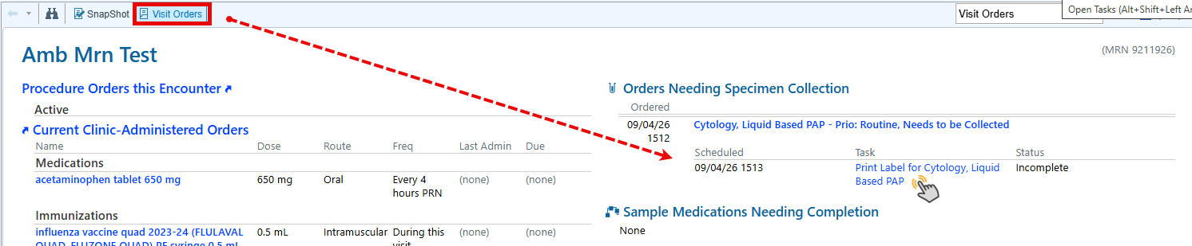
EPIC BEAKER AP
Specimen Collection in the Outpatient Setting
Step 1: Specimen Collection Navigator OR AMB Visit Orders Report from MPS
Step 2: Print Labels, Label Specimen
How to collect AP specimens in an Ambulatory setting: Tip Sheet!

Slide 6
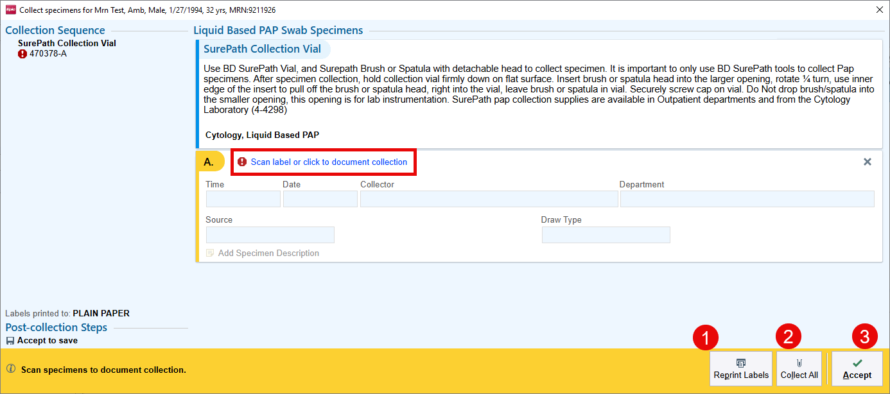
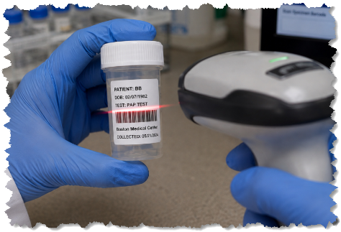
EPIC BEAKER AP
Specimen Collection in the Outpatient Setting
Step 3: Document Collection
Scan when you can!! If you work in a department that uses barcode scanners, you can go ahead and scan the specimen. The specimen and collection details will default into the collection window for you. If you do not have a scanner, you can click the hyperlink to document the collection details.
If you need to reprint your labels, click Reprint Labels
If you have multiple specimens to document on, you could click Collect All
  Note: Only use this if the collection details are the same for both specimens, including Collector.
When you are finished, click Accept
What happens next?! Great question. The specimen will be added to a Packing List for the courier to pick up and deliver to the lab.
How to collect AP specimens in an Ambulatory setting: Tip Sheet!

Slide 7

Epic Beaker AP | Go-Live Support Expectations
November 2, 2026 Go-Live
At-the-Elbow (ATE) Support – Weeks 1–3
Ambulatory Clinic Support
CSI will provide ATE support during the first three weeks of go-live.
The ATE Phone Tree will serve as the primary support model for ambulatory clinics.
In-person ATE resources will be deployed to support laboratory operations and specimen collection workflows at designated locations.
Limited in-person ATE resources will be deployed to select ambulatory locations based on regional coverage.
In-Person Support Coverage
Operational Expectations
Support Area | Locations
Laboratory Operations | BMC Main, BMC South, BMC Brighton, DotHouse, Codman
Clinical Specimen Collection | BMC Main, BMC South, BMC Brighton
Select Ambulatory Locations | Codman, DotHouse, Whitman, OB/GYN, Endocrine and other designated locations
Leaders should ensure staff are aware of the go-live support model and how to access assistance.
Staff should utilize designated ATE resources or the Phone Tree for workflow questions and issues encountered during go-live.
Issues requiring additional assistance should be escalated through established support channels.
Go-Live Support Priority: Ensure staff know where to obtain assistance, how to report issues, and when to escalate concerns to support safe and effective operations.
Notes:
Example: at BMC main campus Med Surg, Crosstown Primary Care, Ambulatory Locations, OR, Endoscopy, OB/GYN as well as float ATE support will be available.

Slide 8
Questions?

Slide 10
Appendix

Slide 11

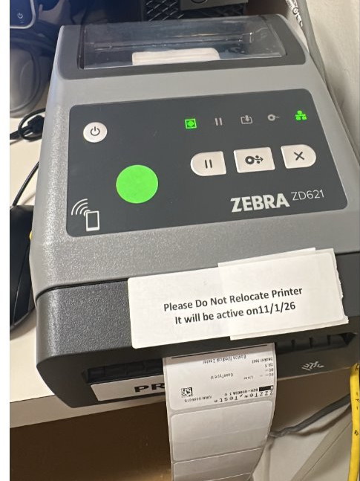

EPIC BEAKER AP · GO-LIVE READINESS
Installation, Testing & TDR Underway
Device Installation & Testing Underway
Device installation and testing, including Technical Dress Rehearsal (TDR), are underway in preparation for the Epic Beaker AP implementation. You may see team members in your area installing, testing, or validating equipment.
IN PROGRESS
Do Not Unplug or Move Validated Equipment
Once equipment has been validated, please do not unplug or move it. Doing so may require retesting and delay completion of TDR.
Prep for Epic Beaker AP implementation

Slide 12
BMC Brighton
Questions? Reach out to the Operational Readiness Champion for your area and please copy Kristin Coffey, CJ Wachs, and Desiree Thompson in your email.
Department | OR Champion | Status
BMCAP B OB/GYN ALLSTON | Erin Stender | Closing
BMCAP B OB/GYN NORWOOD | Erin Stender | Pending
BMCAP B PRIM CARE NORWOOD | Caroline Ward | Pending
BMCAP B THORAC SURG | David Phin | Accepted
BMCB BM PRIMARY CARE | Carolyn Mahoney-Vasconcelos | Accepted
BMCB C DANA FARBER | Mairead O'Riordan | Accepted
BMCB C MULTI SPECIALTY SURG CLN | Mallory Fagone | Pending
BMCB C PODIATRY | Kelli Fitzpatrick | Pending
BMCB CBR CRA LAB | Christine Minranda-Barba | N/A
Department | OR Champion | Status
BMCB DERMATOLOGY NEVIN | Parris Williams | Accepted
BMCB MCH ENT | Xinia Sinacola | Accepted
BMCB MCH MFM | Keshaav Krishnaa Pothapur | US only
BMCB MCH OBGYN | Erin Stender | Pending
BMCB MOB INF DIS NEVIN | Jennifer McInerney | Accepted
BMCB MOB PRIMARY CARE | Humu Marah | Accepted
BMCB MOB UROLOGY | Camille Parker Straker | Accepted
Pain Clinic | Rita Marrochio | No labs
Information accurate as of Tuesday, 10/20 at 9:16 AM.
Department names as listed in Epic (DEP). TBD = champion not yet identified. Status reflects the Confirmed column of the champion tracker.

Slide 13
BMC Main (1 of 2)
Questions? Reach out to the Operational Readiness Champion for your area and please copy Kristin Coffey, CJ Wachs, and Desiree Thompson in your email.
Department | OR Champion | Status
BMC OFFSITE OBGYN | Grace Greenstein, Jessica Ortiz, Katherine Murphy Backup: Ana Jiminian | Pending
CRO ADOLESCENT CLINIC | Michelle Saboliauskas | Accepted
CRO FAM MED START | Kristin Parent | Pending
CRO FAMILY MEDICINE | Danielle Fontaine | Accepted
CRO OBAT | Lexie Bergeron | Pending
CRO PEDI GENETICS | Michelle Saboliauskas | Accepted
CRO PEDI HEMA | Michelle Saboliauskas | Accepted
CRO PEDI STAR UNIT | Michelle Saboliauskas | Accepted
CRO PEDIATRIC CLINIC | Michelle Saboliauskas | Accepted
CRO PRIMARY CARE 5A | Egidia Rugwizangoga | Pending
CRO PRIMARY CARE 5B | Kate Derr | Pending
Department | OR Champion | Status
CRO PRIMARY CARE 5C | Egidia Rugwizangoga | Pending
CRO PRIMARY CARE 6A | Egidia Rugwizangoga | Pending
CRO PRIMARY CARE 6B | Egidia Rugwizangoga | Pending
CRO PRIMARY CARE 6C | Egidia Rugwizangoga | Pending
MOA AMYLOID | Jennifer Yorko | Pending
MOA BELKIN BREAST SURGERY | Mallory Fagone | Pending
MOA DERMATOLOGY - ADULT | Parris Williams | Accepted
MOA HEM ONC | Jennifer Yorko | Pending
MOA OTOLARYNGOLOGY | Ashley Pena | Accepted
MOA SICKLE HEM | Jennifer Yorko | Pending
Information accurate as of Tuesday, 10/20 at 9:16 AM.
Department names as listed in Epic (DEP). TBD = champion not yet identified. Status reflects the Confirmed column of the champion tracker.

Slide 14
BMC Main (2 of 2)
Questions? Reach out to the Operational Readiness Champion for your area and please copy Kristin Coffey, CJ Wachs, and Desiree Thompson in your email.
Department | OR Champion | Status
MOA THORACIC ONCOLOGY | Jennifer Yorko | Pending
OCM BU CHARLES RIVER | Parris Williams | Accepted
PRE CARDIAC REHAB | Jill Ross | Accepted
PRE CARDIOLOGY | Jill Ross | Accepted
PRE ENDO/NUTR | Sophia Copeland | Accepted
PRE FOOT CARE SPECL | Nicky Walker/Renee Alexis | Accepted
SBO PHYSICAL THERAPY | Jeff Merritt | N/A
SHA ANTE NATAL TSTG | Grace Greenstein, Jessica Ortiz, Katherine Murphy Backup: Ana Jiminian | Pending
SHA CENTER FOR INF DISEASE | Blaise Mbargorba | Accepted
SHA DERMATOLOGY | Parris Williams | Accepted
Department | OR Champion | Status
SHA GASTROENTRLGY BUMG | Keith Ellis | Accepted
SHA GERIATRIC PRACTICE | Celina Cruz | Accepted
SHA GYN SPECIALTY | Grace Greenstein, Jessica Ortiz, Katherine Murphy Backup: Ana Jiminian | Pending
SHA OB/GYN MAIN | Grace Greenstein, Jessica Ortiz, Katherine Murphy Backup: Ana Jiminian | Pending
SHA OMFS | Kate Masters | Pending
SHA OMFS URGENT CARE | Kate Masters | Accepted
SHA PLASTIC SURGERY | Luisa Gomes | Accepted
SHA RHEUMATOLOGY CLINIC | Keith Ellis | Accepted
SHA SURGICAL | Priscilla Melo | Pending
SHA UROLOGY | Suzete Dos Santos | Accepted
Information accurate as of Tuesday, 10/20 at 9:16 AM.
Department names as listed in Epic (DEP). TBD = champion not yet identified. Status reflects the Confirmed column of the champion tracker.

Slide 15
BMC South & Community Health Centers
Questions? Reach out to the Operational Readiness Champion for your area and please copy Kristin Coffey, CJ Wachs, and Desiree Thompson in your email.
BMC South | OR Champion | Status
BMCAP S ENT | Danielle McCann | Pending
BMCAP S GEN SURG B ST | Cerissa DiRusso | Pending
BMCAP S GEN SURG P ST | Cerissa DiRusso | Pending
BMCAP S MOB PC BROCKTON | Katie-Ann Henault | Pending
BMCAP S OBGYN 223E | Keshaav Krishnaa Pothapur | Pending
BMCAP S WHIT PRIM CARE | Roberta Child | Pending
BMCS MOB HEM ONC | Tammy DiPietro | Accepted
BMCS MOB INFUSION | Tammy DiPietro | Accepted
BMCS NEC BREAST SURG | Cerissa DiRusso | Pending
BMCS WASH DERMATOLOGY | Parris Williams | Accepted
BMCS WASH GASTRO | Amy Lyons | Pending
BMCS WOUND CENTER | Cerissa DiRusso | Pending
Codman Square HC | OR Champion | Status
CSHC FAMILY MED | Erica O'Brien | Pending
CSHC INTERNAL MED | Erica O'Brien | Pending
CSHC PERINATAL AND GYN | Erica O'Brien | Pending
CSHC URGENT CARE | Erica O'Brien | Pending
CSHC X CLINIC | Erica O'Brien | Pending
DOT House HC | OR Champion | Status
DHH FAMILY MED | Erica O'Brien | Pending
DHH LAB SERVICES | Erica O'Brien | Pending
DHH WOMENS HEALTH | Erica O'Brien | Pending
Information accurate as of Tuesday, 10/20 at 9:16 AM.
Department names as listed in Epic (DEP). TBD = champion not yet identified. Status reflects the Confirmed column of the champion tracker.

