Slide 1
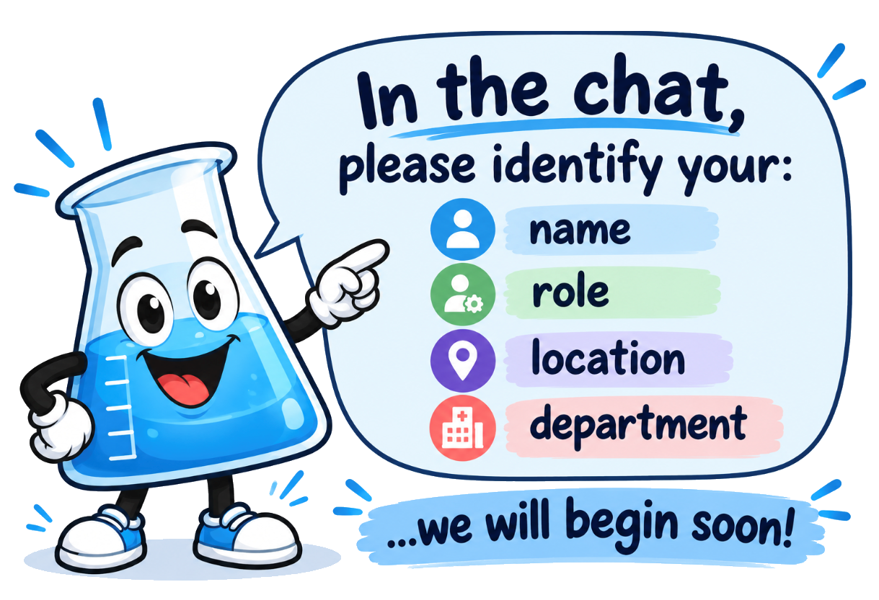
Beaker AP Workflow Support Session
2026

Slide 2
Agenda
Workflow Walkthroughs
Workflow Questions
Appendix
Brief Overview of Project
Ordering, Collection, Labeling
Packing Lists

Slide 3
Purpose
Support organizational readiness for Beaker AP implementation across BMC Ambulatory Practices.
Reinforce understanding of future-state Beaker AP workflows through review and discussion.
Enable ambulatory leaders to identify and begin planning necessary changes to local operational workflows.
Provide direct access to project subject matter experts to address questions and support workflow redesign efforts.

Slide 4
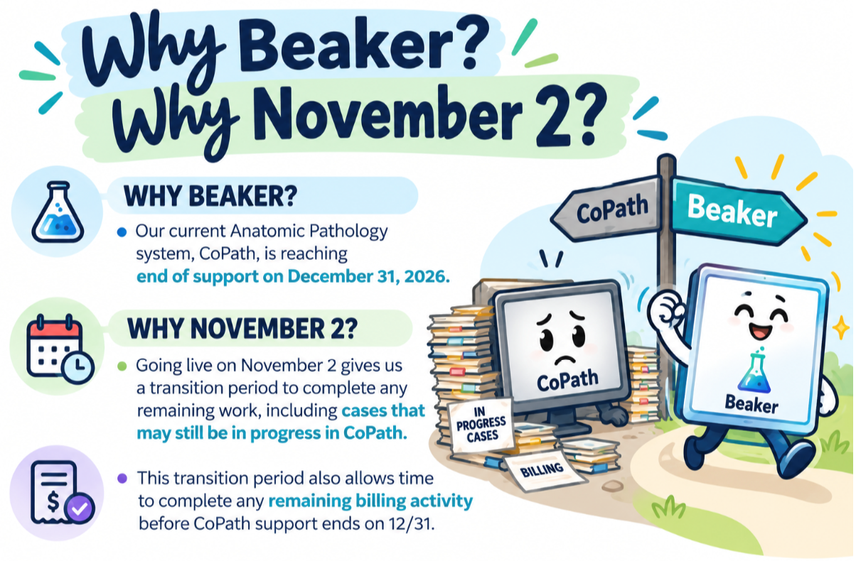
Notes:
Current state: AP tests resulted by CoPath system
CoPath is going out of support effective 12/31/26
BMC may no longer use CoPath as of 12/31/26
Make sure Denise sees this so I’m not lying about anything – KC

Slide 5




What tests are moving to Beaker?
IN SCOPE
Anatomical Pathology (AP) tests
OUT OF SCOPE
Examples
Blood tests
Pap smears
Surgical specimens/Tissue Exams
Biopsies
Examples
LAB1750 | Tissue Exam
LAB12 | Autopsy
LAB904A | Gynecologic Cytology
LAB8A | Non-Gynecology Cytology
LAB3030 | Molecular Genetics
LAB1729 | Flow Cytometry
LAB1950 | NGS
LAB9040 | HPV Self Collect
LAB534 | Fine Needle Aspiration
BMP/CMP
CBC
HgbA1C
Urine tests
Microbiology
5

Slide 6

Go-Live Logistics
Training
At the Elbow / Ear (ATE)
Command Center
A training module has been developed which walks through collecting specimens in every care setting (Outpatient, Inpatient, Procedural/Surgical, and Emergency Department).
Nurses and Medical Assistants have been assigned the module in their LMS:
    BMC Main: Symplr
    BMC South & Brighton: Workday
Please use the F1 dashboard in Epic! Training content will continue to be made available!
Three weeks of ATE with a taper plan
In person ATE deployed at specimen collection clinical locations:
    BMC Main
    BMC South
    BMC Brighton
Phone Tree ATE will be the primary mode of support for ambulatory clinics
    Some in person ATE deployed at ambulatory clinic locations (by region)
        Codman, DotHouse, Whitman, OBGYN locations, Endocrine etc.
We will staff a command center with IT analysts and leaders to triage issues, answer questions, and expedite solutions in real time.
If you are looking for ATE support, please contact the Command Center and someone will be dispatched to you!
Notes:
Done – KC

Slide 7
Workflow Walk Through

Slide 8
Order Creation and Collection
Demo and Visio

Slide 9
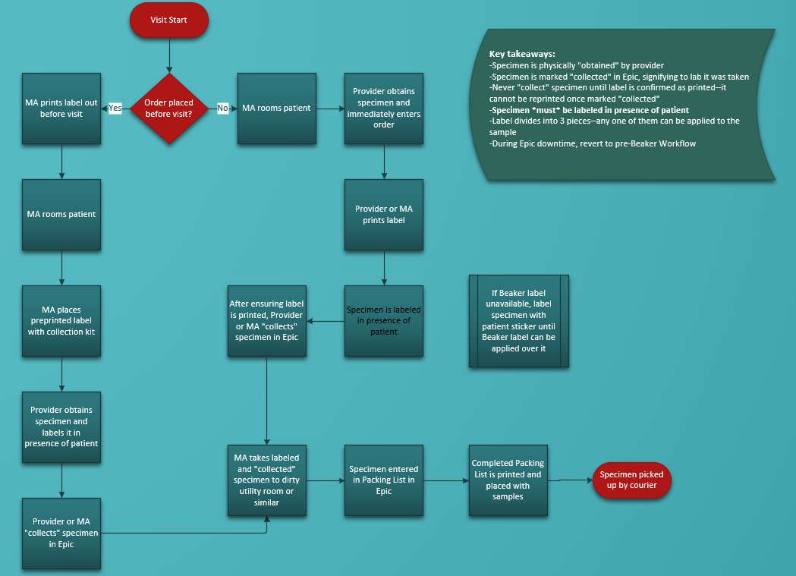

Slide 10
New AP Printer & Label

Slide 11
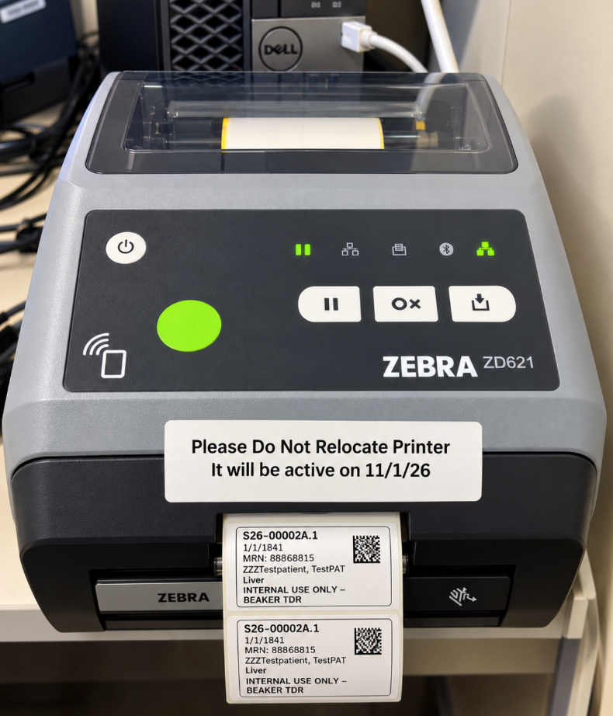
New AP Label Printer
New Label Printer
New Label Printer Locations
Commonly placed in centralized locations
    MA workstations
    Patient exam rooms- High demand departments/locations (Surgical Suites/OB-GYN)
    Nursing Pods/Stations

Slide 12
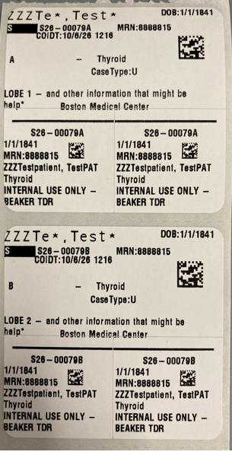
New AP Label Example
3 separate labels available:
    1 large
    2 small
Only one label is required per container

Slide 13
YOUR TURN – Future Workflow Considerations
BEFORE PROCEDURE:
How and who will enter AP orders and Print labels?
AFTER PROCEDURE:
How and who will enter AP orders and Print labels?
What changes are required in your collection process?

Slide 14
Packing List
Demo and Visio

Slide 15
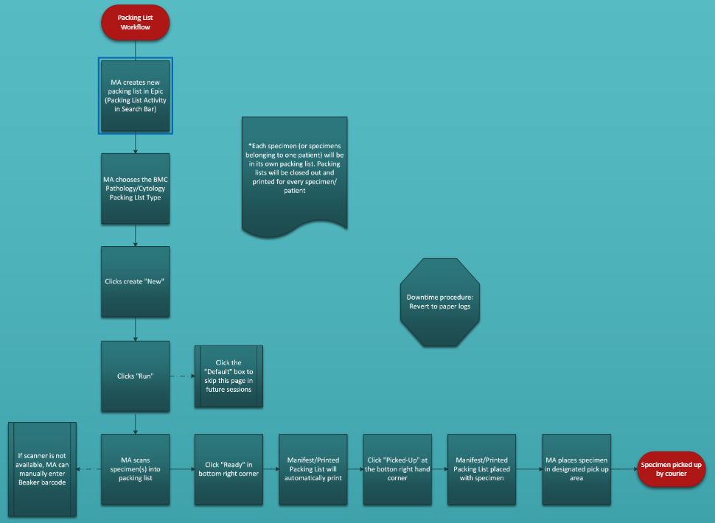

Slide 16
YOUR TURN – Future Workflow Considerations
How will you BE PREPARING packING specimens LISTS for lab?
Other workflow considerations for your area(s)?

Slide 17
Any Outstanding
Workflow Questions?

Slide 18
Additional Readiness Opportunities

Slide 19



Life of a Specimen Workshops
Using real-world patient scenarios, these sessions will walk through the specimen journey across the continuum of care, including specimen ordering, collection, handling, documentation, testing, reporting, and charging. The goal is to provide participants with a practical view of the workflows, technologies, and clinical considerations that support specimen management and high-quality patient care.
Clinicians and Nursing Staff: The first 30 minutes of each Life of a Specimen session will focus on workflow and care-setting considerations most relevant to clinical teams, including ordering, collection, documentation, and patient care impacts
Tuesday, October 13
Wednesday, October 14
Time | Session | Location
8:30–9:30 AM | Life of a Specimen – Outreach For Lab staff only | BMC Main 85 E Concord St. 8th Floor Conference Room
10:00–11:30 AM | Life of a Specimen – ED/Inpatient/Peri-op Encounter Surgical Encounter & Pathology Testing | BMC Main 85 E Concord St. 8th Floor Conference Room
12:00–1:30 PM | Life of a Specimen – Clinic/Ambulatory Workflow Medical Assistant Collection Workflows | BMC Main 85 E Concord St. 8th Floor Conference Room (and virtual option; Click here)
2:15–3:15 PM | Reporting Workshop For Lab staff only | BMC Main 85 E Concord St. 8th Floor Conference Room + Brighton/South staff joining virtually; Click here
3:30–4:30 PM | Q&A with Lab Leaders For Lab staff only | BMC Main 85 E Concord St. 8th Floor Conference Room
Time | Session | Location
8:00–9:15 AM | Life of a Specimen – ED/Inpatient/Peri-op Encounter Surgical Encounter & Pathology Testing | BMC Brighton MCH Conference Rooms 3 & 4
9:30–10:30 AM | Life of a Specimen – Clinic/Ambulatory Workflow Medical Assistant Collection Workflows | BMC Brighton MCH Conference Rooms 3 & 4 (and virtual option; Click here)
10:45–11:45 AM | Q&A with Lab Leaders For Lab staff only | BMC Brighton MCH Conference Rooms 3 & 4
1:15–2:30 PM | Life of a Specimen – ED/Inpatient/Peri-op Encounter Surgical Encounter & Pathology Testing | BMC South Room TBD
2:45–3:45 PM | Life of a Specimen – Clinic/Ambulatory Workflow Medical Assistant Collection Workflows | BMC South Room TBD (and virtual option; Click here)
4:00–5:00 PM | Q&A with Lab Leaders For Lab staff only | BMC South Room TBD

Slide 20
Next Steps

Slide 21

Next Steps
Ensure your areas have updated workflows based on the new AP process
Please make sure to complete your assigned training
    Managers and Leaders: Please continue to encourage staff to complete their module in Workday and/or Symplr
Note the location of the new AP printers in your areas
Escalate any issues or needs you have to the project team prior to go-live
Share project updates and timeline with your peers and staff

Slide 22
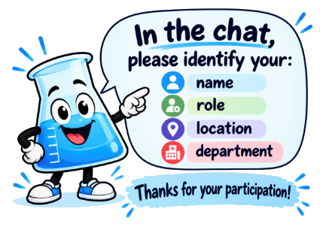
Reminder

Slide 23
FAQs
QUESTION | ANSWER
When will label printers be installed in my area? | Currently in process- all areas working on Procedural areas at this time
Why is BMC transitioning from CoPath to Beaker? | Our current AP system, CoPath, will be out of support on 12/31/26, and we will no longer be able to use it for AP tests.
It’s a busy time of year, why do we have to transition to CoPath in November? | Going live in November ensures we are fully transitioned out of CoPath and into Epic Beaker prior to the 12/31/26 deadline.
What do I do if I can’t or didn’t print the label prior to collecting the specimen? | While in the room, use a patient name label, add the collection date and time, and affix to container. Once completed, print and add the new AP label to the container. (It is ok if there are two labels or the new label covers the old)
What do I do if Epic is down? | Use old forms as part of the downtime process. Only when Epic down.

Slide 24
Appendix

Slide 25
Beaker Project Overview
On November 2nd, we will replace our current Anatomic Pathology system (CoPath) with Epic Beaker.
Anatomic Pathology refers to the examination of tissues and cells to diagnose various diseases. This includes biopsies, surgical pathology specimens, cytology specimens, fine-needle aspirations, and Pap smears.
The Epic Beaker project will affect how pathology and cytology specimens are collected, labeled, tracked, and processed.
This project does not include blood tests, cultures, or other Clinical Pathology or Lab Medicine work.
This is a significant change that extends beyond the Laboratory to the clinical teams who collect pathology and cytology specimens. For example, in our outpatient areas, nurses, medical assistants, and physicians will now directly document specimen collection and print labels in Epic for all biopsies and tissue specimens.
In Scope: AP Specimens
Examples:
    Surgical Specimens/Tissue Exams
    Pap Smears
    Pathological fluid exams
    Autopsy
    Out of Scope: CP Specimens
Examples:
    Blood tests, i.e., CMP, CBC, etc.…
    Urine tests
    Respiratory specimens
Notes:
Only use this slide if we want! This is a duplicate of slide 4 with more information - KC

Slide 26
Project Timeline
Today
Discovery
Build
Testing
Training
Go-Live
Workstream | March 2026 | April 2026 | May 2026 | June 2026 | July 2026 | August 2026 | September 2026 | October 2026 | November 2026 | December 2026
Communications and Readiness
Epic Beaker Build Saul Becker (BMC) Grace Owen (Epic)
Testing Saul Becker (BMC) Grace Owen (Epic)
Interfaces and Integration Kim Woodson-Ellcock (BMC) Cormac Calcaterra (Epic)
Training & Activation Support Kristin Coffey (BMC) Grace Owen (Epic)
End User Devices John Ewart-Cyzon (BMC) Brian Smith (Epic)
Go-Live Readiness Program
90-Day
60-Day
30-Day
Comms Planning and Awareness
Workflow and Readiness Comms
Training & Workflow Reinforcement
Countdown, Support and Go-Live Comms
Go-Live
Nov 2
Post-Live Support & Stabilization
Build Wave 1
Build Wave 2
Build Wave 3
Build Wave 4
Cutover
App Testing
Charge Testing
Int Testing + PRCT
CCV Phase 1
CCV Phase 2
Outreach BLRR
Interface Design and Connectivity Testing
Primary Functional Testing
Functional Testing
Mapped Record Testing
Content Review / Sign Off
Curriculum Development
Beaker Training Environment Planning
MST Build
SU Training
End User Training
Enterprise MST Change Management
ATE Onboard
ATE Support
Hardware Assessment & Gap Analysis
Hardware Procurement
Hardware Deployment
TDR Script Prep + Build
TDR Testing
LWS Creation
Print Mapping
Not Started
On Track
At Risk
Delayed
Complete
Notes:
Pete, I added the project timeline here from GLRA. This might be too busy for what we were looking for but just trying to move fast to get this done for the AM - KC

Slide 27
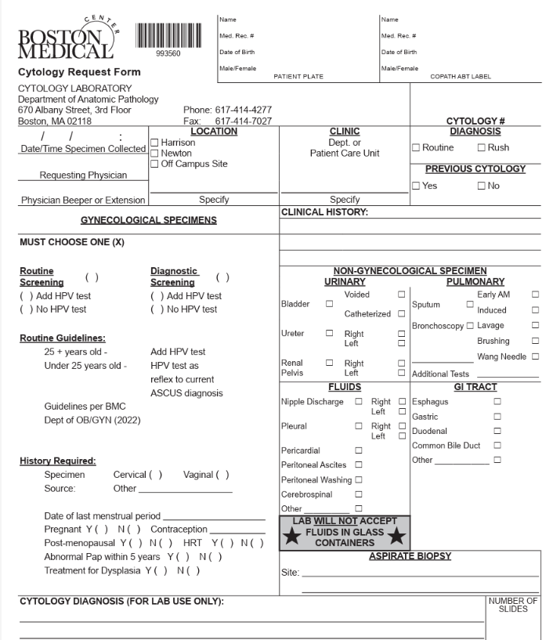
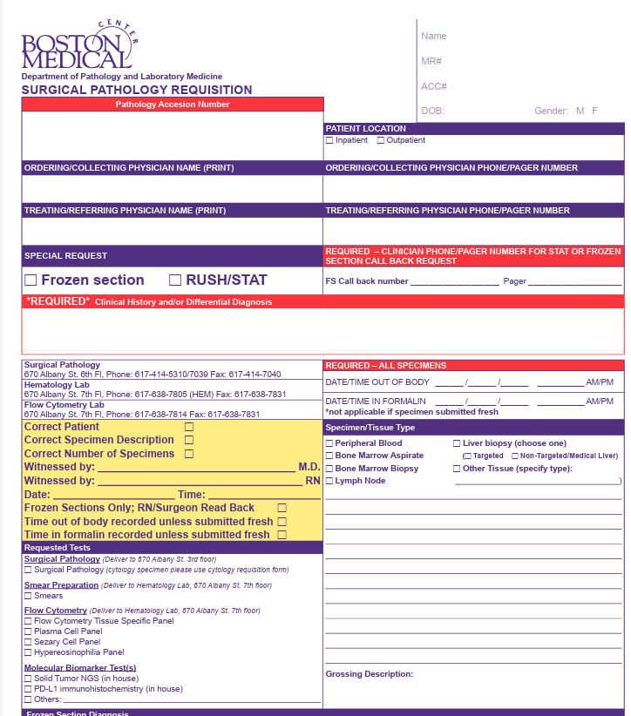
Replacing Paper Forms

Slide 28
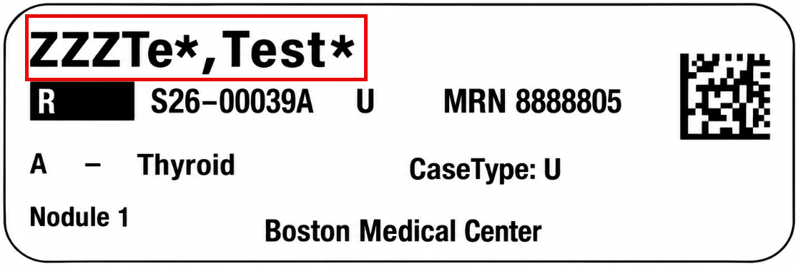
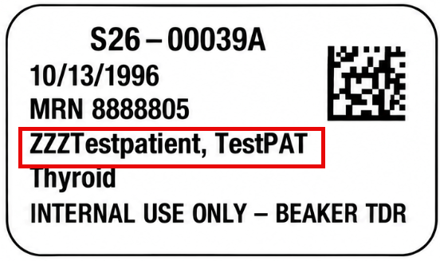
New AP Label Fields: NAME
Large Label
Small Label

Slide 29
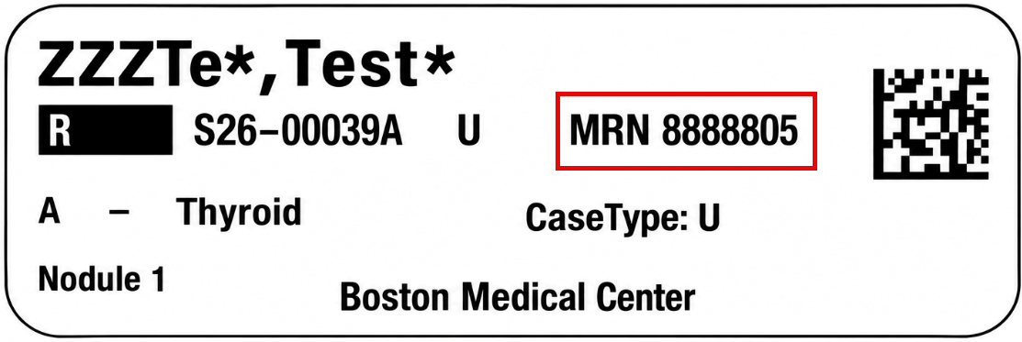
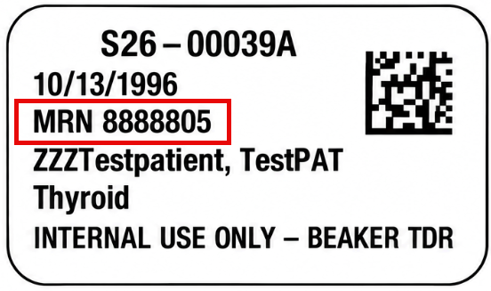
New AP Label Fields: MRN
Large Label
Small Label

Slide 30
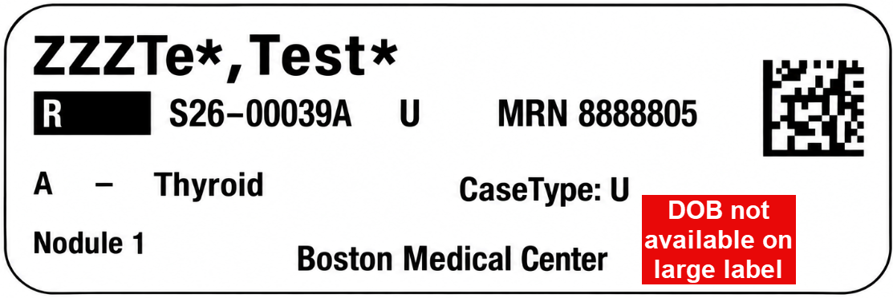
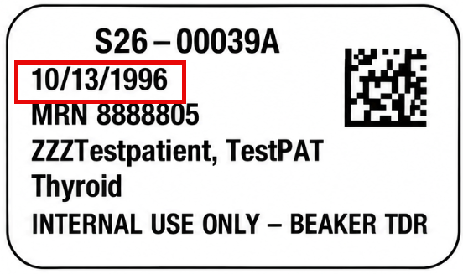
New AP Label Fields: PATIENT BIRTHDATE
Large Label
Small Label

Slide 31
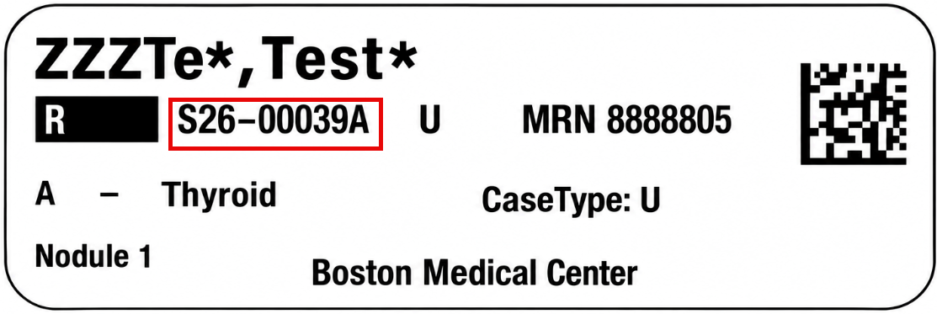
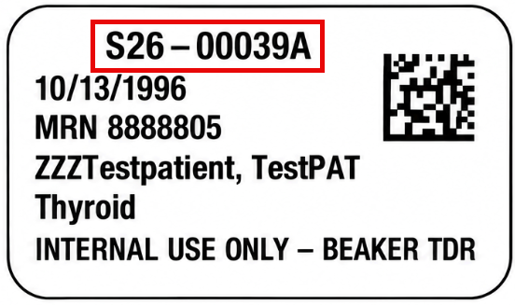
New AP Label Fields: TEST NUMBER
Large Label
Small Label

Slide 32
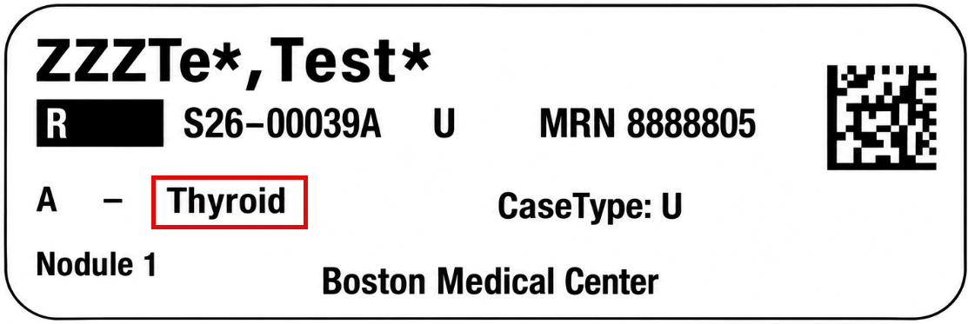
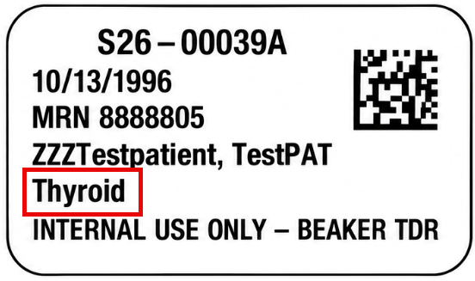
New AP Label Fields: SPECIMEN TYPE
Large Label
Small Label

Slide 33
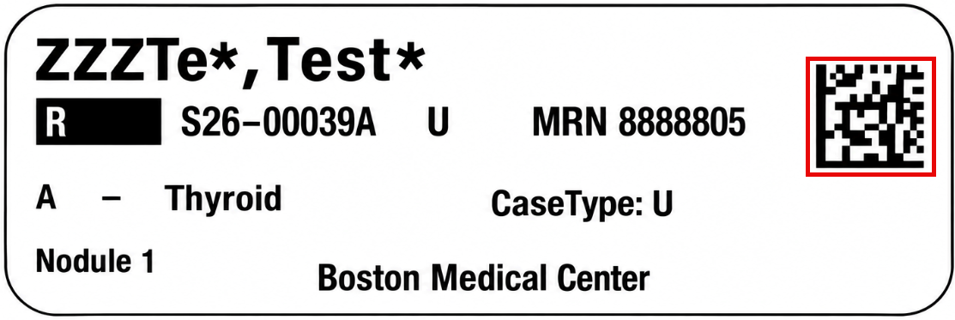
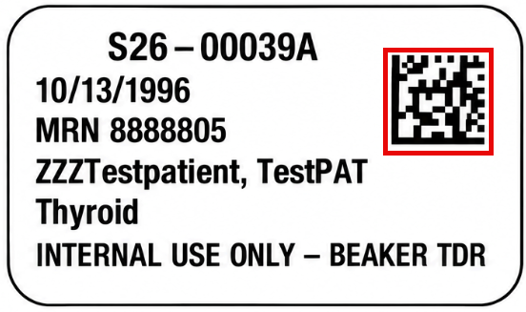
New AP Label Fields: SCANNABLE CODES
Large Label
Small Label

