Slide 1
BMC Research Enterprise Town Hall Meeting
December 10th, 2024
Megan Bair-Merritt, Vice President & Chief Scientific Officer

Slide 2
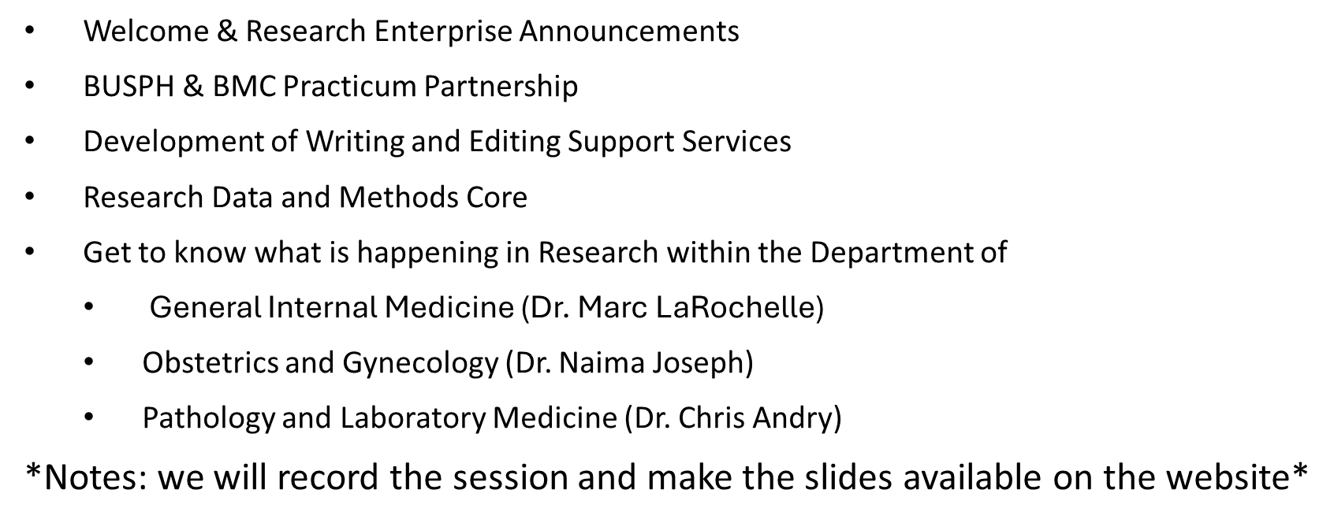
Agenda

Slide 3
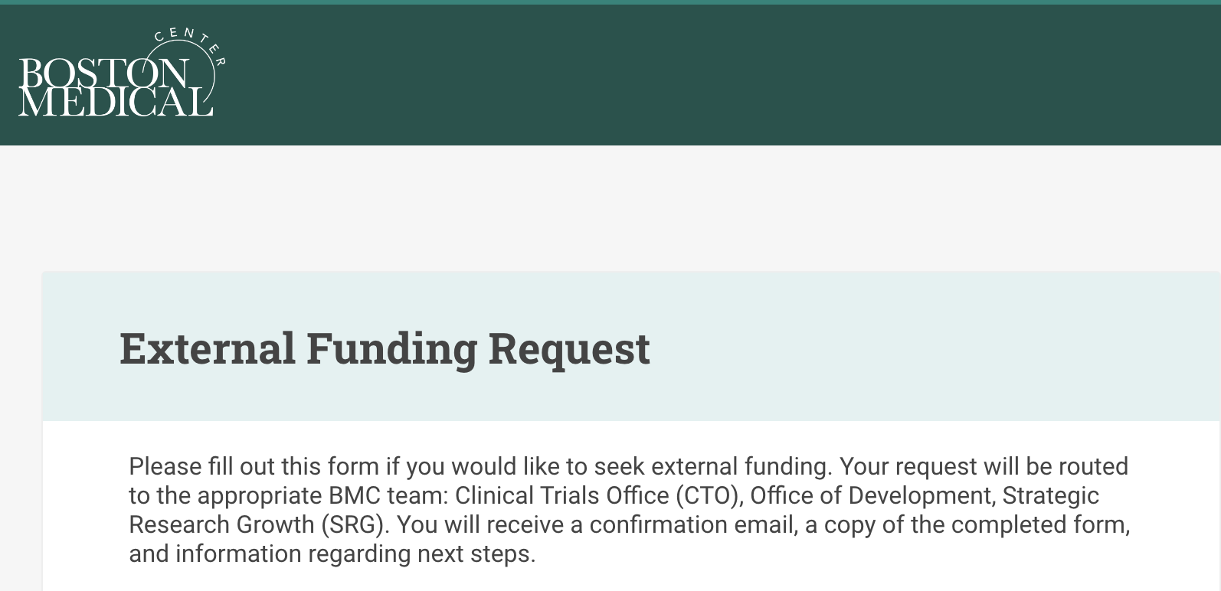
BMC's Development and Research teams are accelerating growth and maximizing efficiency for external funding by aligning portfolios with their expertise
The Foundation Relations and Government Grants team and the portfolio of government grants and institutional-funded research-related grants transitioned to the Office of the Chief Scientific Officer, Megan Bair-Merritt, MD, MSCE, as Strategic Research Growth
The Office of Development, under the direction of Chief Development Officer Susie Posner-Jones, MHA, will continue to manage relationships with individual donors, family foundations, corporations, and private and non-profit foundations
Together, they created a new external funding request form for anyone seeking external funding, including industry sponsored clinical trials
  To submit a funding request, please visit bmc.org/external-funding
Notes:
Foundation Relations and Government Grants transitioned research-related grants to the Office of the Chief Scientific Officer under a new team known as Strategic Research Growth
The Office of Development will continue to manage relationships with individual donors, family foundations, corporations, and private and non-profit foundations.
As a reminder, Development is the only department authorized to secure philanthropic support and Sponsored Programs Administration is the only department authorized to submit government and research-related grants on behalf of the hospital, its departments, and faculty
To submit an external funding request, regardless of the source, please use this new form
I appreciate your collaboration and look forward to seeing how the new teams and process accelerate BMC's growth

Slide 4
Officially Welcoming Strategic Research Growth to the Research Enterprise
The Foundation Relations and Government Grants team and the portfolio of government grants and institutional-funded research-related grants moved to the Office of the Chief Scientific Officer, as Strategic Research Growth (SRG)
  SRG will continue to collaborate with you to make your research and government-funded proposals more compelling, responsive, and competitive
The Office of Development, led by Chief Development Officer Susie Posner-Jones, will continue to manage relationships with individual donors, family foundations, and non-research engagements with corporations and foundations
There is now an external funding intake form for anyone seeking external funding, including for industry-initiated clinical trials
  To submit a request, please visit bmc.org/external-funding

Slide 5
Boston Medical Center
Clinical Research Unit
December 2024

Slide 6
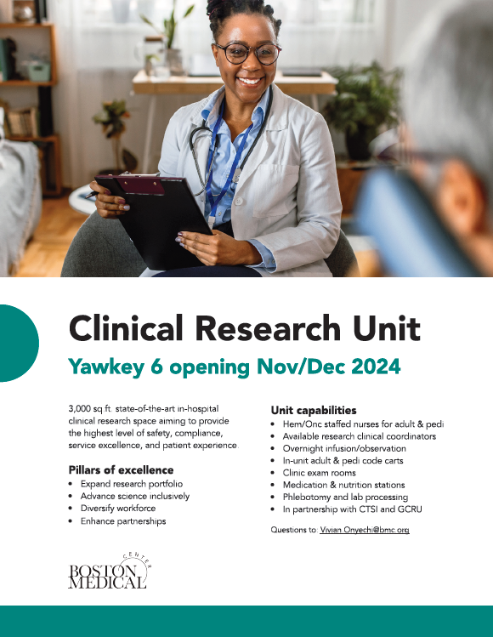
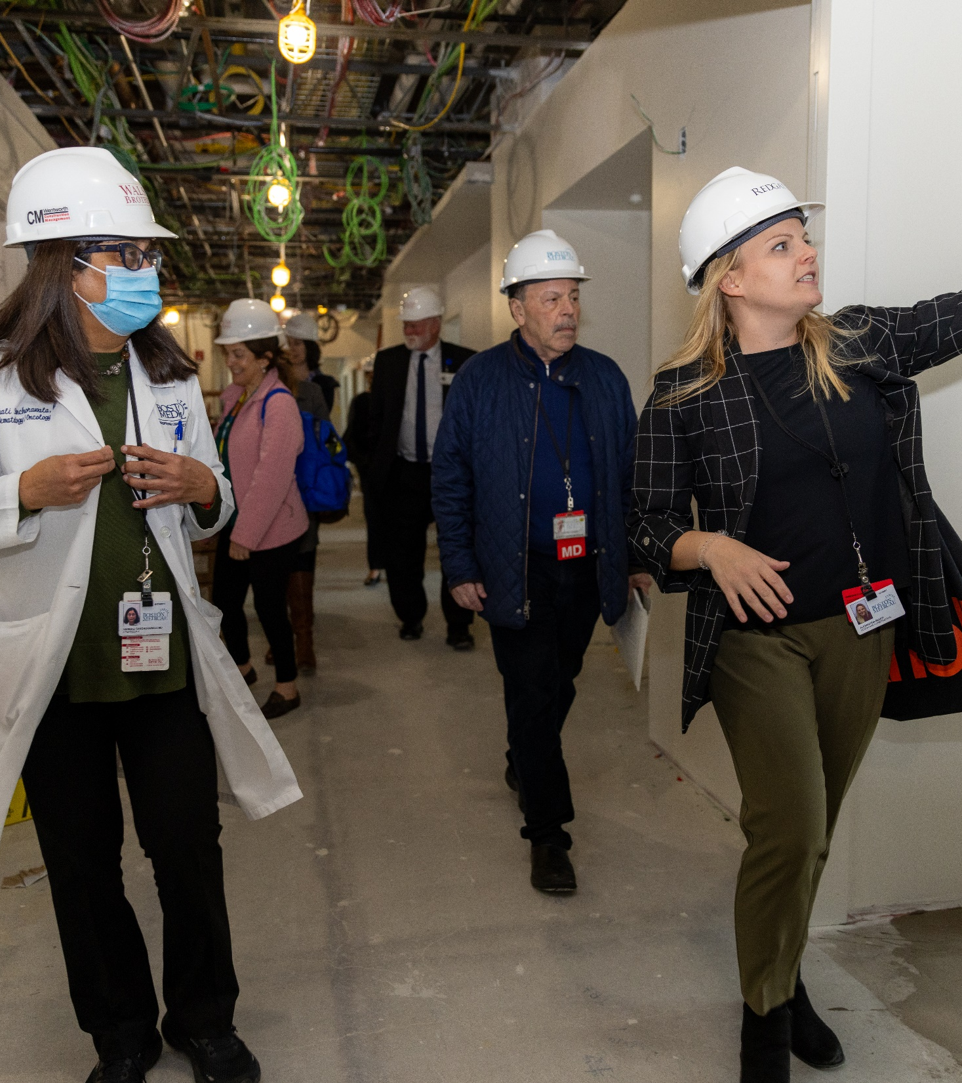

Slide 7
Driving inclusive research
BMC Clinical Research Unit is now open.
Notes:
Special Thanks to…
Dr. Ravin Davidoff
Our CSO, Dr. Megan Bair-Merritt
Sr. Dir CCRA, Johanna Chesley

Slide 8
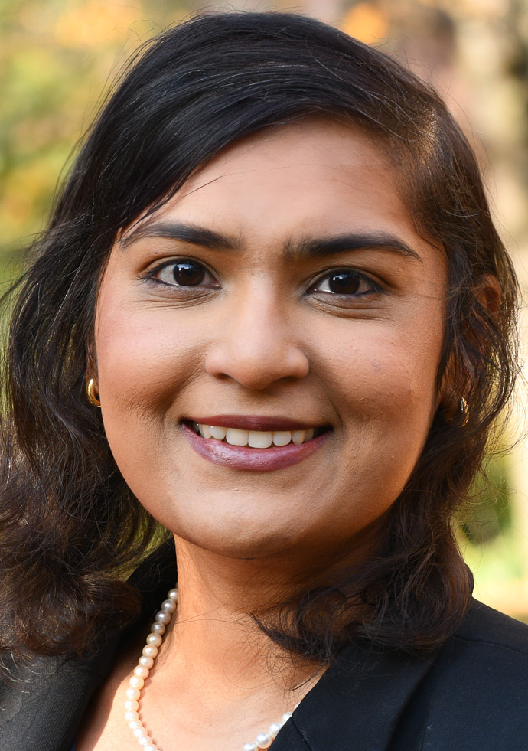
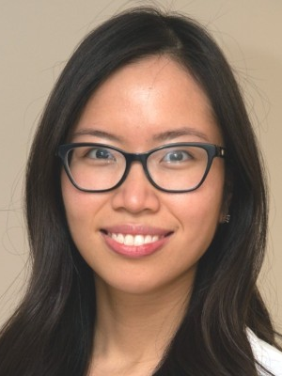
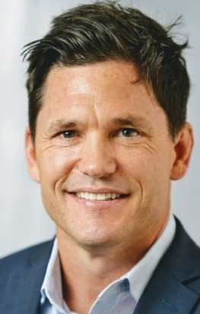
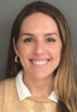
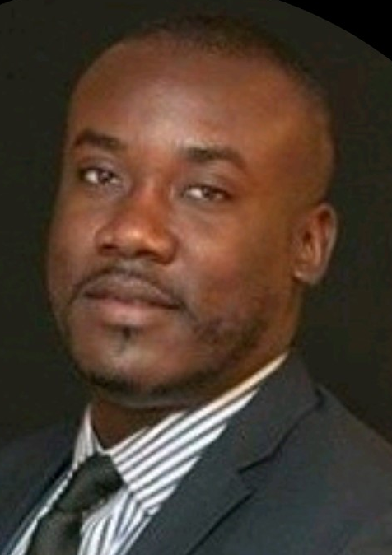
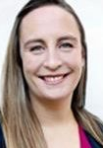

Clinical Research Unit Team
  As we continue to elevate our research profile, we are thrilled to be opening new clinical research space that will enable more studies at the forefront of innovation and health equity
  BMC's Clinical Research Unit, or CRU, features 3,000 square feet of state-of-the-art clinical research space and will help us extend our research mission to advance science for all
Archana Asundi, MD
Medical Director
Anh Tran, MS, BSN, RN
Clinical Director
Ryan Schroeder
Director of Business Operations
Maggie Faulds, MSN, RN, CNL
Director, HemOnc RN Pool
Dean Robinson
Financial Analyst
Elizabeth Duffy, MA
Director, Research Lab Services Core
Recruiting
Office Coordinator
Recruiting
Clinical Coordinator
Notes:
Optional team slide 1

Slide 9
Clinical Research Space (CRS) – Clinical Research Unit (CRU) Timeline
2019-2021
East Newton closure disconnecting GCRU, COVID and creation of GCRU beyond walls, and programmatic growth emphasized need for dedicated hospital CRS
Fall 2022
RO completed information interviews with BMC SMEs to evaluate need for CRS and leadership advocated for CRS as a part of BMC’s expansion 2.0
April 2023
RO commenced working with expansion 2.0 architects on “CRU” design, held informational interviews with BMC SMEs
May-August 2023
Included various SMEs to finalize space design: Lab/pathology, pharmacy, infection control, nursing, GCRU
November 5, 2024
Projected CRU grand opening on Yawkey 6
Aug 2023-Oct 2024
Individual Working Groups to lead each of their areas and partner across working groups for a November launch
Sept 11 & 25 2024
Ribbon cutting tours: 1. Inclusive Round Table for industry partners and 2. research community
July 2024
CRU construction complete
Driving inclusive research
The value of partnerships.
Notes:
Another big thank you to our foundational partners that include GCRU leadership and clinical team
Dr. George O’Connor
Helia Morris
Ridiane Denis
IPS – Sam Bliss and team
Lab Services – Dr. Chris Landry, Liz Duffy and team
And the whole clinical team (Mona Lauture, RN pictured here)

Slide 10
Getting Started
Where are the research units located?
The CRU at BMC is located on the 6th floor of the Yawkey Building. The GCRU at BU is housed on the 8th floor of the Evans Building, in the CTSI.
What is the cost for CRU services?
For contracts negotiated before Jan. 1, 2025, studies will continue to be charged GCRU agreed upon rates for the remainder of the study. Starting Jan. 1, 2025, any studies using the CRU at BMC space or services being negotiated will be subject to the new rates for services associated with the CRU at BMC.
How will the CRU at BMC and GCRU at BU work together?
If you are working on a new clinical study, please fill out the new GCRU and CRU Central Intake Form, which will be assessed by clinical staff from both the CRU at BMC and the GCRU at BU teams. Once a determination is made, you and your study team will be notified and provided with additional information. Click here to submit the WebCAMP Intake Form.
Who can I contact with further questions about the CRU at BMC or GCRU at BU?
For inquiries about the CRU at BMC, please contact Anh Tran, Clinical Director, at Anh.Tran@bmc.org
For questions related to the GCRU at BU, please reach out to Ridiane Denis, Director of Clinical Research Operations, at redianed@bu.edu

Slide 11
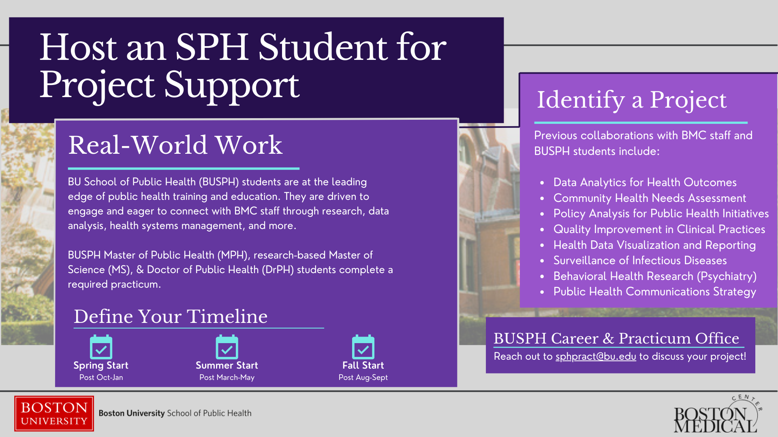

Slide 12
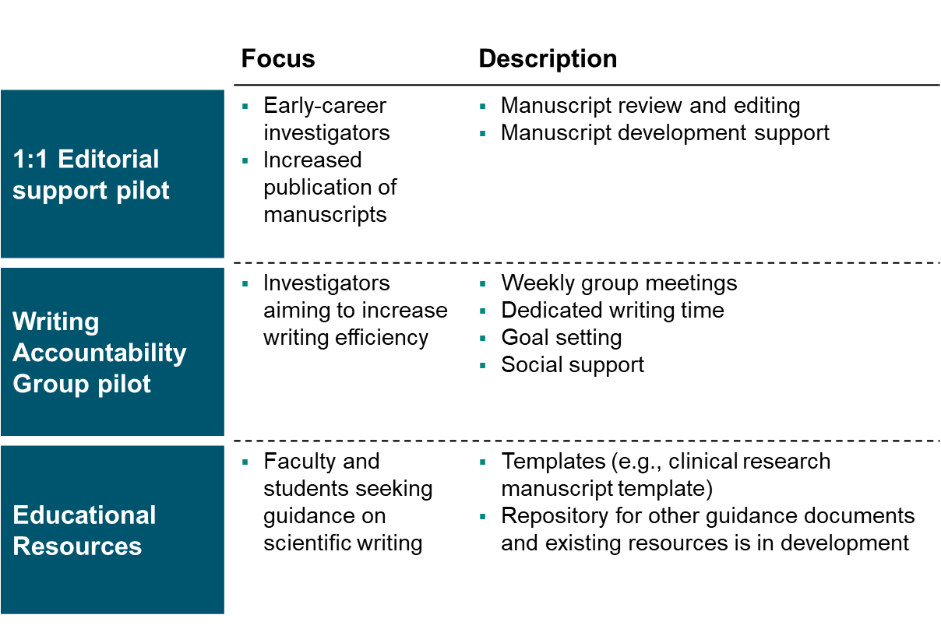
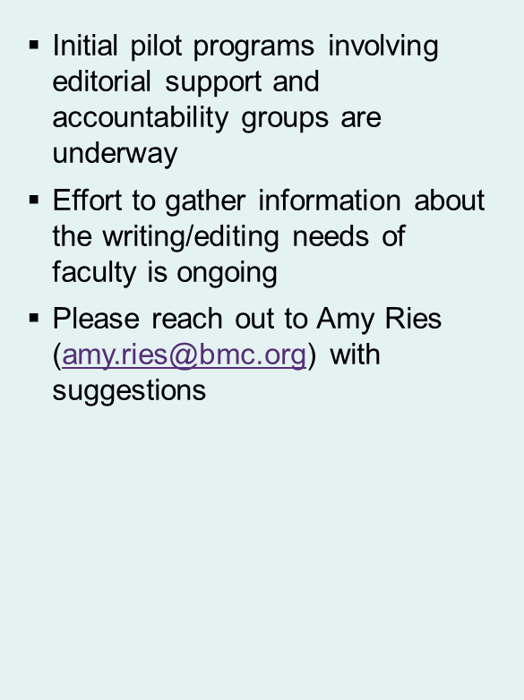
Development of Writing and Editing Support Services
This layout is specific to the guidelines only. Do not use as a sample slide.

Slide 13
The Data and Methods Core
Consultation and Planning
Data Management
The Data and Methods Core is now available for BUMC researchers!
Its goal is to support clinical and translational research across BUMC through statistical expertise and services applied flexibly in planning, proposing, and executing analyses, with particular emphasis on early-to-mid career investigators.
The team, led by Michael Fischer and Tim Hesselton, includes one PhD level Biostatistician and two Master’s level Senior Data Analysts.
For more information, email Tim Hesselton at Timothy.Hesselton@bmc.org.
Analysis Consultation
Power and Sample Size Calculations
Analysis plan development
Wrangling
Cleaning
Quality Control
Data Mining
Organization
Visualization
Statistical Analysis
Descriptive Analysis
Basic Inference
Linear Modeling
Survival Analysis
Mixed Effect Modeling
Longitudinal Analysis
Factor Analysis
Structural Equation Modeling
Machine Learning
Results Interpretation

Slide 14
BMC Research Town Hall: General Internal Medicine
December 10th, 2024
Presented by
Marc LaRochelle, MD, Associate Chief for Research
Heather Quinlan-Baron, Research Program Operations Manager

Slide 15
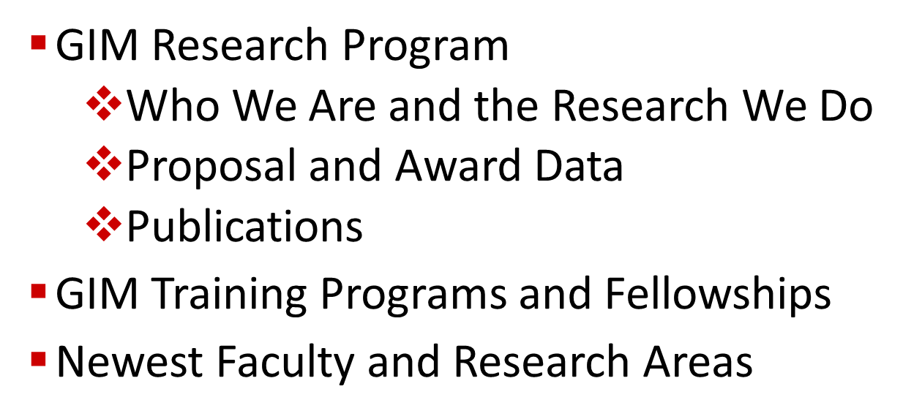
Agenda

Slide 16
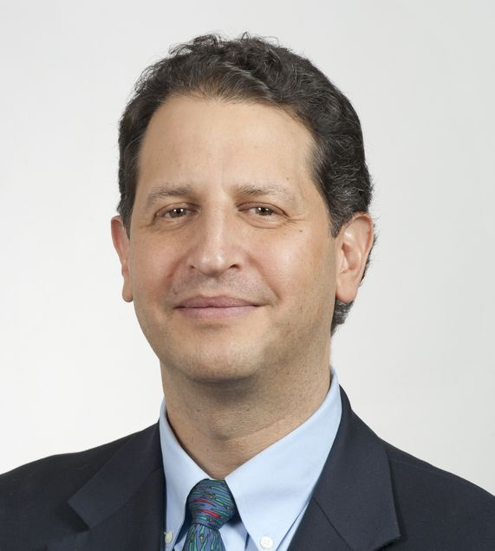
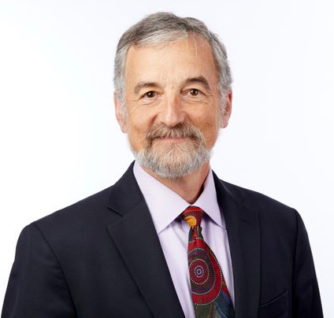
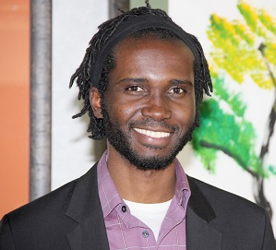
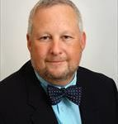
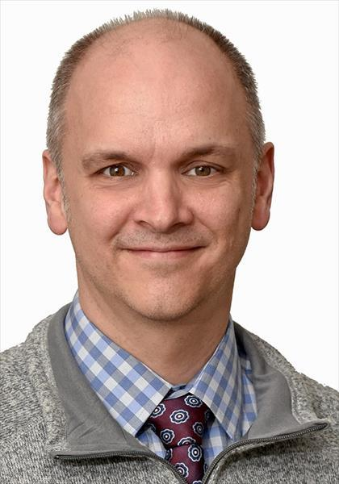
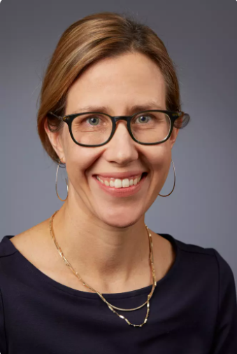
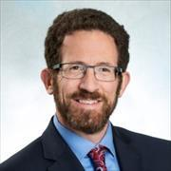

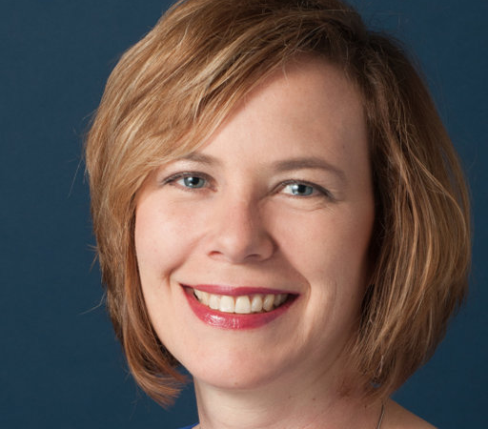

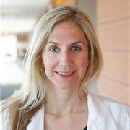


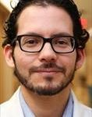
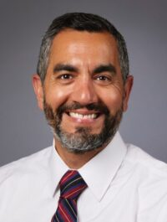
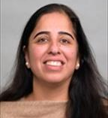
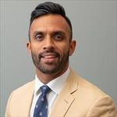
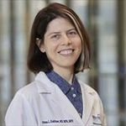
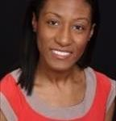
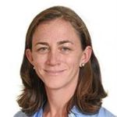
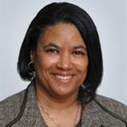
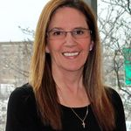
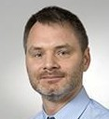
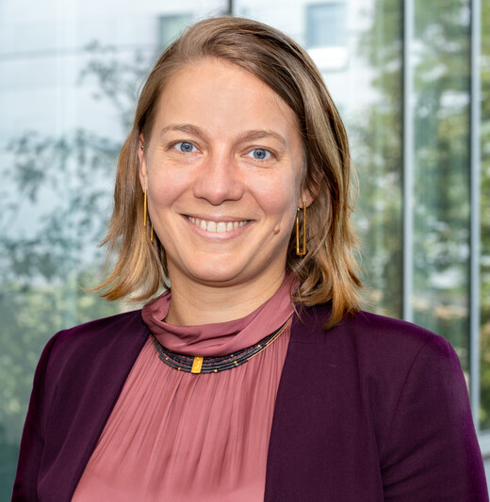
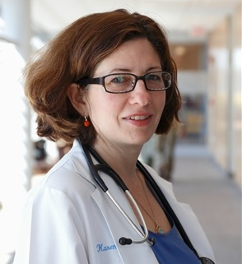
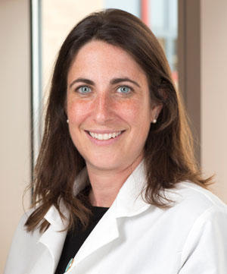
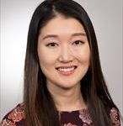
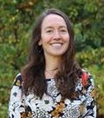
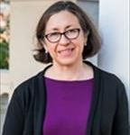
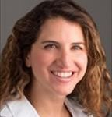
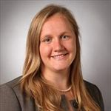
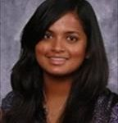
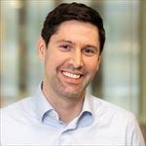
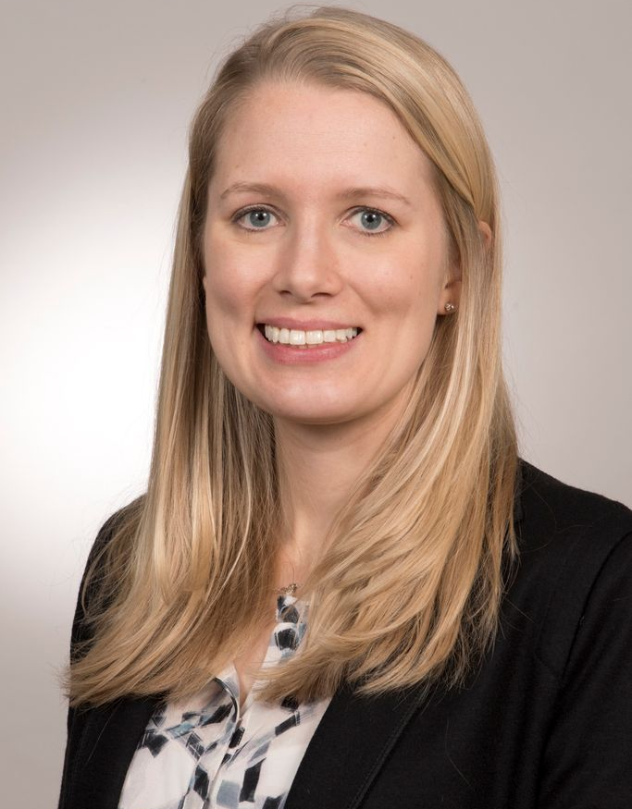
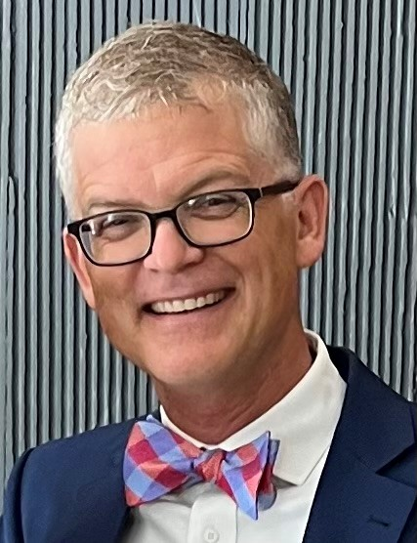
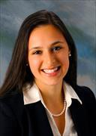

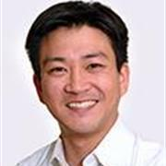

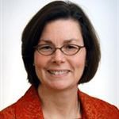
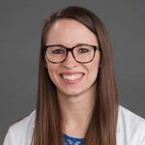
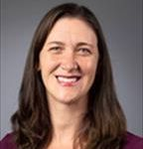






The Many Faces of GIM Research

Slide 17

Research Areas:
What We’re Known For

Slide 18


Substance Use Disorder/ Addiction Medicine
  HEALing Communities Study- Jeffrey Samet
  Overdose Monitoring and Prevention Hotline- Alex Walley
Global Health
  Preventing Mental Disorders Among Women Internally Displaced by War in Ukraine- Karsten Lunze
HIV/AIDS
  Providence/Boston Center for AIDS (CFAR)- Kaku So-Armah
Immigrant & Refugee Health
  Refugee Health Assessment Serivces- Sarah Kimball
Together for Hope Boston Addiction Conference 2024
Team Photo - Karsten Lunze, Care Model for Displaced Persons in Ukraine
Together for Hope Boston Addiction Conference

Slide 19

Sexual Gender Minority/ LGBTQ+ Health
  Assessing the Burden of Dementia on Transgender Populations- Carl Streed
Social Determinants of Health/Health Equity
  THRIVE-DM: Improving Diabetes Care with Strategies for Addressing Health-Related Social Needs and Community Partnership- Pablo Buitron de la Vega, Julien Dedier, Michael Fischer
  Comparative effectiveness of interventions to improve hypertension control in safety-net settings: The Boston Hypertension Equity Alliance in Treatment (BHEAT)- Michael Fischer
Natalia Morone OPTIMUM study and IMPACT study team photo after dinner outing
Alternative Pathways to Health and Well-being
  Remote Tai Chi for Knee
  Osteoarthritis- Eric Roseen
Together for Hope Boston Addiction Conference

Slide 20
Publications
~2,820 total existing publications across GIM research faculty
Some published this month:
      “Racial and Ethnic Disparities in Referral Rejection from Postacute Care Facilities among People with Opioid Use Disorder in Massachusetts.”
        J Addict Med. Weinstein, So-Armah, Yan, Larochelle, Walley, Kimmel
      “Effectiveness of Virtual Yoga for Chronic Low Back Pain: A Randomized Clinical Trial”
        JAMA Network Open. Roseen.
Example of policy impact
    “Cardiovascular disease among transgender adults receiving hormone therapy.”
        Ann Intern Med. Streed. > 200 citations
        Cited in The White House “Recommendations on the Best Practices for the Collection of Sexual Orientation and Gender Identity Data on Federal Statistical Surveys”
Notes:
*Note that the numbers are based off of a report of publications automatically drawn from PubMed on a weekly basis, in addition to publications added by faculty manually. As of Nov 21, 2024.
~2,820 total existing publications across GIM research faculty
32 in New England Journal of Medicine
170 in JAMA
83 in Journal of Addiction Medicine
Gemmae Fix - “Exploring Perspectives on HIV Vulnerability Communication among Transgender and Gender Diverse Patients and Primary Care Providers.”
Marc Larochelle, Sim Kimmel, Zoe Weinstein, Alex Walley, Kaku So-Armah – “Racial and Ethnic Disparities in Referral Rejection from Postacute Care Facilities among People with Opioid Use Disorder in Massachusetts.”
Eric Roseen – “Effectiveness of Virtual Yoga for Chronic Low Back Pain: A Randomized Clinical Trial”
Examples of our impact on policy
Carl Streed’s 2017 narrative review in Annals of Internal Medicine, “Cardiovascular disease among transgender adults receiving hormone therapy,” has over 200 citations and is a key study in the research literature on transgender health.
He has also been cited in The White House “Recommendations on the Best Practices for the Collection of Sexual Orientation and Gender Identity Data on Federal Statistical Surveys”

Slide 21
BMC Research Forum
Proposal and Award Data: FY 2024
Proposals
    69
    $84,050,13
    29 Clinician Investigators and Researchers
Awards
    31
    $28,376,879
    21 Clinician Investigators and Researchers

Slide 22
BMC Research Forum
GIM Training Programs and Fellowships
5 Total Training Grants
  Two T32s
      Spots shared amongst GIM/Pediatrics/Family Medicine/Surgery:
      AHRQ: Training in Health Services Research for Vulnerable Populations; 3 Pre-docs and 3 Post-Docs supported
      HRSA: National Research Service Award; 5 Post-Docs supported
  HRSA Preventive Medicine Training Grants
      Primary Care Training and Enhancement
      Preventive Medicine Residency
  HRSA Fellowship
      Addiction Medicine

Slide 23



New Faculty and Developing Research Areas
Carceral Health
  Massachusetts HIV and Justice-Involved
  Populations Research Network- Alysse Wurcel
  Health, Access to Care, and Social
  Determinants of Health for Sexual and Gender
  Minority People with Criminal Justice
  Involvement- Emily Lupez
Somatic Therapies for overlapping PTSD and Pain
  A Mind and Body Approach to PTSD with
  Chronic Pain: Acceptability and Feasibility of
  Somatic Therapy- Karim Sariahmed

Slide 24
We love collaborating, please reach out!

Slide 25
Research Activities
Department of
Obstetrics & Gynecology
Naima T. Joseph, MD

Slide 26

Department of OBGYN Research
Incoming Vice Chair for Research: Dr. Sheree Boulet
Lab of Sheree Boulet, DrPH, MPH | Emory School of Medicine
Population health researcher
NICHD, NIMHD, NHLBI, NCATS Funded research in health disparities,
Who we are:
Physician-scientists, Epidemiologists, Post doc
What we do
Study racism and impact on reproductive health outcomes
Health system interventions to improve health outcomes
Health outcomes across identities and conditions (e.g. people living with HIV, substance use, justice-involved pregnant people, persons in the military)
Basic science underpinning leading causes of preeclampsia, infertility, fibroids

Slide 27

Dr. Naima Joseph
Evaluating the Effectiveness of Remote B/P Monitoring in Reducing Perinatal Morbidity in Black patients
Assistant Professor, Obstetrics and Gynecology, Boston University Chobanian and Avedisian School of Medicine
Research Interests: Health systems equity, quality of care in low resource settings, maternal mortality, infectious diseases
AIM 1. To evaluate trends in perinatal morbidity since program implementation using historical controls using quasi-experimental (difference in difference) design
AIM 2. To isolate the effectiveness of remote blood pressure monitoring in the mitigation of preeclampsia related perinatal morbidity using target emulation approach in a contemporary cohort
AIM 3. To understand factors influencing patient engagement, acceptability, and unanticipated adverse events associated with this program using sequential mixed methods design and implementation science frameworks
Supported by Agency for Health Care Research and Quality and the Patient Centered Outcomes Research Institute on Learning Health Systems Training Grant P30 HS029752-01, The Department of Health and Human Services Hypertension Innovation Prize, and the BMCHS Health Equity Accelerator
Other research in health system strengthening in low and middle income countries, pregnancy-related and associated death, perinatal infectious diseases, pregnancy vaccination

Slide 28



Dr. Wendy Kuohung
Placental Cell Model of APOL1 Risk Variants
Apolipoprotein 1 Gene (APOL1)
  Coding variants (G1 and G2) are strong risk factors for kidney disease in people of African ancestry (OR ~7-29 for severe kidney disease)
  Transgenic mice with APOL1 variants had preeclampsia and ↓litter sizes
  In humans, fetal APOL1 genotype is associated with preeclampsia risk
    Gene dosage affects preeclampsia severity, “second hit” required
We generated stably transfected BeWo lines that conditionally express G0 and variants G1 and G2 under control of Tet-On promoter
  BeWo cells – immortalized choriocarcinoma cell line, trophoblast cell model
  Untransfected BeWo cells express APOL1 wild type G0 haplotype, low levels of APOL1 protein
Cell model will be used to study potential mechanisms of APOL1-associated trophoblast injury that may contribute to the genesis of preeclampsia
Associate Professor of Obstetrics and Gynecology, Boston University Chobanian and Avedisian School of Medicine
Research interests: Infertility and in vitro fertilization, fertility preservation, menstrual disorders, fibroids, endometriosis, minimally invasive and robotic gynecologic Surgery
Will adapt cell lines for use in a high-throughput assay to screen compound libraries for novel preeclampsia therapeutics
  Homogenous time-resolved fluorescence sandwich assay (Revvity)
  Potential readouts – GRP78 (highly expressed in first trimester placenta,
  ↑ in renal podocytes overexpressing G1 and/or G2), eIF1
Acknowledgments: Gabrielle Cherfane, B.S., Janice Nam, M.S., Ann Doherty, M.S., Eesha Sachdeva, B.A., Cassandra Lee, B.A., Matthew Layne, Ph.D., Lauren Brown, Ph.D., John Porco, Ph.D., Nader Rahimi, Ph.D., John Sedor, M.D. (Cleveland Clinic), Julie Palmer, Sc.D., and Shanshan Sheehy, M.D., M.Sc., Sc.D. (BWHS).
Funded by the Peter Joseph Pappas Research Grant, Preeclampsia Foundation.

Slide 29

Dr. Glenn Markenson
Impact of Pregnancy on Activity Related Injuries During Pregnancy and the Postpartum Period
Professor of Obstetrics and Gynecology, Boston University Chobanian and Avedisian School of Medicine. Director, Center for Military Health Center, Boston University.
Research Interests: Preterm birth prevention, vaccines in pregnancy and optimizing the health of current members of the military and veterans
Objectives
Determine the incidence of musculoskeletal injuries during the first year postpartum for active-duty military women.
Compare the incidence of musculoskeletal injuries during the first year postpartum in active-duty women to a cohort of matched non-postpartum women during a one-year period.
Prevalence and Correlates of Sexual Dysfunctions in Females with Traumatic Brain Injury: A mixed-methods study
Objective:
A pilot study is to assess the feasibility and acceptability of performing a larger study to assess the risk of female sexual dysfunction after suffering traumatic brain injury
Notes:
Objective:
A pilot study is to assess the feasibility and acceptability of performing a larger study to assess the risk of female sexual dysfunction after suffering traumatic brain injury
Methods: Using a survey tool sexual health will be compared between three groups:
Women with isolated traumatic brain injury
Women with non-pelvic orthopedic injuries
Women without a history of severe physical trauma
Primary outcomes measure:
The percentage of women that were contacted both in the exposed TBI group and the control groups that enrolled in the study and completed the study survey tools.
Secondary Outcome Measures
The percentage of participants with sexual dysfunction that have received treatment for this disorder.
The percentage of TBI participants who feel sexual function should be routinely assessed during follow up medical evaluations.
The percentage of participants that were asked about sexual function during any medical evaluation.

Slide 30

Dr. Julie Mottl-Santiago
Patient perspectives on implementation of a low-risk Birth Center at BMC to promote maternal health equity (seed grant)
Assistant Professor, Boston University School of Medicine, Midwife, Boston Medical Center, Department of Obstetrics & Gynecology
Research interests: Doulas, labor person support, birth centers
Objective: To describe the preferences and self-reported needs of Black pregnant people related to the implementation and adoption of a low-risk Birth Center model of care
Significance: Low-risk Birth Centers are evidence-based interventions that improve childbirth outcomes and reduce health disparities but are inequitably accessible by income and race.
Methods:
Design: Qualitative study
Participants: Convenience sample of 15 people with medically low-risk pregnancy, 24-40 weeks GA, self-identified as Black
Data collection: In-depth interviews using a semi-structured interview guide
Analysis: Rapid qualitative analytic methods; coding guided by the Health Equity Implementation Science Framework (Woodward, 2019) to understand equity-related, patient-level factors influencing implementation

Slide 31





Dr. Nyia Noel
Centering Patients with Fibroids (CPWF)
Assistant Professor, Obstetrics and Gynecology, Boston University Chobanian and Avedisian School of Medicine
Fibroids, endometriosis, disparities in maternal morbidity and mortality, health care access and systems delivery
Led by Dr. Nyia Noel, CPWF is a prospective, mixed-methods cohort study investigating the efficacy of an 8-week education and empowerment program for patients with uterine fibroids.
  Study aims:
    Conduct a pilot quasi-experimental trial of Centering Patients with Fibroids (CPWF) at BMC and Emory University/Grady Hospital in Atlanta
    Identify modifiable intervention targets and organizational, provider, and patient-level factors associated with successful implementation of CPWF
    Amplify and scale the impact of CPWF through “QRmmunity Health Education,” a social media campaign
Other research
Site PI: NIH P50 PEACE Center
Emergency Department Utilization for Fibroids
Isolating Fibroid Stem Cells from Human Explants

Slide 32


PLACES: Postpartum, Lifestyle, & Cardiovascular Evaluation Study
Longitudinal study to gather comprehensive postpartum data including information on breastfeeding, sleep, nutrition, and exercise
Participants will complete a survey between 4-8 weeks postpartum and a follow up survey around 3 months postpartum
Eligibility Criteria
  Read English, Spanish, or Haitian Creole
  Be 18 years or older
  Delivered at BMC
  Be between 4 and 8 weeks postpartum at the time of the first survey
Participants will be compensated for each survey
Website: https://sites.bu.edu/places/
Funded by a BUSPH pilot award
Dr. Liberty Reforma
Assistant Professor,
Obstetrics & Gynecology
Dr. Samantha Parker Kelleher
Associate Professor,
Epidemiology

Slide 33



Dr. Kelly Treder
Development of a Shared Decision-Making Tool for the Management of Uterine Fibroids
  Clinical tool that allows BMC providers and patients to discuss fibroid management options and co-create a treatment plan
  We will interview a total of 10-15 providers and 25-30 patients on their experiences using the tool, and collect survey data from 100 patients
  So far: 8 provider interviews & 10 patient interviews completed; 53 surveys completed
  Supports patients:
    Increases autonomy & centers patient values in medical decisions
    Enhances understanding of various management options
    Combats racial disparities in management recommendations
  Supports providers:
    Provides resources for patient education
    in one place
    Detailed images help with visualization
    Increases visit efficiency
Assistant Professor, Obstetrics and Gynecology, Boston University Chobanian and Avedisian School of Medicine
Research interests: Family planning, health equity
Qualitative Evaluation of an Antenatal Remote Blood Pressure Monitoring Program- To evaluate the acceptability, appropriateness, feasibility, and sustainability of a prenatal remote blood pressure monitoring program at Boston Medical Center from the patient perspective

Slide 34


Dr. Katharine White
NIH/NICHD Contraceptive Clinical Trials Network
Professor and Chair, Obstetrics and Gynecology, Boston University Chobanian and Avedisian School of Medicine
Research interests: Contraceptive development, shared decision-making
  PI: Katharine White, MD, MPH
  What is the CCTN?
  Conducts clinical trials of new contraceptive drugs and devices to develop novel female and male contraceptive methods
  Contract-based funding for sites with access to clinical facilities capable of conducting first-in-human and Phase I, II, and III clinical trials
  New injectable contraceptive (levonorgestrel butanoate) - alternative to Depo-Provera
    Alternative to Depo-Provera, hoping for improved side effect profile
    Phase 2a study, have enrolled 12 participants to date
  New barrier method (Ovaprene)
    Monthly intravaginal non-hormonal drug/device
    Physical barrier + iron impedes sperm motility
    Single arm, open-label pivotal contraceptive efficacy study
    Phase 3 study, have enrolled 10 participants to date

Slide 35
Collaboration with Venova Technologies
  PI: Katharine White, MD, MPH
  What is Venova?
  Boston-based, women-led start-up
  Development of a novel, non-hormonal, long-acting barrier device
  NIH funding
    STTR, X011 service contracts x 2
    New application for SBIR Phase II (score = 20)
    Primate studies, sperm flow studies, biocompatibility study
  Mass Life Science Center Women’s Health Innovation Grants x 2
    Hysterectomy study – placing device after uterus has been surgically removed
    Cervical measurement study beginning
      Assessing changes in cervical dilation over the course of a menstrual cycle
      Could improve counseling about GYN procedures at various stages of the cycle
      Aiming to recruit 20 people

Slide 36
Thank you,
please reach out!

Slide 37
Department of Pathology & Laboratory Medicine
Research Portfolio
Christopher D. Andry M.Phil., Ph.D.
Chief and Chair, Department of Pathology & Laboratory Medicine
Professor of Pathology & Laboratory Medicine and Family Medicine
12/10/24

Slide 38
The department has a number of areas of focused interest:
Cancer biology (lung, epigenetic studies, CRC, breast, prostate, thyroid)
  Anatomic Pathology group
  Eric Burks MD
  Sandra Cerda, MD
  Sara Higgins, MD
  Robert Pistey, MD
  Carmen Sarita-Reyes, MD
  Zhichun Lu, MD
  Grace Zhao, MD, PhD
  Tao Zuo, MD, PhD
  Basic science group
  Jim Crott, PhD
  Dennis Jones, PhD
  Thomas Clarke, PhD

Slide 39
The department has a number of areas of focused interest cont.
Renal pathology (Joel Henderson, MD, PhD)
Neuroscience
  Alzheimer’s Disease & othe neurodegenerative diseases(Ivana Delalle, MD, PhD)
  Traumatic Brain Injury (Thor Stein, MD, Jon Cherry, PhD)
  Dietary models for cognitive pathologies(Krzysztof Blusztajn, PhD, Tiffany Mellott, PhD)
Collaborative Translational Clinical Research: Laboratory Medicine (Reggie Thomasson, MD, Yachana Kataria, PhD, Nancy Miller, MD, Marisa Nielsen, PhD,)
Commitment to education and experiential learning (Andry, Duffy, Kataria, Jones)
Biospecimen Science (Duffy & Andry, LABS Core Team)

Slide 40

Breast Cancer Immunology
Overview: Our strategy aims to reduce compressive forces in advanced breast cancer to improve blood vessel function, facilitate T cell infiltration, and synergize with therapies that enhance anti-cancer T cell activation.
Funding: 1R01CA284133-01A1; National Cancer Institute; Improving anti-tumor immunity in advanced breast cancer by targeting solid stress; 06/2024-05/2029
Recent Publication: Jana S, Li W, Lei, P-J, Wang Z, Huang P, Jones D. Isolation and characterization of a novel mammary adenocarcinoma, MCa-P1362, with Hormone Receptor Expression, HER-2 Positivity, and Enrichment in Cancer and Mesenchymal Stem Cells. American Journal of Pathology, 2024 Jun;194(6):1137-1153.
Dennis Jones, PhD
Assistant Professor,
Pathology & Laboratory Medicine
Lymphatic Vessel Biology
Overview: Our ongoing studies aim to uncover fundamental aspects of lymphatic muscle cell biology and identify novel targets to improve their function, enhance lymphatic vessel contractility, and strengthen immune responses in the context of disease.
Funding: 1R01AR084505-01; National Institute of Arthritis and Musculoskeletal and Skin Diseases; Enhancing immunity by protecting lymphatic muscle cells from MRSA-Induced dysfunction; 07/2024-06/2029; HT9425-24-1-0008; Department of Defense Peer Reviewed Medical Research Program; Enhancing Lymphatic Function with Transplanted Muscle Cells after Bacterial Infection; 03/2024-02/2026
Recent Publication: Arroyo-Ataz G, Yagüe AC, Breda JC, Mazzilli SA, Jones D. Transcriptional, developmental, and functional parallels of lymphatic and venous smooth muscle. bioRxiv, 2024 Jul 22:2024.07.18.604042.

Slide 41

Jim Crott PhD. Associate Professor, Pathology and Laboratory Medicine.
Associate Editor, Nutrition Research.
Lab focus:
To study the interaction between aging, gut microbiome and colorectal cancer.
To identify beneficial bacteria and understand their mechanism of action.
Current funding
“Gut microbiota modulate the effect of diet on inflammation and tumorigenesis”
USDA AFRI # 2020-67017-30845
Dates: 2020 – 2025. Role: PI
“Strengthening gut barrier integrity with beneficial microbes to increase lifespan and healthspan”
NIH/NIA R01# 1R01AG069917-01A1
Dates: 2021 – 2026. Role: PI
Recent Publications
Crossland NA, Beck S, Tan WY, Lo M, Mason JB, Zhang C, Crott JW. Fecal microbiota transplanted from old mice promotes more colonic inflammation, proliferation, and tumor formation in azoxymethane-treated A/J mice than microbiota originating from young mice. Gut Microbes. 2023 Dec;15(2):2288187. doi: 10.1080/19490976.2023.2288187. Epub 2023 Nov 29. PMCID: PMC10730208.

Slide 42

Recent and Future work
Boston Medical Center (BMC) Laboratory and Biorepository Services (LABS) Core Center of Excellence for Serology Development and Emergency Preparedness (CESDEP)
SIG-COVID Longitudinal Study of SARS-CoV 2 exposure in healthcare workers at BMC
Yachana Kataria, PhD DABCC, FADLM
Medical Director, Clinical Chemistry
Assistant Professor,
Pathology & Laboratory Medicine
The Role of Neutrophil Gelatinase-Associated Lipocalin (NGAL) in the Boston Kidney Biopsy Cohort (BKBC). Kataria & Waikar
Boston Medical Center (BMC) Laboratory and Biorepository Services (LABS) Core Center of Excellence for Clinical Translational Research, Experiential Learning and Career Development
CKD of unknown etiology in a longitudinal study –Dr. Waikar and colleagues at Stanford.
Noninvasive testing for Steatotic Liver Disease - The role of Laboratory Medicine
Socio-environmental context in monoclonal gammopathy of undetermined significance (MGUS) disparities
Determinants of the racial/ethnic disparity in MGUS risk: An epidemiologic study in 4 cohorts

Slide 43
Ivana Delalle, MD, PhD, Professor of Pathology & Laboratory Medicine, Neuropathologist, conducts research bridging basic and clinical science to advance the understanding of the pathogenesis of neurodegenerative diseases. Her present focus, supported by the by National Institutes of Health (NIH) / National Institute of Aging (NIA) (~ $ 7 millions), is on novel, early, and reliable biomarkers of Alzheimer’s Disease.
Recent NIH/NIA supported studies, directed by Dr. Delalle and her co-senior authors at the University of Goettingen, Germany, and Indiana University, demonstrated that evaluating microRNAs in blood can be used not only to diagnose mild cognitive impairment (MCI) but also, critically, to predict the conversion from MCI to Alzheimer’s Disease (AD). Moreover, the team uncovered microRNA candidate molecular biomarkers that associate with current Amyloid, Tau, and Neurodegeneration (A/T/N) AD biomarkers.
These novel findings are important because, unlike the current AD biomarkers, microRNAs may serve as blood molecular biomarkers years before AD-associated clinical symptoms begins, enabling successful AD prevention and/or early intervention to stop AD.
Funding (NIH/NIA):
RF1AG078299 (09/2022 - 08/2027): MicroRNAs as Diagnostic and Prognostic Biomarker of Alzheimer's Disease.
R01AG084624 (09/2024 - 08/2029): Long Non-coding RNAs as Therapeutic Targets and Biomarkers of Alzheimer's Disease and Related Dementias.
2024 publications:
The plasma miRNAome in ADNI: Signatures to aid the detection of at-risk individuals. Alzheimers Dement. 2024 PMID: 39291752
Plasma miRNAs across the Alzheimer's disease continuum: Relationship to central biomarkers. Alzheimers Dement. 2024 PMID: 39291737
PRDM16-DT is a novel lncRNA that regulates astrocyte function in Alzheimer's disease. Acta Neuropathol. 2024 PMID: 39207536
Regulation of Zbp1 by miR-99b-5p in microglia controls the development of schizophrenia-like symptoms in mice. EMBO J.2024 PMID: 38528182
Cortical-sparing chronic traumatic encephalopathy (CSCTE): a distinct subtype of CTE. Acta Neuropathol. 2024 PMID: 38407651

Slide 44

Recent collaboration:
Higgins, S, MD, Zhao QG, MD, Clarke T, PhD
"Understanding the roles of ZNF280A in DNA damage repair and therapy response in colorectal cancer“
BMC Cancer Center Early Career Faculty Funding

Slide 45

NEIDL Comparative Pathology Laboratory (NCPL), NEIDL, BU
Nicholas Crossland DVM, DACVP
Ming Lo, DVM, PhD, DACVP
Pathogen-host interactions of highly pathogenic microbes. Histopathology, spatial transcriptomics and quantitative image analysis.
This approach enables the discovery of biological pathways driving and preventing disease. At the translational level, we use our expertise to evaluate the efficacy of medical counter measures with the ultimate goal of alleviating and preventing human suffering.

Slide 46

How to access and utilize biospecimens:
Creating and sustaining a biospecimen procurement, storage, management and distribution program LABSCore, in the setting of a Safety Net Hospital and Academic Medical Center in Boston, MA
Elizabeth R Duffy, MA, Chris Andry, PhD, Yachana Kataria, PhD
Boston Medical Center and Boston University Chobanian &
Avedisian School of Medicine, Boston MA, USA

