Slide 1
Translating Research Into Practice: A City-wide Breast Cancer Equity Intervention
Tracy A Battaglia MD MPH
On behalf of the TRIP Consortium
June 13, 2023
Notes:
Add in TRIP overview

Slide 2
The Boston Breast Cancer Equity Coalition
How can a city replete with so many resources continue to tolerate such disparities??
Mission: Develop city-wide solutions to eliminate inequities in breast cancer outcomes
www.bostonbcec.org
Notes:
Jennifer

Slide 3
Treatment Delays among Black NH and Medicaid
Black NH and Medicaid patients are 2-3x more likely to have delays in initiating treatment > 60 days
Notes:
Jennifer
Data not published: MA Cancer Registry
In Boston,
Black non-Hispanic women have a mean time to first treatment of 54 days (SD 47.4) vs 41 days for White non-Hispanic women (SD 35.2)*
Karen
I removed image, as not really clear -- changed to Jennifer’s data

Slide 4
City-Wide Collaboration
Research Leads
Local Academic Medical Centers
Notes:
Jennifer

Slide 5
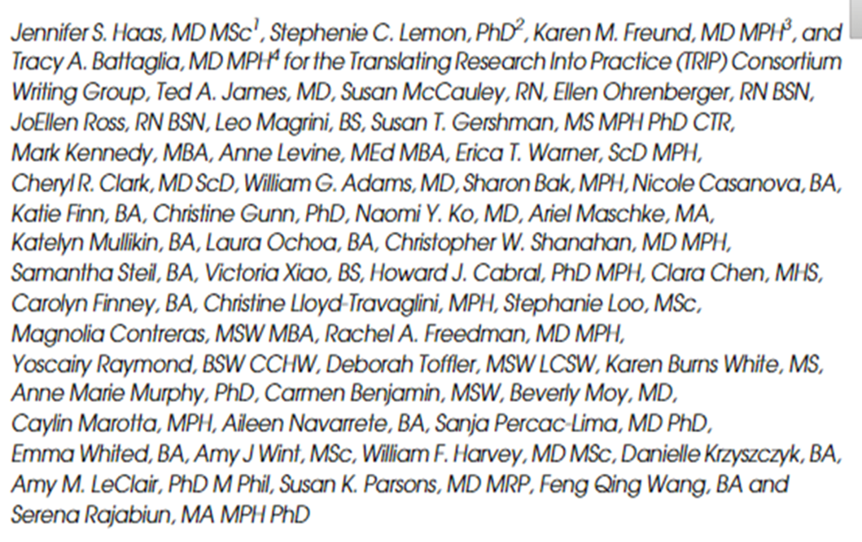
“Elimination of health disparities requires a paradigm shift from individual or institutional responsibility to regional responsibility; this revised focus is critical to address delivery gaps that promote disparities, and presses institutions to work collaboratively to take responsibility for events that occur outside of their walls.”
Journal of General Internal Medicine, volume 36
Notes:
Tracy, pass to Jennifer

Slide 6
Stakeholder groups
Tracy Battaglia MD MPH (BU/BMC)
Karen Freund MD MPH (Tufts)
Jennifer Haas MD MPH (MGH)
Stephenie Lemon PhD (UMass)
Principal Investigators
Erika Christenson (Project Manager)
Debi Amburgey (Project Coordinator)
BMC Research Team
Mady FitzGerald (RA)
Julia Vance (Project Coordinator)
Tufts
Registry
Karen Freund MD, MPH
Amy LeClair PhD
Will Harvey MD
BEDAC
Clara Chen
Carolyn Finney
Chris Lloyd-Travaglini
BMC
Bill Adams MD
Chris Shanahan MD
Cost
Howard Cabral PhD (BU)
Serena Rajabiun PhD (UMass Lowell)
Implementation
Stephenie Lemon
Amy LeClair
Aunt Bertha/SDoH
Jennifer Haas, MD MPH
Caylin Marotta MPH (MGH)
Cheryl Clark MD, ScD (BWH)
Amy Wint, MPH (MGH)
Steering Committee
Karen Burns White (DFCI)
Rachel Freedman MD (DFCI)
Howard Cabral PhD (BU)
Tracy Battaglia
Christine Gunn
Stephanie Loo
Ariel Maschke
Sharon Bak
Courtney Winkle-Miller
Nicole Casanova
Victoria Xiao
Katelyn Mullkin
Maha Ashraf
Steve Kanem
Charlotte Robins
Clinical Advisory Panel (CAP)
BMC
Naomi Ko MD, MPH
BIDMC
Ted James MD
Monica Valero Camacho MD
Tufts
Susan Parsons MD
DFCI
Rachel Freedman MD, MPH
MGH
Beverly Moy MD, MPH
JoEllen Ross RN
Feng Qing Wang
Joan Nagel
Anne Marie Murphy
Navigators
BMC
Jackie Hernandez (PN)
Alexis Finney (Supervisor)
BIDMC
JoEllen Ross RN (PN)
Ellen Ohrenberger RN (PN)
Tufts
Feng Qing Wang (PN)
DFCI
Magnolia Contreras (Supervisor)
Marlene Escobar (PN)
MGH
Talissa Adrien (PN)
Janice DeBrito (PN)
Supervisor
Alexis Higgins
Sam Steil
Notes:
Tracy: we intentionally engaged with diverse stakeholder groups longitudinally to guide our approach
Karen: “There are too many names to do a shout out to all, the green group reflects our research group and investigators, and within this, focused on multiple activities
We had a Steering Committee in Blue who did….
We had a group of navigators ( change to a different color) actively involved in helping the research team undersatdn how to improve the process for navigators and patients
We had a Clinical Adivsory Panel in purple who provided…

Slide 7
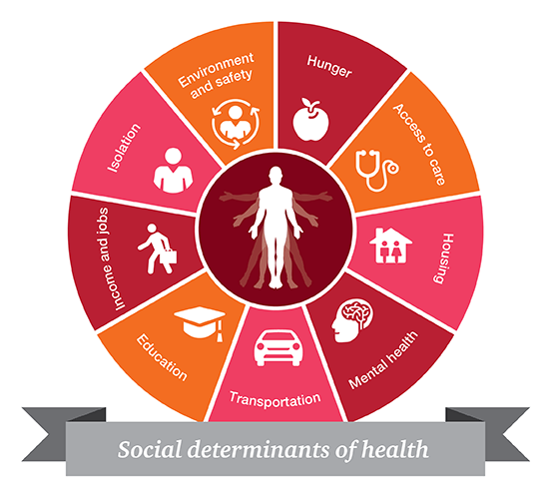
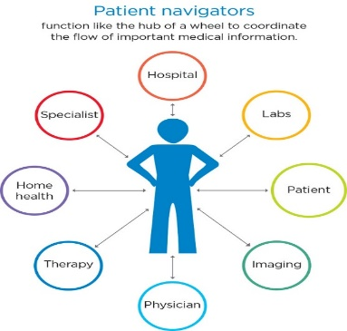
The Problem: Evidence-based strategies for combating delays do exist, but are not systematically implemented within or across hospitals
Patient Navigation to Guide and Support
Patient Registry to Track
at risk Population Over Time
Systematic screening to address Social Barriers
Notes:
Jennifer

Slide 8
The Research Question
“Can we systematically implement evidence-based patient navigation across the city of Boston to reduce delays in care for women?”

Slide 9
Research Methods
Community-engaged implementation study: Integrating evidence-based navigation in partnership with key stakeholders
Type 1 hybrid clinical effectiveness-implementation trial:
Clinical outcomes: time to initiation of treatment; quality of care
Implementation outcomes: acceptability, adoption, fidelity to protocol, sustainability, and cost
Pragmatic clinical trial: Cluster stepped wedge study design allows for rolling out iteratively in real life practice settings
Battaglia TA et al. Contemporary Clinical Trials, 2020, volume 93
Notes:
Jennifer

Slide 10
Journey to Today!
 | Pre-TRIP | Year 1: 2018 | Year 2: 2019 |  |  |  | Year 3: 2020 |  | Year 4: 2021 | Year 5: 2022
1 |  |  | BW-Faulkner Hospital
2 |  |  |  | Beth Israel Deaconess Medical Center
3 |  |  |  |  | Tufts Medical Center
4 |  |  |  |  |  | Boston Medical Center
5 |  |  |  |  |  |  | Mass. General Hospital
6 |  |  |  |  |  |  |  | Dana-Farber Cancer Institute
Notes:
Jennifer: here we are today,
The big additional challenge of the grant was the pandemic

Slide 11
TRIP Study Findings Preliminary…
Notes:
Tracy

Slide 12
TRIP Participants
Historical Controls 2016-2019 | Intervention Period 2019-2022
553 | 1179

Slide 13
TRIP Participants

Slide 14
TRIP Participants

Slide 15
Implementation Fidelity: did study sites successfully adopt the navigation protocol?
Levels of Fidelity | Definition
0 | No Navigation
1 | Navigator identified patient and entered in Shared Registry
2 | Social needs assessment completed at time of diagnosis
3 | Social needs assessment repeated within 6 months
4 | In registry and two social needs assessments completed
Notes:
Tracy

Slide 16
Implementation Fidelity: did study sites successfully adopt the navigation protocol?
Notes:
There were another 600 patients across all the sites who were eligible , but were never navigated.
This took us by completed surprise
It was all sites.
Was this COVID?
Does this reflect, that despite our EMR and all our work, none of us have systems to help us find all patients in need of navigation?

Slide 17
Social Needs Assessments at diagnosis N=407
Notes:
Tracy

Slide 18
Social Needs Assessments at diagnosis N=196
Percentage (%)
Notes:
Tracy

Slide 19
Notes:
Tracy

Slide 20
Summary
With stakeholders across the City, we studied a diverse group of new breast cancer patients across five hospitals
Despite these collaborations and ample resources, getting navigation services to patients was challenging
COVID impacted treatment for many patients
When we do navigate, it improves timely treatment
Much more data to analyze……..
To achieve equity, more work is needed to ensure proven treatments (like navigation) get to those who need it!
Notes:
Stephenie/Tracy

Slide 21
Notes:
ALL

