Slide 1
Translating Research Into Practice: A community-engaged, city-wide Implementation Study
Tracy A Battaglia, MD MPH
November 4, 2019
Dana-Farber Cancer Institute

Slide 2
Agenda
Breast Cancer Disparities in Boston
The Boston Breast Cancer Equity Coalition
TRIP Collaboration
TRIP Methods
Challenges to implementation
Discussion

Slide 3
Black:White disparities in breast cancer mortality
Across the 50 largest cities in the U.S. between 1990 and 2009
race-specific breast cancer mortality rates and corresponding rate ratios
35 cities increase in Black:White rate ratio
Increase largely because White rates improved substantially
Boston had the fifth-highest rate ratio: 1.49; 95% CI: (1.18, 1.88)
Between 1990-1994 (T1) and 2005-2009 (T2), in Boston:
T2:T1 rate ratio of cancer mortality for Black women: 0.90
T2:T1 rate ratio of cancer mortality for White women: 0.57
1710 excess Black deaths annually, an average of about 5 each day.
Hunt, Whitman, and Hurlbert (2014). Increasing Black:White disparities in breast cancer mortality in the 50 largest cities in the United States. Cancer Epidemiology.
Notes:
Numerator data from national death files
Population-based denominators from the U.S. Census Bureau
*Where Black = non-Hispanic Black and White = non-Hispanic White

Slide 4
The Boston Breast Cancer Equity Coalition
Est. in 2014 in response to Hunt article
Multidisciplinary stakeholders including: Nonprofits, government agencies, institutions and providers, patients, advocates, policy makers, researchers
Goal: Develop city-wide solutions with the specific aim of eliminating inequities in breast cancer outcomes
www.bostonbcec.org

Slide 5
MA Registry Data: Confirmed the disparity
**
**p<0.01
Death rates are average annual (i.e., annualized 12-year) age-adjusted rates.
Death data for 2012 is preliminary.
DATA SOURCE: Boston Resident Deaths, Massachusetts Department of Public Health
DATA ANALYSIS: Boston Public Health Commission Research and Evaluation Office
Notes:
The first thing the Coalition did, was to go back and confirm the data which was presented in the Hunt paper. Which unfortunately, was correct.
In the city of Boston inequities in breast cancer mortality have persisted among Black, non-Hispanic women compared to women of other racial/ethnic groups

Slide 6
Mortality disparity persists in Boston
Cancer Mortality for Boston Females by Race/Ethnicity
 | All | Asian | Latina | Black | White
All Breast Cancer | 19.9 | 9.9 | 8.2 | 26.2 | 21.3
Breast Cancer <65 Years | 8.1 | 11.1 | 4.4 | 10.9 | 7.1
DATA SOURCE: Massachusetts Department of Public Health, Boston Resident Deaths, 2015-2017 combined
Notes:
DFCI CHNA report

Slide 7
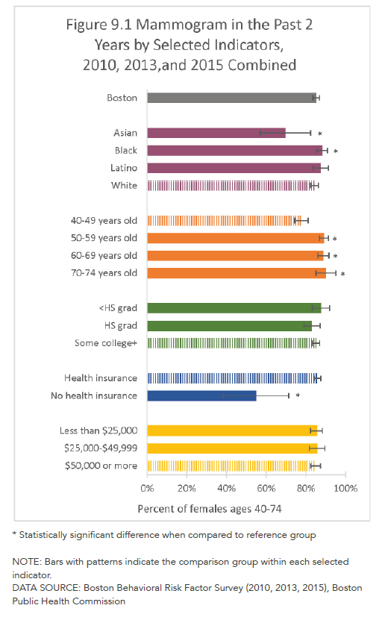
Parity in Breast Cancer Screening
2010-2015:
88% of Black women in Boston ages 40-74 received a mammogram
84% of White women in Boston ages 40-74 received a mammogram
DATA SOURCE: Boston Public Health Commission, Boston Behavioral Risk Factor Surveillance System, 2010, 2013, and 2015 combined
2013-2017:
89% of Black women in Boston received a mammogram
87% of White women in Boston received a mammogram
DATA SOURCE: Boston Public Health Commission, Boston Behavioral Risk Factor Surveillance System, 2013, 2015, and 2017 combined
Notes:
Health of Boston 2016-2017 report
DFCI CHNA

Slide 8
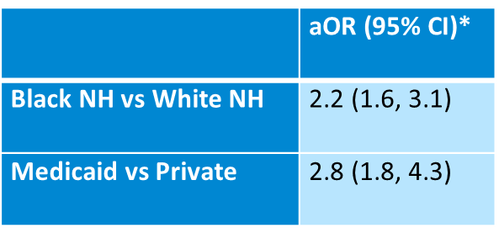
Treatment Delays Lead to Disparities
Black NH and those on Medicaid 2-3 times more likely to have delays > 60 days between diagnosis and initiating treatment
MA Cancer registry data 2010-2014: Boston women with breast cancer stages 0-3
Notes:
In Boston,
Black non-Hispanic women have a mean time to first treatment of 54 days (SD 47.4) vs 41 days for White non-Hispanic women (SD 35.2)*

Slide 9
Community Health Needs Assessment: Social Determinants of Health
Boston has many health care assets, but challenges to treatment exist for those in need of cancer care.
Lack of care coordination
Cost of treatment
Maintaining employment
Transportation
Childcare
Language barriers
Lack of cultural competency among providers
Institutional racism
Lack of clinical trial opportunities
Enhance support to help patients navigate cancer services and related care was most frequent suggestion

Slide 10
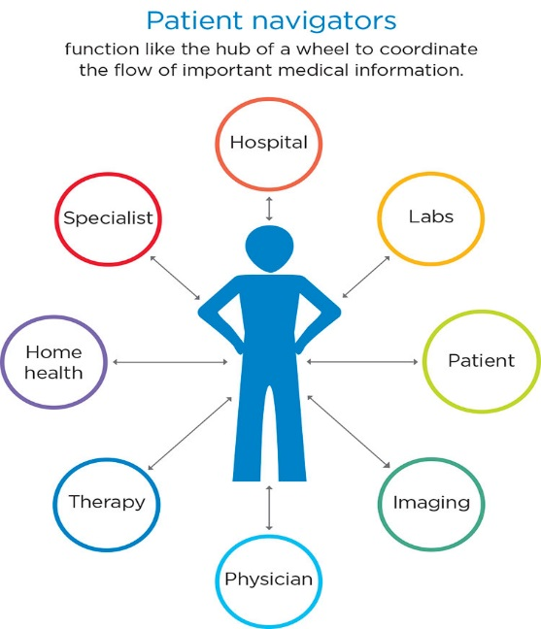
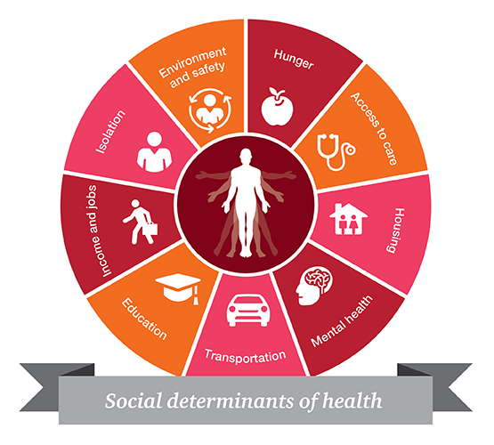
Evidence-based strategies for coordinating care are not systematically implemented within or across hospitals
Patient Navigation to Guide and Support
Patient Registry to Track
at risk Population Over Time
Systematic screening to address Social Barriers to Care

Slide 11
TRIP: Addressing disparities together
Tracy Battaglia, MD MPH | Karen Freund, MD MPH | Jennifer Haas, MD MPH | Stephenie Lemon, PhD
Boston Patient Navigator Network
Boston Patient Navigator Network
Clinical
Advisory
Panel
Funded by:

Slide 12
TRIP: The Research Question
“Can we systematically implement evidence-based coordination of care across the city of Boston to reduce delays for the most vulnerable women?”
“Can we systematically implement evidence-based coordination of care across the city of Boston to reduce delays for the most vulnerable women?”

Slide 13
TRIP Study Aims
#1: Conduct formative work to develop delivery models to integrate the multi-component intervention (patient registry, platform to screen/address social needs, and a patient navigation network) across six participating health systems. (Years 0-2)
#2: Execute a stepped wedge hybrid effectiveness-implementation trial at six health systems in to assess effectiveness and implementation of the integrated intervention. (Years 2-4)
#3: Disseminate the integrated intervention to other CTSA hubs and community-academic partnerships. (Years 3-5)

Slide 14
TRIP Study Methods
Community-engaged implementation science: Integrating evidence-based interventions in partnership key stakeholders
Pragmatic clinical trial: Cluster stepped wedge study design allows for rolling out iteratively in real life practice settings
Type 1 hybrid clinical effectiveness-implementation trial:
Clinical outcomes: time to initiation of treatment; quality of treatment
Implementation outcomes: acceptability, fidelity to protocols, penetration and cost

Slide 15
Stepped Wedge Study Design
 | Pre-TRIP | Year 1 | Year 2 |  |  |  | Year 3 |  | Year 4 | Year 5
1 |  |  | BW-Faulkner Hospital
2 |  |  |  | Beth Israel Deaconess Medical Center
3 |  |  |  |  | Tufts Medical Center
4 |  |  |  |  |  | Boston Medical Center
5 |  |  |  |  |  |  | Mass. General Hospital
6 |  |  |  |  |  |  |  | Dana-Farber Cancer Institute
536 historical controls and 564 intervention = 1100 women.
Eligible women reside in Boston ZIP code and:
Non-White race or Hispanic ethnicity;
No insurance or public health insurance; or
Primary language other than English

Slide 16
Aim 1 Formative Work
Patient focus groups, site surveys, interviews, work flow assessments
Developed TRIP Intervention components:
1. Patient Navigation Guidelines
2. Social Determinants of Health Screening and Referral
Online Social needs Assessment
Online referral platform Aunt Bertha
3. Shared Registry to manage population
REDCap platform (HIPAA Compliant)

Slide 17
Navigation at BMC:
navigation is a process not a person!
Radiology
Medical Oncology
Radiation Oncology
Surgical Oncology
Belkin Breast Navigator (conducts THRIVE screen)
Belkin Breast Navigator
Medical oncology Patient Navigators follow patients until barriers are met or patients can navigate on their own
Oncology Social Worker

Slide 18
11 TRIP Navigation Guidelines
Identify eligible patients
Initial contact
Communication with healthcare team
Tracking patients over time
# of contact attempts to reach patient
Missed appointment follow-up
Patients lost to follow-up
Completing SDoH assessment
Follow-up regarding social needs referrals
Transitions in Care/End of Navigation
Monitoring Caseload
Cancer 2019. Freund et al.

Slide 19
RedCap Registry screen shot

Slide 20
Aunt Bertha Screen shot

Slide 21
Aim 2: Execute Stepped Wedge Trial
 | Pre-TRIP | Year 1 |  |  | Year 2 |  |  |  | Year 3 |  |  |  | Year 4 |  |  |  | Year 5
Sites | 2016-17 | Sept-Nov 2017 | Dec 2017- Feb 2018 | March-May 2018 | June-Aug 2018 | Sept-Nov 2018 | Dec 2018- Feb 2019 | March – May 2019 | June – Aug 2019 | Sept – Nov 2019 | Dec 2019 –Feb 2020 | March – May 2020 | June – Aug 2020 | Sept –Nov 2020 | Dec 2020- Feb 2021 | March – May 2021 | June – Aug 2021
1 |  |  |  |  | BW-Faulkner Hospital
2 |  |  |  |  |  | Beth Israel Deaconess Medical Center
3 |  |  |  |  |  |  | Tufts Medical Center
4 |  |  |  |  |  |  |  | Boston Medical Center
5 |  |  |  |  |  |  |  |  | Mass. General Hospital
6 |  |  |  |  |  |  |  |  |  | Dana-Farber

Slide 22
Aim 2: Execute Stepped Wedge Trial
 | TOTAL patients on-study | Anticipated # of patients on-study
BWFH | 4 | 35
BIDMC | 26 | 41
Tufts MC | 10 | 11
BMC | 40 | 47
MGH | 3 | 10
DFCI | - | 5
TOTALS: | 83 | 149
TOTALS (w/o BWFH): | 79 | 114

Slide 23
DFCI projections and plan
 | Projected Enrollment |  |  | Enrolled to Date
 | Control | Intervention | Quarterly
DFCI | 132 | 88 | 11 | 0
BWFH | 49 | 91 | 7 | 4
Totals: | 181 | 179 | 18 | 3
Site Initiation Meeting
(July 2019)
Platform Demo Webinar
(Oct 2019)
On-Site Experiential Training
(Oct 2019)
GO LIVE
Late Oct/early Nov 2019
Follow-Up #1
(Oct-Dec 2019)
Follow-Up #2
(Jan-Mar 2020)
Follow-Up #3
(Apr-June 2020)
12-Month Data Collection (Sept 2020)
Presentation to Breast Program (June 2019)
24-Month Data Collection (Sept 2021)

Slide 24
Development of Navigator Network
Navigators from each site communicate via RedCAP registry
Protocol for communicating/documenting
Quarterly navigator meetings
Monthly Newsletter to share resources
Aunt Bertha “favorites” folder: community resources

Slide 25
Aim 2: Data Collection
Clinical outcomes data:
MA Cancer Registry historical controls
EMR abstraction for clinical outcomes: time to first treatment
Implementation outcomes data:
Quantitative metrics from navigator documentation of activities
Navigator/Provider interviews
Navigator observations
Navigator/Supervisor surveys

Slide 26
Implementation Challenges
Community Engagement Challenges:
competing demands for clinical providers and navigators
BBCEC volunteers
Chicago partners
Health System Navigation Challenges:
Navigator turnover
Unique health system workflow
Competing navigation protocols based on other funding streams
Multiple complex data systems
Data/Technical Challenges:
Data sharing agreements
Reducing the need for double data entry

Slide 27
Aim 3: Disseminate
leverage CTSA collaboration to disseminate our findings so they may be applied to other disease types and other cities
Chicago is an ideal location:
Similar cancer outcomes disparities exist
Metropolitan Chicago Breast Cancer Task Force
CI3: A collaboration of the three Chicago CTSI community engagement programs
Who is the audience for dissemination?
What tools can TRIP create to support dissemination?

Slide 28
TRIP Summary
Pragmatic oncology navigation intervention complex given unique health systems differences
Provider, navigator stakeholders committed to meaningful collaboration
Data collection challenges threat to implementation outcomes

