Slide 1
Translating Research Into Practice (TRIP)
March 14, 2022
ASPO 46th Annual Meeting
Notes:
Add in TRIP overview

Slide 2
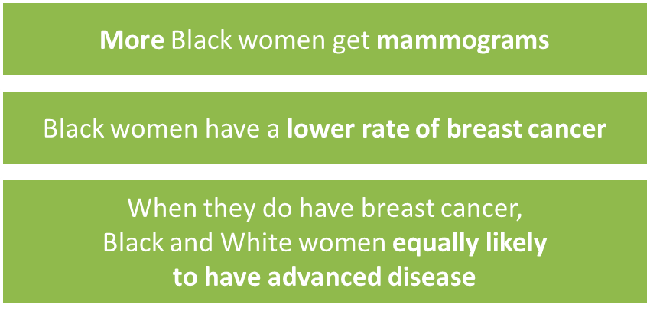
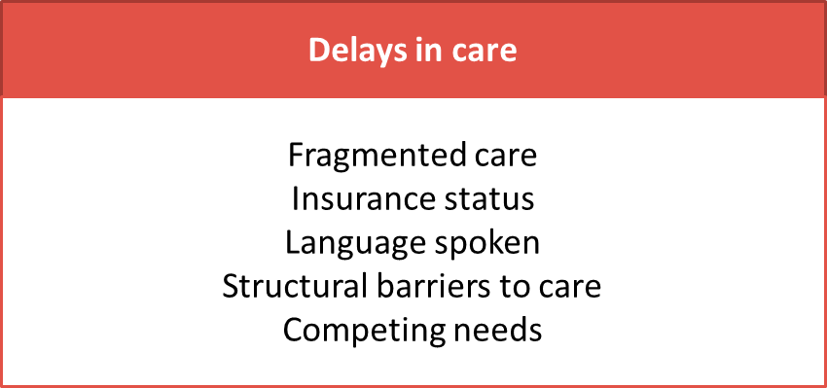

Slide 3
City-Wide Collaboration
Research Leads
Local Academic Medical Centers
Notes:
Table 3
Remove new patients

Slide 4
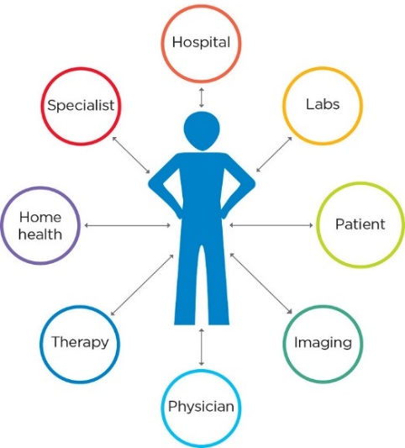
The Research Question
“Can we systematically implement evidence-based coordination of care across the city of Boston to reduce delays in care for minority women?”
“Can we systematically implement evidence-based coordination of care across the city of Boston to reduce delays for the most vulnerable women?”
Patient navigation network
Shared registry
Standard social needs screen

Slide 5
Eligibility Criteria
All:
Age ≥ 18 years
Sex: Female
Diagnosis: Breast cancer
Lives within 25 mi of Boston
At least one:
Black and/or Hispanic/Latina
Preferred language is not English
Uninsured or on public insurance
AND

Slide 6
Demographics
 |  | Intervention (n=616) | Historical Control (n=595)
Age Category | <50 | 156 (25%) | 158 (27%)
 | 50-65 | 264 (43%) | 229 (38%)
 | >65 | 196 (32%) | 208 (35%)
Race | White Non-Hispanic | 74 (12%) | 99 (17%)
 | Black Non-Hispanic | 279 (45%) | 251 (42%)
 | Asian Non-Hispanic | 75 (12%) | 74 (12%)
 | Hispanic | 169 (27%) | 151 (25%)
 | Other Race | 19 (3%) | 7 (1%)
 | Unknown | 0 (0%) | 13 (2%)
Language | English | 319 (52%) | (53%)
 | Not English | 297 (48%) | 282 (47%)
Region | Boston | 379 (62%) | 384 (65%)
 | Greater Boston | 237 (38%) | 211 (35%)
Insurance | Private | 228 (37%) | 217 (36%)
 | Medicare | 101 (16%) | 108 (18%)
 | Medicaid | 275 (45%) | 261 (44%)
 | Uninsured | 9 (1%) | 9 (2%)
 | Unknown | 3 (0%) | 0 (0%)
Data as of 11/30/2021
Notes:
Table 3
Remove new patients

Slide 7
Demographics
 |  | Intervention (n=616) | Historical Control (n=595)
Originating Site | BWFH | 4 (1%) | 36 (6%)
 | BIDMC | 121 (20%) | 115 (19%)
 | MGH | 73 (12%) | 91 (15%)
 | BMC | 279 (45%) | 148 (25%)
 | TMC | 49 (8%) | 37 (6%)
 | DFCI | 90 (15%) | 168 (28%)
Data as of 11/30/2021
Notes:
Table 3
Remove new patients

Slide 8
Social Needs Assessments
Baseline
418/616 patients screened
Top 3 needs
Follow-up (3 month)
220/616 patients screened
Top 3 needs
Employment
25%
Food
15%
Utilities
10%
Employment
17%
Food
18%
Transportation
13%
Data as of 2/1/2022

Slide 9
Lessons Learned: Interviews and Observations
Barrier | Facilitator | Value Added
Expansion of program or navigator scope Relative priority of TRIP Increased complexity from documentation | Compatibility with existing workflow Adapting protocol to existing workflow Continuous support and response to feedback | Formalizing navigation process Regional approach to care

Slide 10
Additional Implementation Data Sources
Observations of Navigation in the field (12 months after study launch)
Navigator Interviews: 12 and 27 months
Patient Interviews
Cost Analysis
Time motion Surveys and administrative cost worksheet
Notes:
Add in slide with papers and links (E.g. In Cancer, we published the 12-step protocol…)

Slide 11
Publications
Standardized activities for lay patient navigators in breast cancer care: Recommendations from a citywide implementation study (Freund et al., 2019)
Translating research into practice: Protocol for a community-engaged, stepped wedge randomized trial to reduce disparities in breast cancer treatment through a regional patient navigation collaborative (Battaglia et al., 2020)
Outside our walls: the Case for city-wide collaboration to reduce disparities (Haas et al., 2020)
Re: How the coronavirus disease-2019 may improve care: Rethinking cervical cancer prevention (Clark et al., 2021)
Development of a workflow process mapping protocol to inform the implementation of patient navigation programs in breast oncology (Casanova et al., in press)
Assessment of patient navigation programs for breast cancer patients across the city of Boston (LeClair et al., in press)
Notes:
Do you want manuscripts in press and presentations as well?

Slide 12
Timeline
Goal | Timeline
End of enrollment | 11/30/2021
End of navigation funding | 5/31/2022
Analysis | 5/31/2023

Slide 13
Dissemination and Sustainability
ACS Council of Advisors
Boston Breast Cancer Equity Coalition
Equal Hope (Chicago)

Slide 14
Questions?

