Slide 1
Collaborative Innovation Award Breast Cancer Disparities
Tracy Battaglia, MD MPH | Karen Freund, MD MPH | Jennifer Haas, MD MPH | Stephenie Lemon, PhD
6 Clinical Sites
Driven by Community Partners
Boston Patient Navigator Network
U01TR002070 (Battaglia)

Slide 2
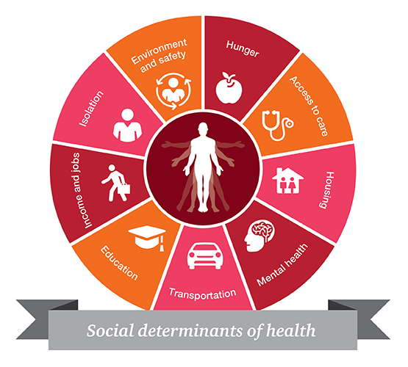
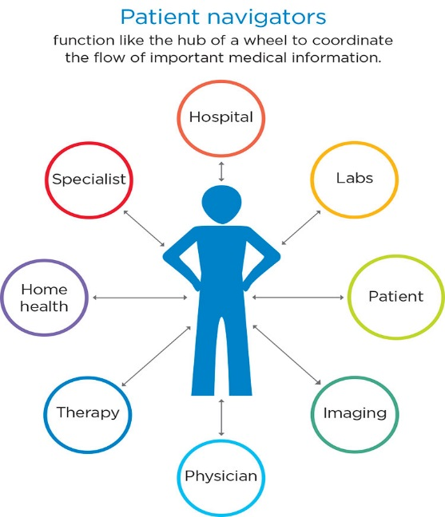
Evidence-based strategies to coordinate breast cancer care not systematically implemented within or across hospitals
Patient Navigation
Guide and Support
RedCAP Patient Registry
Track Population Over Time
Systematic screening to address Social Barriers to Care

Slide 3
Enrolled Subjects 8.5.2020
 |  | Total n=182
Race | White | 21%
 | Black | 53%
 | Asian | 13%
 | Other Race | 16%
Ethnicity | Hispanic | 25%
 | Non-Hispanic | 75%
Preferred Language | English Speaking | 95 (52%)
 | Non-English Speaking | 87 (48%)
Insurance Status | Private Insurance | 53 (29%)
 | Uninsured | 1 (1%)
 | Medicare | 39 (21%)
 | Medicaid | 98 (54%)
 | Other Insurance | 25 (14%)

Slide 4
Publications
Freund K et al. Standardized activities for lay patient navigators in breast cancer care: Recommendations from a citywide implementation study. Cancer, 2019.
Battaglia TA et al. Translating research into practice: Protocol for a community-engaged, stepped wedge randomized trial to reduce disparities in breast cancer treatment through a regional patient navigation collaborative. Contemporary clinical trials, 2020.
Haas JS, Lemon SC, Freund KM, Battaglia TA; Translating Research Into Practice (TRIP) Consortium Writing Group. Outside Our Walls: the Case for City-Wide Collaboration to Reduce Disparities. J Gen Intern Med. 2020
Casanova N et al. Development of a workflow process mapping toolkit to inform the implementation of patient navigation programs in breast oncology, submitted to JCO Oncology Practice (2020).
Clark CR et al. Centering Equity in the Transformation of Cancer Care Delivery: The Need to Address the Social Determinants of Health, submitted to Journal of Clinical Oncology (2020).

