Slide 1
A Real-time Registry to Track Breast Cancer Patients Across Boston
REDCapCon, September 22, 2020
Amy LeClair, PhD, Tufts Medical Center, Boston, MA
Clara Chen, MHS, Boston University, Boston, MA
Notes:
Hi everyone
Thank you for being here.
We are excited to be invited to present this use case, A real-time registry to track breast cancer patients across Boston.

Slide 2
Funding & Disclosures
Principal Investigators
Views expressed are our own, do not represent NIH/NCATS.
No financial interests to declare.
Tracy Battaglia, MD MPH
Boston Medical Center
1U01TR002070-01
Jennifer Haas, MD
Mass General Hospital
Karen M. Freund, MD MPH
Tufts Medical Center
Stephenie Lemon, PhD
UMass Medical Center
Notes:
First we’d like to thank the National Center for Advancing Translation Sciences for funding this week under the guidance of our 4 principal investigators, who represent the 4 Massachusetts’ CTSAs.
The views expressed are our own and do not represent the views of NIH or NCATS.
We have no financial interest to declare.

Slide 3
Translating Research Into Practice (TRIP)
Goal: address racial and socioeconomic disparities in receipt of timely breast cancer treatment
Intervention: Standardized patient navigation protocol across 6 academic medical centers
Notes:
Translating Research Into Practice, TRIP for short, is an NCATS funded study whose goal is to address racial and socioeconomic disparities in the receipt of timely treatment for women with breast cancer across the city of Boston
We aimed to achieve this goal by implementing a standardized patient navigation protocol across 6 academic medical centers

Slide 4
Problem: How to Create a Real-time Registry?
Track patients in real-time
Identify patients most vulnerable for delays
Allow navigators to see which patients need attention
Facilitate Inter-System Communication
Monitor Navigators’ Activities
Notes:
To do this, we needed to develop a place where patients could be tracked across multiple healthcare systems in real time.
We needed to identify those patients we knew to be most-vulnerable for delays in care so that navigation services could target those women
Over and over again, the clinical advisors on our project stressed the need for a tool that would tell them which patients needed attention today or this week versus who could wait, so we wanted a system that could help navigators manage their caseload.
And we had some evidence that patients seeking a second opinion or switching hospital systems were at greater risk delays, so we wanted navigators to be able to connect with one another across institutions.
In order to increase adoption, we made a strategic decision early on that we would treat this registry as a CLINICAL tool, NOT a research tool. That guided us in the design of the features – we still needed to use it for research purposes, but we wanted to maximize clinical utility.
We did want, on some level, to be able to monitor navigators’ activities to assess their adherence to our protocol.

Slide 5
Solution:
Benefits
Challenges
HIPAA compliant
Free for researchers - embedded within CTSA hubs
Facilitates dissemination
Designed for data capture, not clinical use
Minimize double-data entry
Notes:
After considering multiple options, we chose REDCap.
REDCap has the benefits of:
- being HIPAA compliant
Generally being free for researchers that are embedded within Clinical and Translational Science Award hubs.
And we thought using REDCap would facilitate dissemination of our intervention, which is an explicit aim of our grant – if we can get this to work and move the needle on disparities in Boston, can we help other cities or regions do the same
Choosing this platform did have some challenges:
It is designed for data capture, NOT clinical use
This intervention presented a change in clinical workflow. Patient navigators were using multiple systems within institutions.

Slide 6
Goals for the Registry
Streamline data entry for PNs
Visual tracking at-a-glance
Facilitate communication between sites

Slide 7
Streamlining data entry – Clinical challenges
Six sites, each with own existing methods of tracking
Electronic medical record, MSExcel, Outlook, sticky notes
Patient Navigators biggest challenge is a lack of time
Reduce the burden of double data entry
Notes:
Our intervention had to be standardized so we could have some minimal level of continuity of protocol across all out our sites
It also had to be flexible enough that it could be integrated into the clinical workflow at 6 sites, each of which has their own electronic medical records and databases of tracking systems which included, Excel spreadsheets, Outlook calendars and sticky notes.
The biggest challenge navigators faced was competing demands on their limited time, so minimizing the burden of double data entry has high importance. So if data existed in the EMR, we didn’t want them to have to re-enter it into REDCap

Slide 8
Streamlining data entry – Technical solutions
Multiple projects combined using dynamic SQL joins
Site-specific dropdowns and piped fields
Use of embedded links and referring URL to reduce keying on external partners’ websites
Notes:
CLARA EXPLAINS IT ALL – PART 1

Slide 9
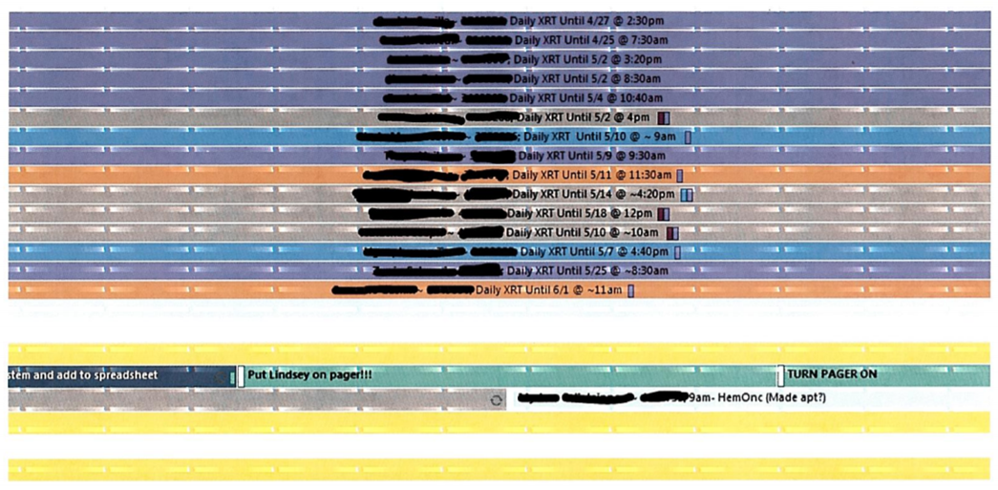
Visual Tracking At-a-Glance – Clinical challenges
Notes:
We wanted patient navigators to be able to log into a platform, look at their patient panel and know who needed action
Who did they have to follow up to see if they were able to fill out the form for transportation?
Who needed a reminder call about their next appointment?
This is one example of one day in a shared outlook calendar – the black out information is the patient name and medical record number, and then the colors denote different activities in terms of who needed to be seen in person, who needed help with transportation, etc. This wasn’t scalable.

Slide 10
Visual Tracking At-a-Glance – Technical solutions
Technical solutions
More customized dashboards and reports
Notes:
CLARA EXPLAINS EVERYTHING – PART 2

Slide 11
Population health: Patient Tracking Report
Notes:
Clara has offered better screenshots so it doesn’t look like my 2.5 yr old son prepared this slide

Slide 12
Facilitate Communication Across Sites – Clinical Challenges
No easy way to document communications between hospitals
Each site had their own EMR and notes

Slide 13
Facilitate Communication Across Sites – Technical Solutions
Technical solutions
Data entry forms around transitions
REDCap Messenger
Notes:
CLARA EXPLAINS EVERYTHING – PART 3

Slide 14
Governance/HIPAA
(Amy, can I leave this to you?)
Notes:
ummmmmmmm

Slide 15
For more information
Contact….
[provide WHU TRIP website URL and QR code – Katelyn is on this]

Slide 16
Acknowledgements
TRIP Registry Team
Tracy Battaglia, Boston Medical Center
Christopher Shanahan, Boston Medical Center
Sharon Bak, Boston Medical Center
Bill Adams, Boston Medical Center
Victoria Xiao, Boston Medical Center
Katelyn Mullikin, Boston Medical Center
Carolyn Finney, Boston University
Chris Lloyd-Travaglini, Boston University
Marisa Massaro, Boston University
Karen Freund, Tufts Medical Center
Stephenie Lemon, UMass Medical Center
Jennifer Haas, Mass General Hospital
Caylin Marotta, Mass General Hospital
REDCap Team
Mark McEver, Vanderbilt University
Notes:
I want to thank all the people who endured endless conference calls…

Slide 17
Cool things we did
Population health features
Governance/HIPAA
Facilitating PN communication and transitions between sites
Completion/transition form and field notes used to communicate
Reports
REDCap messenger
Multiple projects with dynamic SQL joins, site-specific dropdowns
Links to external partner’s sites, using referring URL to provide info to external partner
Audit log

