Slide 1


A Path Forward:
Driving Sustainability in Patient Navigation for Cancer Care Equity
Tracy A Battaglia MD MPH
Canadian Healthcare Navigation Conference
April 21, 2022
Notes:
Add in TRIP overview

Slide 2


“Personal” Disclosure
1990: Stage IV Hodgkins Lymphoma
White, professional: place of privilege
Did not share the same care experience as my patients
Career focus - understanding and addressing care differences for women historically marginalized
2018: Stage I Breast Cancer
We have a long way to go to get to equity………

Slide 3
Objectives
Define Patient Navigation in cancer care
Review evidence for navigation in driving cancer care equity
Outline major challenges to a sustainable navigation workforce
Share recommendations from the National Navigation Roundtable for a path forward

Slide 4

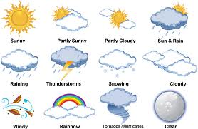
What weather pattern describes your mood today?

Slide 5


Defining Patient Navigation

Slide 6

The Problem: Care Delivery Disparities*
Discovery
Development
Delivery
Critical disconnect between cancer discoveries and care delivery to all patients*
*2013 IOM Report: The Cancer Care Delivery System is in Crisis
Notes:
6
Threatens the realization for health equity

Slide 7

Case #1: TB
48 year old White female physician
No FH breast cancer, personal h/o Hodgkin’s Lymphoma
Last screening mammogram: 18 months ago
May 5, 2018: self palpated left breast mass
May 7: diagnostic mammogram, Ultrasound, biopsy
May 9: ER- PR- Her2+ Invasive Ductal, Genetics and Surgical consult
May 16: Second opinion consult Medical and Surgical oncology
May 21: Staging work up – Stage 1
May 28, 2018: Started neo-adjuvant chemotherapy
23 days from symptoms to treatment initiation

Slide 8

Case #2: HH
68 year old Black female retired bus driver
FH of breast cancer in half sibling, SUD, homeless, T2DM
Last screening mammogram: 18 months ago
Jan 2019 noticed change on self exam, pain
July 2019: reported symptoms to PCP during routine exam
Dec 2019: diagnostic mammogram highly suspicious.
Jan 2020: biopsy ER- PR- Her2 -
Feb, 2020 Staging work up
March 2020 - second opinion
March 5, 2020: started chemotherapy
14 months from symptoms to treatment initiation
Notes:
Was connected with social services
Missed Anti-HER2 infusions for approximately a month and a half, a combination of COVID, child care, and timing

Slide 9
Compared to White women, Black women are:
Less likely to:
More likely to:
have BRCA testing
receive mammogram screening
receive breast conserving surgery
receive breast reconstruction
have oncotype DX testing
complete chemotherapy
adhere to oral medications
experience social barriers to care
detect cancer by self exam
have delays in diagnosis
have advanced stage at diagnosis
have dose delays in chemo
miss treatment appointments
Have premature mortality

Slide 10

U.S. Healthcare System is Complex
Employment/
Loss Wages
Language/interpreter
Fear
Location of Facility
Problems with Scheduling
Transportation
Perceptions and Beliefs
Comorbidities
Communication with Medical Personnel
Uninsured,
Underinsured
Disability
Healthcare Barriers
Literacy
Child/Adult Care
Notes:
10

Slide 11
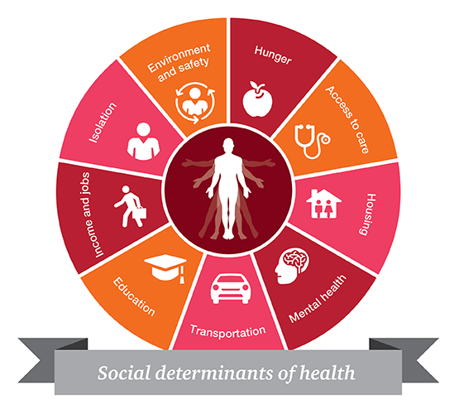
Cancer is Not Always the Worst Problem for our Patients: Social Determinants of Health
Notes:
Besides the fact that a lot of the innovative care is inaccessible, why is it inaccessible? Barriers to care = SDOH
Break down between discoveries and deliveries; and in deliveries

Slide 12
Patient Navigation: The Origins
1989 "Report to the Nation on Cancer in the Poor“ identified individual level barriers to accessing care
1990 Dr. Harold Freeman, Surgical Oncologist in Harlem, New York developed lay patient navigation program to connect the community to screening and follow up care
Evolved as a strategy to improve care for populations at risk for delays by eliminating barriers to timely diagnosis and treatment of cancer

Slide 13

Patient Navigation
Patient-centered health care delivery model
Target barriers to care
Individualized support/guidance
Links individuals to resources to overcome barriers
Across the continuum of cancer care
Goal = Improve the delivery of timely, quality care
Reduce cancer disparities
*Freund et al. Cancer 2008
Wells, Battaglia et al. Cancer 2008.
Notes:
Freeman et als program in Harlem targeting the high incidence of late-stage cancer and poor prognostic outcomes of low income and medically underserved minoriites.
Has served as a pradigm for other navigator programs
Seek to address perceived barriers stemming from mistrust and system complexity by training and employing lay individuals to provide one on one follow up and case management

Slide 14
Patient Navigation
Uses lay health workers as part of care team to:
1) Identify those at risk for delays
2) Identify individual barriers to care
3) Develop individual care plan
4) Track through diagnosis and treatment
Case identification
Abnormal screening
Identify Barriers
Develop/Implement plan to address barriers
Multiple
Encounters
Tracking
Tracking
Resolution
Battaglia et al, Cancer 2008
Notes:
14

Slide 15

CONCEPTUAL MODEL: Navigation
HEALTH CARE SYSTEM
CLINIC (Type, Size, Providers)
PARTICIPANT CHARACTERISTICS
Literacy Race History
Stress/Distress Income Education
Insurance Co-morbidity Language
EVENT
(ABNORMAL TEST or SYMPTOM/CANCER)
Site (Breast, CRC, Cervical, Prostate)
Clinical Characteristics
Type of Definitive Test/Treatment Pursued
BARRIER(S)
Number
Type
Intensity
NAVIGATION
Navigator Characteristics
Patient Relationships
OUTCOMES
Time to Resolution
Time to Treatment Initiation
Satisfaction/Perceptions
Costs
Stress/Distress(IES)
NO NAVIGATION
ACTION(S)
Number
Type
Time
Intensity

Slide 16
Patient Navigation
Position Statement of ONS, AOSW, and NASW*
individualized assistance offered to patients, families, and caregivers to help overcome healthcare system barriers and facilitate timely access to quality health and psychosocial care from prediagnosis through all phases of the cancer experience
outcomes are optimal when:
  a social worker, nurse, and lay navigator (defined as a trained nonprofessional or volunteer) function as a multidisciplinary team
  addresses ‘underserved’ communities
  scope of work and competencies of navigators are clearly defined
*Vol. 37, No. 3, May 2010 • Oncology Nursing Forum

Slide 17
Patient Navigator
A person who helps guide a patient through the healthcare system. This includes help going through the screening, diagnosis, treatment, and follow-up of a medical condition, such as cancer. A patient navigator helps patients communicate with their healthcare providers so they get the information they need to make decisions about their health care. Patient navigators may also help patients set up appointments for doctor visits and medical tests and get financial, legal, and social support. They may also work with insurance companies, employers, case managers, lawyers, and others who may have an effect on a patient’s healthcare needs. Also called patient advocate.
https://www.cancer.gov/publications/dictionaries/cancer-terms/def/patient-navigator

Slide 18
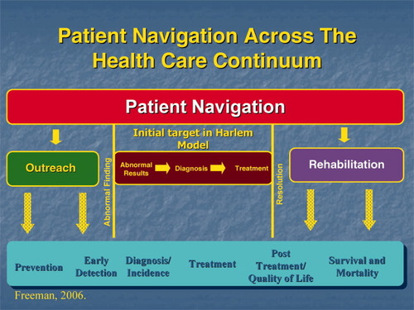
Patient Navigation is a process not a person

Slide 19

Which emoji do you associate with Patient Navigation?

Slide 20


Evidence for Patient Navigation and Cancer Equity

Slide 21
Impact of Lay Navigation on Breast Cancer Outcomes in Harlem, NYC
Pre-Navigation
Post-Navigation
49% late-stage (III and IV)
21% late-stage (III and IV)
6% early stages (0 and I)
41% early stages (0 and I)
70% 5-year survival
39% 5-year survival
Oluwole, Soji F MD, FACS*, **; Ali, Ayoola O MD*; Adu, Albert MD, FACS*; Blane, Brenda P MEd*; Barlow, Barbara MD, FACS*; Oropeza, Ruben MD, FACS*; Freeman, Harold P MD, FACS* Impact of a Cancer Screening Program on Breast Cancer Stage at Diagnosis in a Medically Underserved Urban Community, Journal of the American College of Surgeons: February 2003 - Volume 196 - Issue 2 - p 180-188
doi: 10.1016/S1072-7515(02)01765-9

Slide 22
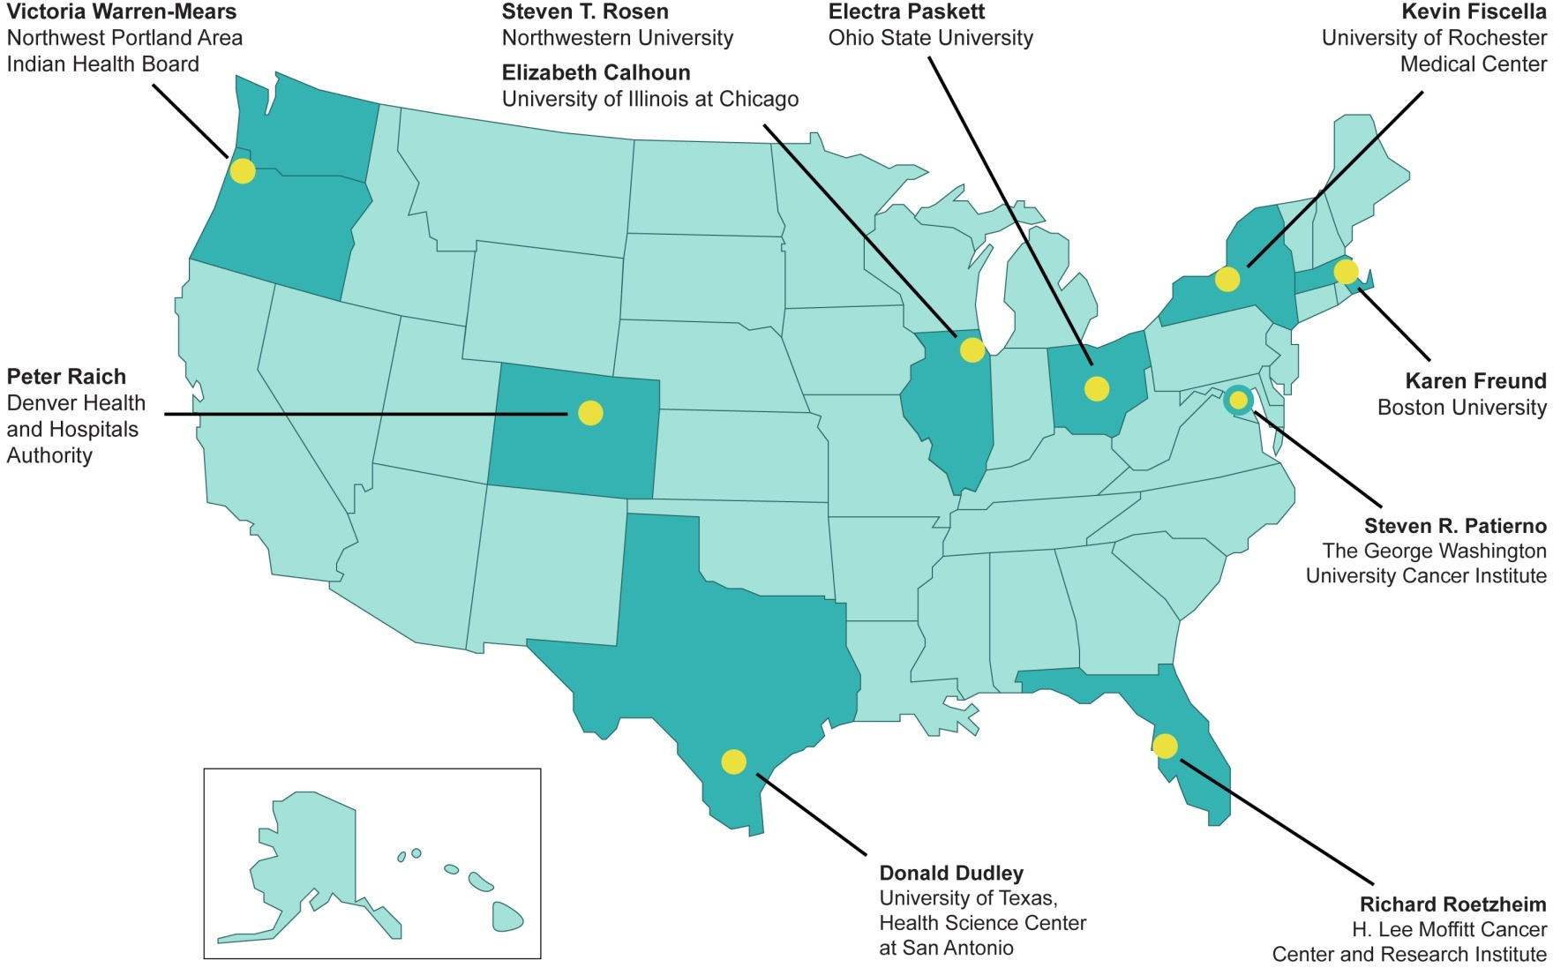

Patient Navigation Research Program (PNRP)
Notes:
22

Slide 23
PNRP Main Questions
Will navigated patients…
Receive timelier, definitive resolution following an abnormal finding?
Receive timelier treatments following a positive diagnosis?
Notes:
23

Slide 24
PNRP Methods
Lay Navigators within healthcare systems serving populations historically marginalized
Breast, Cervical, Colorectal or Prostate
  Screening abnormality
  New cancer diagnosis
% complete diagnostic care in 365 days
Kaplan Meier survival curve estimate timely care
Adjusted Hazards Ratio (aHR) > 1.0 more timely care
Meta-analysis
Notes:
In order to address both the time to diagnostic resolution and the censoring for lack of ever reaching resolution we developed Kaplan-Meier survival curves and proportional hazards regression models to examine the effect of patient navigation on time to definitive diagnosis. The Kaplan Meier curves and hazards ratios were calculated separately for breast and cervical cancer screening abnormalities. The adjusted Hazards Ratios for the proportional hazards models. where the hazard ratio greater than 1.0 indicates that patient navigation is associated with a greater likelihood of diagnostic resolution.

Slide 25
Barriers Targeted by
Patient Navigation
Transportation
Social/Practical Support
Language
Literacy
Location of Health Care Facility
Communication Concerns with Medical Personnel
Fear
Medical & Mental Health Co-morbidity
Patient Disability
Out of Town/Country
Perceptions/Beliefs about Tests/ Treatment
System Problems with Scheduling Care
Attitudes Towards Providers
Housing
Childcare Issues
Adult Care
Insurance (Uninsured, Underinsured)
Financial Problems
Employment Issues
Notes:
EMILY

Slide 26
Navigation improved care the most at sites with the greatest delays in care, N=10,000
100
90
80
70
60
50
Control
Navigated
40
30
20
10
0
A
B
C
D
F
G
H
I
J
K
L
M
N
0
P
Q

Slide 27
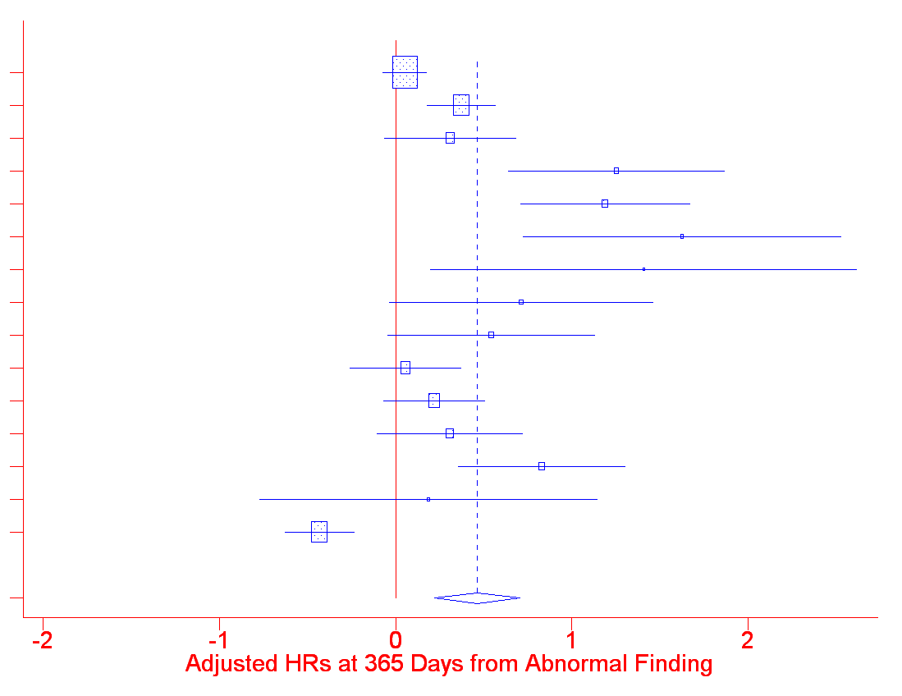
Meta-analysis: Diagnostic Resolution at 365 days
A breast
A cervix
B prostate
B breast
B cervix
C breast
C colorectal
C prostate
D breast
D cervix
E breast
E cervix
F breast
F colorectal
G breast
ALL
0.3
0.5
1
2
3
aHR = 1.4 (95% CI 1.2 – 1.7)

Slide 28
The Patient Navigation Research Program
Impact of Navigation during
Diagnostic and Treatment Phase
HR: Hazards ratio
N=10,000
 | Days 0 – 90 Adjusted HR (95% CI) | Days 91-365 Adjusted HR (95% CI)
Diagnostic Phase | 1.14 (0.96 – 1.34) | 1.51 (1.23 – 1.84)
Treatment Phase | 0.85 (0.71 – 1.01) | 1.43 (1.10 – 1.86)

Slide 29
Navigated patients with barriers have persistent delays
The number and type of barriers matter……
Notes:
Those with one barrier in the other barrier category had less timely resolution than those with no barriers (p=0.010). Those with two or more barriers including a social service barrier had a significantly longer time to resolution than those with no barrier (p<0.001), those with one other barrier (p=0.001), and those with two or more other barriers (p=0.014).

Slide 30
Which Navigator activities improve care??
Task/Network | Patient | Provider | Non-Clinical Staff | Support | EMR
Navigate with specific pt | YES
Facilitate for specific pt |  | YES | YES | YES
Maintain system for all |  |  |  |  | X
Document/ Review |  |  |  |  | X
Notes:
30
Define attributes of the work of patient navigators
Describe variation in navigation
Develop an evaluation instrument for observing navigator work that produces valid, reliable data across sites
Use this instrument to define and compare across sites and programs
*leveraged funds through the Avon foundation

Slide 31

Summary
“Modest” results:
  Reduction in delays in care
  Reduction in # who never complete needed care
  Satisfaction with care
Most effective where delays are the greatest
Navigation activities matter
Delays persist for those with unaddressed barriers

Slide 32
Patient Navigation and Cancer (n=2,134)
Increase
Screening
Recommended care
Treatment initiation within 30-60 days of diagnosis
Quality of Life
Satisfaction
Clinical Trial enrollment
Decrease
Patient Distress
Time to diagnosis
Time to treatment
Lost to follow up
Costs
Healthcare utilization
  No show rates
  ED visits
  Hospitalizations

Slide 33
Which is the biggest barrier you face in implementing Patient Navigation?

Slide 34


Barriers to Sustainable
Navigation Workforce

Slide 35
Launched in 2017
18 member steering committee including Chair/Vice-Chair
Academia, public health, advocacy/survivorship groups, professional societies, industry, training and government agencies
Coalition of over 70-member organizations and invited individuals
“dedicated to achieving health equity and access to quality care across the cancer continuum through effective patient navigation”

Slide 36























Member Organizations
Over 70 member organizations (120 individuals) representing academia, public health, advocacy/survivorship advocacy/survivorship groups, professional societies, industry, training, government agencies and non-profit community-based organizations, such as:
Notes:
Not everyone’s logo are included obviously

Slide 37
Core Principles
What the Roundtable Won’t Do
What the Roundtable Will Do
Duplicate or compete with member organization activities
Take on positions or projects that are in conflict with member organizations
Serve as a forum (collective action)
Provide the “Big Tent”
Identify unmet needs & gaps
Stimulate collaboration
Support Task Groups made up of experts to carry out key initiatives
Prioritize health equity

Slide 38
Major Barriers
Lack of clearly defined professional roles and responsibilities (lay/clinical v professional navigators), and workforce development path forward
Lack of standardized outcome metrics to continue to document benefits of navigation and identify best practices
Need for widespread implementation of evidence-based practices
Lack of a sustainable model for funding: policy to establish navigation as a reimbursable service

Slide 39



Task Groups
Evidence Based Promising Practices
Beth Calhoun, PhD, Med Electra Paskett, Ph.D.
Workforce Development
Linda Burhansstipanov, MSPH, DrPH
Patti Valverde, PhD, MPH
Policy
Elizabeth Franklin, Ph.D., MSW Katie Garfield, JD

Slide 40

The Professional Oncology Navigation Task Force

Slide 41
Professional
Navigators
Oncology
Patient Navigator
Clinical Navigator
Oncology Nurse Navigator
Clinical Navigator
Oncology Social Work Navigator
No clinical training
registered nurse
master’s degree in social work and a clinical license
Oncology-specific clinical knowledge
Oncology-specific psychosocial knowledge
Knowledge of community
Provides assistance to patients/families to improve access to healthcare services
JUNE 2022, VOL. 26, NO. 3
CLINICAL JOURNAL OF ONCOLOGY NURSING

Slide 42
PONT 19 Recommendations for Standards of Practice
Ethics
Qualifications
Knowledge
Cultural and Linguistics Humility
Interdisciplinary and Interorganizational Collaboration
Communication
Professional Development
Supervision
Mentorship and Leadership
Self-Care
Prevention, Screening, and Assessment
Treatment, Care Planning, and Intervention
Psychosocial Assessment and Intervention
Survivorship
End of Life
Advocacy
Operational Management
Practice Evaluation and Quality Improvement
Evidence-Based Care

Slide 43
Further distinction needed between Navigators and Community Health Workers
Community Health Workers (CHW)
Clinical Health Educator
Patient Navigators (PN)
Oncology Patient Navigator
Promotoras/Promotores
Community Outreach Specialist
Lay Health Advisors/Workers/Educators
Community Health Representative
Outreach Workers
Health Navigators
Research CHWs
Clinical Navigator/Oncology Nurse Navigator
Clinical Navigator/Oncology Social Work Navigator

Slide 44
NNRT National Survey to assess barriers and facilitators to

Slide 45
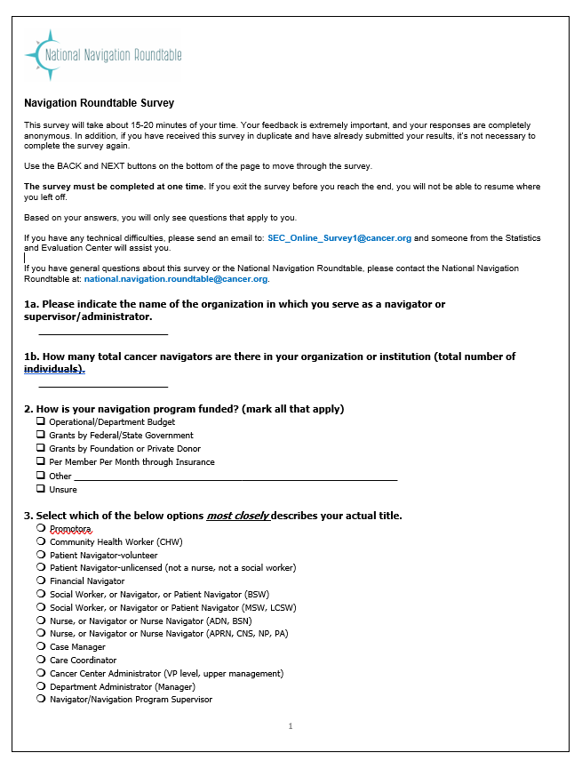
750 navigation programs from across the country represented continuum of care
72% participate in routine data collection
42% use two or more data sources
50% use the Electronic Health Record
20% had discrete reportable navigation fields and only 13% had an identifier for navigated patients
Only 38% use data for regular reporting purposes

Slide 46
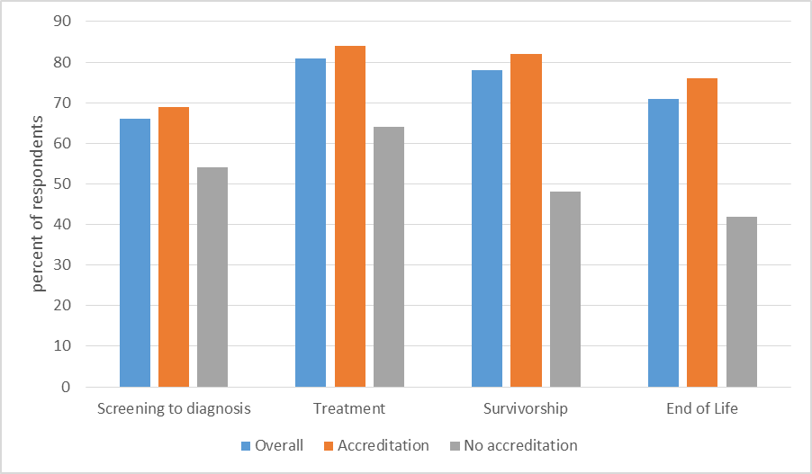
Barriers and Facilitators
Barriers
Limited Time
Complex data systems/platforms with no interface
Facilitators
Participating in accreditation programs
Training and systems support
Lack training and support
Percent of respondents who collect any metric by accreditation status, across the care continuum

Slide 47
Implementation Studies

Slide 48
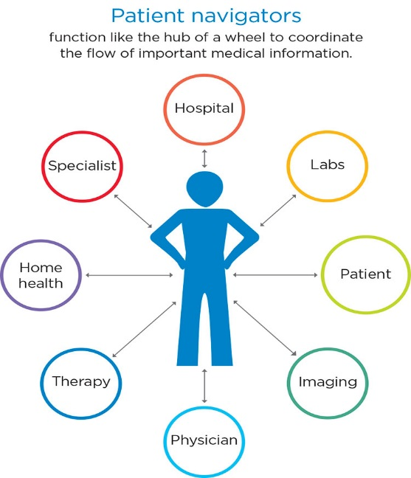
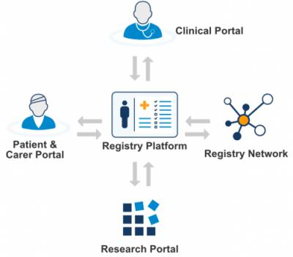
The Problem: Evidence-based strategies for combating cancer care delays are not systematically implemented within or across hospitals
Patient Navigation to Guide and Support
Patient Registry to Track
at risk Population Over Time
Systematic screening to address Social Barriers to Care

Slide 49












City-Wide Collaboration
Research Leads
Local Academic Medical Centers
Notes:
Table 3
Remove new patients

Slide 50

The Research Question
“Can we systematically implement evidence-based navigation across the city of Boston to reduce delays in care for women?”
“Can we systematically implement evidence-based coordination of care across the city of Boston to reduce delays for the most vulnerable women?”
Patient navigation network
(Provider/Care Teams)
Shared registry
(Health System)
Social needs assessment and referral
(Individual Pateint)

Slide 51
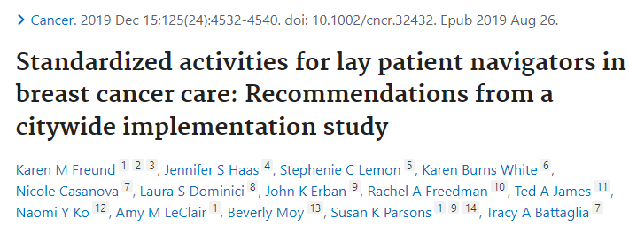
New Standard of Care Approach

Slide 52
Research Methods
Community-engaged implementation science: Integrating evidence-based interventions in partnership with key stakeholders
Type 1 hybrid clinical effectiveness-implementation trial:
  Clinical outcomes: time to initiation of treatment; quality of care
  Implementation outcomes: acceptability, adoption, fidelity to protocol, sustainability, and cost
Pragmatic clinical trial: Cluster stepped wedge study design allows for rolling out iteratively in real life practice settings

Slide 53
TRIP Study Participants (N=1,211)
 |  | Intervention (n=616) | Historical Control (n=595)
Age Category | <50 | 25% | 27%
 | 50-65 | 43% | 38%
 | >65 | 32% | 35%
Race | White Non-Hispanic | 12% | 17%
 | Black Non-Hispanic | 45% | 42%
 | Asian Non-Hispanic | 12% | 12%
 | Hispanic | 27% | 25%
 | Other Race | 3% | 1%
Language | English | 52% | 53%
 | Not English | 48% | 47%
Region | Boston | 62% | 65%
 | Greater Boston | 38% | 35%
Insurance | Private | 37% | 36%
 | Medicare | 16% | 18%
 | Medicaid | 45% | 44%
 | Uninsured | 1% | 2%
Data as of 11/30/2021
Notes:
Table 3
Remove new patients

Slide 54
Preliminary Implementation Data:
Interviews and Field Observations
Barriers | Facilitators | Value Added
Competing demands partners (COVID) Relative priority of TRIP Tension for change related to scope of navigation Navigator turnover Incompatible data systems leading to duplication of effort | Compatibility with existing workflow Adapting protocol to existing workflow Continuous support and response to feedback Clinical Champions | Formalizing evidence-based navigation process Regional approach to care Communication across systems

Slide 55
Patient Navigation in Cancer Care
Review of Payment Models for a Sustainable Future

Slide 56
Short-Term Funding Models
Private Grants
Government Grants
Merck Foundation
Federal: CMMI
American Cancer Society
Susan G Komen
State: BCCEDP
Notes:
http://navigationroundtable.org/wp-content/uploads/Patient-Navigation-in-Cancer-Care-Review-of-Payment-Models_FINAL.pdf

Slide 57
Long-Term Funding Models
Fee-For-Service Models
Managed Care/Alternative Payment Models
Establish reimbursement for navigation services when provided by licensed nurses, SWs, or lay navigators operating under supervision
Establish billing codes for specific navigator duties
Seek a commitment from major payers-including CMS- to include patient navigation in future payment models
Create a network of state-level experts who can advice on inclusion of patient navigation in payment reform and value-based payment models
Notes:
http://navigationroundtable.org/wp-content/uploads/Patient-Navigation-in-Cancer-Care-Review-of-Payment-Models_FINAL.pdf

Slide 58
How do you fund your navigation programs?
Private Grants
Federal Grants
Operating Budget
Philanthropy
Fee for Service
Value-based payment model (ACO, bundled)
Other

Slide 59


National Navigation Roundtable: recommendations for a path forward

Slide 60
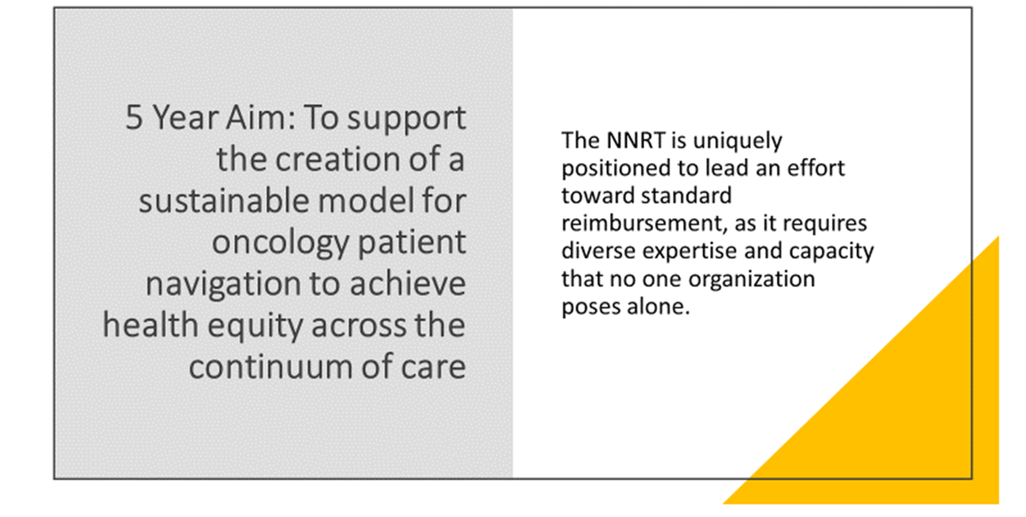
NNRT 5 Year Aim

Slide 61
Sustainability Model (ASTHO)
Recommendation | Goal
Workforce Development | Support standardized training and certification of PN and Community Health Workers (CHWs)
Occupational Associations | Create occupational networks to strengthen PN and CHW effectiveness in the workforce.
Long Term Financing | Support standard reimbursement for PN and CHW services

Slide 62
Sustainability Framework Constructs (Wash U)
1. Funding Stability = making long-term plans based on a stable funding environment
2. Partnerships = connection between program and community
3. Organizational Capacity = resources needed to effectively manage the program and its activities
4. Program Evaluation = monitoring and evaluation of process and outcome data associated with program activities
5. Program Adaptation = ability to adapt and improve in order to ensure effectiveness
6. Communications = strategic dissemination of program outcomes and activities with stakeholders, decision-makers, and the public
7. Strategic Planning = process that defines the program direction, goals, and strategies
8. Environmental Support = internal and external political environment which influences program funding, initiatives, and acceptance.

Slide 63
NNRT: Where We’re Headed
Work with its membership and leadership to develop a 5 year blueprint to lead to the creation of a stable funding environment for patient navigation at all levels.
Continue to convene our member organizations to support alignment with 5 Year Aim.
Continue to connect and promote the work of member organizations in the sustainability constructs.

Slide 64
Call to Action
Increase recognition that navigation is a process that must extend across the care continuum to achieve its promise to reduce inequities in care delivery
We must come together now to adopt clear and consistent job titles and occupational identities
Move toward professionalization of each of these positions and classify workers into occupational categories in cancer care
Sustainability of patient navigation in oncology requires routine data collection: the right analytics with the right technology
Purse funding models that support successful transition to value-based care
Become a member of NNRT: https://navigationroundtable.org

Slide 65

Final Thoughts
Community partnerships and collective action are necessary to address the complex challenges to equitable care delivery
Next steps require ongoing partnership to address persistent obstacles to implementing best practices
The expertise we bring from our lived experiences are powerful vehicles to achieving equity ☺

