Slide 1



In Pursuit of Equity in
Breast Cancer Care:
A Generalist’s Perspective
Tracy A Battaglia, MD MPH
January 7, 2020

Slide 2
Disclosures
None to report

Slide 3


“Personal” Disclosures
Why is a general internist talking about breast cancer?
Age 20: Stage IV Hodgkins Lymphoma
White, professional: place of privilege
Not all share the same care experience
Understand and address differences for vulnerable women
Age 48: Stage I ER-/PR-/Her2+ Breast Cancer
We have a long way to go to get to equity…

Slide 4
Objectives
Describe the “disconnect”: disparities in breast cancer care delivery
Understand the general internist’s role in “repairing” the breast cancer care delivery problem
Explore opportunities and challenges to achieving equity in breast cancer care delivery

Slide 5
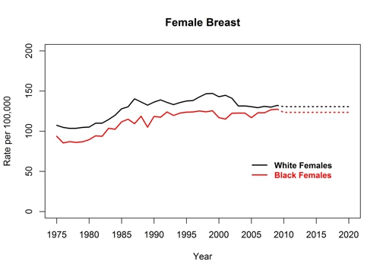
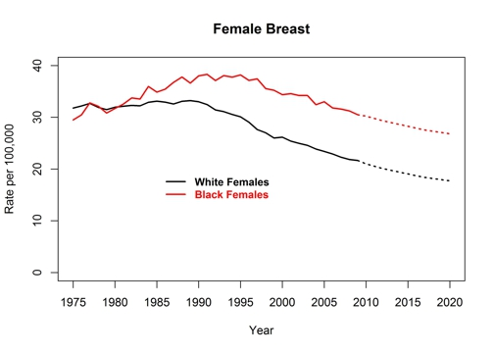
Breast Cancer Incidence and Death Rates
United States, 1975-2020
Division of Cancer Prevention and Control Centers for Disease Control and Prevention (2018).

Slide 6
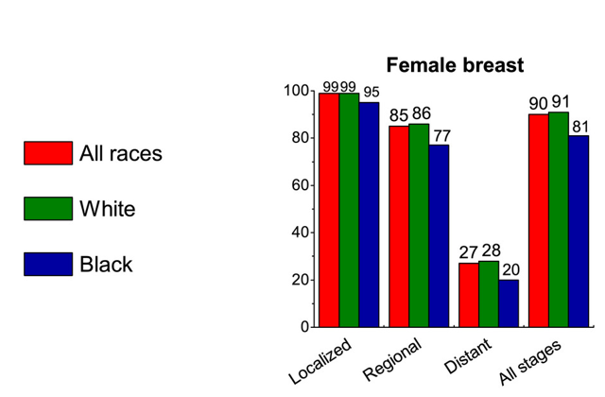
5 Year Relative Survival Rate for Breast Cancer by Race and Stage at Diagnosis
United States, 2008 to 2014
Siegel, R.L., et al. (2019). CA: A Cancer Journal for Clinicians.

Slide 7

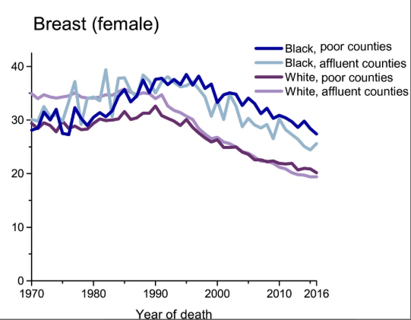
Cancer Mortality Rates by County-Level Poverty, United States, 1970-2016
Cancer Mortality Rates by County‐Level Poverty, United States, 1970 to 2016. Rates are per 100,000 population and are age adjusted to the 2000 US standard population. County‐level poverty was derived from the 2012 to 2016 American Community Survey. “Poor” and “affluent” refer to extreme county‐level poverty categories: 21.18% to 53.95% and 1.81% to 10.84%, respectively.
Siegel, R.L., et al. (2019). CA: A Cancer Journal for Clinicians.

Slide 8
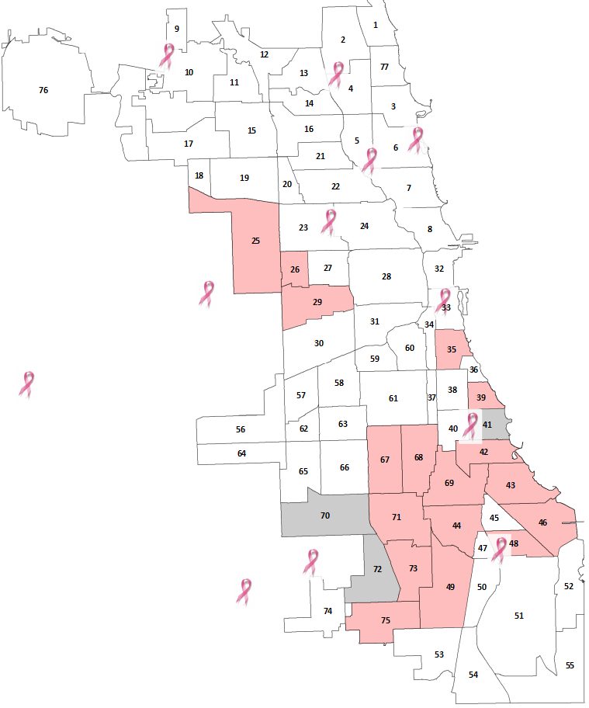
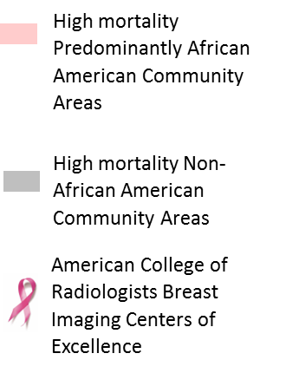

Where You Live in Chicago Matters

Slide 9
Multiple “Opportunities” for Disparities
Across the Cancer Care Continuum
BIOLOGIC
PROVIDER
SYSTEM
PATIENT
Prevention
Screening
Diagnosis
Treatment
Survivorship

Slide 10
Compared to White women, Black women are:
Less likely to:
More likely to:
have BRCA testing
receive mammogram screening
receive breast conserving surgery
receive breast reconstruction
have oncotype DX testing
complete chemotherapy
adhere to oral medications
experience social barriers to care
detect cancer by self exam
have delay after screening
have dose delays in chemo
have advanced stage at diagnosis
miss treatment appointments

Slide 11
The Problem: Care Delivery Disparities
Discovery
Development
Delivery
Critical disconnect between cancer discoveries and cancer care delivery to all patients
Notes:
11
Threatens the realization for health equity

Slide 12
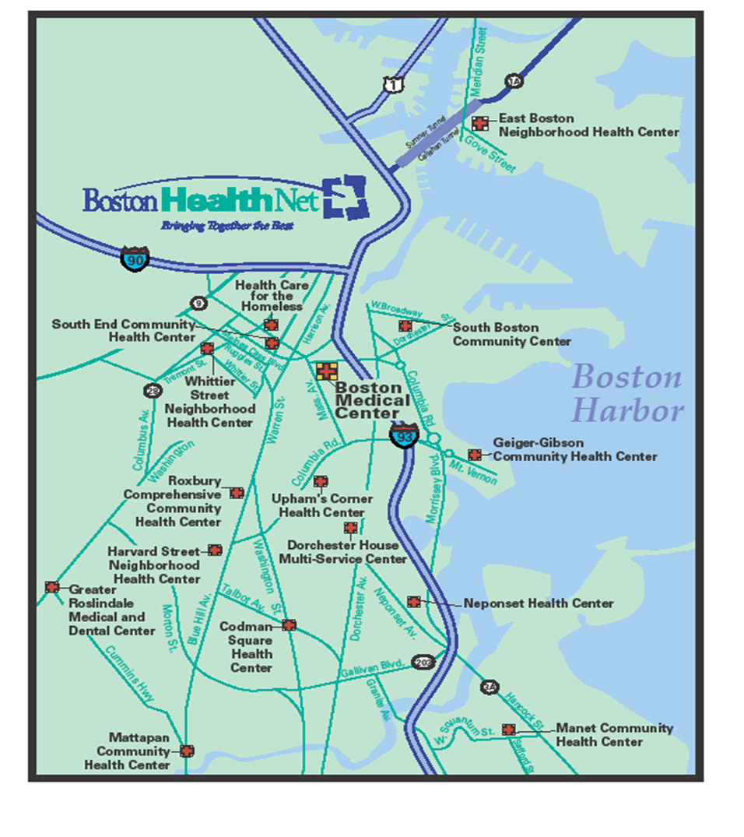


Boston Medical Center
Primary teaching hospital: Boston University
Public hospital serving inner-city with 13 federally qualified health centers
Largest safety net institution in New England
  747,554 annual visits
  70% racial/ethnic minority
  >50% uninsured or Medicaid
  30% non-English speaking
“Exceptional care without exception”

Slide 13



  Women’s Health Unit
  A DHHS Center of Excellence in Women’s Health
Primary-care based academic clinical research unit
Vision: Lead the nation in delivery of equitable,
comprehensive, coordinated and compassionate
women’s health
Research
(Care delivery)
Training
&
Education
Clinic care
coordination
Community Engagement

Slide 14

The Generalist Lens
BIOLOGIC
PROVIDER
SYSTEM
PATIENT
Longitudinal relationships patient/family
Understanding health system challenges
Public health relationships: local context
Unique position to understand and begin to address care delivery disparities
The generalist

Slide 15
Mammography Screening Rates in Massachusetts
BRFSS MA Mammography rates among highest in the nation
85% of women aged 40-74 mammogram 2016-2018
No Black:White differences
Local data reveal certain populations remain at risk
Asian women*: 70%
Uninsured women*: 55%
Foreign-born Muslim*: <50%
Residency practices at BMC**: 55%
Health of Boston Report 2017
*Boston CHNA-CHIP Collaborative
**Schroff, Battaglia et al SGIM 2013.
Behavioral Risk Factor Surveillance System (BRFSS)

Slide 16
Days to Diagnosis After Abnormal Mammogram
*Battaglia et al Cancer 2010.
Notes:
Among 523 women with mammography abnormalities and 474 women with Pap test
abnormalities, >90% achieved diagnostic resolution within 12 months. Median time to resolution
was longer for Pap test than for mammography abnormalities (85 versus 27 days). Site of care, rather
than any sociodemographic characteristic of individuals, including race/ethnicity, was the only
significant predictor of timely follow up for both mammogram and Pap test abnormalities.

Slide 17
Breast Cancer Care at BMC
EMR Chart review
Diagnosis: In 2005, 36% referrals for screening abnormality NEVER arrived for evaluation (Battaglia et al, Cancer 2007)
Treatment: ER+/PR+ Breast Cancer 2006-8
36% non-complaint initiation HT within 365 days
Non-complaint: non-white, non-US born
Longest delays related to social language, transportation, insurance, health literacy (Crowley, Battaglia et al, J Onc Practice, 2014)

Slide 18
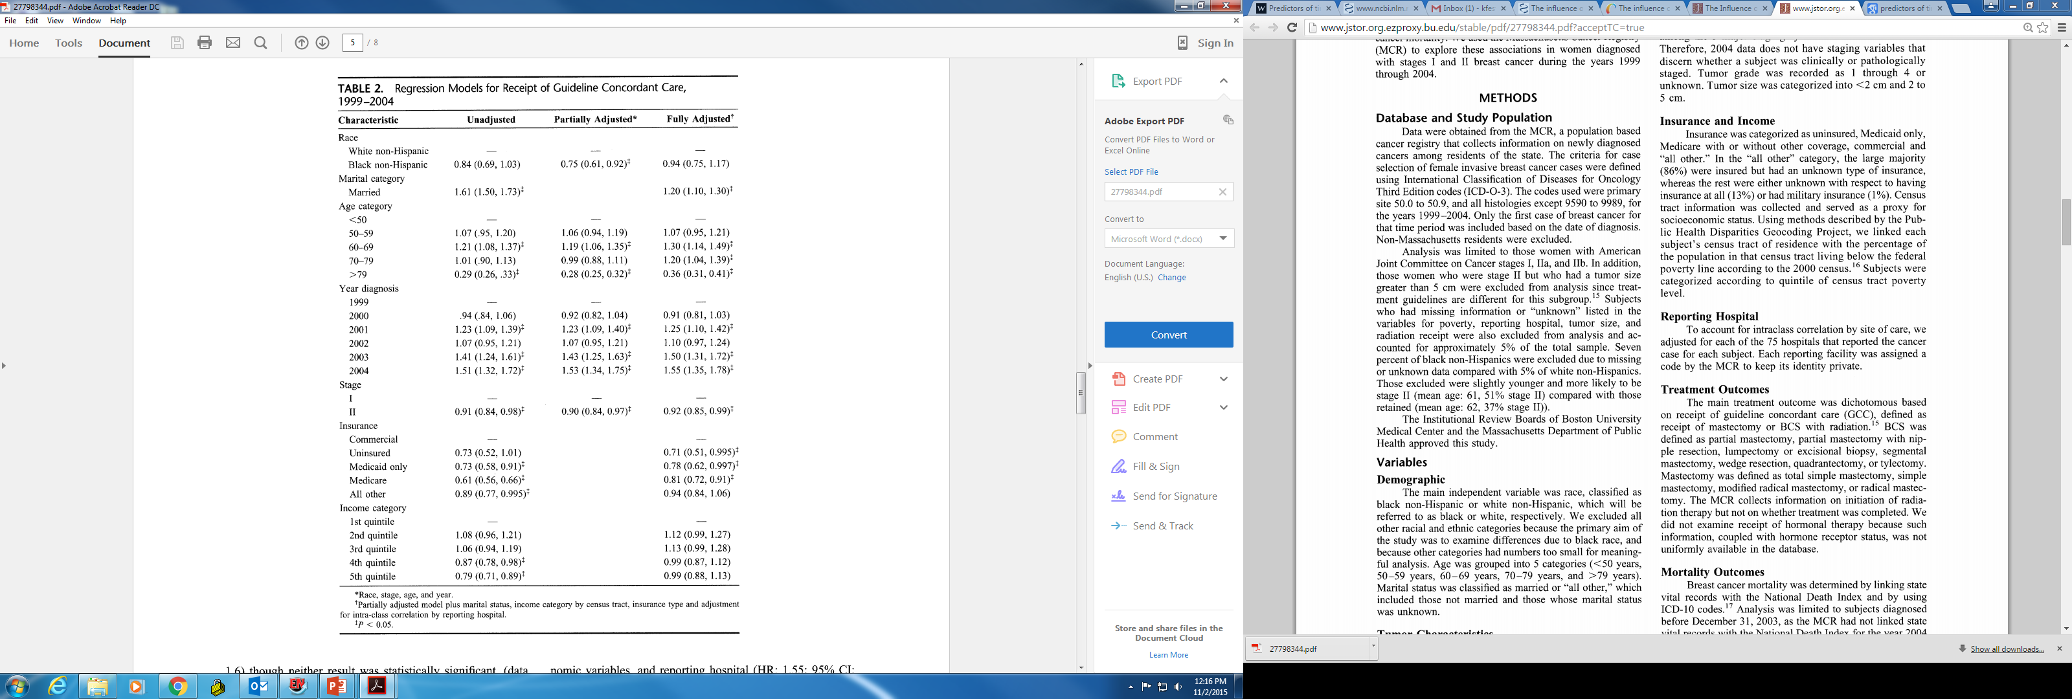
MA Cancer Registry:
Black, non Hispanic women less likely to receive guideline concordant treatment;
mediated by
Insurance status and Income
Berz, J. P., Johnston, K., Backus, B., Doros, G., Rose, A. J., Pierre, S., & Battaglia, T. A. (2009). Medical Care.
Notes:
: Blacks were less likely to receive GCC after adjusting for age and clinical variables (OR: 0.75; 95% CI: 0.61, 0.92). Marital status and insurance were predictors of receipt of GCC. After adjustment for all covariates, there were no longer significant differences between black and white women regarding the receipt of GCC. Nevertheless, black women were more likely to die of early-stage breast cancer than white women after adjusting for clinical, treatment, socioeconomic variables, and reporting hospital (HR: 1.6; 95% CI: 1.1–2.1).
Conclusions: Socioeconomic factors are mediators of racial differences in treatment outcomes. Significant racial differences exist in disease-specific mortality for women with early-stage breast cancer. Attention to reducing socioeconomic barriers to care may influence racial differences in breast cancer treatment and mortality.

Slide 19
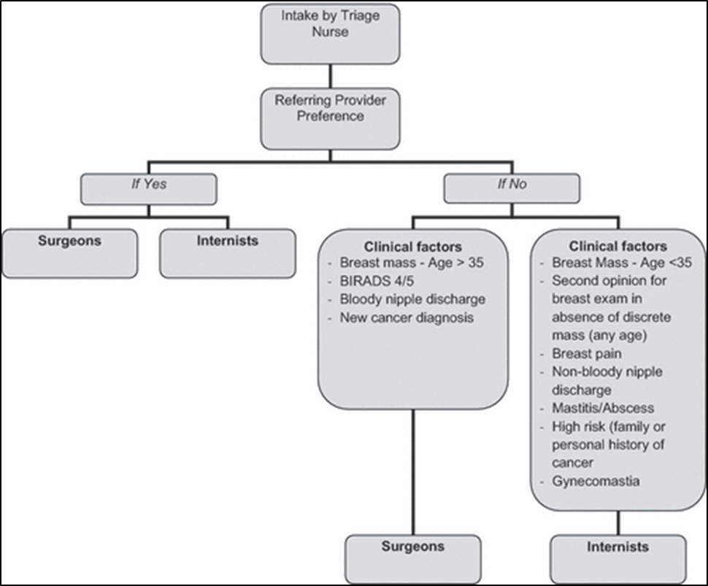
The Addition of Internists to a Diagnostic Breast Services Model
Multi-disciplinary diagnostic practice
  Primary care
  Surgical oncology
  Radiology
  Cyto-pathology
Triage system
  Low Risk = medical providers
  High Risk = surgical providers
Services Provided Concurrently
Battaglia, T.A., Howard, M.B., Kavanah, M., Prout, M.N., Chapman, C., David, M.M., McKinney, R., Kronman, A., Dumont, T., Freund, K.M. (2011). The Breast Journal.

Slide 20
Pilot Patient Navigation Intervention
Patient Navigation (culturally congruent lay health worker) guided by principles of Care Management:
    Identify Case
    Identify individual barriers to care
    Design and implement care plan
    Long term tracking
Timely Follow-Up = arrival to diagnostic appointment within 120 days from referral

Slide 21
Timely Follow-Up (N=1,391)
Pre-Intervention | 64%
Intervention | 79%
p <0.0001
Women in Intervention group had 39% greater odds of having timely follow-up
Battaglia, Roloff, Posner, Freund. Cancer 2007.

Slide 22
Phillips et al. JGIM. (2010)

Slide 23
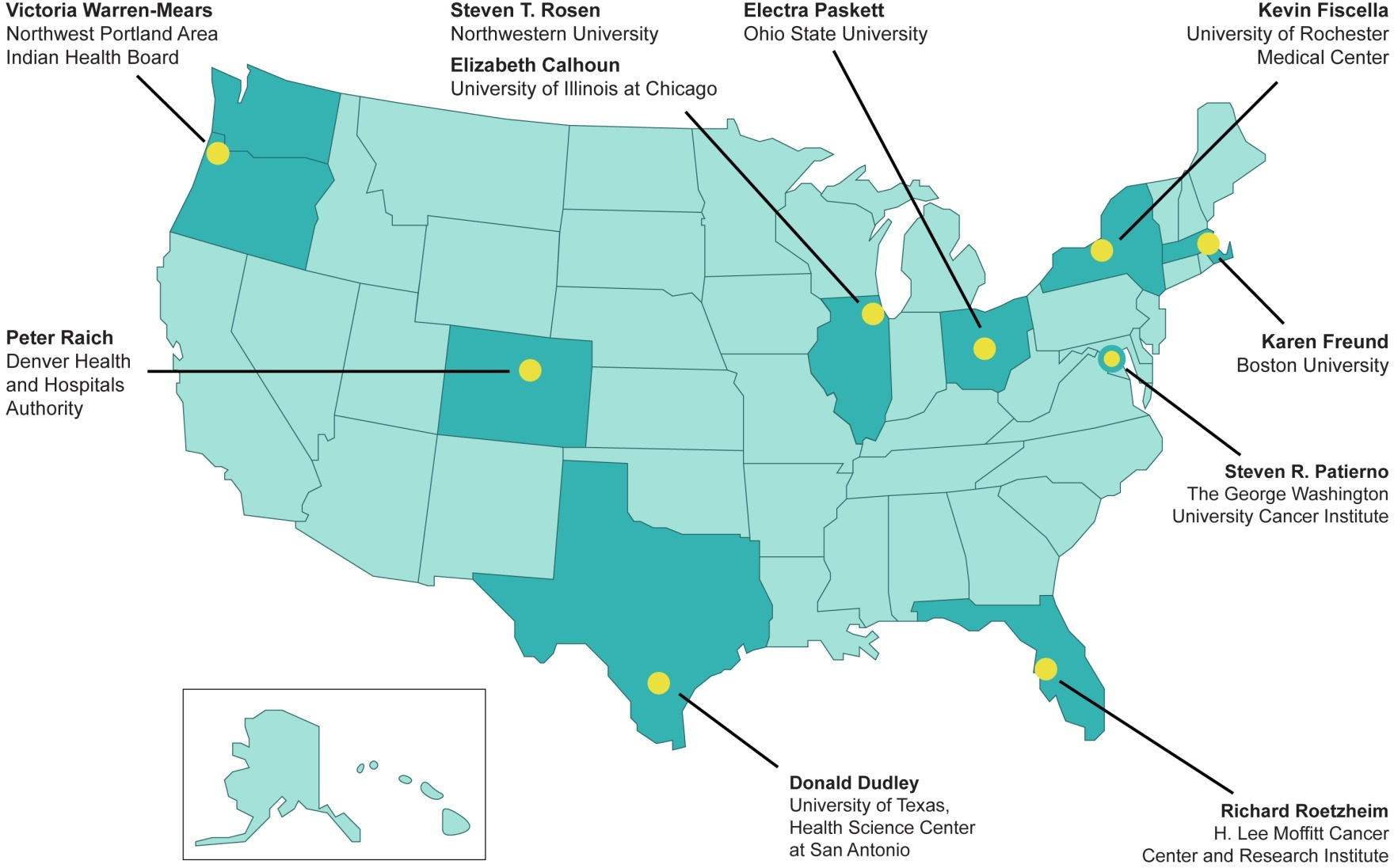

Patient Navigation Research Program (PNRP)
Notes:
23

Slide 24
PNRP Main Questions
Will navigated patients…
Receive timelier, definitive resolution following an abnormal finding?
Receive timelier treatments following a positive diagnosis?
Improve their satisfaction with the health care system experience?
Notes:
24

Slide 25
PNRP Methods
Breast, Cervical, Colorectal or Prostate
  Screening abnormality
  New cancer diagnosis
% complete diagnostic care in 365 days
Kaplan Meier survival curve estimate timely care
Adjusted Hazards Ratio (aHR) > 1.0 more timely care
Meta-analysis
Notes:
In order to address both the time to diagnostic resolution and the censoring for lack of ever reaching resolution we developed Kaplan-Meier survival curves and proportional hazards regression models to examine the effect of patient navigation on time to definitive diagnosis. The Kaplan Meier curves and hazards ratios were calculated separately for breast and cervical cancer screening abnormalities. The adjusted Hazards Ratios for the proportional hazards models. where the hazard ratio greater than 1.0 indicates that patient navigation is associated with a greater likelihood of diagnostic resolution.

Slide 26
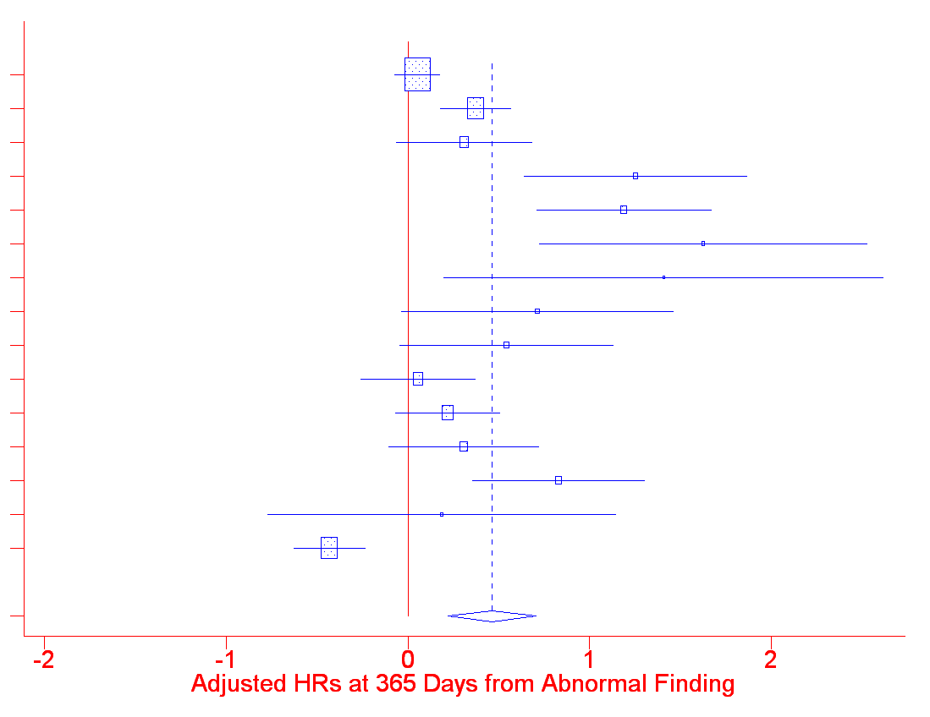
Meta-Analysis: Diagnostic Resolution at 365 Days
A breast
A cervix
B prostate
B breast
B cervix
C breast
C colorectal
C prostate
D breast
D cervix
E breast
E cervix
F breast
F colorectal
G breast
ALL
0.3
0.5
1
2
3
aHR = 1.4 (95% CI 1.2 – 1.7)

Slide 27
Adjusted Odds Ratios for Treatment Measures
Adjusted for age, race, insurance, marital status and study design
Quality Measures | aOR | 95 % CI | P value
Hormone Therapy | 1.78 | (1.22, 2.57) | 0.002
Radiation Therapy post Lumpectomy | 1.12 | (0.70, 1.79) | 0.643
Chemotherapy | 0.48 | (0.24, 0.95) | 0.035
Ko NY, Darnell JS, Calhoun E, Freund KM, Wells KJ, Shapiro CL, Dudley DJ,Patierno SR, Fiscella K, Raich P, Battaglia TA. Journal of Clinical Oncology. (2016)

Slide 28
Type of Barriers Matter
Notes:
Those with one barrier in the other barrier category had less timely resolution than those with no barriers (p=0.010). Those with two or more barriers including a social service barrier had a significantly longer time to resolution than those with no barrier (p<0.001), those with one other barrier (p=0.001), and those with two or more other barriers (p=0.014).

Slide 29
Navigator Activities Matter
Task/Network | Patient | Provider | Non-Clinical Staff | Support | EMR
Navigate with specific pt | YES
Facilitate for specific pt |  | YES | YES | YES
Maintain system for all |  |  |  |  | X
Document/ Review |  |  |  |  | X
Notes:
29
Define attributes of the work of patient navigators
Describe variation in navigation
Develop an evaluation instrument for observing navigator work that produces valid, reliable data across sites
Use this instrument to define and compare across sites and programs
*leveraged funds through the Avon foundation

Slide 30
Summary: PNRP
Patient navigation results in:
  Reduction in delays in diagnostic care and certain treatments
  Reduced differences by income and housing status
  Most effective where delays and needs are the greatest
  Delays persist for those with unaddressed barriers to care

Slide 31

Cancer is Not Always the Worst Problem for our Patients: Social Determinants of Health
Notes:
Besides the fact that a lot of the innovative care is inaccessible, why is it inaccessible? Barriers to care = SDOH
Break down between discoveries and deliveries; and in deliveries

Slide 32

“Socio-legal” Barriers to Care at BMC
Patient survey: “Over the past two weeks I have been concerned about…”
  Income Supports
  Housing
  Education/Employment
  Legal Status
  Personal and Family Stability & Safety
104 respondents seeking cancer care
80 (77%) reported 1 or more concerns
Ko, Battaglia, et al. (2016)

Slide 33
Project SUPPORT
Socio-legal Services for Underserved Populations through Patient Navigation to Optimize Resources during Treatment
Hypothesis: Among newly diagnosed cancer patients, patient navigation enhanced with legal advocacy to address socio-legal barriers will improve clinical and patient reported outcomes
Randomized controlled trial at BMC funded by PCORI
Outcomes: time to first treatment, satisfaction, cancer needs

Slide 34
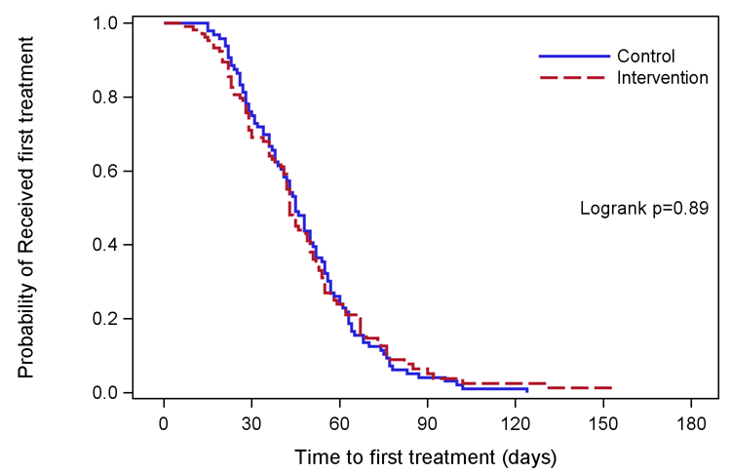
Kaplan-Meier Plot for time to first treatment (n=201)

Slide 35
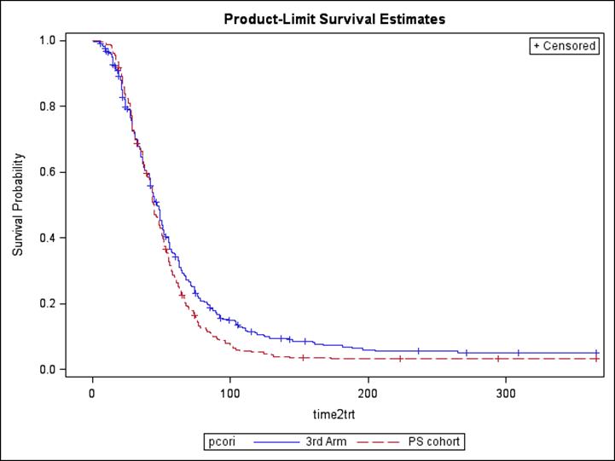
Project SUPPORT vs. “Third” Arm
Adjusted OR
2.79 (1.52, 5.13)

Slide 36
2014: Disparities Breast Cancer Mortality Increasing
50 largest US cities 1990 - 2009
35 cities increase in Black:White mortality rate ratio
Increase largely because White rates improved substantially
Chicago had a mortality rate ratio of: 1.48; 95% CI: (1.34-1.64)
Boston had a mortality rate ratio: 1.49; 95% CI: (1.18, 1.88)
1,710 excess Black deaths annually, an average of about 5 each day.
Hunt, Whitman, and Hurlbert (2014). Increasing Black:White disparities in breast cancer mortality in the 50 largest cities in the United States. Cancer Epidemiology.
Notes:
Numerator data from national death files
Population-based denominators from the U.S. Census Bureau
*Where Black = non-Hispanic Black and White = non-Hispanic White

Slide 37

The Boston Breast Cancer Equity Coalition
Est. in 2014 in response to Hunt article
Multidisciplinary stakeholders: public health agencies, academic institutions, providers, patients, advocates, policy makers
Mission: Develop city-wide solutions to eliminate inequities in breast cancer outcomes
Local care delivery data: disproportionate treatment delays, transfers in care among the most vulnerable women
www.bostonbcec.org

Slide 38
Where are there opportunities to “repair” the disconnect?
Care Delivery Research is critical
Dissemination and Implementation Science to bring scientific discoveries to real life settings
Multi-level Pragmatic clinical trials that target quality outcomes
Community Engaged Research involving stakeholders to ensure meaningful results

Slide 39
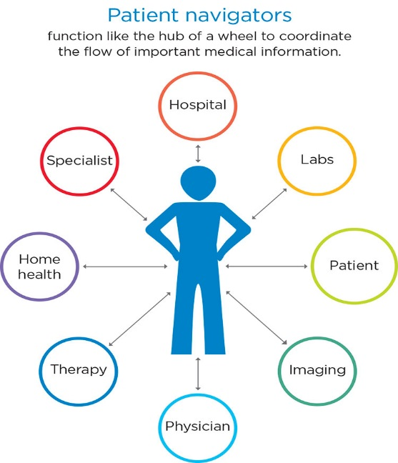
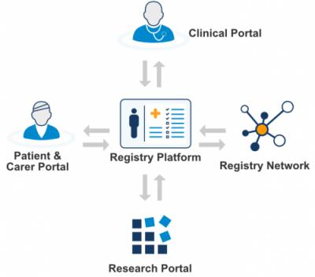
Evidence-based strategies for coordinating care are not systematically implemented within or across hospitals
Patient Navigation to Guide and Support
Patient Registry to Track
at risk Population Over Time
Systematic screening to address Social Barriers to Care

Slide 40






TRIP: Translating Research Into Practice
Tracy Battaglia, MD MPH | Karen Freund, MD MPH | Jennifer Haas, MD MPH | Stephenie Lemon, PhD
Boston
Patient Navigator Network
Boston
Patient Navigator Network
Clinical
Advisory
Panel
Funded by:

Slide 41






The Research Question
“Can we systematically implement evidence-based coordination of care across the city of Boston to reduce delays for the most vulnerable women?”
“Can we systematically implement evidence-based coordination of care across the city of Boston to reduce delays for the most vulnerable women?”

Slide 42
Specific Aims
#1: Conduct formative work to develop delivery models to integrate TRIP across six participating health systems. (Years 0-2)
#2: Execute a stepped wedge hybrid effectiveness-implementation trial to assess effectiveness and implementation of TRIP (Years 2-4)
#3: Disseminate the integrated intervention to other CTSA hubs and community-academic partnerships. (Years 3-5)

Slide 43
Research Methods
Community-engaged implementation science: Integrating evidence-based interventions in partnership with key stakeholders
Pragmatic clinical trial: Cluster stepped wedge study design allows for rolling out iteratively in real life practice settings
Type 1 hybrid clinical effectiveness-implementation trial:
  Clinical outcomes: time to initiation of treatment; quality of care
  Implementation outcomes: acceptability, adoption, fidelity to protocol, penetration, sustainability, and cost

Slide 44
Stepped Wedge Study Design
 | Pre-TRIP | Year 1 | Year 2 |  |  |  | Year 3 |  | Year 4 | Year 5
1 |  |  | BW-Faulkner Hospital
2 |  |  |  | Beth Israel Deaconess Medical Center
3 |  |  |  |  | Tufts Medical Center
4 |  |  |  |  |  | Boston Medical Center
5 |  |  |  |  |  |  | Mass. General Hospital
6 |  |  |  |  |  |  |  | Dana-Farber Cancer Institute
536 historical controls and 564 intervention = 1100 women.

Slide 45
Eligibility Criteria

Slide 46

Implementation Challenges
Community Engagement Challenges:
Competing demands for clinicians and navigators
Coalition volunteers
Chicago partners
Health System Navigation Challenges:
Navigator turnover
Unique health system workflow
Competing navigation protocols based on other funding streams
Multiple complex data systems
Data/Technical Challenges:
Single IRB but different institutional perspectives
Data sharing agreements
Reducing the need for double data entry

Slide 47

How do we achieve Equity vs. Equality?

Slide 48
Community Engaged Research
Research approach that focuses on collaboration with key stakeholders
Characterized by:
  the principles that guide the research
  the relationships between communities and academic researchers
Increasingly recognized to address complex public health issues
Community Engagement
Research
Notes:
Stakeholders: patients, family members, caregivers, community members & organizations as well as researchers, scientists and physicians.
Groups of people with similar affiliation:
Location: those living in the same city or neighborhood
Shared Special interest: access to fresh fruits and vegetables OR making their community safer
Similar situations: cancer survivors, have children with asthma, suffering from chronic pain

Slide 49
Continuum of Research
Traditional Research
Community Engaged Research
Community Based Participatory Research (CBPR)
Community stakeholders are partners in ALL aspects of the research process.
Community stakeholder is involved in some meaningful way.
Community members participate in study as a research subject.

Slide 50
Levels of “Engagement”
Notification: Inform the community of the intentions of the research
Consent: Obtaining some expression of community approval
Endorsement: Community representatives formally support the research
Participation: Seeking and obtaining community advice
Origination: Research purpose/goals set by expressed community needs
Jenkins, B. “Health Disparities: Why we have not solved the problem, Why we need new approaches.” The Research Center on Health Disparities, Morehouse College, April 2004.

Slide 51
Engagement Competencies for Researchers
Perceived value of CE
Introspection & openness
Knowledge of community characteristics
Appreciation for stakeholders’ experiences
Preparedness for collaborative decision making
Collaborative planning
Communication effectiveness
Equitable distribution of resources & credit
Sustaining the partnership
Shea et al., 2017

Slide 52
Final Thoughts
Disparities in cancer mortality are pervasive and not improving
New and improved treatments won’t do anything if we can’t get them to our patients
Reasons for delivery disparities is complicated and multifaceted
To address them we need to understand the patient care experience
Take time to get to know your community
Bring in all stakeholders to create solutions
Don’t be afraid to let your own experiences drive your approach

Slide 53


