Slide 1
August 9th Research Admin Meeting

Slide 2
Agenda
9:00am – 10:00am
Welcome
Interpreter Services & Clinical Research Workflow
Research Operations updates
10:00am – 10:30am
Talent Acquisition
Website Redesign

Slide 3
Welcome!

Slide 4
Interpreter Services in Research Alegna Zavatti
August 2022

Slide 5
Overview
Interpreter Services Overview
Current challenges
New ISD vendor
New research workflow

Slide 6
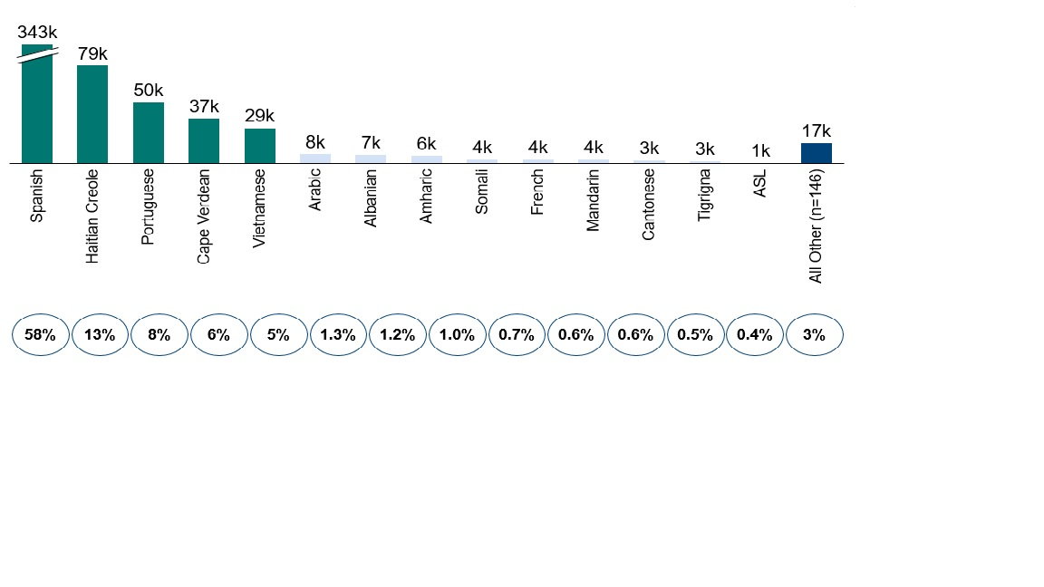
Boston Medical Center (BMC) has a very diverse patient population which mirrors the diversity we see in Massachusetts and the US
In the US, 8% of the total population are considered Limited English Proficiency (LEP) meaning a person that does not speak English as their primary language and have limited ability to speak, read, write or understand English.
In Massachusetts, 24% of the population speaks a language other than English at home
In the City of Boston 17.4% of the residents are considered LEP
In FY21, BMC’s LEP population was 25%
*Source: US Census Bureau and City of Boston Data, Epic and ISD’s internal reporting systems

Slide 7
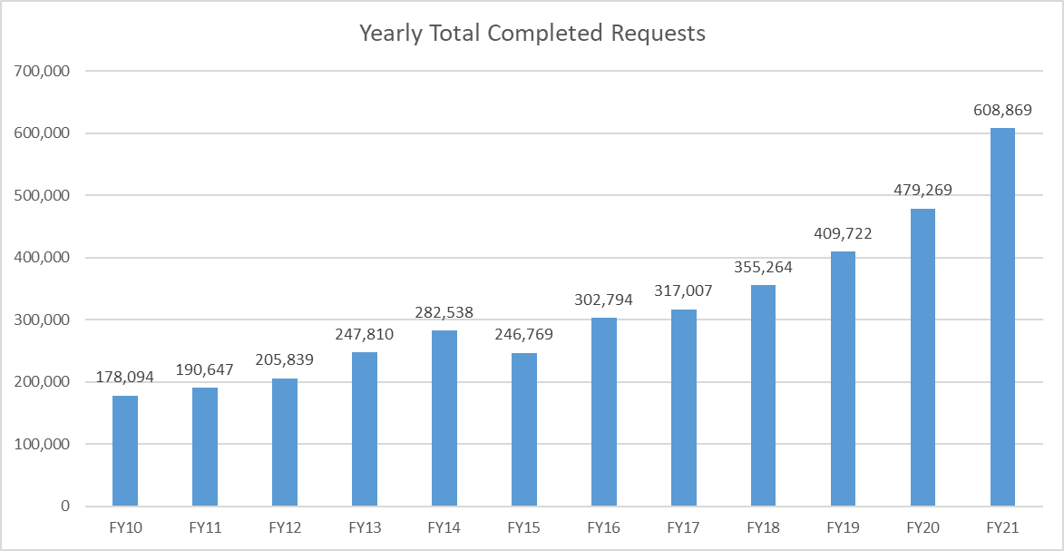
We have been experiencing a 15% growth for the last 5 years and demand continued increasing despite the challenges we faced with the pandemic

Slide 8
When we look at health outcomes among minorities, we see a great disparity in LEP patients
~50% of adverse events experienced by LEP patients can be linked to failures in communication.
Baystate Medical Center to pay $135,000 to resolve claims it violated ADA
https://www.bostonglobe.com/2021/11/16/metro/baystate-medical-center-pay-135000-resolve-claims-it-violated-ada/
Lawsuit Against Hospital Over Allegedly Unnecessary Leg Amputation to Proceed
https://www.newsweek.com/deaf-mans-suit-against-hospital-over-allegedly-unnecessary-leg-amputation-proceed-1672248
LEP patients are 25% more likely to be readmitted for the same conditions (as inpatient or to the ED) or to have longer hospital stays.
LEP patients are more likely to have life-threatening diseases go undiagnosed.

Slide 9
Clinical staff interested in providing direct care to their limited English proficient (LEP) patients in a language other than English must have their language proficiency skills assessed by the Interpreter Services Department (ISD)
Any clinical staff interested in becoming an approved bilingual provider should send a request to DG-LanguageAssessments@bmc.org with the candidate’s name, department, ID number, language to be assessed, and title.
If the candidate passes the assessment, they will be considered an Approved Bilingual Provider (ABP) and will receive a number and instructions on how to document in EPIC when working with LEP patients.
For candidates that completed university studies abroad, we will waive the assessment test upon submission of their diploma.
This allows the individual to have direct conversations with their patients, but cannot work as interpreters for anyone hospital wide.
- For more information about this process visit:
https://hub.bmc.org/departments/interpreter-services/bilingual-provider-information

Slide 10
We have been having challenges with research teams abiding by our current guidelines and partnered with the Clinical Trial Office to address these issues
Current Guidelines | Challenges
Research groups are responsible for the interpreter costs and need to build these costs in the funding/grant budget during the IRB process | Not all research teams have funding and we do not want to discourage research teams from accessing interpreters because of this
Teams have to complete an organization information form and we create an account with our phone vendor and have direct access to interpreters | Teams complete this step, however data shows very low usage of these accounts
Direct billing from vendor and your own call data reports | Teams that use the services reach out to notify they do not have funding and ISD has to absorb costs, creating extra admin work for our department Usage of current workflow is low, therefore we do not have research specific data
Overlapping of clinical and research responsibilities and teams using their department’s code to access interpreters for research | This also contributes to lack of research specific data that we can share with leadership
Research requests come directly to ISD and Clinical Trial is not part of the process | Lack of communication between all parties
ISD has a research database | Unsure which research studies are still active. Database need to be updated

Slide 11
Some of our goals with the new workflow we are creating are
Contribute to research that is inclusive and diverse
Have research specific data that show:
Average length of encounters
Languages accessed by individual teams and by all research teams hospital wide
Ensure all clinical teams are following new workflow
Continue partnering with the Clinical Trial Office to identify workflow issues and find solutions to challenges

Slide 12
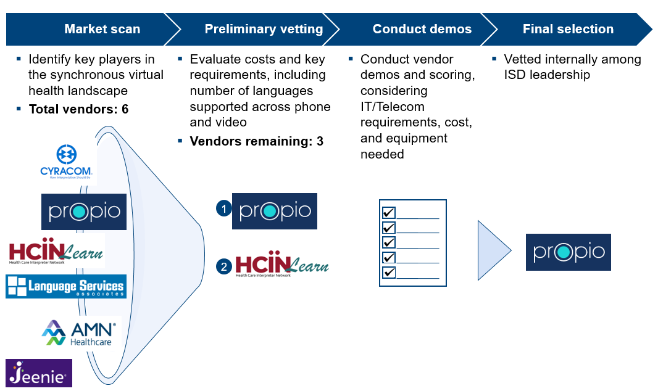
Based on feedback from stakeholders, we embarked on a journey to choose a new phone and video interpretation vendor

Slide 13
Implementation timeline

Slide 14
New workflow for Research teams:
Study team fills out the Interpreter Services Form available on CTO website
Provide details on research project information, principal investigator, site coordinator, department, main contact, etc.
Once the form is submitted, an mail notification will be sent to interpreter services
Interpreter team provides phone number and study specific 3-digit code, and submits the form
ISD will keep a database with 3-digit codes
Email notification with all information will be sent to PI, study coordinator, study team main contact, Interpreter Service Team and CTO.
Next steps:
Share list with current research teams in our database to verify which research studies are still active
Obtain information from current research teams to create 3-digit codes

Slide 15
Alegna Zavatti, CHI
Director Interpreter Services
Email: Alegna.Zavatti@bmc.org
Phone: 617-414-3308

Slide 16
Research Operations Updates

Slide 17
Research Finance Tyler Flack

Slide 18
International Wire Payments
Wire payments are used to pay foreign entities
Departments must follow Procurement of Supplies, Equipment and Service Policy, which requires a PO for invoices being paid pay via wire, prior to being invoiced for the goods or services. All exceptions must be approved by the Manager, Research Finance or the Director, Research Finance.
Research Operations will open POs for executed sub agreements that will be paid via wire.
Accounts Payable | Boston Medical Center Intranet (bmc.org)

Slide 19
International Wire Payments
Non-subcontract Expenses
Department completes wire payment request form and provides:
Invoice from vendor in US dollars
PO number
Vendor bank account information on bank letter head (BMC requires this for all wire payments as they are risky transactions; we have little recourse to retrieve any payment that is issued incorrectly). The information that is necessary to process an international wire includes the following, but may vary depending on the country:
Beneficiary Name
Bank Name
ABA or Routing Number
Bank Account
SWIFT Code
Department submits the above documentation to their RFA for review.
Once approved by the RFA, the wire request will be routed to Treasury for payment.
Treasury will return any requests for payments on sponsored projects (any distribution that includes cost center 10201100 or a project that begins with 4) that do not follow this approval path.
Foreign Sub Invoice Payment
Department or subrecipient submits invoice to BMCsubinvoice@bmc.org
BMCsubinvoice@bmc.org inbox administrator will submit invoice to AP for approval routing, and will and complete wire payment form and submit the wire payment request to Treasury once the invoice is approved in Infor.

Slide 20
Time and Effort
Effort Reporting Cycle for January to June 2022 has begun for both BU and BMC:
Anyone over the HHS Salary Cap directly charging salary and wages to an HHS grant/contract must report Over the Cap Cost Share
Key Personnel must meet their effort commitments. Any reduction in effort greater than 25% of what was committed must have prior written approval form the sponsor. Please work with Sponsored Programs Administration for all prior approval requests
Workday Effort Reporting
Please have salary adjustments for Workday employees submitted by 8/19, so that there will be ample time to have them process them before Workday effort certifications are issued on 8/29.
If a Workday effort report needs to be adjusted, please attach the Labor Distribution Report from Infor as support.
Reminder: it is the department’s responsibility to request new PARs/Effort Reports to recertify, if they submit a retro allocation that impacts a previously certified period, including Workday Effort Reports.

Slide 21
GCRU Invoicing Process Update – BMC studies
BMC study teams will be required to open a PO for all GCRU services prior to work starting. Study teams should work with the GCRU to get quotes for services based GCRU’s established rates. These quotes will be the support used to open PO Requisitions in Infor.
If the amount or duration changes, POs can be updated by contacting Supply Chain
This link provides several trainings on the PO requisition process
Please begin opening POs for existing projects with the GCRU. We will require the POs for the July billing cycle. This should provide ample time to get a PO requisition submitted and approved.
GCRU will send monthly invoices to study teams for work completed
If the study team approves, they will submit the invoice to Accounts Payable with PO number. See AP website for guidance on submitting invoices. If the study team has questions or disputes any charges they can work directly with the GCRU to resolve the issue or acquire a revised invoices, as the case may be.
AP will match the invoice with the PO number provided and pay the GCRU

Slide 22
Other Updates
Research Home Cost Center Deadline
All salary posted to a Research Home Cost Center (RHCC) must be moved to the appropriate project or cost center by fiscal year end (9/30).
Department and Section Administrative Directors have access to the RHCC reports and can open a FIS service now ticket to grant other staff in their department/section access to the report
Expense Posting and Invoices for Cost Reimbursable Projects
RFAs will only invoice for posted expenses. The federal Letter of Credit Projects follow the same rules. In some cases posted expenses are ineligible for billing and are excluded from an invoice
Items received but not invoiced (RNI)
Approved invoices that have yet to be paid

Slide 23
Sponsored Programs Administration Agreement Workflow
Mahara R. Pinheiro, Director, Sponsored Programs Administration
Notes:
If Tina hasn’t already announced, Dave to introduce Mahara as Dir SPA
After a long search I’m pleased to announce Mahara Pinheiro is the new Director of Sponsored Programs Administration. Mahara is no stranger to the BMC and BU research community. She joined BMC as a Senior Grants Administrator in 2018, was promoted to Manager in 2019 and more recently was the Sr Manager of Sponsored programs.
In her new role Mahara will lead the pre-award and post-award (non-financial) team by successfully supporting the mission and strategic priorities of BMC research.
She is responsible for the management and oversight of the pursuit and implementation of resources and training.
Development of policies and procedures that support a culture of effective sponsored programs management that is compliant with funder terms and conditions and industry standards; identify and promote workflow efficiencies that strengthen and optimize service levels to the research community.
We are grateful for Mahara’s commitment and dedication to the success of sponsored programs administration at BMC.

Slide 24
Staffing Updates
Staff Updates:
Gina Daniels, Manager, Sponsored Programs Administration
Christopher Garcia, Team Lead, Sponsored Programs Administration
Vacancies:
Team Lead, Sponsored Programs Administration
Senior Grants and Contracts Administrator
Grants and Contracts Administrator

Slide 25
SPA Agreement Workflows
SPA agreement workflows are currently under review. Updates to follow in the upcoming months.
Agreement workflows managed by SPA:
Grant Award Agreements (Government and Foundation)
Subcontract Agreements
There is currently a backlog for subcontracts. Please send follow-up inquiries to Mahara Pinheiro for requests submitted before 5/31/2022.
DUA/MTA Agreements
Agreement workflows currently not managed by SPA that are under review:
Consultant Agreements
Vendor Agreements

Slide 26
Grant Award Agreement Workflow
Agreement Receipt
The agreement is received by Sponsored Programs Administration.
Agreement Review
Agreements are forwarded to the Grants and Contracts Administrator assigned to the PI’s department for review.
Department Approval
The Grants and Contracts Administrator verifies with the PI and Department Administrator that budget amounts, scope of work and reporting terms are accurate and acceptable.
All incoming agreements should be sent to Grants.Admin@bmc.org.
All agreements are forwarded to Grants and Contracts Administrator, PI and Department Administrator within 2 business days of receipt.
This process can take up to 10 business days.
The PI and Department Administrator is copied in the correspondence.

Slide 27
Grant Award Agreement Workflow
Legal Review
The Grants and Contracts Administrator may determine that additional legal review is required.
Partial Execution or Negotiation
If no revisions are required, the Grants and Contracts Administrator sends the agreement to the Director for signature.
Full Execution
The sponsor forwards the fully executed agreement to Grants.Admin@bmc.org. The fully executed agreement are forwarded to the Grants and Contracts Administrator, PI and Department Administrator.
If revisions are required, the proposed changes are sent to the sponsor.
Research Counsel may have additional questions for the PI and Department Administrator.
Legal review can take up to 10 business days.

Slide 28
Subcontract Agreement Workflow
Subcontract Request Form
The Department Administrator submits Subcontract Request Form. The form can be found in the Res Ops website
Agreement Drafting
Grants and Contracts Administrator drafts agreement.
Department Approval
The Grants and Contracts Administrator sends draft agreement to PI and Department Administrator for review.
Agreements are drafted in the order they are received.
This process can take up to 10 business days.

Slide 29
Subcontract Agreement Workflow
Partial Execution
The agreement is forwarded to subrecipient for review and partial execution.
PO Request
A corresponding PO is requested or updated.
Full Execution
Subrecipient sends partial executed agreement to subaward@bmc.org.
Fully executed agreement is sent to subrecipient, PI, and Department Administrator.
Once the partial executed agreement is received, the Grants and Contracts Administrator forwards the agreement to the Director for signature.

Slide 30
DUA/MTA Agreement Workflow – Incoming
Agreement Receipt
The agreement is received by Sponsored Programs Administration.
Agreement Review
Agreements are forwarded to the Grants and Contracts Administrator assigned to the PI’s department for review.
Department Approval
The Grants and Contracts Administrator verifies with the PI and Department Administrator that scope and terms are accurate and acceptable.
All incoming DUA/MTA agreements should be sent to DUA.MTARequest@bmc.org along with DUA/MTA Request Form. The form can be found in the Res Ops website.
All agreements are forwarded within 2 business days of receipt.
The PI and Department Administrator are copied in the correspondence.
This process can take up to 10 business days.

Slide 31
DUA/MTA Agreement Workflow – Incoming
Legal Review
The Grants and Contracts Administrator may determine that additional legal review is required.
Partial Execution or Negotiation
If no revisions are required, the Grants and Contracts Administrator sends agreement to the Director for signature.
Full Execution
The collaborator sends the fully executed agreement to DUA.MTARequest@bmc.org. The fully executed agreement is forwarded to the Grants and Contracts Administrator, PI and Department Administrator.
If revisions are required, the proposed changes are sent to the collaborator.
Research Counsel may have additional questions for the PI and Department Administrator.
Legal review can take up to 10 business days.

Slide 32
DUA/MTA Agreement Workflow – Outgoing
DUA/MTA Request Form
The PI and/or Department Administrator sends DUA.MTA Request Form to DUA.MTARequest@bmc.org. The form can be found in the Res Ops website.
Agreement Drafting
Grants and Contracts Administrator drafts agreement.
Department Approval
The Grants and Contracts Administrator sends draft agreement to PI and Department Administrator for review.
This process can take up to 10 business days.
Agreements are drafted in the order they are received.

Slide 33
DUA/MTA Agreement Workflow – Outgoing
Legal Review
The Grants and Contracts Administrator may determine that additional legal review is required.
Partial Execution
Agreement is forwarded to collaborator for review and partial execution.
Full Execution
Partial executed agreement should be sent to DUA.MTARequest@bmc.org.
Fully executed agreement is sent to collaborator, PI, and Department Administrator.
Once the partial executed agreement is received, the Grants and Contracts Administrator forwards agreement to the Director for signature.
Research Counsel may have additional questions for the PI and Department Administrator.
Legal review can take up to 10 business days.

Slide 34
Clinical Research at BMC
Building trustworthy approaches to inclusive medicine
Notes:
Honored to be present, thank you for Trina Cherry and team for partnering with us.

Slide 35
BMC is seeking partners to shift research perceptions
Research can be intentionally inclusive and bi-directional; with the goal of building trustworthy relationships and striving for health equity
Notes:
1. We recognize that research has historically contributed to misuse and abuse of people of color, women, indigenous populations, and other racial and ethnic minorities
2. We are here to co-develop strategies to dismantle systemic racism through one lens of shifting impressions of research, opening conversations to decrease inequities in social determinants of health, and build trust
3. First and foremost, we are hear to LISTEN

Slide 36
Objectives summary
Review Research Operations Office Support Workflow
Summarize CTO and CRN project collaboration
Receive update on CRN community engagement efforts

Slide 37
Research Operations intake/pre-award management and post-award management
Pre-Award Intake
Post-Award
Post-Award
(Research Billing CTO manages)
Sponsored Programs Administration
-Grant Award Agreement (PI Initiated: Federal, Foundation, and Industry)
-Subcontract Agreement
-Data Use Agreements (DUA) and Material Transfer Agreements (MTAs)
Clinical Trial Office (CTO
-Confidential Disclosure Agreement (CDA)
-Clinical Trial Agreement (Industry)
BU Industry Relations or OSP
Research Finance
All Federal, All Foundation, and non-Human Subjects Industry Grant
Federal, Foundation, Industry Grants Awarded
-CTO activates study in VelosCT-Epic
-Study team enrolls participants and reviews research charging
-Study team notifies CTO when project is closed
CTO
All Industry, human subjects, PI initiated or sponsor lead clinical research
BU Studies
Managed by BU Industry Relations (all research) or Office of Sponsored Projects (Federal/Foundation)
BU Studies
-CTO activates study in VelosCT-Epic
-Study team enrolls participants and reviews research charging
-Study team notifies CTO when project is closed
*CTO Intake form: https://bmc.tfaforms.net/46

Slide 38
CTO-Supported Projects
What are CTO-supported projects?
Clinical research studies or proposals are where the full lifecycle of the project is not managed by the Clinical Trial Office (CTO) but require CTO involvement as these projects utilize BMC clinical services and/or infrastructure.
BMC SPA, Development, Research Finance, or the Boston University equivalent offices are responsible for the pre-award and post-award management of these projects.
CTO-supported projects may fall the following categories:
1. PI-initiated and applying for external funding (industry, federal, or foundation) as the Prime Awardee
2. Sub-contracted from a federal or foundation award as a BU or BMC site

Slide 39
CTO-Supported Projects: Process Overview
Pre-Award Intake
Pre-Award
(BMC services/infrastructure)
Post-Award
(Research Billing)
-Study Teams submit the CTO Intake Form* to notify CTO of new projects & proposals
-CTO reviews the intake form to confirm if CTO’s services are required
Federal, Foundation, Industry Grant Applications
-CTO reviews the grant application or budget; provides pricing
Federal, Foundation, Industry Grants Awarded
-CTO activates study in VelosCT-Epic
-Study team enrolls participants and reviews research charging
-Study team notifies CTO when project is closed
Federal, Foundation, Industry Grants Awarded
-Study team enters study into VelosCT
-CTO provides coverage analysis & pricing
BU Studies
-Study team enters study into VelosCT
-CTO provides coverage analysis & pricing
BU Studies
-CTO activates study in VelosCT-Epic
-Study team enrolls participants and reviews research charging
-Study team notifies CTO when project is closed
*CTO Intake form: https://bmc.tfaforms.net/46

Slide 40
CTO-Supported Projects: Why is this important?
What are the risks when CTO is not informed of these projects?
Financial Risks
Logistic Risks
Billing Compliance Risks
Under-funded for BMC services/ infrastructure in proposals/ projects
Ancillary services are not informed/ set-up for projects
Clinic/ space is not set-up for projects
Patients are incorrectly billed for research procedures
Double-billing for procedures covered by sponsors or insurance
Projects could run into deficit

Slide 41
CTO-Supported Projects: How to improve process?
Systems Enhancements
Training / Education
How can we improve the process?
How can you help with this process?
Communication (internal & external)
Workflow & Forms

Slide 42
Clinical Research Network (CRN) and Clinical Trial Office (CTO) partnership
Clinical Research Network (CRN) and Clinical Trial Office (CTO) partnership
CRN contributions to study budget improvements
CRN teamed with CTO to design new budget template
Provide critical feedback on true cost of conducting research
Paxlovid Study Reimbursement & Staffing
CRN Community Engagement Fee
Partnering with Study Teams
Notes:
Cost of Conducting Research:
Tiered start-up fees; Monitoring fees; Audit Fees, Consenting; Interp. Services;
Paxlovid: (fill role of study team during both pre/post award. Should this offering be stressed for others? Played large role in ensuring robust budget and continued financial security in post funding stage)
CRN Partnering w Study Teams: (summarize core CE goals, how they align with the hospital, and how the work impacts all studies; introduce fee and positive sponsor interaction – sponsors seek us out in part for our diversity; future industry standard)
Lead into CRN portion after applause
Description of CRN Community Engagement Services:−The CRN identifies and partnerswith existing patient focusgroupsand community-based organizations to educate about the importance of clinical trial participation and learn about participant needs. −Working with BMC’s 12 Community Health Centers to expand our outreach and recruitment network.−Involvestudy coordinators,patients, patient advocates, and caregivers to identify and remove barriers. −BMC teamswith trusted community leaders and native speaking physiciansand staffto champion outreach.−Provide cultural competency and proficiency training for clinical investigators and research staff to help facilitate the building of a trusting relationship with participants, decrease biased communication and behavioral practices, and help avoid the use of cultural generalizations and stereotypes. −Provide research educational materials and hold community outreach events in multiple languages and withmultilingual research staff and/or interpreters.−Analyze and aggregate community feedback to identify trends that will make trial participation less burdensomefor participants.−Track institution-wide clinical research diversity data(approached vs. enrolled) to be aware of progress or setbacks.−Development of broad marketing and communication plans to repair trust and promote the importance of diversity in research.−Remain engaged with communities after the conclusion of trialsand shareresults to strengthen bi-directional relationships with communities.

Slide 43
CRN VISION
Community Engagement
Facilitate bi-directional dialogue between the community and our researchers to improve trust and co-create future research
Optimized Budgeting
Utilize costing and negotiation expertise in CRN to increase study funding and remove financial barriers to diverse participation
Rapid Activation of the Right Studies
Focused, senior level resources to rapidly activate our most important studies
Research Staffing
Provide highly experienced staffing for under-resourced PIs and studies of strategic importance
Build Infrastructure
CRN will share and implement best practices broadly to improve research infrastructure at BMC
Art: Ugo Rondinone (“Clockwork for Oracles”), Institute of Contemporary Art – Boston, 4/11/08 – 3/1/10
Notes:
BMC is making the investment in the CRN as a commitment to equity, quality and compliance in research

Slide 44
Community Engagement Through Internal & External Partnerships
The CRN, CTSI and Community Engagement & External Affairs are Partnering to:
Raise the voice of our community
Promote/facilitate the co-development of research
Educate about research and value of inclusive participation
Share world class scientific discovery and innovation
Create bi-directional community and researcher dialogue
Share research results with community
Position BMC as leaders in inclusive research
BMC Community
CRN
CE & External Affairs
CTSI CE
Notes:
Notes:
CRN, CTSI and Trina’s Team (CE & External Affairs) meet monthly to collaborate on strategy and joint initiatives.
Developing workflows to map out how researchers and the community can engage with our services and support.

Slide 45
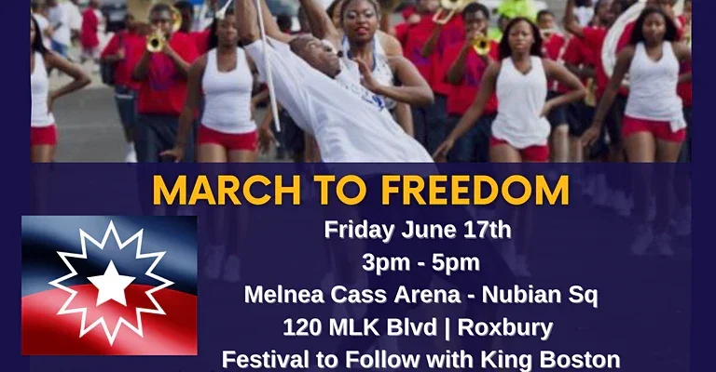
CRN In The Community
THE MUSE
Notes:
Hip Hop as a social justice vehicle, youth worker, violence interrupter and front line trauma responder

Slide 46
CRN CE Impact Projects
Clinical Research Network
Notes:
Ben

Slide 47
COMMUNITY ADVISORY BOARD Engaging with our communities to build long-term trust and improve diversity in research
CAB
Pilot grants for CAB to award or implement
Stipends for board members
Research training for board members
Workflows Developed for Researchers to Engage CAB
CRN Provides CAB Navigator Support for Researchers
CAB may develop process to provide researchers with seed funding to deploy engagement recommendations when there are funding barriers
Clinical Research Network
Notes:
Ben

Slide 48
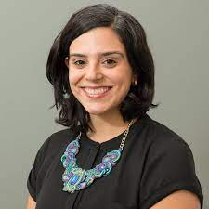
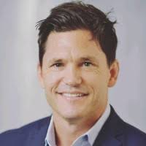
INTERPRETER SERVICES RESEARCH TRAINING
When the course is complete, medical interpreters will:
Learn about the research process
Learn how to advocate for people before and during the research process
Learn the importance of diversity, equity and inclusion in research
Comprehend and use key research terminology in English and our 5 top Non-English languages
Dr. Michael Paasche-Orlow
Professor of Medicine, BU
Alegna Zavatti
Director, Interpreter Services
Ryan Schroeder
Director, CRN
Notes:
Ben
48

Slide 49
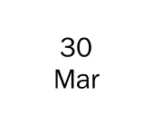
PFIZER PAXLOVID CASE STUDY Rapid Activation & Costing/Budget Support
PI: Katherine Gergen Barnett, MD
BMC Family Medicine
CRN Negotiated a 109% increase to Initial Pfizer Per Patient Budget, totaling $385,900 (15 pts)
CRN Introduced and Negotiated +$65,500 in New Invoiceable Fees, including funding for community engagement
Notes:
Quinneil
Notes:
New Invoiceable Fees represent both new categories of fees introduced by CRN as well as significant increases to existing rates, backed by CRN-provided justification and leading negotiations.
Final Per Patient Budget for Paxlovid x 15 patients = $385,900. Original Per Patient Budget X 15 patients was $184,935.

Slide 50
Sample of New Standards for Clinical Research Fees
Fee Description | Amount | Frequency
Consenting Fee | $360-$400 | Per Pt.
Interpreter Support (Interpreter Services + Administration) | $75 | Hourly Rate
Study Specific CE Time & Effort | $1200 | Monthly
Patient Screening Fees | $1940 | Monthly
Translation of All ICFs & Recruitment Materials into (Spanish, HC, Portuguese, Vietnamese | Sponsor Paid (Value $30k+) | Ongoing
Screen Fails (varies by sponsor) | $3,375 | Per Pt.
SAE(s) | $395 | Per SAE
Marketing/Social Media/Advertisements | $4000 | One Time
Audits (Sponsor Directed or FDA) | $2600/$3900 | Per Day
IRB Amendments (with ICF Revisions) | $1375 | Per Amendment
CDW Reporting | $Varies | Varies
CRN Community Engagement Fee (Industry Sponsors) | $1500 | One Time

Slide 51
Policy, Education, and Communications Update
Kaye Mottola
Bi-monthly Meeting
9 August 2022

Slide 52
Intersecting initiatives commenced, FY2022 Q2-Q3
Policy
Updating, socializing – pre- and -post, mini-trainings, eg, bi-monthly meeting reviews
Goal FY 2023: providing multiple job aids/occasions for understanding policy
Web presence: easily accessed library
Diligence: benchmarking; draft updates to SMEs– 1st communication
Education
Onboarding
General curriculum, commenced piloting, June; testing for individuate
Job-specific structural platform; hiring manager adds content, further structure
Ongoing:
Testing onboarding program for adaptability
SPA, RF, CTO/CRN
catalogue existing material for new web architecture, June
analyze for needed updates, July-August
9 August 2022 BMC Research Bi-Monthly

Slide 53
RPEC intersection
Standing Operating Procedures
Complement to policy
Provides self-guided training – or materials facilitated training
By roles and responsibilities (R&Rs)
Operational: departmental only
Research community (RC)
General structure: governance and process
Committee, charter, catalogue
Approval calendar, template, naming conventions, web library, training
A model of communications
Already proceeding: CRN-CRRO SOPs for participant and data safety

Slide 54
Subaward Agreement Policy
Bi-monthly Meeting
9 August 2022

Slide 55
“Subaward Agreement” update
The main players
Sponsor – authorizes BMC funding to be passed through to a third-party institution
BMC – the pass-through entity, charged with following subaward requirements
Research Operations (RO): BMC sponsored program official
PI/PD, Department Research Administrator (DRA)
Sub-recipient: fits definition (2 CFR 200.92), is vetted by PI/PD, follows detailed scope of work (SOW)
PI and DRA kick off the process
PI/PD evaluates need for and requirements of a sub while planning sponsored program
Expertise, qualifications, availability, cost, technical resources
TIP: conduct early during proposal development
Complicated preparation
Post-award subaward additions complicate, slow down process
Departments complete subrecipient vs contractor determination form
Submits to SPA prior to proposal submission
9 August 2022 BMC Research Bi-Monthly

Slide 56
Process requirements
Research Operations
SOW: description of work to be performed; timeline for reports and deliverables
Budget and budget justification – direct and indirects (BMC, sub’s)
Letter of Intent: including project period, amount, SOW’s project title
Signed by sub-recipient’s designated officer
Other items as required by prime sponsor: eg, cost/pricing data, bio-sketches
At time of award, PI/PD/DRA request issuance
upon official notification of project set-up, PI/DA initiate subaward process
Post-subaward
BMC: responsible for monitoring subs through agreement lifetime
PI: responsible for managing subrecipient’s performance
In accord with terms, conditions, BMC policy
Required changes?
PI/PD/DRA notifies RO of changes, in case amendment is required
9 August 2022 BMC Research Bi-Monthly

Slide 57
Subaward news and RO plans
Federal scrutiny
Subawards face increasing scrutiny from agency inspectors general, auditors, federal awarding offices
Pass-through entities must be especially careful when awarding federal funds to subrecipients
Workflow improvement
Research Operations is working toward replacing BMC’s present tracker with InfoEd workflow
Like RO policy initiative, improved workflow will include natural language when possible
Instead, eg, of MOA and MOAA, “Subaward” and “Subaward Amendment”

Slide 58
References
Subaward Agreement Policy https://bostonmedicalcenter.policytech.com/dotNet/documents/?docid=3276
Federal Uniform Guidance, 2 CFR 200
§200.92 Definition, “Subaward”
§200.330 “Subrecipient and contractor determinations”
§200.332 “Requirements for pass-through entities”

Slide 59
Research Operations Meeting
Talent Acquisition update
Sandi Molettieri
August 9, 2022

Slide 60
Talent Acquisition and Hiring
Talent acquisition partners are responsible for a company's ongoing strategy to find, attract and recruit top talent.
HR business partners are human resources professionals who help align an organization's 'people strategy' with their 'business strategy. ' They help leaders envision, develop and execute an HR strategy that supports their growth, performance and future objectives.
Hiring managers work alongside recruiters where they oversee the selection and hiring of new talent. Their main goal is to ensure that the candidate with the best qualifications and characteristics is selected and hired.
Entering a requisition
Approval process
Assigning to a recruiter
Posting
Screening/Interviewing
References and Offers
Pre-onboarding

Slide 61
Editing Open and Posted Requisitions
What happens when the need arises to edit a requisition
Why were we able to do this in the past?
What changed?
What can be edited
Titles, spelling errors, department responsibilities
What cannot be edited without entering a new req
Job Qualifications
What are job qualifications
Years of experience
Education/licensure/certification requirements
Shift
Location
Any other minimum qualifications

Slide 62
Talent Acquisition Recruitment Activities/Initiatives
Optimum req load per recruiter
Virtual and In-person job fairs
All jobs posted on careers page also posted to Indeed/Linkedin/Diversity job sites
Targeted recruitment outreach on LinkedIn and Indeed
Partnering with contingency based search firms (perm placement)
Dedicated BMC Sourcers
Local Schools/Handshake upgrade
Regular email campaigns using BMC’s Talent Community
Utilize Supplemental Health for contractors
Temp to perm for top performers
Social Media – ie. Facebook/LinkedIn
Sharing openings on social sites
Employee Referral programs
Networking - Who do you know – sharing jobs on social media
Posting on niche sites/professional organizations

Slide 63
REVIEW OF OFFER PROCESS
Offer Confirmed/Requested by Manager (Union or Non-Union Position)
References can be running in parallel while offer is in process
Recruiter Drafts Compensation Worksheet (union) – Send Over to Comp (24 hour turnaround) or Recruiter pulls internal equity and forwards HRBP with recommendation
Compensation reviews comp sheet and confirms rates (24 hour turnaround)
Call Candidate and Extend Verbal Offer (same day as offer received from comp)
Candidate has 3 business days to review offer unless they verbally accept (up to 3 days)
Draft and Send Candidate Offer Letter
Externals electronically sign
Internals are emailed an offer letter that they sign and return, this is uploaded to Workday
Recruiter notified once offer letter has been received
Candidate has Confirmed Acceptance of Offer – Send Email to Manager
Update Workday, unpost and disposition remaining candidates
Review offer deadlines versus start dates

Slide 64
Potential Roadblocks to Hiring
Reference checks
Waiting for them to complete prior to offer being extended
Turnaround time can sometimes take as long as 2 weeks to complete
Fraudulent references (requires time to investigate)
Delayed start dates due to notice periods and planned vacations
Hiring Managers being out or not available for interviews
Frequency of orientation dates
Incorrect job code on req (i.e. should be union but is entered as non-union)
Using a position code that is already occupied
Competing priorities/Communication reasonable turnaround times
Turnaround time on compensation (union or non-union)
Shortage of candidates

Slide 65
Website Redesign Michael Perrone August 9, 2022

Slide 66
Engagement Process for Improving Website Content
1
Discovery meeting: Marketing and Communications will meet with you to discuss your current website, including latest website analytics, your vision for changes, etc.
2
Content audit: Following the meeting, you will assess your web content and other content assets (eg. PDFs) to determine what information is up-to-date, needs to be updated, or is outdated. We can provide content development assistance.
3
Content strategy: Together, we discuss what content assets are most suitable for web, and what can be turned into other communication tools, email, one-pagers, infographics, etc.
4
Content organization: Together, we organize your website content in a manner that best represents your department and is both user-friendly and SEO-focused. Project scope and timelines are confirmed.
5
Website development: Marketing and Communications provides a mock up of your improved website for you to review and provide feedback.
6
Website goes live: Once you approve the new site, it will go live.

Slide 67
Research Operations Site Relaunch Timeline
Progress to date
5/9 - Kickoff ✔
Content audit ✔
5/23 - Forms/Docs: Keep/Remove/Replace ✔
5/23 - Pages: Unchanged/Edit/Unpublish ✔
6/20 - Identify what gets moved and where ✔
6/20 - Identify what current downloads could be a web page ✔
Sitemap
8/5 - Item categorization/sitemap ready for initial review ✔
Content creation and updates
8/5 - Supply any new and/or edited content (draft) ✔
8/15 - Supply any documents/forms that are being replaced (draft)

Slide 68
Research Operations Site Relaunch Timeline
Path forward
~2 weeks - Sitemap revisions and approval
6-8 weeks - Build out of all new site pages by Digital team
Timeline will be mapped out in greater detail once sitemap is approved.
Pages will utilize existing templates and design elements from within the BMC.org ecosystem.
Pages will be mocked up, reviewed by RIS, and revised, with an anticipated 48-hour turnaround for feedback.
Pages will be built out using draft content.
~2 weeks - Final site review and feedback by RIS
Review of all new site pages for typos, broken links, formatting inconsistencies, or errors
2-3 weeks - Final page updates completed by Digital team
10/31 – 11/22 - Site re-launch

Slide 69
Open Discussion and Questions
Thank-you for attending today’s meeting!

