Slide 1
June 14th Research Admin Meeting

Slide 2
Agenda
9:00am – 10:00am
Welcome
Research Operations updates
10:00am – 10:30am
Research Newsletter
Introduction to Research SOPs

Slide 3
Welcome!

Slide 4
Research Operations Updates

Slide 5
Research Operations Updates
FY22 DHHS agreement
Advisory committee to Exec Director
Proposed full direct and indirect costs
Better utilization of sponsored funding
Metrics and performance standards
Annual Space Survey
Uniform Guidance Audit
Communications
Website redo
Res Ops newsletter
CTO/CRN
Clinical Research SOP Steering Committee
Other
Reposition BMC Research enterprise with sustainability to support today’s research and future growth

Slide 6
Reorganization of Research Operations
Optimize most important resource
Re-branding
Org structure
Update and refine role and responsibilities
Onboard New staff, Manage open recruitments
Notes:
Most important resource is our staff
Re-branding SPA and RF
Investing in growing CRN infrastructure and building a central library of P&Ps to support clinical Research at BMC

Slide 7
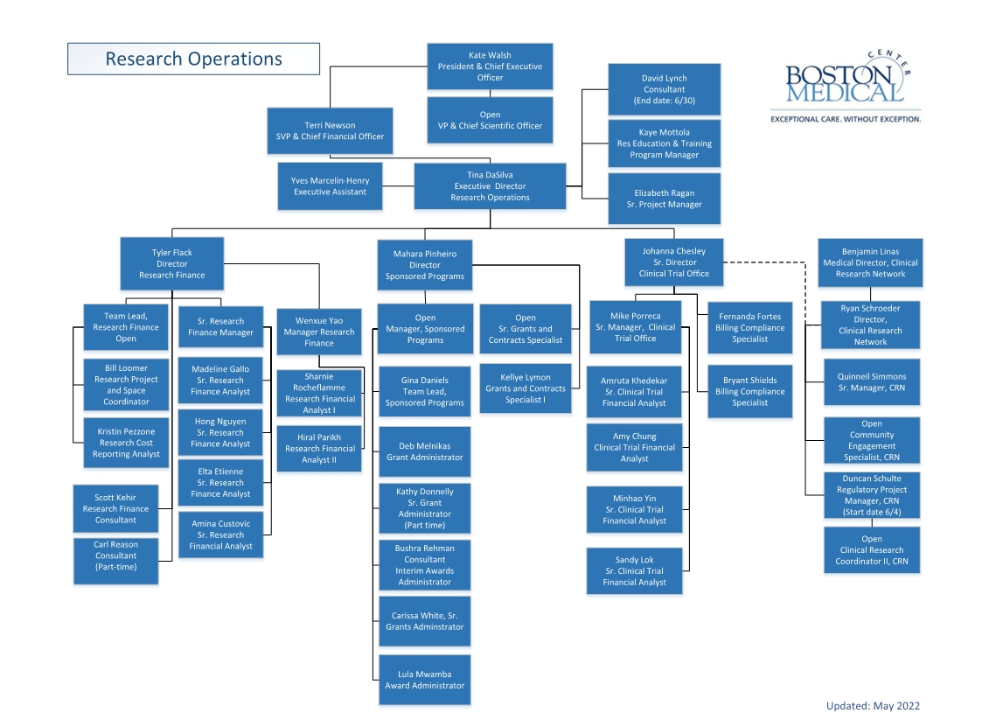
Sponsored Programs Administration

Slide 8
Research Operations FY 22 Priorities
1
1
1
2
3
Recruitment
and
Onboarding
Systems
Optimization
Process
Improvement
Align recruitment with needs assessment
Invest in training and retention
Knowledge Transfer
Strengthen onboarding process
Leverage technology
Leverage Systems Capabilities
InfoEd Application Approval Route
Agreements Module
Velos upgrade
Research Metrics Dashboard
Tracking and Reporting
New Res Ops Website
Policies and Procedures
Training and Education
Funds Management
Tracking and Reporting
Process Automation and Transparency

Slide 9
Sponsored Programs Administration
Mahara R. Pinheiro, Director, Sponsored Programs Administration
Dave Lynch, Interim Director
Notes:
If Tina hasn’t already announced, Dave to introduce Mahara as Dir SPA
After a long search I’m pleased to announce Mahara Pinheiro is the new Director of Sponsored Programs Administration. Mahara is no stranger to the BMC and BU research community. She joined BMC as a Senior Grants Administrator in 2018, was promoted to Manager in 2019 and more recently was the Sr Manager of Sponsored programs.
In her new role Mahara will lead the pre-award and post-award (non-financial) team by successfully supporting the mission and strategic priorities of BMC research.
She is responsible for the management and oversight of the pursuit and implementation of resources and training.
Development of policies and procedures that support a culture of effective sponsored programs management that is compliant with funder terms and conditions and industry standards; identify and promote workflow efficiencies that strengthen and optimize service levels to the research community.
We are grateful for Mahara’s commitment and dedication to the success of sponsored programs administration at BMC.

Slide 10
Sponsored Programs Administration
Primary Responsibilities
Work closely with PIs/PDs and DRAs in maintaining proposal and award records via InfoEd
BMC authority on proposal conformity with BMC policy, sponsor requirements, signature and submission on behalf of BMC
BMC authority on JIT response and post-submission information
Reviews and negotiates research agreements and acceptance of awards
Initiating the award setup in InfoEd in accordance with BMC policies and award parameters
Serve as BMC authority on issuance of subawards, including risk assessment, drafting agreements, coordinating PI/PD and DRA review, FFATA reporting
Serve as BMC authority on post-award, administrative (non-financial) responsibilities including processing technical reports, prior approvals, transfers (non-financial), early terminations, and project closeouts (non-financial).
The management of awards is a shared responsibility between departments and the central office. SPA relies heavily on DRAs to facilitate BMC’s management of all proposal submission and award management activity. This includes communicating changes to principal investigators and the study team.

Slide 11
Sponsored Programs Administration
Rebranding
Sponsored Programs Administration (previously called Pre-Award, Grants & Contracts, Grant Administration, etc)
Staffing Updates
Carissa White joined BMC as Sr. Grant Administrator on February 22nd
Gina Daniels was promoted to Team Lead, effective February 27th
Lula Mwamba joined BMC as Awards Administrator (replacing Bushra Rehman), started on May 16th
Mahara Pinheiro was promoted to Director, Sponsored Programs Administration, effective May 16th
Manager, Sponsored Programs Administration, recruitment in progress
Shaniel Walker, Sr. Contracts Administrator left BMC on May 10th, recruiting in process
Kathy Donnelly, Sr. Grant Administrator will retire on June 30th, recruitment planned
Dave Lynch, Huron Consulting Group engagement ends on June 30th

Slide 12
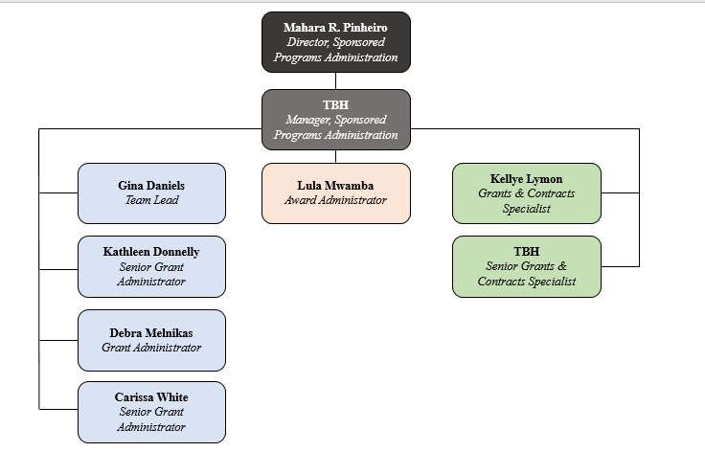
Sponsored Programs Administration
Organizational Structure
Grants Team (Blue):
Proposal review and submission
JIT review and response
Incoming agreement review and negotiation
Non-financial post-award activities (technical report review and submission, transfers, prior approvals, etc)
Awards Team (Orange):
Project setup and updates
Data integrity
Roll file
Contracts Team (Green):
Issue subcontracts
DUA/MTA review and negotiation
FFATA reporting

Slide 13
Sponsored Programs Administration
Major Initiatives for Q2 and Q3
Proposal Submission Internal Deadline Implementation:
September 2021: The policy was adopted.
February 2022: The policy was formally socialized.
May 2022 : SPA started tracking internal deadline compliance.
July 2022: Compliance reports will be provided to departments and department leadership. These reports will be provided on a quarterly basis.
Research Operations Website (May 2022- August 2022): developing and updating existing content into new structure.
InfoEd Routing Project:
All electronic Proposal Submission Forms (ePSF) approvals will be conducted via InfoEd.
SPA is launching a pilot with the Department of Psychiatry this month. Other departments will be enrolled on an individual basis throughout 2022.
Policy Implementation: continuing socialize and reinforce new policies.

Slide 14
Research Finance Restructure Tyler Flack
May 2022

Slide 15
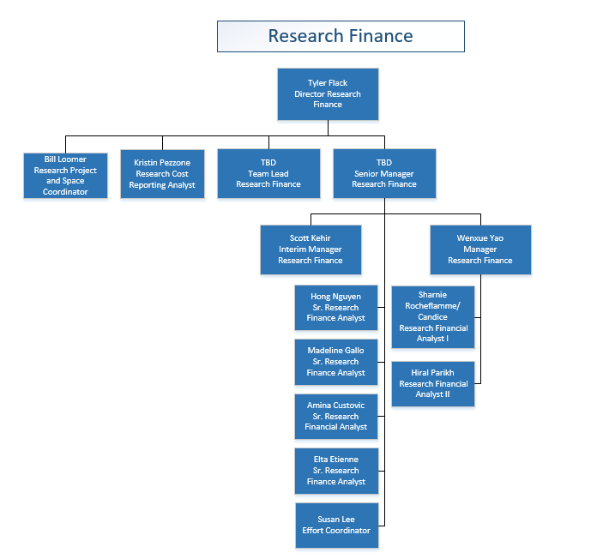
Organizational Chart

Slide 16
Timeline
1 Month
Staff Retention
Director meets with staff individually to assess career aspirations, engagement, and pain points
Restructure Plan Socialization
Meet with research Depts to set expectations of RF in short and medium term Assurance of process improvements for Depts
3 Months
Recruitment
Promote Research Finance Manger
Manager Training Plan
Develop standardized reports for high level portfolio management
RF Document Storage
Collocate SOPs, training docs, etc.
Identify gaps
6 Months
Portfolio Redistribution
Right-size portfolio workload
Recruitment
1 Year
Complete RF Resource “Manual"
Singular comprehensive training and reference guide for RFA responsibilities
Cross Training
All roles and responsibilities have back-up staff identified and trained
This process will start immediately but plan to be complete in a year
Hire a Senior Research Finance Manger
System SMEs
Assess opportunities for specializing functions among staff

Slide 17
Observations for Process Improvements and System Enhancements
Focus on Core Business
Document guides, SOPs, and training materials for RFAs, including updating file storage for team
Finalize management dashboard as primary tool for accountable management of RFAs
Collaborate with other departments to create alignment with business processes that fall outside sponsored programs management:
Vendors uploads
Fisher procurement website
Align non-sponsored program activity in coordination with Finance
Collaborations with Pre-Award
Strengthen award Terms and Conditions by highlighting impact to post-award
Work with Pre-Award and Research Attorneys to ensure conditions of funding do not create undue post-award administrative burden, especially for sponsors paying below approved IDC rates
Identify a person responsible for Pre to Post transition and develop a meeting or report to monitor process
Delays in setups create salary allocation issues
Establish recurring meetings with pre and post award teams to build synergy and transparency

Slide 18
Policy: Indirect Cost Rate for Sponsored Programs Tyler Flack
Updated May 2022

Slide 19
Purpose and Background of IDC Rate Policy
Purpose: to recover IDC of conducting sponsored programs (SPs)
Background
SP costs: actual direct or indirect costs
Direct: costs each program incurs through its specific activities
Indirect: costs an institution incurs across programs
Not readily assignable to specific programs
Serve a common or joint purpose benefitting many programs
Failure to recover costs fully places a burden on the BMC’s primary purpose: providing exceptional care to all patients
Every BMC purpose ultimately goes back to our patients
IDC recovery requires
Proposing maximum allowable IDC
Securing IDC reimbursement for each program
Central, robust data collection and analysis of IDC, negotiation with DHHS

Slide 20
Specific Examples of Indirect Costs
Human Resources, including costs for Kronos and Workday and all the staff that support those systems
Supply Chain costs for maintaining vendor relationships, staffing buyers, and receiving goods
Space/Facilities costs
Depreciation or lease costs on space study teams occupy
Utilities costs
Maintenance costs
Campus Safety
Finance, including Accounts Payables, Accounting, and Treasury
Legal (OGC) - Contract negotiations and review, legal defense, agreement execution (NDA, MTA, etc.), managing agreement/sponsor conflicts, policy oversight
Research Operations: Sponsored Programs Administration, Research Finance, CTO, Training and Education
Compliance
IT – system costs and system support, including research systems: InfoEd, Velos (CTMS), ClinCard, etc.
Shared Services: technology development, export controls, IRB, IACUC, IBC, Radiation Safety, Environmental Safety, etc.
Notes:
What do you get?

Slide 21
Indirect Cost Rate – The Basics
IDCs are associated with the general operation of an institution in conducting sponsored programs, often referred to as “F&A”
BMC requires IDC on all sponsored programs*
Facilities
Equipment depreciation /use allowance
Administrative
Compliance systems and staffing
Operations & maintenance
Other (environmental, security, etc.)
Sponsored projects administration
Other administrative costs
General and departmental administration
Building depreciation/ use allowance
*The rate is determined by type of activity and sponsor and, in a few cases, by sponsor IDC policy restriction
Notes:
“IDC” Cost principles for hospitals – UG that BMC must follows

Slide 22
Roles in IDC Rate Process
BMC’s IDC Rates, prepared annually
Research Operations, Research Finance (RF)
collaborates with BMC Finance
to determine SP portion of BMC cost pools
includes “space” calculations
prepares IDC analysis
proposes, negotiates federal rate with DHHS
IDC proposal budget and recovery of IDC per sponsored program
Departmental Administrator/PI/Program Director
requests IDC rate appropriate to the activity/sponsor type, program site location
Department head or appropriate designee
reviews, approves proposal elements, including stipulated IDC rate
Research Operations
confirms applicable rate is budgeted at proposal and recovered

Slide 23
IDC rate application, time of proposal
All proposals must include the maximum allowable indirect costs, appropriate to the activity (research, other sponsored activity) and location
IDC rates are based on actual costs incurred by BMC to support sponsored activity
Applied to all externally sponsored award types; grants, contracts, cooperative agreements, and subawards
Applied to all sponsor types, including federal, other governmental, business or industry, and non-profits
Consistent application of IDC rates allows BMC to recover the cost of facilities, utilities, administration, compliance, safety, and all services associated with sponsored activities

Slide 24
Federal IDC rates apply, with limited exceptions
BMC’s negotiated IDC rates apply to all sponsored programs
A lower rate may be applied when non-federal sponsors limit IDC rates in its bylaws or written policies
In these cases the project must be of sufficient benefit to BMC’s research and patient care mission to warrant loss of cost recovery
Some federal funding mechanisms cap the IDC rate: BMC must apply the maximum rate allowed
Notes:
Example Training Grants

Slide 25
IDC rate by site, activity, sponsor restriction
IDC rate determination, based on:
type of activity
location of activity
sponsor’s policy restrictions, when applicable
On-and Off-site rates apply
where does majority of activity occur?
In all cases, maximum allowable should be budgeted
Consult RO, Sponsored Programs Administration, when in doubt
Notes:
Define on-site

Slide 26
References
Indirect Cost Rate Policy
https://bostonmedicalcenter.policytech.com/dotNet/documents/?docid=3691
Indirect Cost Rate Agreement
https://www.bmc.org/sites/default/files/Research/Boston_Medical_Center_Signed_Rate_Agreement.pdf
Frequently Asked Questions
(coming soon)
Notes:
Open to attend meetings if helpful. Research P&L at August meeting to inform

Slide 27
Clinical Trial Office Johanna Chesley & Michael Porreca

Slide 28
Good Faith Estimates For Patients
No Surprises Act - Good Faith Estimates for Uninsured (or Self-pay) Individuals, Requirements for Providers & Facilities
Beginning January 1, 2022, health care providers & facilities must provide a “good faith estimate” of expected charges prior to the patient receiving the item or service if the patient is uninsured or does not plan to submit their claim to a health plan
Providers & facilities must also give a good faith estimate any time the patient requests for one, or when the patient schedules an item or service
Good faith estimate should include expected charges for the primary item or service the patient is receiving, plus any other items or services provided as part of the same scheduled encounter
For additional information, visit CMS.gov:
https://www.cms.gov/newsroom/fact-sheets/requirements-related-surprise-billing-part-ii-interim-final-rule-comment-period
https://www.cms.gov/nosurprises/consumers/new-protections-for-you
https://www.cms.gov/nosurprises/consumers/understanding-costs-in-advance

Slide 29
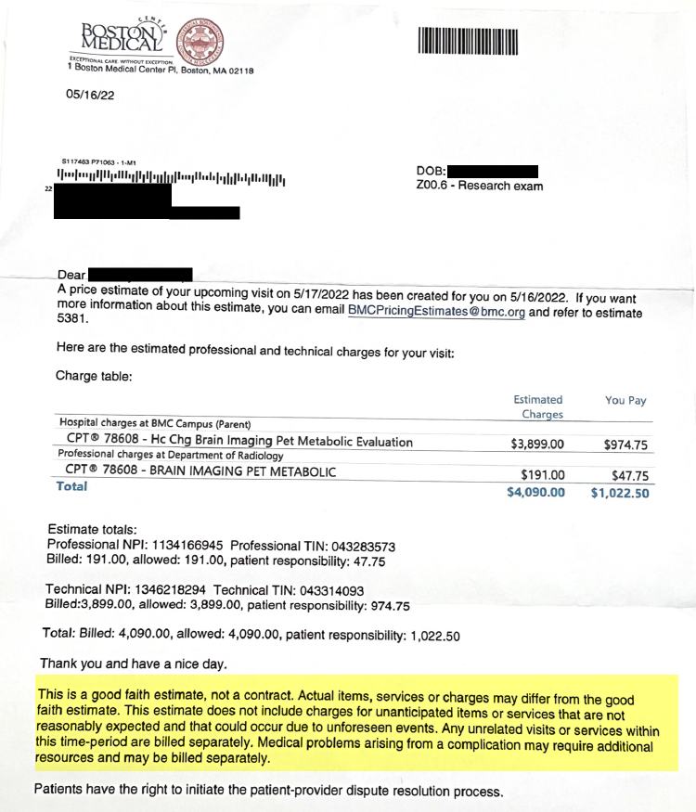
Good Faith Estimates For Patients & Research
How does this affect Research?
January 2022, Revenue Cycle started sending good faith estimate letters to patients with upcoming visits at BMC
Some of the patients receiving these letters are research participants, whose visits may already be covered by research funds
CTO is working with Revenue Cycle to include additional language for research participants
Study teams should:
Be aware that their participants may receive these letters
Assure participants that the letters are not bills!
Assure participants the letters may not reflect the actual cost to them for the visit, especially if the visit is covered by research funds

Slide 30
Smart Form Updates
Intake Forms
Department | Status | Form Name | Link
Clinical Trial Office | Complete | CTO Intake Form | https://bmc.tfaforms.net/46
Investigational Pharmacy Services (IPS) | Complete | IPS Protocol Planning Worksheet | https://bmc.tfaforms.net/35
Radiology | Complete | Radiology Research Study Form | https://bmc.tfaforms.net/33
Interpreter Services | Draft In Testing
Pathology/Laboratory Medicine | Pending Department - PDF Form |  | https://hub.bmc.org/doc/laboratory-study-request-form
Ophthalmology | Pending Department
Marketing | Existing Web Form on Airtable |  | https://airtable.com/shrwoEWUWetzKLSI6
GCRU | Existing Web Form on WebCamp |  | https://webcamp.bumc.bu.edu/webcampv5/SourceCode/WebCAMP_Protocol/NoLogin/NotificationOfIntent.cfm?RFA=15&DSN=1&RootURL=https$$webcamp.bumc.bu.edu$webcampv5$SourceCode$

Slide 31
Research Information Systems Christopher Sullivan

Slide 32
InfoEd Routing Pilot
PROJECT OVERVIEW – CURRENT PHASE: Implementation
Problem Statement
Manual emailing/printing of proposals documentation for review and approval; This makes pre-award phase of proposal development more challenging to track, hinders the ability to prepare for new proposals that are identified for development, and overall the process is less transparent to all stakeholders.
Proposed solution:
Configure the “Routing” functionality in InfoEd:
Automate and streamline the proposal development process;
Enable proactive monitoring of compliance/review/approvals;
Provide an in-system audit trail of communications and approvals for proposal submissions
Business Owners: Sponsored Programs Administration| Collaborators: Development/Psychiatry [pilot group]
Technical Owners/Collaborators: Research Information Systems/InfoEd ITS
Method: Pilot Approach - Gradually implement across all departments and applicable users

Slide 33
InfoEd Routing Pilot
SCOPE:
Key areas of the project:
Design electronic workflows within InfoEd to route pathways and elements of progression
Automate communication:
Email and via ‘Messages’ in system to identified users when a proposal is created/approved/revised in the system
Defining reminder schedules/rollover rules
Defining email message templates
Defining certification text
Restructure existing User Security privileges, roles, and setup to integrate with Routing Workflow roles and improve overall end-user experience and security within InfoEd.
Configure “Review Dashboard”
Develop new Security Input Form needed to capture routing needs and user security access
Training

Slide 34
InfoEd Routing Pilot
TIMELINE:
= Current Phase

Slide 35
VelosCT Upgrades
PROJECT OVERVIEW – CURRENT PHASE: Implementation
VelosCT: Clinical Trial Management System used to manage financial, administrative and clinical research activities for many aspects of clinical research including study start-up timelines, tracking and reporting of protocol information and accrual data, and patient billing compliance.
Three Upgrades:
Amazon Web Services: Provides more flexibility and easier management of the hardware resources therefore providing improved overall application performance.
VelosCT application version 12. High-Level Improvements include:
Budgeting and tracking revenue/costs within Velos
Tracking study setup, post-award progress and revenue
User friendly interface and visual improvements
Additional enrollment controls
Enabling potential Integrations with ClinCard
Key defects addressed
eTools application version 7: Enabling stronger system administration controls, back-end reporting, and improved data migration features for RIS and CTO
Business Owners: Clinical Trials Office
Technical Owners & Collaborators: Research Information Systems & BMC Information Technology Services
Method: Direct Cutover from Old Application version to New; TEST to PROD

Slide 36
VelosCT Upgrades
TIMELINE:
= Current Phase

Slide 37
Contact
Please contact us at RIS@BMC.org for questions/feedback.

Slide 38
Research Technology Program Caitlin Gaudreau

Slide 39
Research Technology Program Website Updates
To find out more information about RTP, please visit our website on the HUB:
Research Technology Program (RTP) - Our Homepage
RTP Request Guidance – More information about how RTP can help and how to request help.
RTP Resource Page – More information about software resources. Including downloads, tip sheets, etc.
RTP Equipment Overview - Research equipment purchasing process flow and specifications for available BMC supported hardware
Upcoming website updates:
IT Approved Software list

Slide 40
Research Newsletter Elizabeth Ragan

Slide 41
Research Operations soon to launch a monthly e-newsletter for BMC’s research community
Monthly e-newsletter, target launch date for first issue: mid-July 2022
Target audience: research investigators, research administrative staff, research support staff
Content:
Research news and announcements
Internal (e.g., new internal policies or updates) and external (e.g., sponsor)
Feature article
Introductions and interviews with members of Research Operations; spotlights on resources available to the community
Other research resources
Upcoming events and trainings (internal and external)
Other resources to aid in research administration and implementation
Upcoming funding opportunities
Funding opportunities of special interest
Internal, limited opportunities, opportunities for early career investigators, etc.
HELP US NAME OUR NEWSLETTER!

Slide 42
Introduction to Research SOPs Ryan Schroeder

Slide 43
INTRODUCTIONS – Clinical Research Network
QUINNEIL SIMMONS – CRN Program Manager (Start Date 4/18)
DUNCAN SCHULTE – CRN Regulatory Project Manager (Start Date 6/20)

Slide 44
CLINICAL RESEARCH SOPs
External Auditors Noted Findings in the following areas:
Site SOPs and Document Control
SOP development, review and approval process to ensure compliance with requirements of study protocols and ICH GCP standards
Integral GCP procedures/policies
Management of essential regulatory documentation
Training inconsistencies and management of training documentation

Slide 45
SOP STEERING COMMITTEE & RESEARCH DEPARTMENT REPS
Steering Committee Executive Leadership: Ravin Davidoff, David Center Co-Chairs CRN, Ryan Schroeder, CRRO, Mary-Tara Roth Research Operations: Executive Director, Tina Dasilva CTO: Johanna Chesley Research Compliance, Education & Training: CRRO: Mary-Tara Roth Research Operations: Kaye Mottola BMC Research Compliance: Craig Bennett, Jami Wood CTSI/GCRU: George O’Connor, Helia Morris, Ridiane Denis IRB: Matt Ogrodnik, Jamie Merrill | Research Department Representation Invitations will go out to research departments within the medical campus with Researcher and administration representation Representatives will be invited to review SOPs

Slide 46
HIGH LEVEL GOALS FOR SOP STEERING COMMITTEE
Ensure the trust and safety of our patients who volunteer to participate in research
Ensure the quality of research conducted at BMC to the highest standards
Provide our physicians and staff with the tools and training to perform their roles with standards of excellence
Create a set of unified standards for the conduct of clinical research at BMC regardless of BU or BMC affiliation
Create a long-standing stainable structure that supports development and maintenance of SOPs that will guide research conducted at BMC
Successfully carry out our audit resolution plan as detailed in our ACTIV 1 audit response

Slide 47
CURRENT LIST OF SOPs – Phase I
IRB Submissions Delegation of Authority and Responsibilities Subject Recruitment HIPAA & Patient Privacy Informed Consent and Process Documentation Case Report Form Completion AE and SAE Reporting Management | Protocol Deviations Essential Research Documents Site Monitoring Visits Audit Preparation Learner Assessment Subject Withdrawal Clinical Research Training SOP Development/Maintenance

Slide 48
SOP DEVELOPMENT PLAN & AUDIT RESPONSE
SOP Development & Training - Milestones
Convene 1st SOP kickoff Meeting
Finalize list of SOPs tobe developed
Define how to progress from Phase 1 Training (CRN & GCRU) to other groups
Determine how/where new SOPs will be hosted (internal site vs. external site)
SOPs drafted, approved by SOP Steering Committee
Develop Training Goals, Education Methods, Approach to Tracking Completion
Begin Phase I of the SOP Trainings for Existing CRN and GCRU Staff
Distribute First Set of SOPs to Research Dept Reps
1/1/23
11/1/22
10/1/22
9/1/22
8/1/22
7/1/22
6/1/22

Slide 49
Open Discussion and Questions
Thank-you for attending today’s meeting!

