Slide 1
April 12th Research Admin Meeting

Slide 2
Agenda
9:00am – 10:00am
Welcome
Research Operations updates
Compliance Corner
Office of General Counsel
10:00am – 10:30am
Policy: Time & Effort Reporting

Slide 3
Welcome!

Slide 4
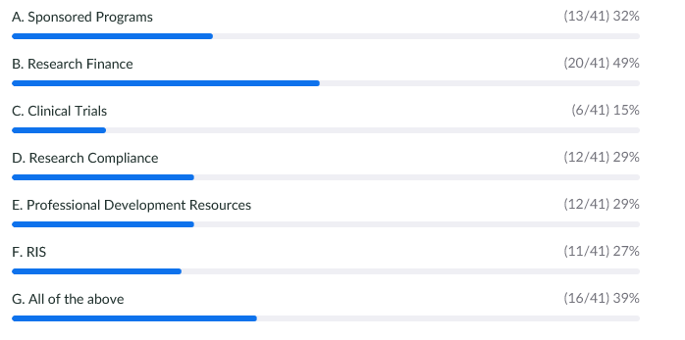
Poll Results from February 8th Meeting
Question 1: What topics would you like to see presented at the meeting?
Question 2: Are you interested in partnering with Research Operations on topics of interest?
  Yes 68%
Question 3: Do you agree with the frequency of this meeting?
  Yes 88%
Notes:
Johanna

Slide 5
Research Operations Updates

Slide 6
Research Operations, Office of Grants and Contracts
Dave Lynch, Interim Director
Mahara Pinheiro, Pre-award team manager
Carl Reason, Research Finance team interim manager

Slide 7
Research Operations, Office of Grants and Contracts
PI departures, require collaborative work between PI, Dept Admin, Fin Mgr and Res Ops
Success with complex transfers out (Peds)
As soon as you know of PI transfers in/out of BMC, notify your GA and FA
Res Ops will facilitate a review of the checklist, grant relinquishment is the final step in the process
PI arrivals also require collaboration by Research Operations and Departments
Accommodate incoming grants, personnel, biomaterials and data
Need notification well in advance, DAs and GAs/FAs to confirm others are notified
Checklist used, opposite of departures process
Notes:
Known PIs leaving
Sunday Clark, Surgery
Meg Parker, Peds
Joe Pare, ED
Nina Lin, ID
Suzanne Mitchell, Fam Med
Joanne Taglieri, retiring

Slide 8
Grants & Contracts Updates
Proposal Submission Internal Deadline
  Principal investigator’s should use BMC’s internal deadline as the official deadline to have all final documents completed. BMC’s internal deadline is five business days prior to the sponsor’s published deadline.
  Res Ops is getting proposals earlier than in the past, which affords a complete review prior to submission
  Proposal Submission Work Plan.
Other Support
  Include the project in consideration under the pending section of Just-in-Time request.
  Include pending grants on OS submitted with RPPRs.
  Wet signatures are not allowed. PIs must sign electronically.
  Consult the FAQ: https://grants.nih.gov/faqs#/other-support-and-foreign-components.htm?anchor=question56559
  Research Operations will be offering a training in the upcoming months.

Slide 9
Grants & Contracts Updates Continued
InfoEd Generic Proposal
  InfoEd is BMC’s grant management system. Departments receiving grants are required to use InfoEd. All grants must have a corresponding InfoEd record.
  Departments/Sections will be required to identify at least one staff member to be trained on how to use InfoEd. We strongly encourage departments/sections to identify two or more staff members to be trained.
  Grants & Contracts will be conducting trainings 3-4 times a year. The next training is on Friday, April 15th.
  A guide on how to create generic InfoEd records can be found on BMC’s Research Operations’ website. https://www.bmc.org/research-operations
  Research Operations will be implementing an approvals routing project in the upcoming months.

Slide 10
Research Finance
Staffing Updates
  Senior Manager, Research Finance
  Introduction: Candice Feldman
  Reminder: BMCsubinvoice@bmc.org
Notes:
Johanna

Slide 11
Research Metrics & Cost Analysis
Bill Loomer & Kristin Pezzone

Slide 12
2021 Sponsored Programs Space Survey
A big thank you to all the departments for helping us complete the 2021 Space Survey. We appreciate you and all your efforts.
We used Attain Space this year as our tool to manage and track Research Space. For Research Metrics this tool was easy to use and seemed to make life easier for this process but we’d like to hear from the rest of the community so we can evaluate and improve our processes going forward. Please consider the following questions and let us know what your experience was with the 2021 Space Survey.
Did you like using Attain Space for our survey? (Why or why not?)
We held Zoom meetings with individual Departments. Were these helpful? If so what did you like? If not what were the problems?
Training. Was it enough or did you need more?
Overall what was your experience with the survey?
Please send feedback to Bill.Loomer@bmc.org

Slide 13
Time and Effort Certifications - Workday
We are currently in the middle of the 7/1/21 – 12/31/21 effort certification process. On Tuesday April 18th and Thursday April 26th we are going to offer 4 one-hour workshops for Effort Reporting on Zoom.
Only for Workday effort certifications
Will be geared towards troubleshooting and guidance on specific issues or questions you have related to effort certifications for 7/1/21-12/31/21
Bill Loomer will be running the workshop
Workshops times on each day will be:
9:30-10:30 AM
1PM-2PM
Please RSVP address questions to Bill.Loomer@bmc.org and he will provide the zoom link

Slide 14
FY21 Audit
Provider Relief Funding
  Testing Selections: invoices, equipment and salary expenses
Last Year’s Audit Finding
  Time and effort
Audit Report Location:
https://www.bmc.org/research-operations/uniform-guidance-audit-reports-formerly-133
Notes:
Johanna

Slide 15
Clinical Trial Office
Johanna Chesley & Michael Porreca

Slide 16
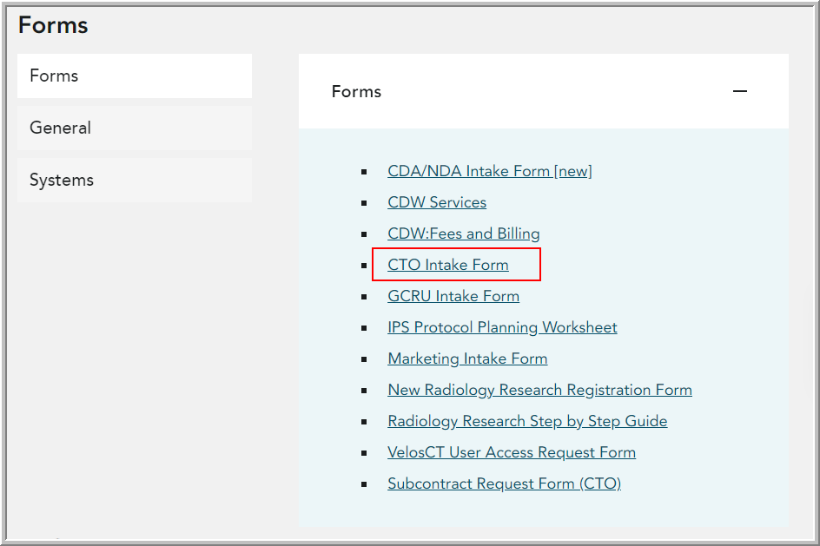
CTO Intake Form
Study teams are required to submit the CTO intake form if their proposals or studies involve Clinical Trial Office. This applies to:
    All studies managed by CTO
    All CTO-supported research – federal and industry proposals and studies managed by Grants & Contracts, Development, Research Finance, and BU
After study teams complete the form, CTFA will review and reach out to team with further instruction:
    CTO-managed studies – VelosCT entry, coverage analysis, budget & contract negotiation, research billing setup
    CTO-supported research – VelosCT entry, coverage analysis, research billing setup. No budget or contract negotiation
Link to CTO intake form is located on CTO website: https://www.bmc.org/research-operations/clinical-trial-office
Notes:
Johanna

Slide 17
CTO Updates
New Working Group
  Review new budget format, workflows, and negotiation improvements
  Initial meeting attendees: Valine Valbrun; Marina Malikova; Astrid Atakov; Olivera Vragovic; Trysha Ahern; Olivera Vragovic
  Please reach out if you are interested!
Velos/Epic Issue
  Patients that were entered into Epic 3/1/22 or later may not appear in Velos
  If you are unable to enroll a new participants, please contact CTO@bmc.org, and include the patient MRN, visit date, and research procedures that will occur
  This is a high priority that we are actively working to resolve
Notes:
Johanna

Slide 18
Research Policy, Education, and Communications: Updates and FYIs
Kaye Mottola
Research Bimonthly, 11 April 2022

Slide 19
Policy Initiative Update: April 2022
Policy | Status | New
Indirect Cost Rate (formerly F&A rate) | Approved 3/8; in RO socialization
Investigator Eligibility | Nearing finalization and submission | ✓
Allowable Costs | Nearing finalization and submission
Equipment Management | Nearing finalization and submission
Cost Transfer | In RO draft circulation
Research Participation Compensation | In RO draft circulation
PI/PD Transfer Out | Drafting to commence mid-April | ✓
Required Use of CTMS (= Velos) | Drafting to commence mid-to-late April

Slide 20
Research Policies, Odd and Ends
Policy socializations
    Some: prior to submission, with collaborating department, BMC leadership, and/or research administrators
      Indirect Cost Rate was socialized with CFO, chief research officer
      Coverage Analysis is being socialized with Compliance, Revenue Cycle,
      Health Information Management
    All: post-approval with research community, through:
      this Bi-monthly meeting
      RO-Department meetings and subsequent department trainings
      self-guided training modules
      website/email announcements
    Please provide feedback and questions to guide FAQs and other job aids
Policy style
    Updated federal requirements
    Plain language, brevity: whenever context permits
    Use of “sponsored programs” and “PI/PD” to clarify scope

Slide 21
Research Education
Time and Effort Reporting training
    March: Piloted 1-hr long training for effort certifiers and reviewers
    Early April: Piloted a teach-back option to assess competency
    Q3-4: Roll-out planned and executed
    Today: live policy overview
    Late April: self-guided module launch
    New RO T&E Coordinator: Susan Lee
Clinical Research SOPs
    CTO/Clinical Research Network (CRN) has developed many new SOPs
    In early planning for governance, library, and training
Department/FRGG - RE collaborations
    Thank you so much for introductory meetings!
    Especially to departments who have reached out!!
    If I have not yet scheduled with you, feel free to email: kaye.mottola@gmail.com

Slide 22
Research Communications
Present Website
    Vestigial: the structure was broken by the 2021 BMC-wide update
    Consists of lists of links
    Neither intuitive, nor user-friends
Website redesign is kicking off
    RO teams commence content curation this quarter
    Phase I: migration of content, updated links, some new content
Relevant now to the research community
    Redesigning your department’s pages?
      Let me know if you (want to) link to RO content
      I can send our new links to you as they are finalized

Slide 23
Research Technology Program (RTP)
Research Technology Equipment Purchasing Process
Caitlin Gaudreau & Daniel DiMatteo

Slide 24
RTP supports a variety of research technology needs
New software used at BMC, used to gather information on BMC patients, or integrating with other hosted solutions at BMC.
  Coordinate Information Security approval
  Assess feasibility with our technical infrastructure
  Identify data and system workflow
  Project manage the implementation
  Go-live support
Enhancements to our Epic EMR System
  Work with our internal Epic teams to finalize scope, IT budget and hire consultants for the required build once awarded.
Sponsor technology questionnaires
Technology equipment purchases required for each research study
  PCs
  Peripherals
  Tablets
  Software

Slide 25
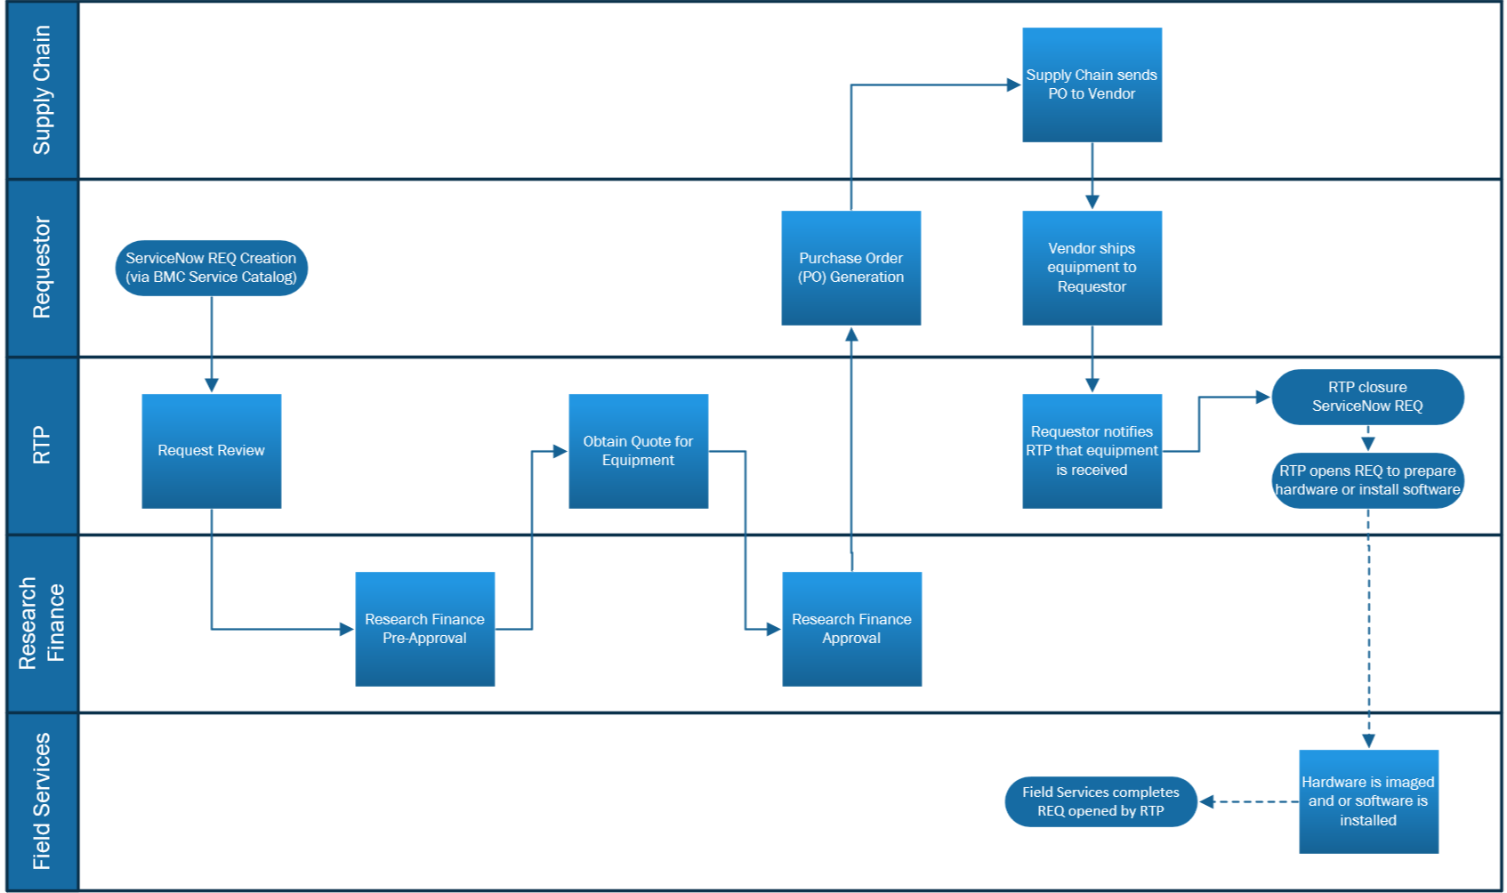
Research Technology Equipment Purchasing Process

Slide 26
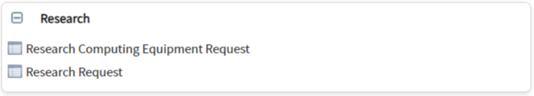
Research Technology Program requests should be submitted via ServiceNow
Login to ServiceNow using your BMC network login
Find Research Section in the Service Catalog and click:
  Research Request for technology requests
  Research Computing Equipment Request for equipment being purchased for a research study
Complete form, click Submit
Form is routed directly to the Research Technology group for prioritization
To find out more information about RTP, please visit our website on the HUB:
Research Technology Program (RTP)
RTP Request Guidance

Slide 27
Research Operations Meeting
Research Compliance
Conflict of Interest Update
Jami Wood
April 12, 2022

Slide 28
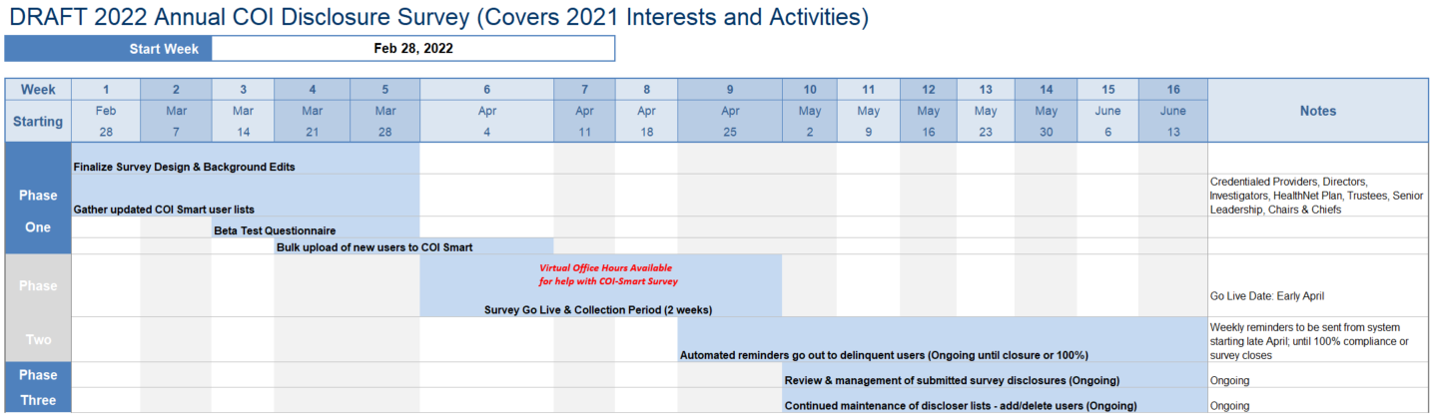
2022 Annual COI Survey Timeline
Includes outreach to Department Leaders

Slide 29
2022 Annual COI Survey – What’s New
Virtual Office Hours available:
  Week 1 (April 7th & 8th)
  Week 2 (Upcoming)
    April 12: Noon – 2 p.m. - https://bostonmedicalcenter.zoom.us/j/96289849430
    April 14: 9 – 11 a.m. - https://bostonmedicalcenter.zoom.us/j/93217668269
New & modified questions:
  Long-term medical supply or device loans
  Debt Forgiveness
  Acquisition payments
Review and management of disclosures begins now and is ongoing

Slide 30
Welcome to BMC’s Annual COI Survey Virtual Office Hours!
About Office Hours:
Two Compliance Staff members are here to help with your questions about the COI Survey.
You will be assigned to a Zoom ‘Breakout Room’ where Compliance Staff will give you 1-on-1 help.
If you are not assigned to a Breakout Room immediately, please wait as Compliance Staff are assisting others.
Common Questions / Issues:
1. I can’t log in?
If you use your BMC credentials to access COI-Smart:
https://bmc.coi-smart.com/
If you use a non-BMC email to access COI-Smart: https://bmc-nonshib.coi-smart.com/
2. What do I need to disclose?
Disclose any relationship or financial interest that may create a potential conflict of interest
  This includes, but is not limited to, all activities and interests in healthcare, medical education or communication, and pharmaceutical companies; as well as any vendors of BMC.
If unsure if you should disclose something, err on the side of over-disclosure.
3. How do I know the amount of income or the value of stocks?
It may be helpful to refer to your tax documents (ex: 1099 form).
For public equity values, you can refer to the stock price.
If you cannot determine the amount or value, use your best estimate. You can include a description of the interest or any clarifying information in the free text box.
Prefer to get help another day?
Email COI-Compliance@bmc.org and we will set up a personal meeting.

Slide 31
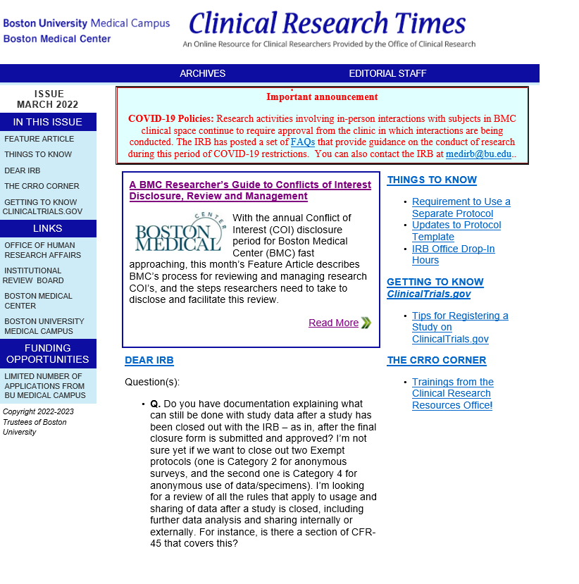
Research COI Process
Research COI is featured in March 2022 Clinical Research Times
Entitled “A BMC Researcher’s Guide to Conflict of Interest Disclosure, Review and Management”
Summarizes BMC’s processes including:
  COI-Smart system for disclosure
  Disclosure requirements, e.g., financial interests, outside relationships
  BU/BMC Faculty Review Committee on Research Financial Conflicts of Interest
  Conflict Management Strategies

Slide 32
COI Disclosure Sources & Connection Points
New COI-Smart Disclosures
New Funding Proposals or NOAs
Research
New Protocol or Proposal Submissions
New Consulting Checklist Submissions
Credentialing Office Updates
Staffing Announcements
VAT & P&T Committees

Slide 33
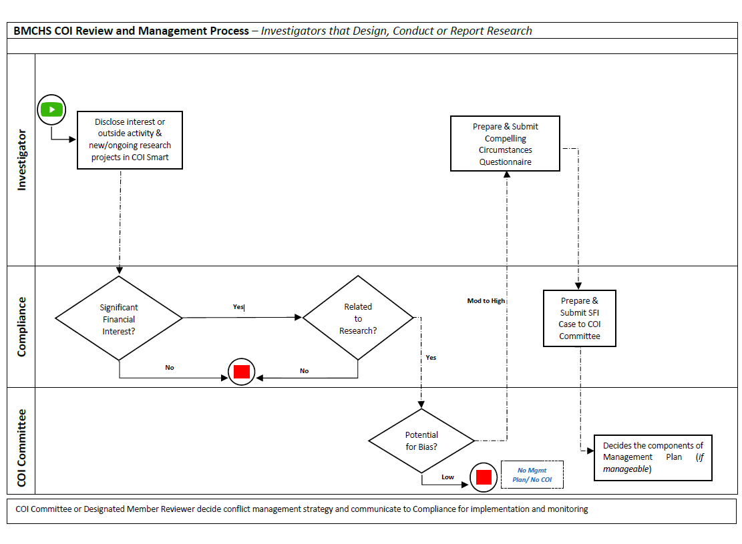
Research COI Process Flowchart

Slide 34
COI Review Process - Research
Significant?
If No, Stop
If Yes, Go to Step 2
Related?
If No, Stop
If Yes, Go to Step 3
Use or involve the entity’s products, IP, drugs, devices
Results could lead to financial gain for entity or investigator
Potential FCOI?
If No, Stop
If Yes, Committee Review & Management
COI Committee evaluates:
If conflicted investigator is uniquely qualified or if there are compelling circumstances for investigator’s involvement
Private – Income >$5K or Equity >$1
Intellectual Property >$1
Public - Income and/or Equity >$5K (in aggregate or separately)
Receive any kind of support (in-kind or monetary)
Potential for SFI to bias research or integrity of data; and
Travel >$5K (for PHS Investigators only)

Slide 35
Contact Us
Jami Wood, Research Compliance Officer
jami.wood@bmc.org
(617) 638-7954
Jackie Presedo, Research Compliance Manager
Jacqueline.Presedo@bmc.org
(617) 638-7976
COI Compliance Mailbox COI-Compliance@bmc.org.

Slide 36
Office of General Counsel
Richard Sugarman & Patricia Bass
Notes:
Policies are institutional rules and principles, written or not, that serve to guide action toward institutional goals. The institution in question could be, eg, the federal government, a particular federal entity, eg, the NIH, or BMC.
In research, as we all know, so many of our rules and guidelines are dictated by federal requirements, and so much of Research Administration is compliance with federal reqs. Less known is the fact that federal agencies expect us to have written policies, and sometimes require specific ones (eg. RFCOI and Scientific Misconduct). Even less known, federal requirements include the rule that a given institution, such as BMC, must follow its own policies.
Examples: Regulation guiding use of federal funds, now called “Uniform Guidance” dictates requirements for certifying effort on a grant or contract. If we do not follow those requirements, our annual audit can identify the non-compliance, which can prompt a federal audit and potential fines. Many research institutions have paid millions for failures of proper effort allocation and documentation.
In addition, if a BMC policy were to require more than federal rule, a federal audit can hold us accountability for our more stringent requirement. If, eg, we stipulated in policy that we would have researchers certify effort weekly, we can be held accountable for failure to follow our own rule.
What continues to surprise me is how few actors failing to apply policy accurately can bring about millions of dollars, for a variety of reasons. One person can commit the same act many times, and each is incident subject to fine. If negligence is identified, fines can be trebled.
Much of our work is governed by federal law, regulations, and other rules, and we must also abide by state and local rules and institutional requirements.
Policies are
Our aim is to make policies easy to read, to provide companion SOPs and other job aids.
Today I’d like to review recent policy history and point to new initiatives.

Slide 37
Staff updates
Patricia Bass, Associate General Counsel & Senior Research Counsel
Notes:
Johanna

Slide 38
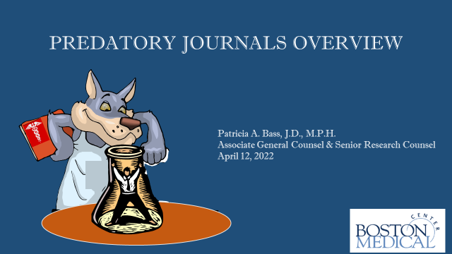

Slide 39
Predatory or Pseudo-Journals
Typical Identifying Attributes
Misleading pricing (e.g., lack of transparency about article processing charges)
Failure to disclose information to authors
Aggressive tactics to solicit article submissions
Inaccurate statements about editorial board membership
Misleading or suspicious peer-review processes
Statement on Article Publication Resulting from NIH Funded Research, NIH Notice Number: NOT-OD-18-011 (November 3, 2017)https://grants.nih.gov/grants/guide/notice-files/not-od-18-011.html
Notes:
Unfortunately, there remains no validated mechanism to reliably define or identify fake, predatory, or pseudo journals, and we therefore emphasize the need to evaluate each journal’s practices carefully
ICMJE

Slide 40
Recent Local Case
Investigators submitted article for publication
Article was “accepted” within days with notification for the first time that there was a $2,000 processing fee
No fee was paid and article was published without permission
Subsequent requests for payment
Refusal to speak to team about retraction
Legal became involved and article was retracted

Slide 41
Federal Trade Commission Action
FTC v. OMICS Group, Inc.: complaint filed in 2016
  did not tell researchers about significant publishing fees until after accepting an article for publication
  used false promises to convince researchers to submit articles, and then held their work hostage over undisclosed publication fees “ranging into the thousands of dollars”
  deceptively promoted academic conferences using the names of prominent researchers as participants without their agreement
April 2019; $50.1 million judgement again OMICS
Anyone can file a formal complaint with the FTC https://reportfraud.ftc.gov/#/

Slide 42
Sources of Help
Statement on Article Publication Resulting from NIH Funded Research, NIH Notice Number: NOT-OD-18-011 (November 3, 2017)
Identifying Predatory or Pseudo-Journals (February 18, 2017), World Association of Medical Editors (WAME)
Identifying predatory or pseudo-journals - PMC (nih.gov)
Journal Evaluation Tool, Loyola Marymount University,
"Journal Evaluation Tool" by Shilpa Rele, Marie Kennedy et al. (lmu.edu)
Open Access Medical Journals: Promise, Perils, and Pitfalls, Association of American Medical Colleges; Academic Medicine: May 2019 - Volume 94 - Issue 5 - p 634-639; https://www.aamc.org/news-insights/problem-predatory-journals

Slide 43
Root Cause
Charlatans have long taken advantage of people’s trust as a means to quick financial gain. We need to be mindful that they are among us
‘Nuff Said
“Fake,” “Predatory,” and “Pseudo” Journals: Charlatans Threatening Trust in Science
https://www.icmje.org/news-and-editorials/fake_predatory_pseudo_journals_dec17.html

Slide 44
Policy: Time and Effort Reporting
Kaye Mottola & David Lynch
12 April 2022
Bi-Monthly Research Meeting
Notes:
Kaye
This training module provides a summary of BMC’s Time and Effort Reporting Policy. By the end of this module, you will be acquainted with:
The purpose of effort reporting
The roles and responsibilities of those involved in the effort reporting process and
Basic features of effort certification for work performed on BMC sponsored programs.
If you have additional questions after completing this module, please refer to its three last slides for definitions and links to additional training resources .
Now, let’s get started.

Slide 45
Purpose of time and effort reporting
Required by federal regulation of those committing ≥1% effort to a federally sponsored program*
creates an auditable record
demonstrates that salaries charged to the project are consistent with the actual effort devoted
Required by BMC for all sponsored programs, to ensure:
consistent application of salary and effort among federal and non-federal sources
contractually committed effort is met, regardless of sponsor
Notes:
Dave
The purpose of the BMC Time and Effort Reporting policy is to ensure compliance with federal regulations and other sponsor policies that require BMC to maintain accurate records of personnel time and effort to substantiate salary and wage costs.
Effort Reporting is the mechanism used to provide assurance to federal sponsors that salaries charged -- or cost shared – to a project are reasonable in relation to the actual work performed. All salaries charged to a sponsored program must be consistent with the actual effort expended. It creates an auditable record.
But it is also to ensure a consistent application of salary and effort among all sources, federal and non-federal. Taken as a whole, BMC Effort Reporting ensures that our contractually committed effort is met, regardless of sponsor.
Establishes compliance with federal and other sponsor requirements
Requires accurate recording of personnel time and effort
Substantiates salary and wage costs

Slide 46
Roles accountable for T&E reporting
 | Responsibilities
PI/PD | Proposes time and effort on a project
PI/PD, sponsored program team members | Ensure salary is charged to project Certify that their actual effort is accurate to the salary charged
Department administrator | Ensures effort is not over-committed at the time of proposal submission Allocates salaries to sponsored programs Tracks and manages effort commitments Supports PI/PD, team in accurate, timely certifications Submits copy of all PARS, at same time as submission to BU’s PAR office, to Research Operations (RO) Reports changes to initial effort percentages to RO
Research Operations | Reviews effort commitments, cost transfers, and certified effort reports
Notes:
Kaye
Effort reporting occurs over the life of a sponsored project, from proposal through final reporting.
It begins when the PI or PD proposes time and effort on a project.
Once the project begins, they and their project team members confirm that the appropriate salary is charged to the project and certify that the effort expended is accurate in relation to that salary.
Department (or, in some cases, development) administrators review “Other Support” for over-commitment across all activities – an early step in compliance with the federal False Claims Act, which carries stiff penalties for overcharging a federal agency.
Administrators then allocate salary and support timely certifications.
Before submitting certifications, administrators review them for consistency with all reports submitted to the sponsor, to further ensure compliance with the False Claims Act.
By BMC policy, the department administrator then submits all PARs to Research Operations and to BU’s PAR office, at the same time. They also report any changes to the initial effort.
Research Operations staff review the initial effort (and cost-share) commitments and subsequent effort certifications.

Slide 47
Effort certifications and PARs
Provide reasonable assurance that the charges are accurate, allowable, and properly allocated
signed by the person doing the work*
  In August for January-June and February for July-December effort periods
  if an employee has left BMC without certifying, a supervisor with first-hand knowledge of the work may certify the effort
reflect the total actual activity for which the employee is compensated = 100%
based on records that accurately reflect the work performed
record as cost share the difference between institutional base salary and capped amount when sponsor imposes a salary cap
*BU signature rules differ: PIs and faculty must sign; the PI or supervisor may sign for others and check box indicating such
Notes:
Dave
In summary, effort certification assures that our claims for payment are accurate, allowable, and properly allocated.
For that assurance to be reasonable, it must
Be Signed by the person doing the work – or, in rare cases, after a person has left BMC, by the PI/PD or a supervisor with first-hand knowledge of the work
Reflect 100% of the activity for which the certifier is compensated
Be based on records that reflect the actual work performed
And
Record the BMC cost-share difference that occurs whenever the sponsor imposes a salary cap that is lower than the certifiers’ institutional base salary.
Please note: bonuses and overbases are not covered by federal sponsors and cannot be included in sponsored-salary or effort percentages
Timely certification is August for January through June effort and February for July through December.

Slide 48
Definitions
Salary Allocation: Portion of salary and wage costs assigned to a specific project and maintained in Workday and SAP
Effort: Time and work dedicated to the project. Typically, salary allocation as a % of total institutional base salary (IBS) is equal to effort: the time dedicated to the project as a % of total time spent on institutional activities
T&E Report aka Personnel Activity Report (PAR): Report of a person’s salary allocations, for all sources of funding, over a specified time; at BU/BMC: January-June, July-December; total effort is always 100%, never less, never more
Certified T&E Report: Signed by the person who performed the work, attesting to accuracy of salary allocations and effort
Institutional Base Salary (IBS): Annual compensation paid to a person for all institutional activity: e.g., research, administration, patient care, teaching, etc.; must be used as the base salary on all proposals; no one may be compensated at a rate exceeding annualized IBS
Salary Cap: Limit set by a sponsor, restricting allowable IBS amount to be charged to the project, most commonly the HHS salary cap; when an IBS is higher, BMC must cover the salary cost in excess of the cap = cost share
Cost Share: Any sponsored-project costs not reimbursed by the sponsor, including but not limited to sponsor salary caps
Notes:
Please refer to this slide for definitions and the next two slides for the many resources available to support Time and Effort Reporting. As we create more resources, we will provide them.

Slide 49
BMC T&E Reporting Resources
BMC T&E Policy
Workday - Changing Home Cost Center and Allocations
Workday – Viewing Cost Center Allocations
Workday Tip Sheets
Effort Certifier (Employee): step-by-step guide
Effort Reviewer (Research Administrator): step-by-step guide

Slide 50
BU PAR Resources
Effort presentation slides (including example PARs and how to run the PA15 report in Business Warehouse)
Effort Reporting (elearning module)*
Effort Reporting (Zoom or in-person)
Training videos on salary cap and cost share
FAQ: Does my grant impose a salary cap?
Effort Presentation October 2020
Effort Zoom Recording October 2020
How to complete the PAR
*Requires BU log-in

Slide 51
Open Discussion and Questions
Thank-you for attending today’s meeting!

